Slide 1
Global Cybersecurity
Threats
By
Mohana Sre . J

Slide 2
Introduction:
  Cybersecurity is the practice of protecting computers, networks, applications, and data from cyberattacks, unauthorized access, and damage.
  Its main goal is to maintain the confidentiality, integrity, and availability of information.
Problem Statement:
  The main aim is to identify cyberattacks with long recovery times, strengthen defences to reduce attack frequency, and minimize financial losses.

Slide 3
Data Cleaning
Tools:
Power bi - data modelling, analysis and dashboard visualization.
Power Query – data cleaning and transformation.
Data Cleaning:
Load data into Power Query.
Add required columns.
Create dimension tables from the fact table.
Model the tables using relationships.
Prepare the data for Power BI analysis.

Slide 4
Star Schema
Fact Table
  Attack ID
  Country ID
  Measures such as financial loss, affected users and recovery time
Dimension Tables
  Country Dimension
  Attack Dimension
Purpose
The star schema makes the data easier to filter, analyze and visualize in Power BI

Slide 5
Overview analyzes
The dashboard provides a summary of the cybersecurity dataset through KPIs and charts.
Main KPIs
Total Attacks
100k
Total Financial Loss
5.05T
Average Affected Users
504.67K
Average Recovery Time
36.48 hours
Peak Attack Year
2017

Slide 6
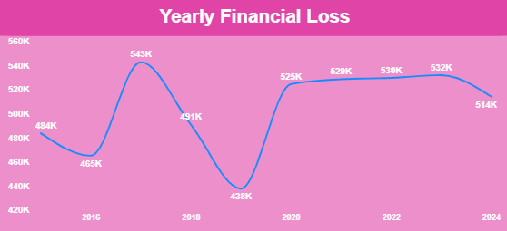
Yearly Financial Loss
X-Axis :
    Represents Years (2016 → 2024).
    Each tick mark corresponds to a specific year.
Y-Axis :
    Represents Financial Loss (in thousands, K).
    The scale ranges from 420K to 560K.
The line shows fluctuations in yearly losses, with a sharp peak in 2017, a dip in 2020, and then a stable but slightly declining trend toward 2024..

Slide 7
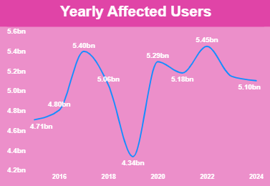
Affected Users by Year
X-Axis :
  Represents Years (2016 → 2024).
  Each tick mark corresponds to a specific year.
Y-Axis :
  Represents Affected Users (in billions).
  The scale ranges from 4.2bn to 5.6bn.
The number of affected users varies significantly between years.
Some years show a much higher impact than others.

Slide 8
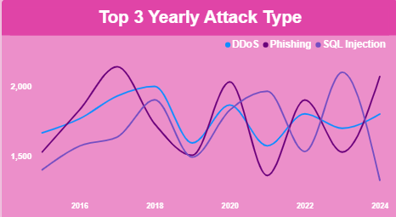
Top 3 Yearly Attack Types
X-Axis :
  Represents Years (2016 → 2024).
  Each tick mark corresponds to a year.
Y-Axis :
  Represents the Number of Attacks.
  The scale ranges from 1,500 to 2,000 attacks.
The chart highlights how different cyberattack types vary in frequency over time, with DDoS and Phishing being more prevalent, while SQL Injection remained steady but lower.

Slide 9
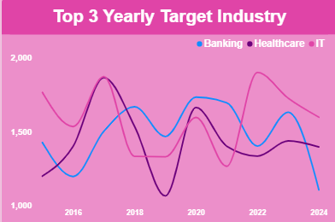
Target industry
X-Axis :
  Represents Years (2015 → 2024).
  Each tick mark corresponds to a year.
Y-Axis :
  Represents Numerical values of attacks/incidents (scale from 1,000 to 2,000).
The chart highlights how different industries were targeted over time, with Banking consistently high, Healthcare showing spikes, and IT maintaining steady but lower levels.

Slide 10
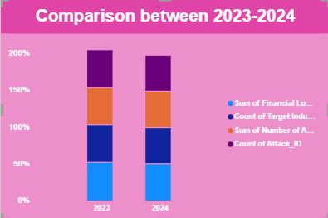
Peak Attack Year
X-Axis :
  Represents the Years 2023 and 2024.
  Each year has a set of stacked bars showing the four categories.
  This axis helps you directly compare metrics between the two years.
Y-Axis :
  Represents Percentages (%).
  The scale ranges from 0% to 200%.
The chart highlights year-over-year changes in financial loss, industry targeting, attack volume, and attack identifiers.
2017 is shown as the peak attack year

Slide 11




COUNTRY & USER ANALYSIS
Its means a comparative study of how different countries are impacted in terms of financial loss, user impact, and defense strength.
Main KPIs:

Slide 12
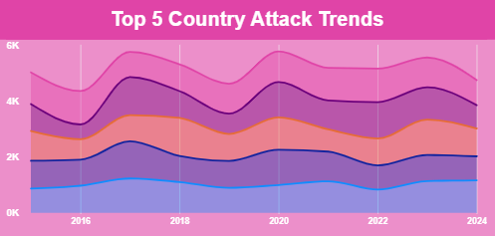
Top 5 Country Attack Trends
X-Axis :
  Represents Years (2016 → 2024).
  Each tick mark corresponds to a year.
  This axis shows the timeline of attack activity across countries.
Y-Axis :
  Represents the Number of Attacks (in thousands, K).
  The scale ranges from 0K to 6K.
  The height of each coloured band shows the attack volume for that country in a given year.
Some countries have sharp rises and drops, while others stay more stable.
The layered format makes it easy to compare each country’s share of attacks.
Global spikes are visible around 2018 and 2023, when overall attack volumes were higher.

Slide 13
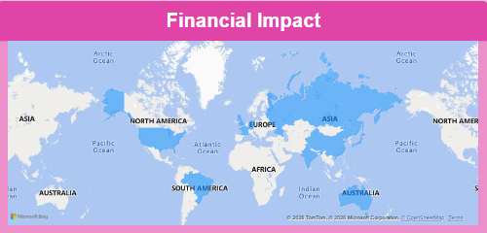
Financial Impact
  The map highlights countries and regions in blue, indicating areas where financial impact was significant.
  It covers all major continents: North America, South America, Europe, Africa, Asia, and Australia, along with the major oceans for geographic context.

Slide 14
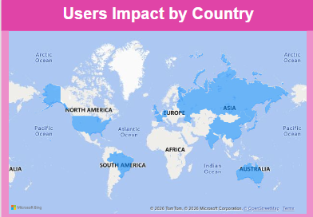
Users Impact by Country
  The Users Impact by Country map shows how many users are affected in different countries.
  According to the dashboard, Brazil has the highest user impact.

Slide 15
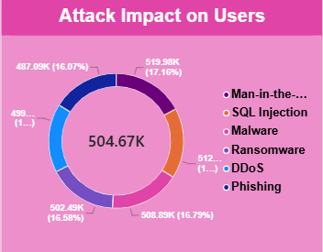
Attack Impact on Users
  The chart is divided into six colored segments, each representing a specific attack type: Man-in-the-middle, SQL Injection, Malware, Ransomware, DDoS, and Phishing.
  Each segment shows both the number of users impacted (in thousands) and the percentage share of total impact.
  At the center, the chart displays the total impact value: 504.67K users.

Slide 16
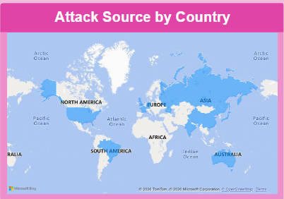
Attack Source by Country
  The Attack Source by Country map shows the geographical distribution of different attack sources.
  It helps us understand the relationship between countries and sources of cyberattacks.

Slide 17





ATTACK & INDUSTRY ANALYSIS
Its refers to a comparative study of how different types of cyberattacks affect various industries in terms of impact and losses.
Main KPIs :

Slide 18
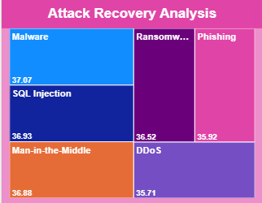
Attack Recovery Analysis
  Each block represents a cyberattack type with a numerical value.
  Attack types included: Malware, SQL Injection, Man-in-the-Middle, Ransomware, Phishing, and DDoS.
  The Attack Recovery Analysis compares the average recovery time for different attack types.
  Malware has the highest displayed recovery time, while DDoS has the lowest among the attack types shown.

Slide 19
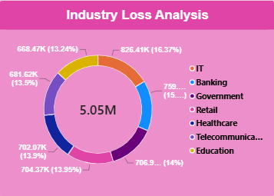
Industry Loss Analysis
  The total loss displayed in the center is 5.05M.
  Each segment of the ring represents an industry, with its loss amount and percentage share.
  Industries included: IT, Banking, Government, Retail, Healthcare, Telecommunications, and Education.
  IT is identified as the top loss industry.

Slide 20
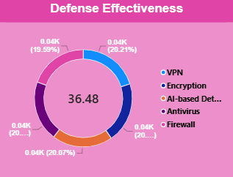
Defense Effectiveness
  The chart is divided into five colored segments, each representing a defense measure: VPN, Encryption, AI-based Detection, Antivirus, and Firewall.
  Each segment is labelled with a value around 0.04K and a percentage close to 20%.
  The center displays the number 36.48, which likely represents the overall effectiveness score or combined measure.
  The Chart identifies VPN as the top defense method.

Slide 21
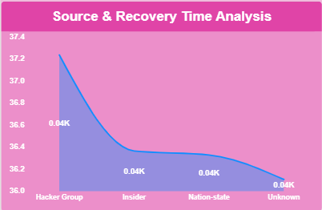
Source & Recovery Time Analysis
  The x-axis lists four categories: Hacker Group, Insider, Nation-state, and Unknown.
  The y-axis ranges from 36.0 to 37.4, representing recovery time values.
  A blue line connects the data points, showing how recovery times change across different sources.
  It helps identify which sources are associated with higher recovery-time values.

Slide 22
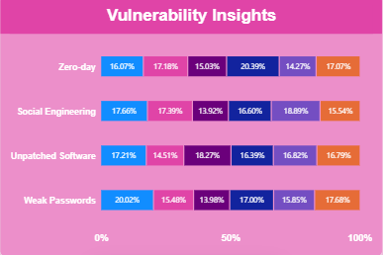
Vulnerability Insights
X-Axis :
  Represents the four categories of vulnerabilities: Zero-day, Social Engineering, Unpatched Software, and Weak Passwords.
Y-Axis :
  Represents the percentage scale, ranging from 0% to 100%.
  The Vulnerability Insights chart compares different security vulnerabilities.
It helps us understand how vulnerability categories are distributed across the attack data.
Unpatched Software is highlighted as the top vulnerability in the dashboard.

Slide 23
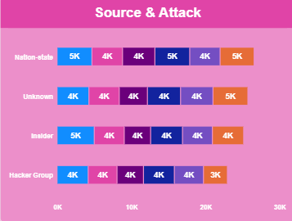
Source & Attack
X-Axis :
  Shows the attack volume scale, ranging from 0K to 30K.
Y-Axis :
  Lists the attack sources: Nation-state, Unknown, Insider, and Hacker Group.
The Source and Attack chart shows the relationship between attack sources and attack activity.
It helps us understand how different sources contribute to cybersecurity incidents.

Slide 24
Conclusion
The project provides a complete view of global cybersecurity threats.
Power BI helps convert cybersecurity data into meaningful visual insights.
The dashboard identifies important patterns in attacks, financial loss, users, industries, countries and defense methods.
The analysis can help organizations understand their major cybersecurity risks.
The insights can support better security planning, monitoring and risk reduction.

Slide 25
Thank you

