Slide 1
JALSETU
Water should flow where it matters most.
Intelligent Water Allocation, Reuse & Decision Support Platform
Detect • Predict • Match • Simulate
HackDevengers 2.0 — Open Innovation Hackathon
By : Mohanasri Konathala

Slide 2
THE PROBLEM
Water Scarcity Isn't Only a Supply Problem
Water is consumed across communities, campuses, industries, hotels and large facilities every day.
But water management is often fragmented:
Consumption
We know how much water is being consumed, but not always where abnormal usage is occurring.
Shortage
Areas may experience increasing demand while nearby usable water resources remain underutilized.
Reuse
Potentially reusable non-potable water and suitable demand are rarely connected intelligently.
Decision Gap
Existing systems mostly monitor and report instead of helping answer:
Where is water being wasted? Where is it needed? What could potentially be reused?

Slide 3
Meet JALSETU
JALSETU is an intelligent water allocation and reuse platform that connects water consumption, availability and demand through a single decision-support layer.
JALSETU can:
Detect abnormal water consumption
Forecast potential shortage risks
Identify potential non-potable reuse opportunities
Match available water with suitable nearby demand
Simulate conservation and reuse strategies
Measure potential freshwater savings
Our approach:
Monitor → Detect → Predict → Match → Simulate

Slide 4
HOW JALSETU WORKS
01 — COLLECT
Capture:
Water consumption
Supply & availability
Location
Demand
Usage category
03 — MATCH
Our Water Matching Engine evaluates:
Quantity
Location
Usage suitability
Demand
Priority
02 — ANALYZE
JALSETU identifies:
Unusual consumption
Shortage risks
Available water
Potential reuse opportunities
04 — SIMULATE
Decision makers can test:
Freshwater reduction
Water reuse
Rainwater harvesting
Other conservation strategies
05 — IMPACT
Estimate:
Potential freshwater avoided

Slide 5
CORE INNOVATION
Water Matching Engine
From:“We should save water.”
To:“Where can potentially available water be used better?”
Example:
FACILITY A Potentially available 8,000 L/day
↓
JALSETU ENGINE
↓
FACILITY B Suitable demand 6,500 L/day
JALSETU evaluates:
Quantity + Distance + Usage Category + Priority
Output:
Potential match identified
Potential freshwater avoided: 6,500 L/day

Slide 6
KEY FEATURES
One Platform. Multiple Water Intelligence Layers.
Consumption Anomaly Detection
Detect unusual water consumption compared with expected patterns.
Shortage Risk Forecasting
Identify locations that may experience increasing water demand or shortage risk.
Water Matching
Find potential matches between available non-potable water and suitable demand.
Water Intelligence Map
Visualize sources, demand zones, alerts and potential matches.
What-If Simulator
Test different conservation and reuse scenarios.
Impact Dashboard
Track potential freshwater avoided and other efficiency indicators.

Slide 7
SYSTEM ARCHITECTURE
WATER DATA
DATA COLLECTION
Consumption
Supply
Availability
Demand
Location
ALERT FORECAST MATCH
DASHBOARD
Map
Analytics
Simulator
Impact
JALSETU INTELLIGENCE
ENGINE
Anomaly Detection
Forecasting
Water Matching
Recommendations
Technology Stack
Frontend: React + Vite + JavaScript
UI: CSS / Responsive Web UI
Analytics: Python / Data-driven models
Backend: FastAPI
Database: PostgreSQL / Supabase
Visualization: Charts + Interactive Map

Slide 8
A Typical JALSETU Scenario
Step 1
A facility records an unexpected increase in water consumption.
Step 2
JALSETU detects the anomaly.
Consumption is significantly above the expected pattern.
Step 3
Another nearby zone shows increasing non-potable water demand.
Step 4
JALSETU searches available potential water sources.
Step 5
The Water Matching Engine identifies a potential match based on:
Quantity + Location + Usage Suitability + Priority
Step 6
The What-If Simulator estimates the potential impact.
Potential freshwater avoided -> XXXX L/day -> XXXX L/month
Result:
Better visibility → Better decisions → Better water utilization

Slide 9
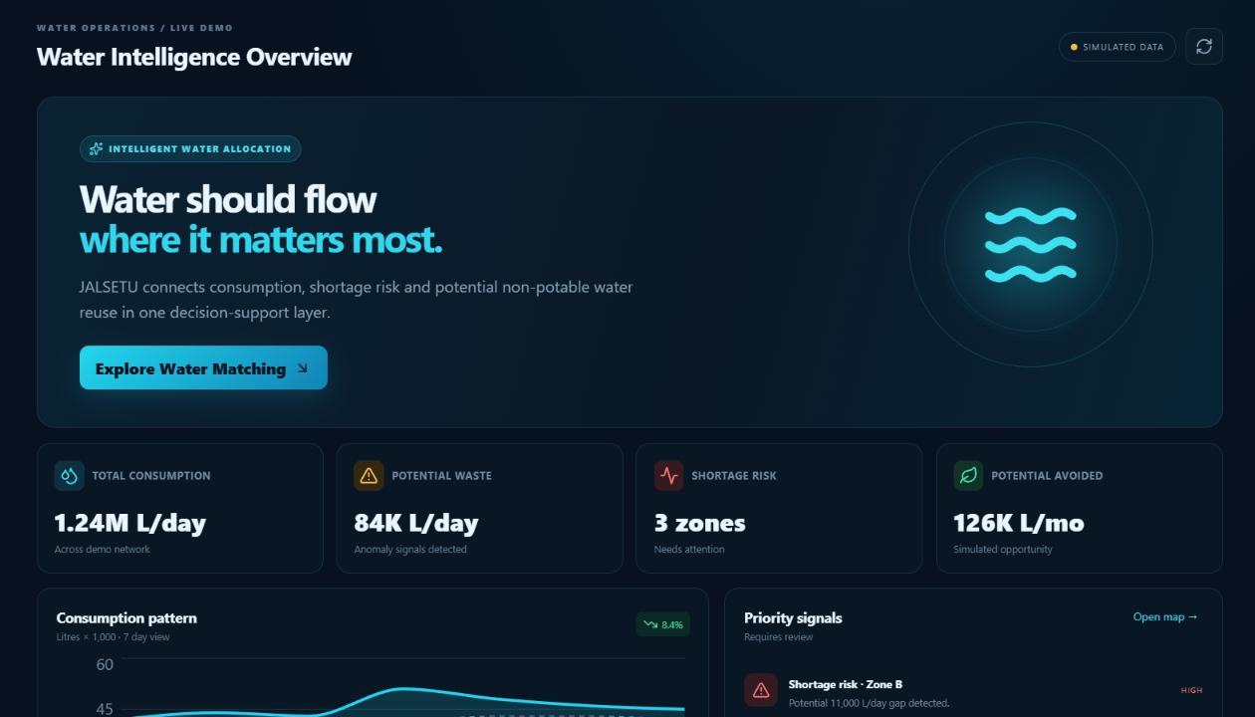
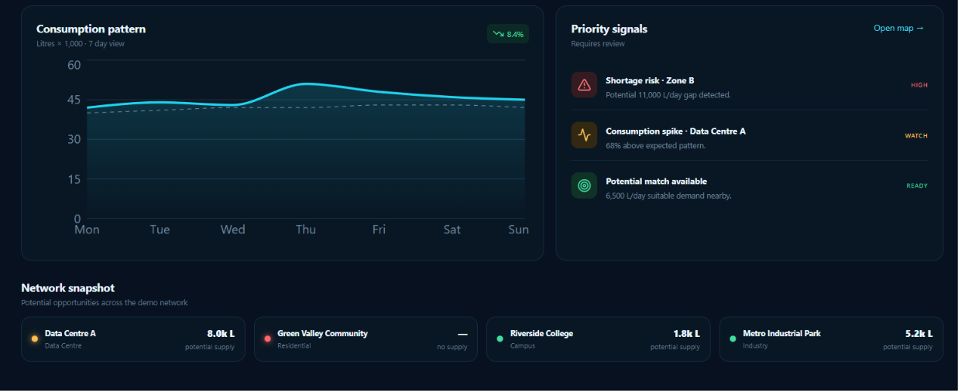
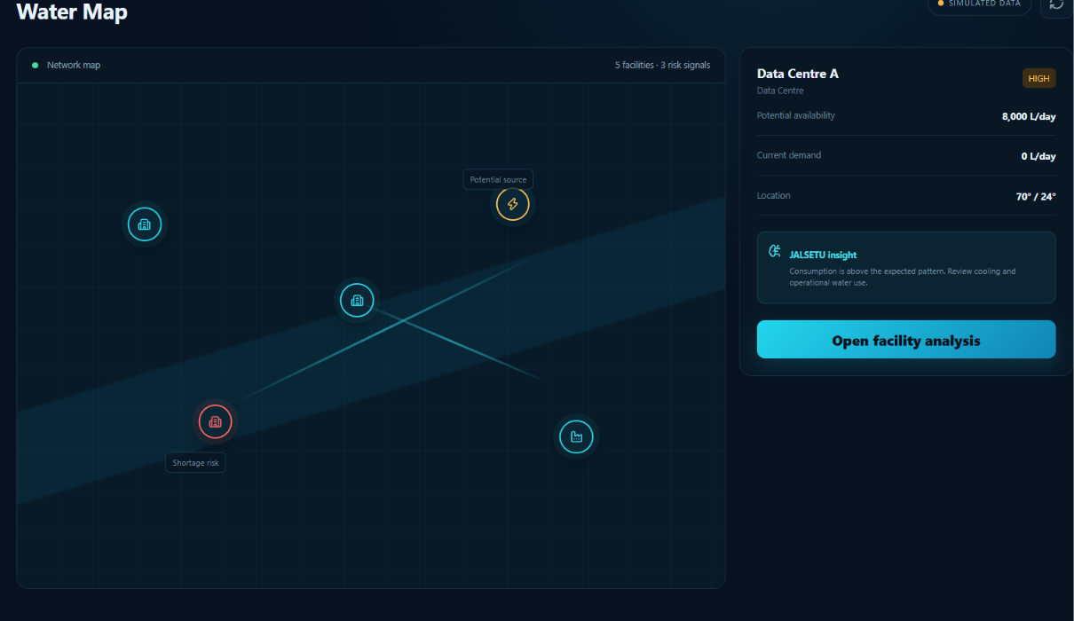
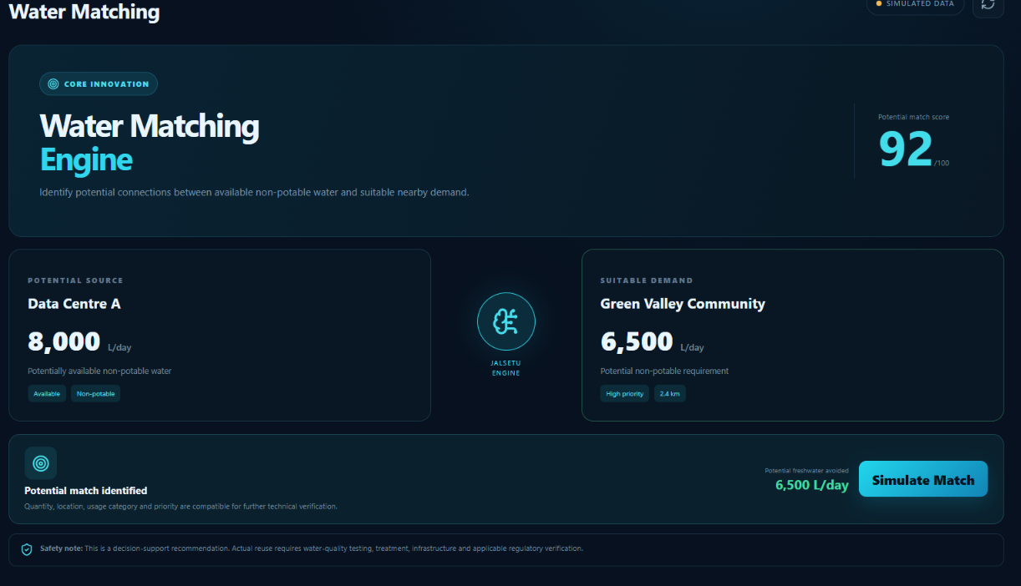
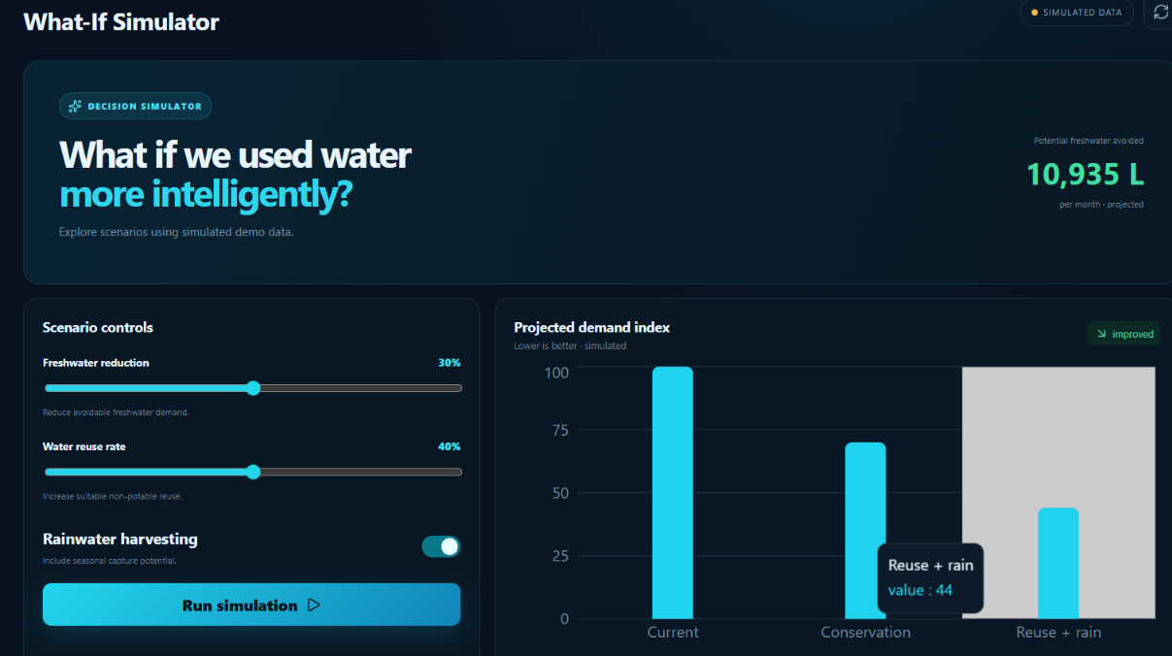
Screenshots

Slide 10
IMPACT & FUTURE SCOPE
Potential Impact
Detect inefficient consumption
Encourage non-potable water reuse
Identify emerging shortage risks
Support evidence-based decisions
Reduce unnecessary freshwater demand
Future Scope
IoT Integration
Connect smart water meters for real-time data.
Water Quality Sensors
Add quality parameters before recommending potential reuse.
Rainfall Intelligence
Integrate rainfall and weather data.
Industrial Water Networks
Connect multiple facilities within industrial clusters.
Municipal Integration
Extend the platform to larger community and city-level networks.
Predictive Water Management
Move from reacting to shortages toward anticipating them.

Slide 11
JALSETU
Water should flow where it matters most.
We don't just monitor water.
We identify where it can potentially be used better.
MONITOR -> DETECT -> PREDICT -> MATCH -> SIMULATE -> IMPACT
JALSETU
Intelligent Water Allocation & Reuse
Thank You
GitHub: https://github.com/MohanasriKonathala/JALSETU-Devengers_hackthon/tree/main
Live Demo: JALSETU — Water Intelligence

