Slide 1

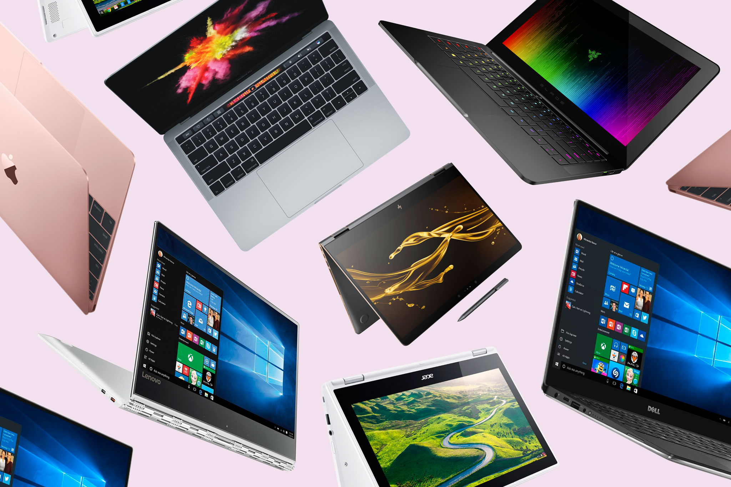
LAPTOP PRICE PREDICTION

Slide 2
PROBLEM STATEMENT
This paper presents a Laptop price prediction system by using the supervised machine learning technique. The research uses Regression as the machine learning prediction method. Using linear regression,Decision Tree Regressor,Support Vector Regressor,Random Forest Regressor there are multiple independent variables but one and only one dependent variable whose actual and predicted values are compared to find precision of results. This project proposes a system where price is dependent variable which is predicted, and this price is derived from factors like Laptop’s model, RAM, ROM (HDD/SSD), GPU, CPU, IPS Display, and Touch Screen.
Keywords— Multiple Linear regression, Laptop Price, Regression model, Machine Learning

Slide 3
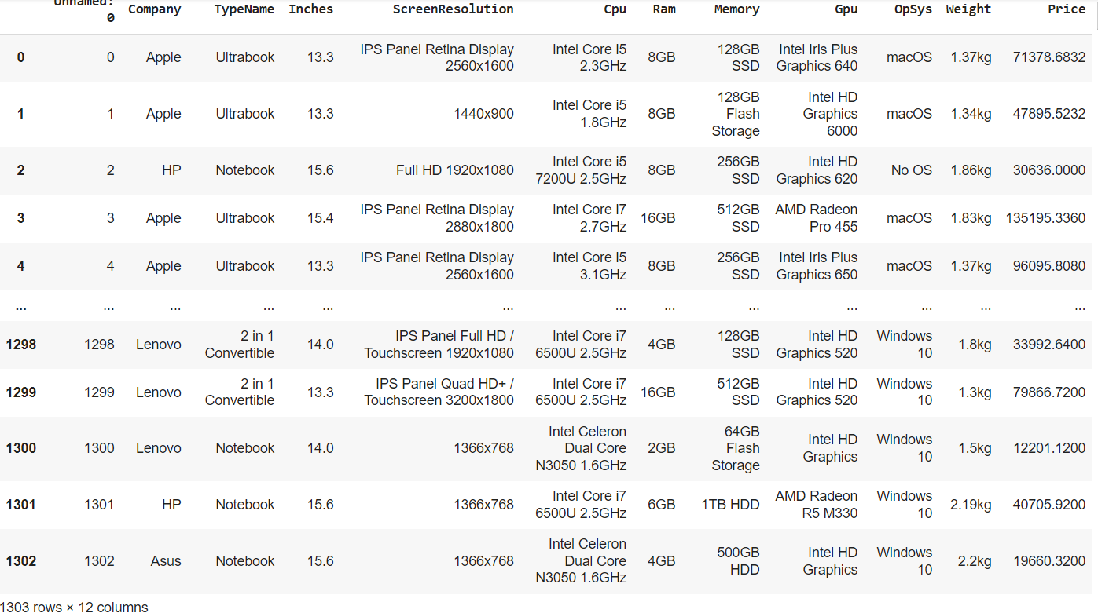
METHODOLOGY
STEP 1:ANALYZING DATASET

Slide 4
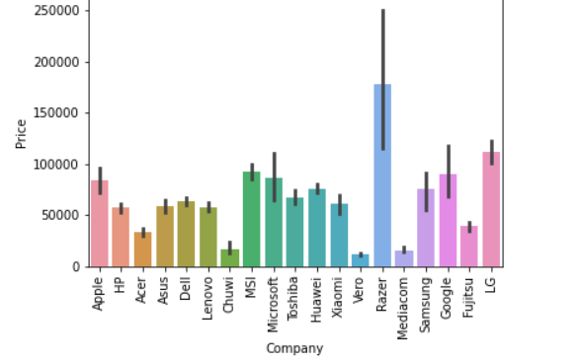
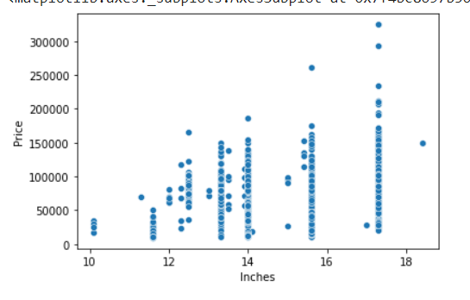
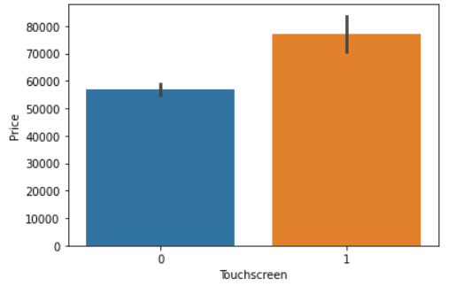
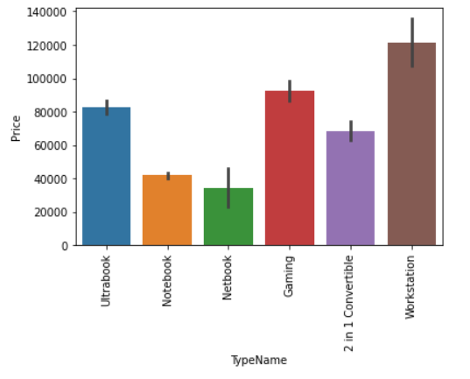
STEP 2:DATA VISUALIZATION

Slide 5
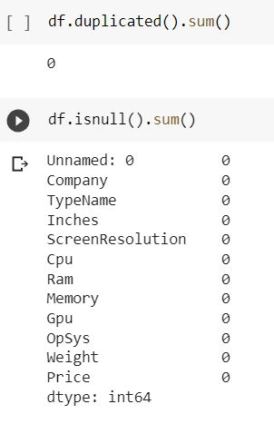
STEP 3:CHECKING NULL VALUES AND MISSING VALUES:
In our dataset we are checking for missing values and null values.
Next we are checking for duplicated values.

Slide 6
STEP 4:NECESSARY SPLITING OF COLUMNS AND ROWS
Removing in weight column kg
Removing in RAM columns GB
Changing float values of Price into Int
Changing screen resolution as x and y both columns
Removing the Screen resolution words such as IPS,Full hd
Combining the OPSYS column by its Windows versions as common,MacOS as common,other all are other OS
Splitting the Memory column into HDD,SSD,Hybrid,Flash Storage
Combining GPU Brand column by all intel in one and amd in one and nividia.

Slide 7
KEY FINDINGS
In this project I used 4 Algorithms:
Linear Regression
Decision Tree Regressor
Support vector Regressor
Random forest Regressor
All these are executed and Random forest regressor gives the higher accuracy of 88%.

Slide 8
Web page
I have used Pickle Library to export the colab file.
And I have imported it in Pycharm
By using Streamlit Library I written a code to display the webpage.
In this webpage we can give our specifications and get our related approximate price of laptop.

Slide 9
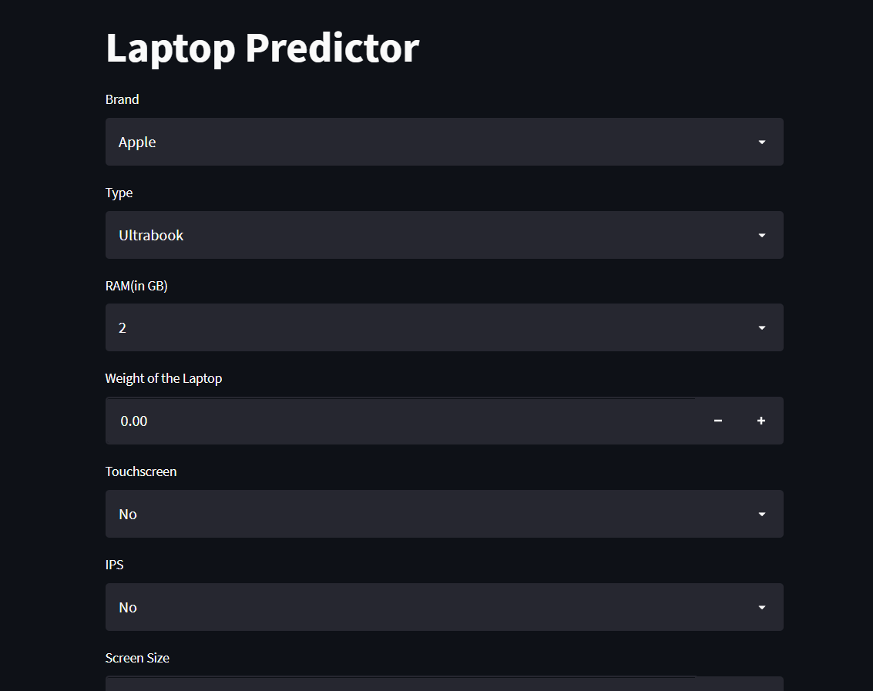

Slide 10
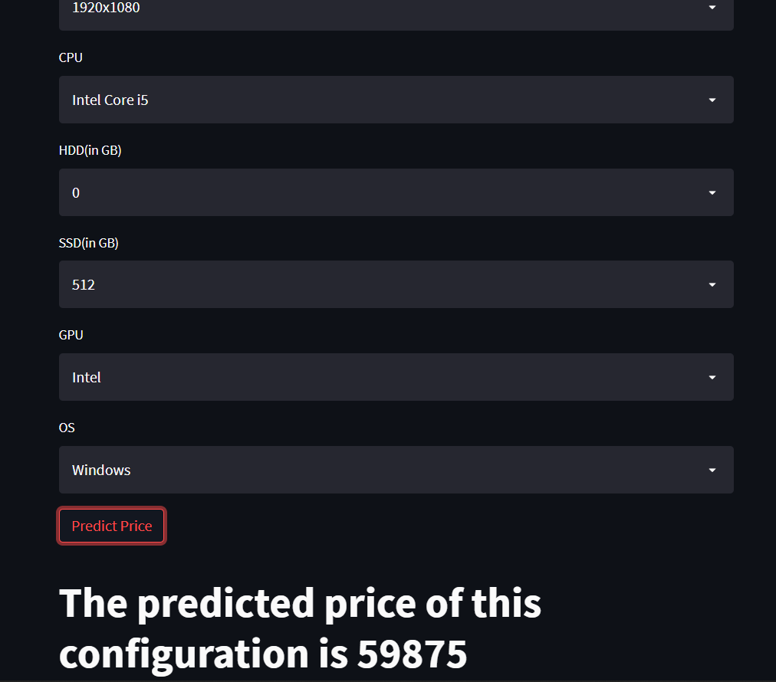

Slide 11
HELPFUL FOR BUSINESS
Most of the peoples in our country do no the price of the laptop.
But they has some thought features how their laptop should be and what are the specifications should include in their laptop.
Our webpage helps them to predict their laptop with their specifications itself
Just people need to give their necessary specification in the particular boxes and click on the predict button.
Our webpage gives the output as the predicted amount in rupees.

Slide 12


