Slide 1


WORLD POPULATION

Slide 2
PROBLEM STATEMENT
This brief statement of population problems indicates the pervasive and depressive effect that uncontrolled growth of population can have on many aspects of human welfare. Nearly all our economic, social, and political problems become more difficult to solve in the face of uncontrolled population growth. It is clear that even in the wealthier nations many individuals and families experience misery and unhappiness because of the birth of unwanted children.
Here we are doing EDA on every country and every state.
By this way we can identify the population increase easily by visualization.

Slide 3
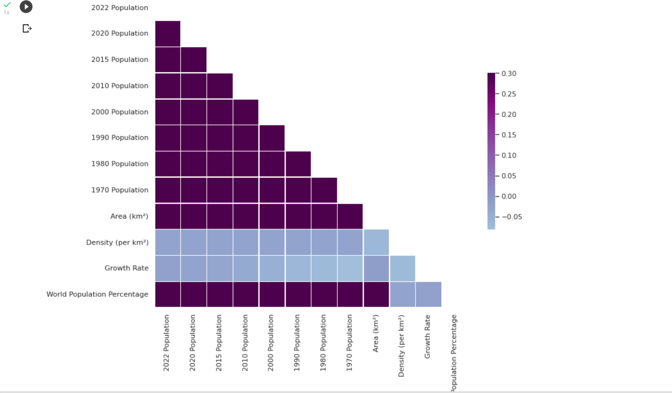
CORRELATION

Slide 4
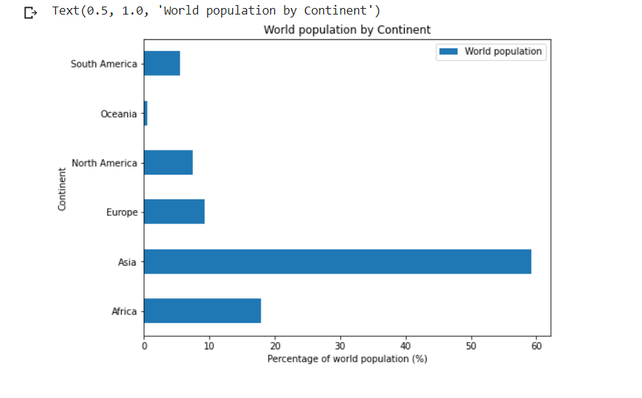
WORLD POPULATION BY CONTINENT

Slide 5
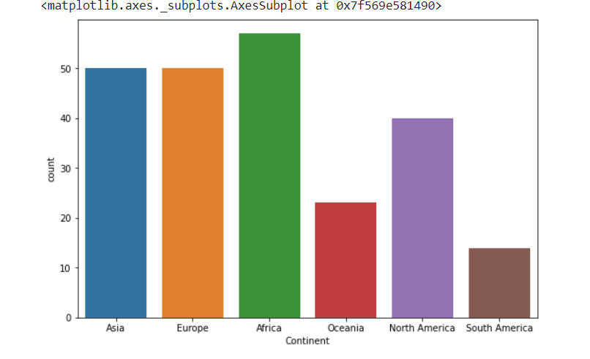
NO OF COUNTRY PER CONTINENT

Slide 6
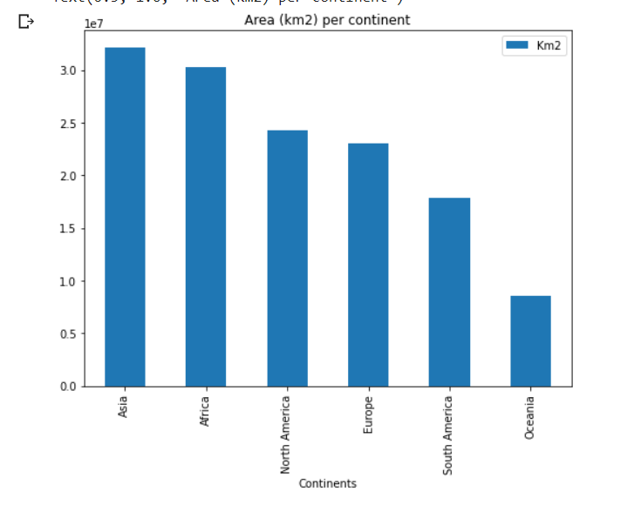
AREA OF EACH CONTINENT

Slide 7
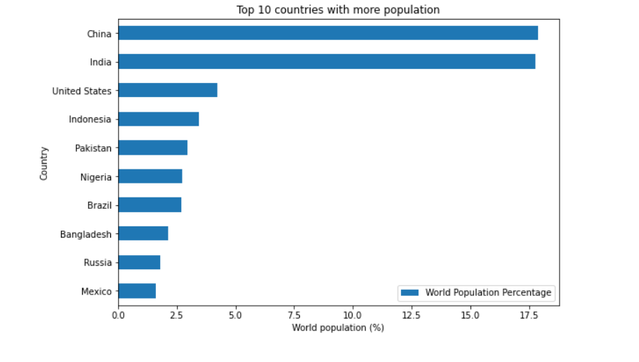
TOP 10 COUNTRIES WITH MORE POPULATION

Slide 8
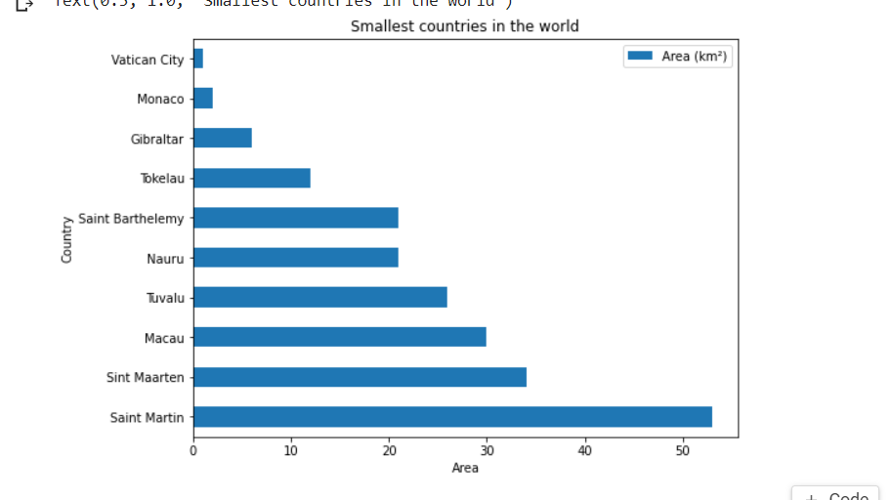
TOP 10 SMALLEST COUNTRIES

Slide 9
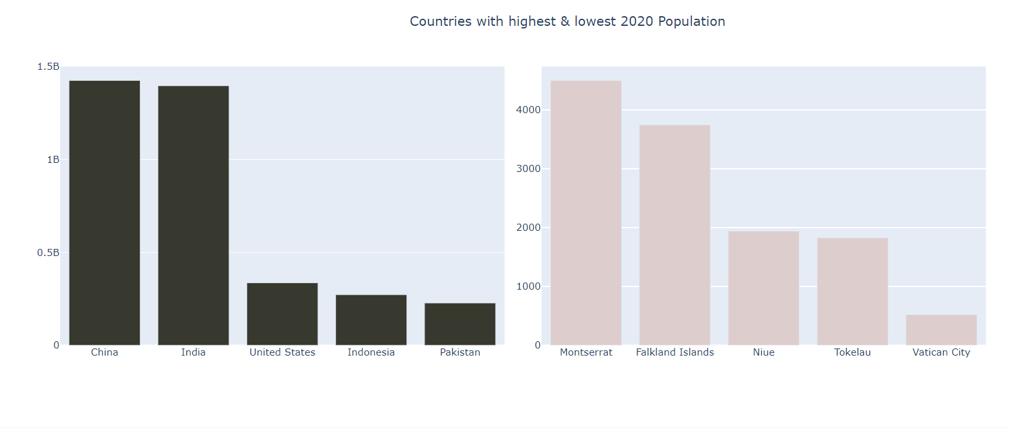
COUNTRIES WITH HIGHEST AND LOWEST POPULATION IN 2020

Slide 10
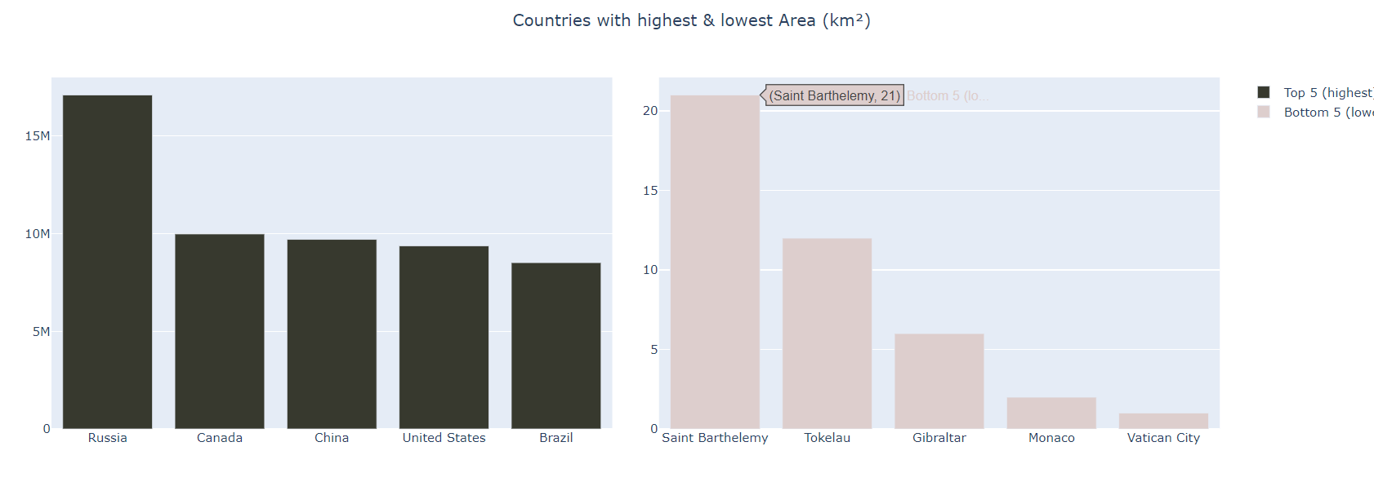
COUNTRIES WITH HIGHEST AND LOWEST POPULATION IN 2020

Slide 11


