Slide 1
Smart body posture recognition and Guiding system
PIP2001 Capstone Project
VIVA - VOCE
Batch Number: CCS-G19
Roll Number | Student Name
20211CCS0124 | SANKETH S
20211CCS0133 | MOHAN C V
20211CCS0140 | MANU K
20211CCS0158 | SHAUN FRANKLYN
20211CCS0190 | V VISHWA KIRAN REDDY
Under the Supervision of,
Ms.Sterlin Minish T N
Assistant Professor
School of Computer Science and Engineering
Presidency University
Name of the Program: COMPUTER SCIENCE AND ENGINEERING - CYBER SECURITY
Name of the HoD: Dr. Ananda Raj S P
Name of the Program Project Coordinator: Dr. Sharmasth Vali Y
Name of the School Project Coordinators: Dr. Sampath A K / Dr. Abdul Khadar A / Mr. Md Ziaur Rahman

Slide 2
Introduction
Self-service health monitoring systems, like wellness KIOSKs, are becoming more and more common in today's hectic society. Without the need for expert assistance, these KIOSKs give customers an easy and accessible way to assess important health factors like body mass index (BMI), bone mass composition (BMC), blood pressure (BP), electrocardiogram (ECG), pulse, and temperature.
The fact that precise measurements of these devices rely significantly on the user's position is one of their main problems. Inaccurate readings can arise from even minor misalignments, such an arm placed wrongly during a blood pressure check.
In order to solve this problem, our project incorporates a sophisticated posture detecting technology into the wellness KIOSK. To ensure proper posture for every health test, the system uses a camera and image processing technologies to record and analyse the user's posture in real time. Through prompt feedback and direction, the system assists users in obtaining precise and trustworthy measurements.

Slide 3
Literature Review
Sl No | Title | Content
1 | Damien Brulin, Yannick Benezeth, and Estelle Courtial, “Posture Recognition Based on Fuzzy Logic for Home Monitoring of the Elderly”, in IEEE TRANSACTIONS ON INFORMATION TECHNOLOGY IN BIOMEDICINE, VOL. 16, NO. 5, SEPTEMBER 2012 | The proposed system performs human detection prior to the pos_x0002_ture analysis; posture recognition is performed only on a human silhouette.The posture recognition method, based on fuzzy logic, identifies four static postures and is robust to variation in the distance between the camera and the person, andto the person’s morphology.
2 | Biljana Cvetkoska, Ninoslav Marina, Dijana Capeska Bogatinoska, Zhanko Mitreski, “Smart Mirror E-health Assistant – Posture Analyze Algorithm” , in IEEE EUROCON 2017, 6–8 JULY 2017, OHRID, R. MACEDONIA | This Model consists of a smart mirror which works on its own algorithm and behaves as smart assistant. This proposed model uses face recognition authentication, posture problem detection, and proper posture guidance, followed with suggestions for preventive healthcare. The algorithm identifies the person’s posture and carefully analyses the posture and body changes over time.

Slide 4
Sl No | Title | Content
3 | Jheanel Estrada, Larry Vea, “Sitting Posture Recognition for Computer Users using Smartphones and a Web Camera”, in Proc. of the 2017 IEEE Region 10 Conference (TENCON), Malaysia, November 5-8, 2017 | Recognize proper / improper sitting postures using accelerometer readings from some human spinal points through small, thin, and lightweight smartphones attached at those points, and by using a web camera which detects the upper body points’ location and distances. It also established relationships of human body frames and proper sitting posture
4 | Chia-Feng Juang, Chung-Wei Liang, Chiung-Ling Lee,I-Fang Chung, “Vision-based Human Body Posture Recognition Using Support Vector Machines” ,in 978-1-4673-2112-9/12/$31.00 ©2012 IEEE | Vision-based human posture recognition method using a support vector machine (SVM) classifier. Recognition of four main body postures two cameras are used to capture two sets of image sequences at the same time. After capturing the image sequences, a RGB-based moving object segmentation algorithm is used to distinguish the human body from background. Two complete and corresponding silhouettes of the human body are obtained. The Discrete Fourier Transform (DFT) coefficients and length-width ratio are calculated from horizontal and vertical projections of each silhouette. Finally, these features are fed to a Gaussian-kernel-based SVM to recognize postures. Experimental results show that the proposed method achieves a high recognition rate.

Slide 5
Sl No | Title | Content
5 | Ling Xie, Xiao Guo, “Object Detection and Analysis of Human Body Postures Based on TensorFlow” , in 2019 IEEE International Conference on Smart Internet of Things (SmartIoT) | Human pose estimation algorithm called OpenPose has been more widely used. But its efficiency is very low. We used deep learning methods based on TensorFlow to recognize human body postures.designed eight sets(MobileNet V2,Inception V2,Inception V2, ResNet101,ResNet152, Inception_ResNet_v2,YOLO) of experimental schemes through combining the classification model and the detection algorithm.

Slide 6
Existing method Drawback
Environmental Dependency: For proper performance, a lot of models rely significantly on regulated settings. Variations in occlusions, backdrop, and illumination can have a big impact on how reliable they are.
User Comfort and Compliance: Although useful in certain situations, wearable technology can be bothersome or uncomfortable for users, especially for the elderly or people with impairments.
Data Requirements: For training, deep learning models usually need a lot of labelled data, which might be hard to come by. This may lead to models that aren't optimised for particular user requirements.
Accuracy and Generalization: When applied to various people or contexts, some models may perform worse, even though they show great accuracy in controlled circumstances. Their efficacy in practical applications may be constrained by this lack of generalisation.
Feature Extraction Complexity: Conventional machine learning techniques frequently call for extensive manual feature extraction, which can be laborious and rely on domain-specific expertise. Because of this, it could be difficult to modify models for various situations or user groups.

Slide 7
Proposed Method
Body Posture Detection and Correction Using Mediapipe
Overview:
In order to identify and adjust user posture in the self-service wellness KIOSK, the system makes use of the Mediapipe architecture. In order to provide accurate findings, the goal is to make sure the user adopts the proper posture for a variety of health tests, such as blood pressure, ECG, and BMI. The framework helps the user make modifications in real time by recognising body landmarks and analysing postural abnormalities.
Key Features:
Landmark Detection: Mediapipe identifies key body landmarks such as hand, leg, and torso positions, relevant to each health test.
Reference Axis Comparison: The system establishes a reference axis for each posture, and deviations from this axis are measured in real-time.
Posture Correction Guidance: If the user's posture deviates beyond a defined angle, the system provides visual or audio feedback to guide the user into the correct posture.

Slide 8
Proposed Method
Real-Time Image Processing for Posture Adjustment
Overview:
The KIOSK's camera records the user's posture and uses image processing algorithms to analyse it. In order to ensure that poor posture does not compromise the accuracy of the vital data, this is compared to the postures needed for particular health tests.
Key Features:
Posture Image Capture: Real-time image capture of the user’s body is initiated when the user begins a test.
Posture Analysis: The system uses the captured images to check alignment against the optimal posture for each health test.
User Feedback: If the posture is incorrect, the system provides immediate feedback to help the user adjust their position accordingly.

Slide 9
Objectives
Develop a Non-Assisted Wellness Kiosk:
To design and implement a self-service wellness kiosk that enables users to measure vital health parameters like BMI, BMC, BP, ECG, Pulse, and Temperature without the need for external assistance.
Ensure Accurate Health Measurements:
To improve the accuracy of vital health measurements by guiding users to adopt correct body postures using real-time image processing and posture analysis techniques.
Utilize Mediapipe for Posture Detection:
To leverage the Mediapipe framework for detecting key body landmarks and ensuring that users maintain the correct posture during health tests.
Provide Real-Time Feedback:
To develop a system that can analyze user posture in real-time and offer immediate feedback, either visual or auditory, to correct deviations from the required posture for each health test.

Slide 10
Enhance User Experience through Automation:
To create a user-friendly and fully automated system that facilitates seamless operation, ensuring that users are accurately guided through the process without requiring assistance from medical personnel.
Implement a Flexible Posture Correction System:
To develop a posture correction mechanism that can adapt to various users' body types and health tests, providing tailored posture corrections based on individual deviations.
Improve Health Awareness:
To promote better health awareness by educating users on the importance of correct posture during health tests, contributing to more accurate monitoring and healthier lifestyle practices.

Slide 11
Methodology/Modules
Image Capture and Processing Module
Overview:
This module captures images of the user's posture using an integrated camera system and processes them using computer vision techniques.
Features:
Utilizes the Mediapipe framework for landmark detection of key body parts (e.g., hands, legs, torso).
Extracts posture-related features such as the angle of joints and alignment of body parts.
Posture Analysis and Guidance Module
Overview:
This module is responsible for analyzing the detected body landmarks to ensure that the user's posture is correct during the measurement process.
Features:
Reference Axis Calculation: A reference axis is established using the detected landmarks, and the system calculates the angle of deviation from the ideal posture.
Deviation Detection: If the posture deviates beyond a predefined threshold angle, the system provides visual and audio guidance to help the user correct it.
Feedback System: Real-time feedback loop that helps users adjust their posture before taking the measurement, ensuring accurate results.

Slide 12
Architecture
Acquire Required Landmarks
Draw Landmarks and Connections
Capture Frame
Pre-Process
Is Aligned
Posture Matched
Yes
Check alignment for required test
No
Display Warning
Re-Check

Slide 13
Hardware/software components
Software Components
Operating System : Windows 10 or Higher
Development Environment : Visual Studio Code,Jupyter Notebooks
Image Processing and Machine Learning : OpenCV, MediaPipe .
External Libraries and Dependencies : NumPy, Pandas, Keras.
Hardware Components
Camera: 720p HD Webcam.
Processor: Intel Core i3 or equivalent.
RAM: 4GB.

Slide 14
Timeline of Project

Slide 15
Outcomes / Results Obtained
Accurate Health Monitoring:
The system improved the accuracy of key health metrics like Blood Pressure (BP), ECG, Pulse Rate, and BMI by ensuring users maintained the correct posture during the measurement process.
Posture correction led to 12.2% improvement in BP accuracy and 7.7% improvement in ECG readings, enhancing the overall reliability of health assessments.
Effective Posture Detection:
The system utilized the Mediapipe framework to detect and correct posture in real time.
Posture deviations, such as neck inclination and torso misalignment, were successfully reduced. For example, neck deviation was corrected from an average of 15.8° to 3.2° after feedback was provided.

Slide 16
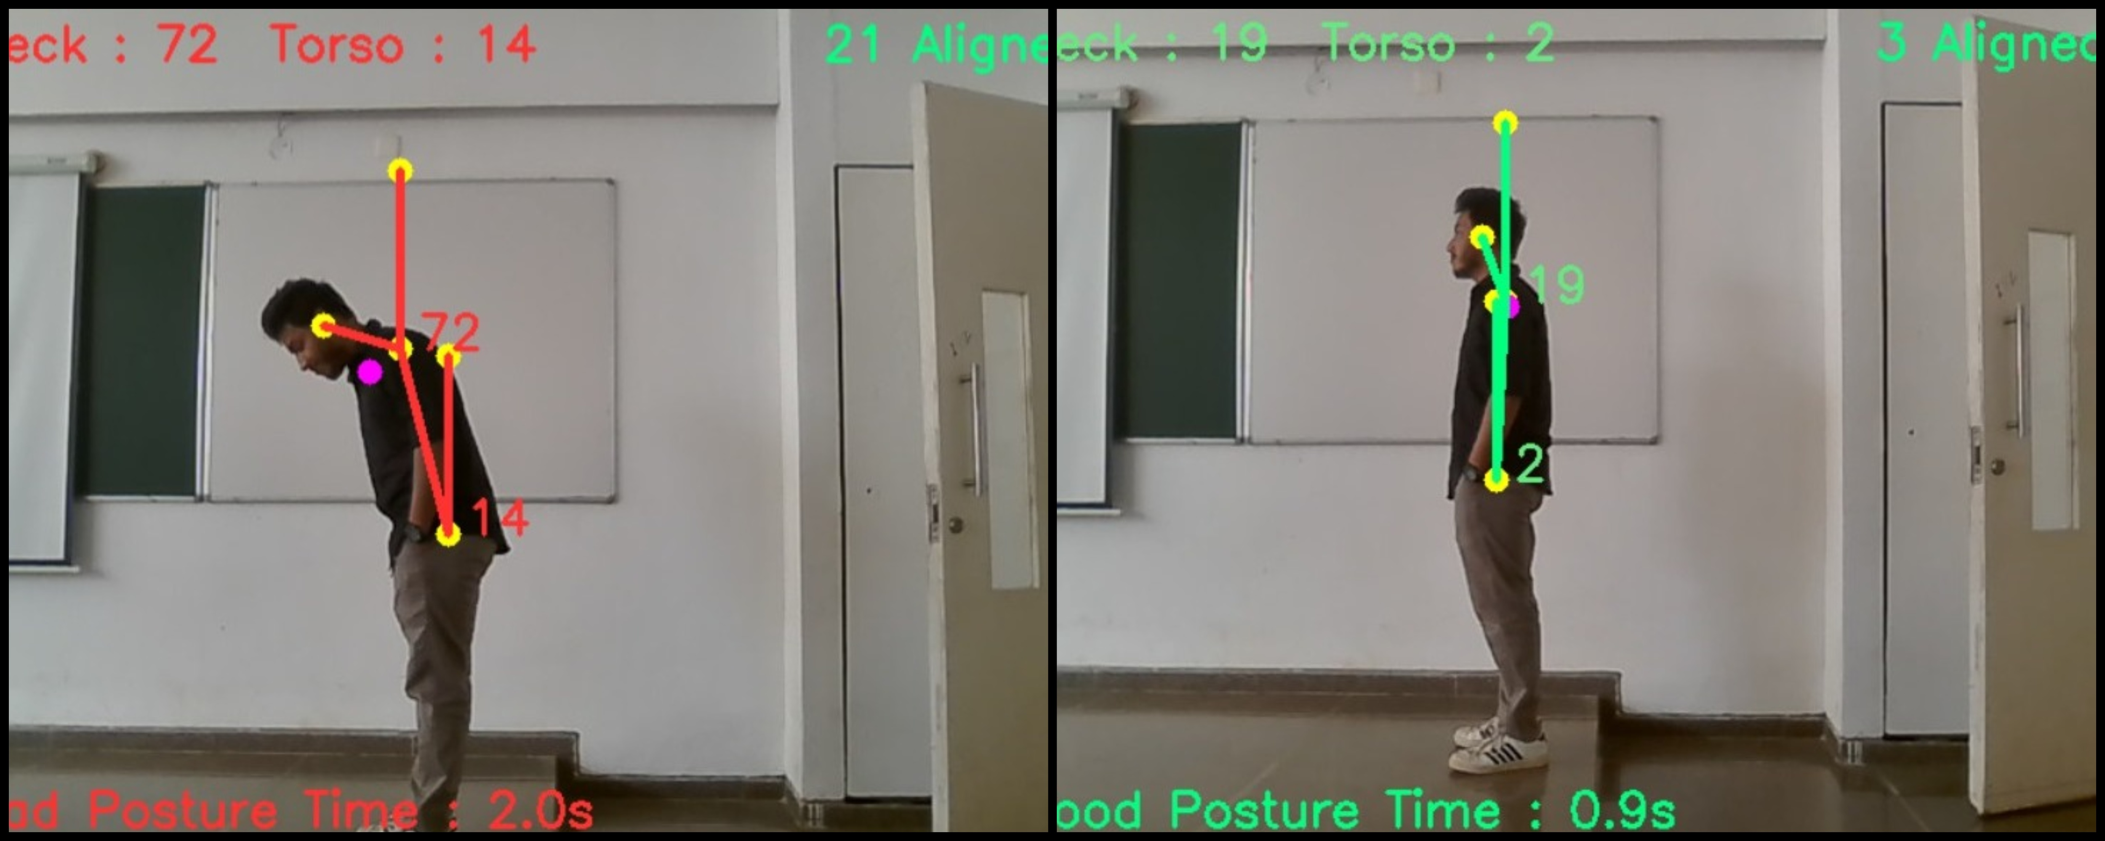
Fig: Neck and Torso Angle Deviations Before and After Feedback

Slide 17
User-Friendly and Autonomous System:
The kiosk provided real-time feedback, using visual and auditory cues to guide users in maintaining proper posture. This feedback was clear and easy to follow, enabling 92% of users to adjust their posture correctly without external assistance.
Non-Intrusive and Scalable Design:
The system used a camera-based approach for posture detection, making it non-intrusive and comfortable for public use.
It also featured a modular design, allowing for future scalability, such as integrating additional health sensors and AI-powered features.

Slide 18
Conclusion
An important development in non-assisted health monitoring systems is the creation of a self-service wellness KIOSK that combines vital health parameter measurement with posture correction coaching.
The technology guarantees that users maintain proper posture throughout exams by utilising the Mediapipe architecture for posture detection, which produces more accurate health data.
By empowering people to take measurements on their own, the real-time feedback and correction system improves accessibility and convenience while also improving the user experience.

Slide 19


Publication Details

Slide 20

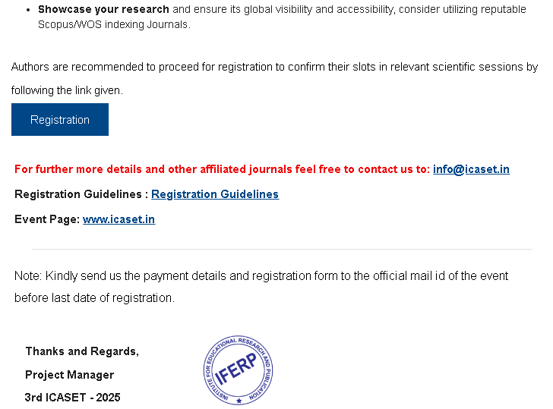

Slide 21
Github Link
https://github.com/Mohancv2003/CCS-G19_Smart_body_posture_recognition

Slide 22
References
Reference Papers, https://ieeexplore.ieee.org/Xplore/home.jsp
Damien Brulin, Yannick Benezeth, and Estelle Courtial, “Posture Recognition Based on Fuzzy Logic for Home Monitoring of the Elderly”, in IEEE TRANSACTIONS ON INFORMATION TECHNOLOGY IN BIOMEDICINE, VOL. 16, NO. 5, SEPTEMBER 2012
Biljana Cvetkoska, Ninoslav Marina, Dijana Capeska Bogatinoska, Zhanko Mitreski, “Smart Mirror E-health Assistant – Posture Analyze Algorithm” , in IEEE EUROCON 2017, 6–8 JULY 2017, OHRID, R. MACEDONIA
Jheanel Estrada, Larry Vea, “Sitting Posture Recognition for Computer Users using Smartphones and a Web Camera”, in Proc. of the 2017 IEEE Region 10 Conference (TENCON), Malaysia, November 5-8, 2017
Chia-Feng Juang, Chung-Wei Liang, Chiung-Ling Lee,I-Fang Chung, “Vision-based Human Body Posture Recognition Using Support Vector Machines” ,in 978-1-4673-2112-9/12/$31.00 ©2012 IEEE
Ling Xie, Xiao Guo, “Object Detection and Analysis of Human Body Postures Based on TensorFlow” , in 2019 IEEE International Conference on Smart Internet of Things (SmartIoT)
Mediapipe Documentation, https://pypi.org/project/mediapipe/

Slide 23
Thank You

