Slide 1
Key Findings
1- Overall Employee Attrition:
The Company Has 1,500 employees , of whom 396 have left , resulting in an overall attrition rate of 26%.
2- Attrition by Tenure:
Employees with 10 or more years of service have the highest attrition rate at 31% , compared with 24% for employees with 0-2 years of service.
3- Attrition b job satisfaction:
Employees with job satisfaction levels of 1 and 2 have higher attrition rates(35% and 36%),than employees with satisfaction level of 3 and 4 (19% and 18%).
4- Attrition by business travel:
Employees who travel frequently have the highest attrition rate at 30% , compared with 25% for employees who travel rarely.
5- Attrition by Overtime :
Approximately 61% of employees who left the company had overtime responsibilities.

Slide 2
Key Findings – Workforce Overview
1- Department Distribution:
Sales had the highest number of employees , while finance had the lowest.
2- Job Title Distribution:
Customer service Representative was the most common job title , while Network technical was the least common .
3- Age Group Distribution:
Employees aged 25-34 formed the largest age group with 420 employees. While 55+ group represent the smallest age group with 253 employees .
4- salary Band Distribution:
The Very High Salary band represented 38.53%of employees , while the low salary band represented 13.07% .

Slide 3
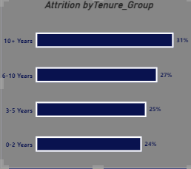
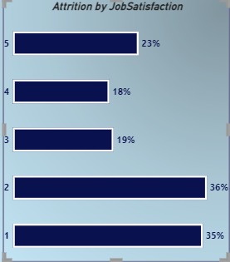
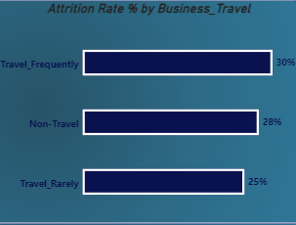
Recommendations
1- Improve employee Retention:
Investigate the reasons behind the high attrition rate among employees with 10 or more years of service . And review opportunities for career development and promotion.
2- Improve Job Satisfaction :
Investigate the factors contributing to low job satisfaction and develop initiatives to improve employee satisfaction and retention.
3- Review Workload And Business Travel:
Review overtime workload and frequent business travel to identify potential factors contributing to employee attrition and improve working conditions.
4- Monitor Employee Attrition:
Monitor attrition rate regularly by department job title , and tenure group to identify emerging trends and evaluate the effectiveness of employee retention initiatives.

