Slide 2

Rent It!

Slide 3
Agenda
Data Description
Pre-processing
Data analysis
Feature Scaling/Transformation
Regression Techniques
Regression Techniques Result

Slide 4
Data Description
Date :The Date ranges between 2017-2018
Rented Bike Count :The number of rented bikes (Class Label)
Hours of the Day :daytime [0-23]
Temperature(°C) : Temperature Degree in Celsius
Humidity(%) : Parentage of humidity
Wind speed (m/s):Wind speed (The values approximately ranges between [0-5])
Visibility (10m):means that a person should be able to see and identify in the daytime
Dew point temperature(°C) : the air needs to be cooled
Solar Radiation (MJ/m2) : electromagnetic radiation emitted by the sun
Rainfall(mm) : Rainfall
Snowfall (cm) : Snowfall
Seasons : Winter, Spring, Summer, Autumn
Holiday : Holiday/No holiday
Functioning Day : NoFunction (Non-Functional Hours), Fun(Functional hours)

Slide 5
Pre-Processing
Check null values.
Convert date column to year, month &day.
Drop year column(Because dataset only one year).
Divide day column to weekdays & week ends(Saturday&Sunday).
Concatenate train & test data(To Handle missing data that are found in train but not found in test & vice versa).
One hot encoder on season, holiday& function day by get dummies.
Label encoder on holiday & function day.
distribution plot to check if data follow gaussian distribution or not and to check the type of normalization that we’ll use(Standard Scaler)

Slide 6
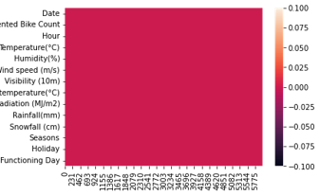
Check Null Values
There is No Null Values

Slide 7

Data Analysis

Slide 8
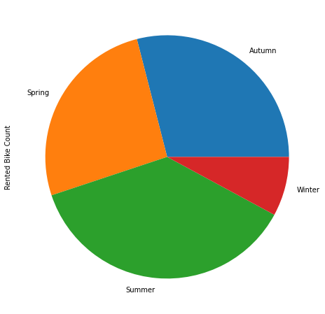
pie chart of bike count in different seasons
The rented bikes in winter season is less than the other seasons because of snowfall

Slide 9
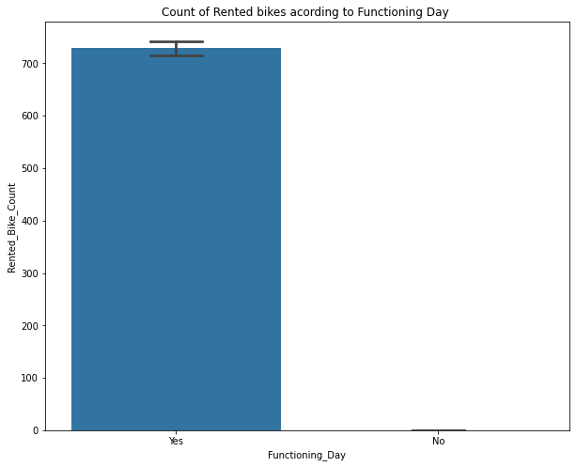
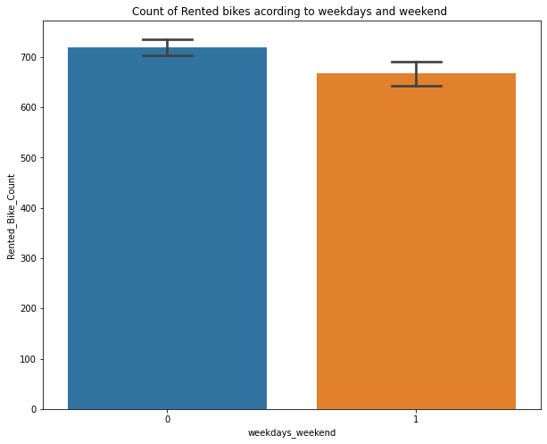
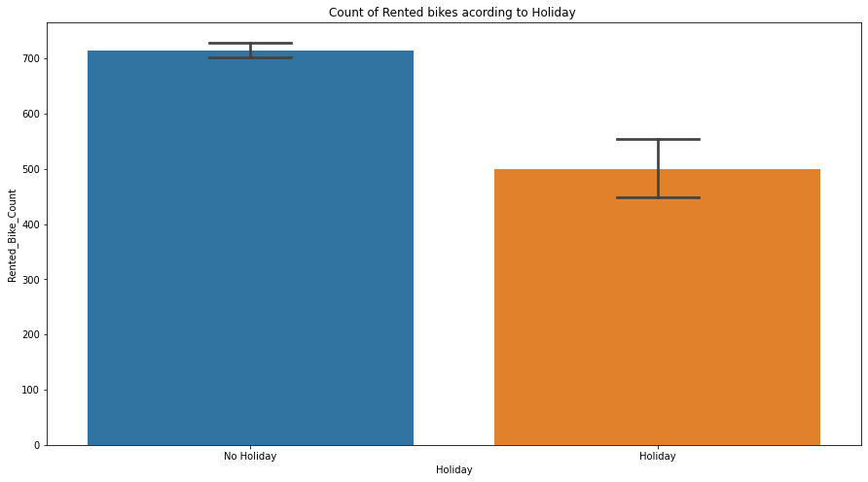
Analysis of categorical Features
When Function Day is Yes ,the rented bike increase, else decrease
In the rented bike count in the weekdays is greater than in the weekends
The rented bike in the holiday is greater than in no holiday

Slide 10
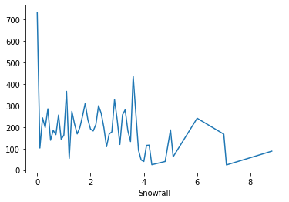
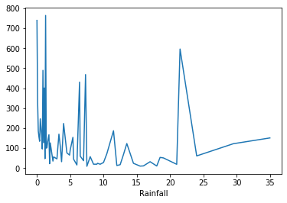
Analysis of Numeric Data
the amount of rented bike is very low When we have more than 4 cm of snow
even if it rains a lot the demand of rent bikes is not decreasing

Slide 11

Feature Scaling/Transformation Distribution Plot

Slide 12
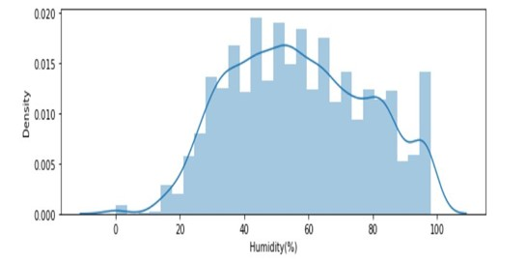
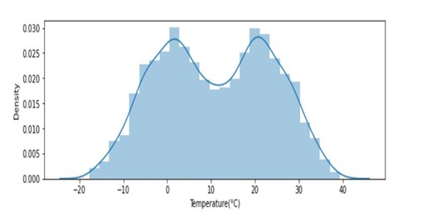
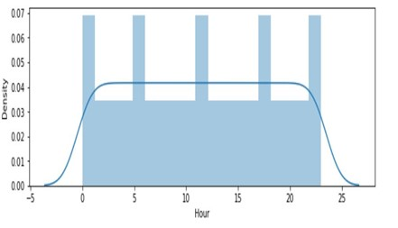
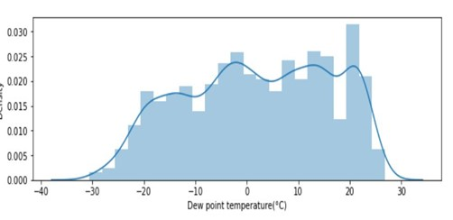
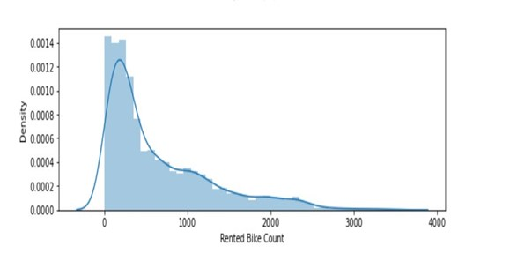

Slide 13
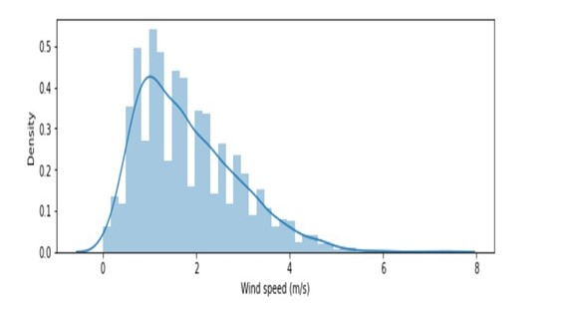
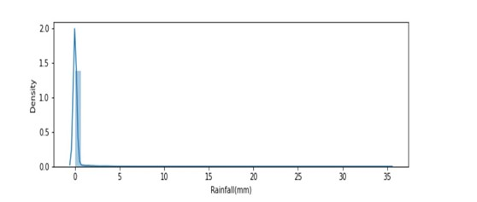
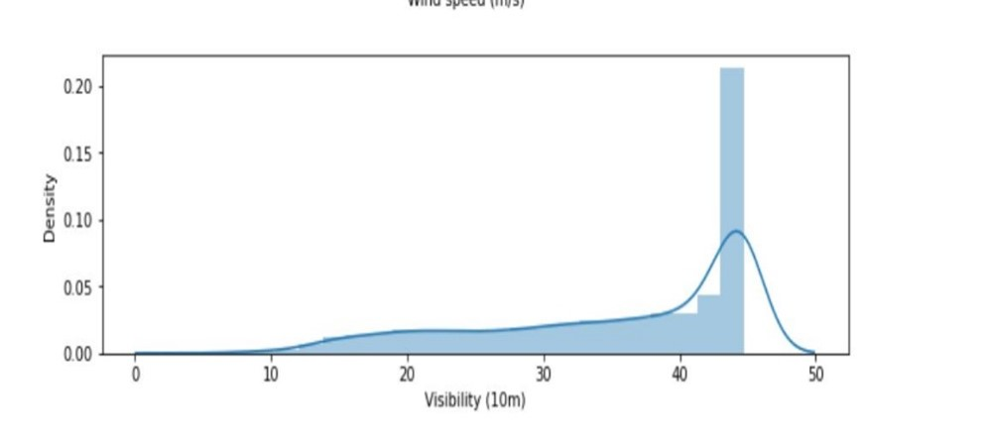
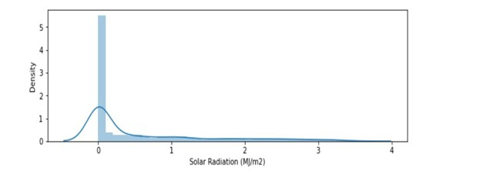
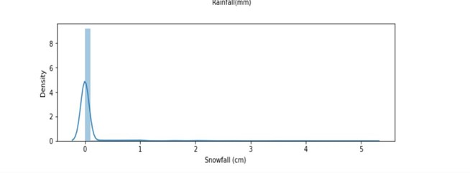
All this feature follow Gaussian Distribution, so we applied Standard Scalar

Slide 14
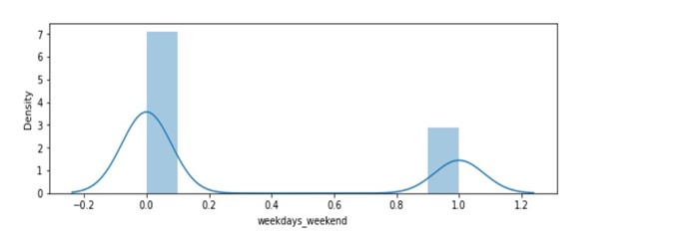
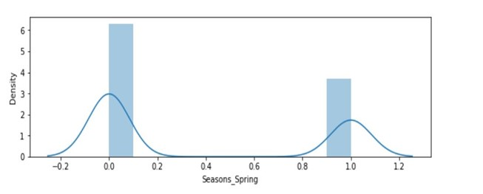
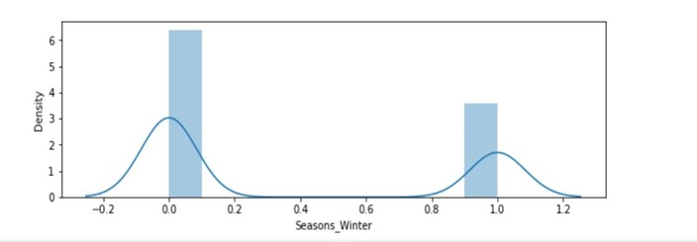
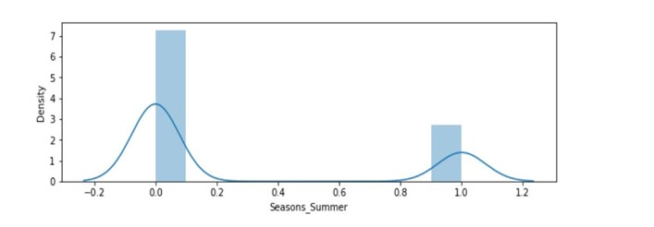
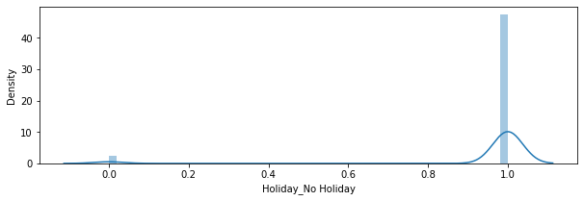
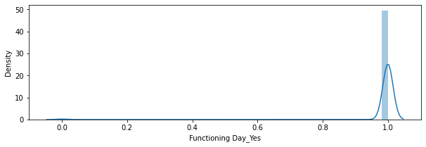
These Feature are in range of [0,1],so they needn’t Feature Scaling

Slide 15
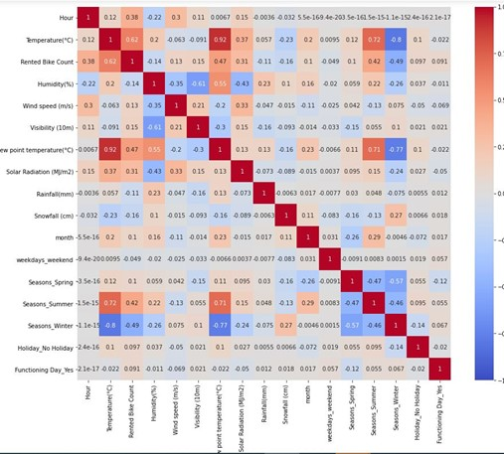
Visualizing Correlation

Slide 16

Regression Techniques

Slide 17
Model | Accuracy | Error
Linear Regression | Train Score=65.4% Test Score=62.3% | Test Error=56.2% Train Error=49.3%
Random Forest (Cross Validation) | Train Score=99% N-Estimators=100 Test Score=92% Mean Accuracy=92.9% | Test Error=10.6% Train Error=1.3%
Gradient Boosting | Train Score=91% Test Score=88.9% | Test Error=16.4% Train Error=12.8%
CatBoost | Iterations=1999 Train Score=97.9% Test Score=94.8% | Test Error=7.6% Train Error=2.9%
Decision Tree (Max Depth) (Max Leaf Node) | Train Score=92.9% Test Score=88.2% 100 150 | Test Error=17.5% Train Error=10%
XGBoost | Train Score=99.2% Test Score=94.3% | Test Error=8.3% Train Error=1%
AdaBoost | Train Score=74.8% Test Score=73.5% | Test Error=39.5% Train Error=35.9%
Split Train data(80%) ,Test data(20%) & Random state (0%).
Models & Trials:

Slide 18
Note:
Cat Boost doesn’t affect by feature scaling
We tried to take sqrt(rented bike count , Visibility)
Apply the model(Cat Boost)
Post-Processing after applying the model
Applied power 2 to the prediction column(Rented bike count)
Convert float to int & round up numbers
All these give us the highest score

Slide 19

Thank You

