Slide 2

Segment it!

Slide 3

Agenda
Data Description
Pre-Processing
Data Analysis
Feature Scaling
Classifications Techniques

Slide 4
Data Description
ID: Unique ID
Gender: Gender of the customer
Ever_Married: Marital status of the customer
Age: Age of the customer
Graduated: Is the customer a graduate?
Profession: Profession of the customer
Work_Experience: Work Experience in years
Spending_Score :Spending score of the customer
Family_Size: Number of family members for the customer (including the customer)
Var_1: Anonymised Category for the customer
Segmentation (target): Customer Segment of the customer

Slide 5

Pre-Processing
Function (isnull) to check the null values.
Fill the missing values.
Label encoder for categorical data.
Check normal distribution for the features by Dist Plot.
We found that the feature (Age) is normal distribution so we applied standard scaler, features (Profession, Work Experience, Spending score, Var1, Family size) doesn’t follow the gaussian distribution so we applied MinMax scaler.

Slide 6
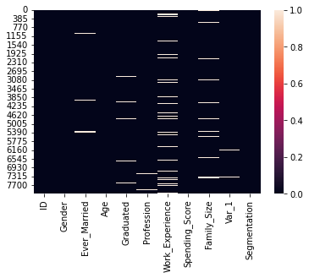
Check Null Values
There is Null values in:
Ever_Married
Graduated
Profession
Work_Experience
Family_size
Var_1

Slide 7

Data Analysis

Slide 8
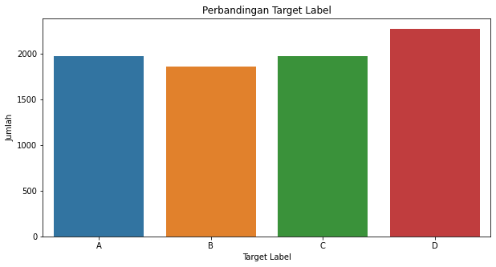
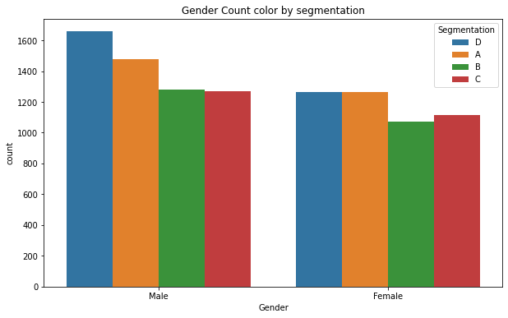

Slide 9
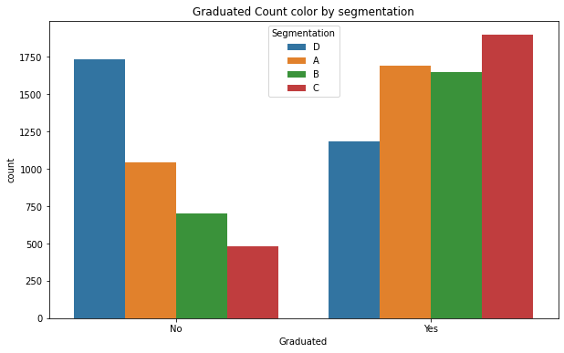
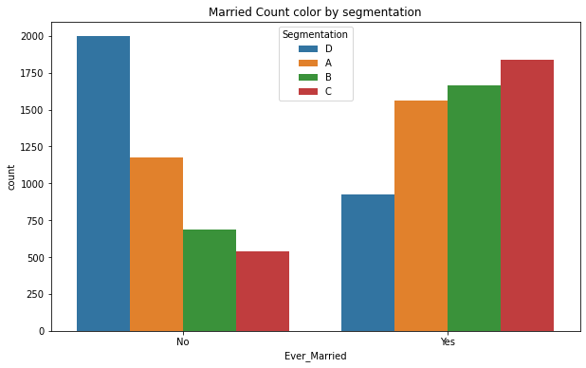

Slide 10
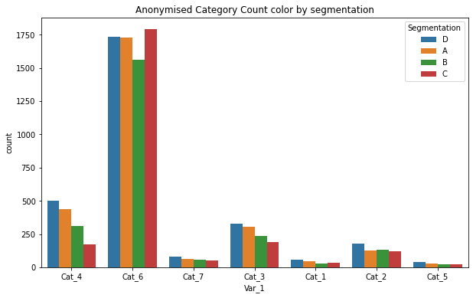
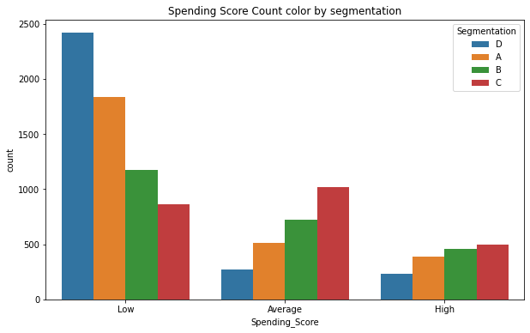

Slide 11
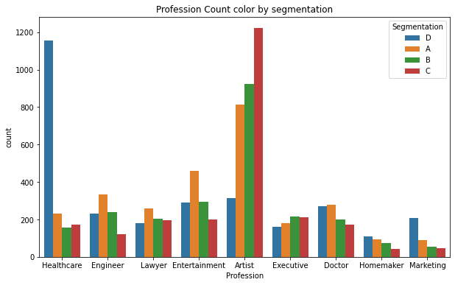

Slide 12
Notes about this data:
This Data is illogical because there is people whose age is less than 30 years old have work experience more than 8 years
There are people whose age greater than 30 and they aren’t graduated on the other hand people whose age less than 20 are graduated
people with age more than 40 years old have work experience less than 3 years
People who are married their family size is 1
People who have larger family size they have low Spending Score

Slide 13
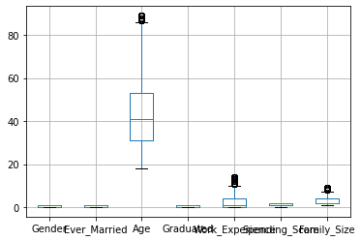
Check the Outliers
We noticed that the outliers are:
Work_Experience
Family_Size
Age

Slide 14
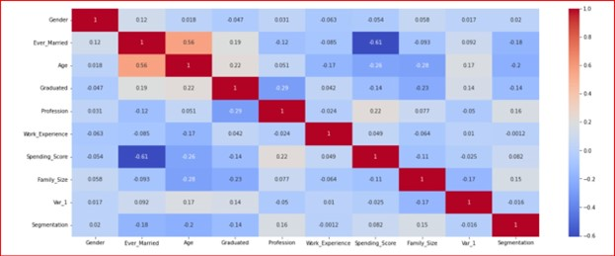
Visualizing Correlation

Slide 15
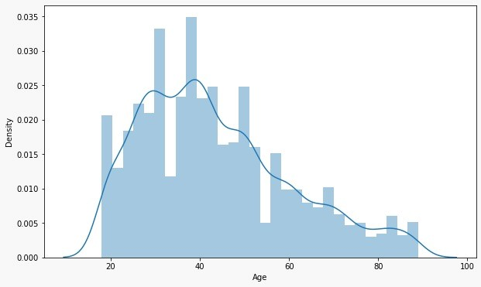
Feature Scaling
Age follow Gaussian distribution so we applied Standard Scalar

Slide 16
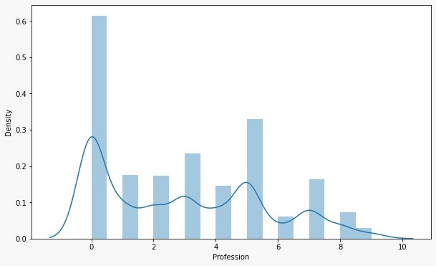
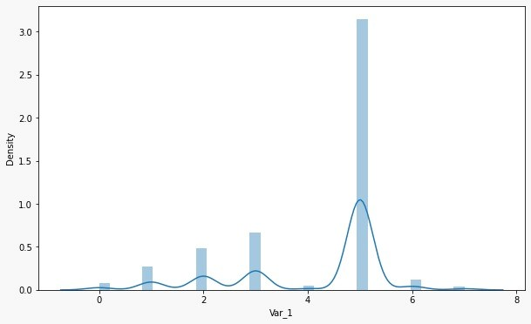
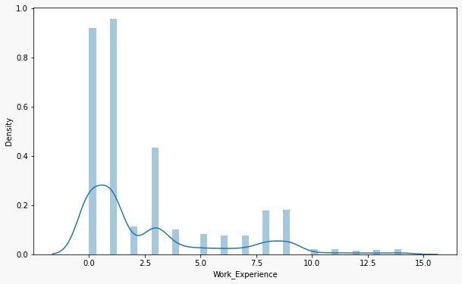
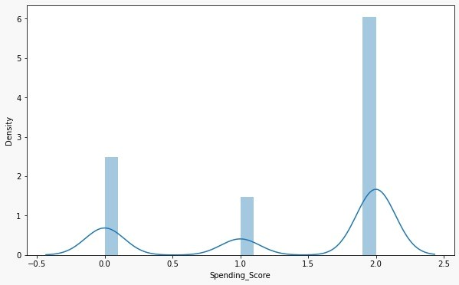
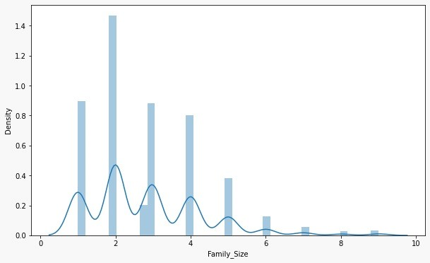
These Features doesn’t follow Gaussian Distribution ,so we applied MinMax Scalar
Profession,Work_Experience,Spending_Score,
Family_size,Var_1

Slide 17
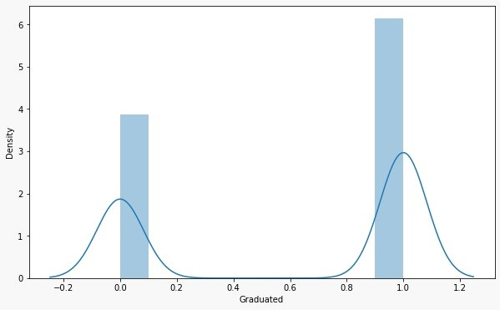
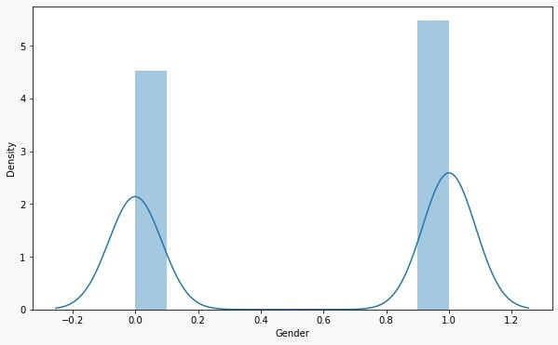
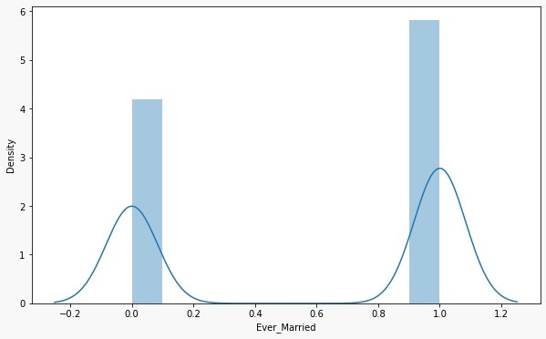
These Feature are in range of [0,1],so they needn’t Feature Scaling

Slide 18
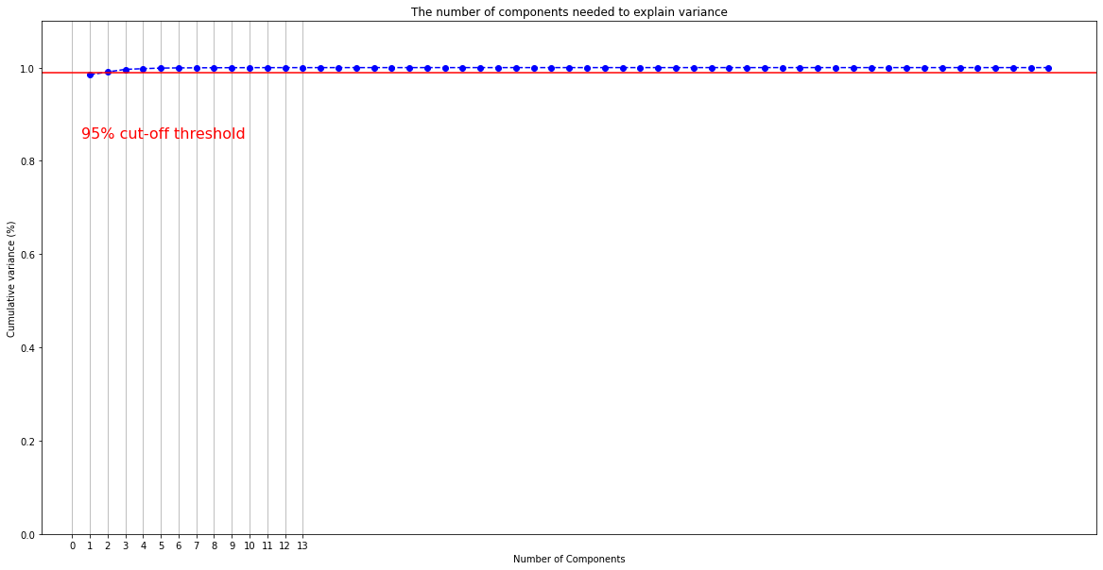
We tried the Polynomial Feature and applied PCA with number of components =13

Slide 19
Trials for Pre-Processing
We checked for the outliers existence, we tried to handle it.
We tried to apply one-hot encoder on features (profession, Var1).
We tried to made discretization on features (Work experience- Family size).

Slide 20

Classification Techniques

Slide 21
Split Train data(80%) ,Test data(20%) & Random state (0). Models & Trials:
Model | Accuracy | Error
Random forest | Train score =94.9% Test Score = 95.9% | Train error = 0.14 Test error = 0.12
SVM Technique : Grid-search (Best parameters: Gamma= 0.1, C=1200, Kernel function (RbF), decision function shape =OVR, ) | Train score = 48.2% Test score =52.2% | Train error =1.8 Test error = 1.7
Bagging(SVM ,n_estimators=50, max_samples=0.8) | Train score = 52.9% Test score =48.5% | Train error = 1.76 Test error = 1.80
Cat-boost | Train score= 73.6% Test score =45% | Train error = 0.89 Test error = 1.96
Stacking | Train score = 67.8% Test score = 68.5% | Train error= 0.82 Test error= 0.75
KNN(knn=5) | Train score= 59.4% Test score= 41.9% | Train error= 1.43 Test error= 2
Logistic regression | Train score = 45.8% Test score = 46.8% | Train error = 2.1 Test error= 1.9
Decision tree | Train score = 95.5% Test score = 38% | Train error = 0.12 Test error= 2.1

Slide 22
Notes:
We applied Cross Validation for all algorithms (CV=5)
We tried to train the models using all the training data
We used Stratify with train test split function
The SVM and Bagging give us the highest score

Slide 23
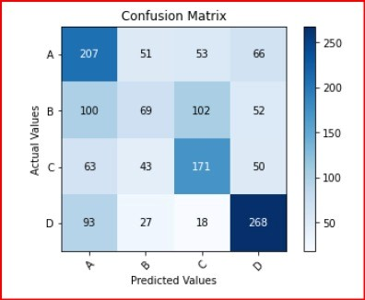
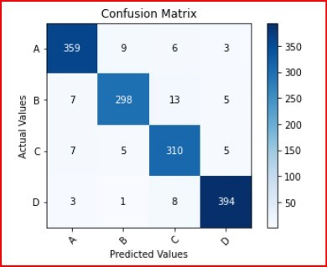
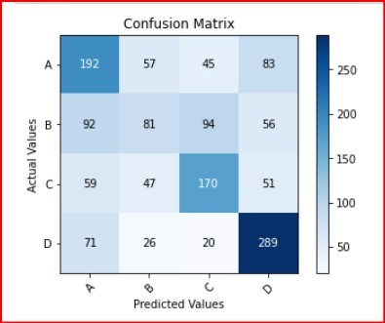
Confusion Matrix
Bagging
Random Forest
SVM

Slide 24

Thank you

