Slide 1
Predicting Absenteeism and Identifying Employee Risk Patterns using Machine Learning
Name:Mohan M
Enrolment No:EN12024081944
Batch Code:DA326S32
Mentor:Komila Bhatia

Slide 2
Problem Statement:
Employee absenteeism significantly impacts productivity and business performance
Frequent and prolonged absences disrupt workflows and increase costs for organizations
The project’s main goals are:
Analyze absenteeism patterns using historical employee data.
Predict factors that lead to extended absenteeism durations.
Identify employees who are at higher risk of prolonged absenteeism.
Group employees with similar absenteeism patterns for better management and understanding.
These insights will help businesses mitigate absenteeism risks and develop strategies to improve attendance.

Slide 3
Data Description:
Dataset Size: Includes employee details such as absenteeism hours, age, reason for absence, distance from residence to work, service time, and various demographic and work characteristics
Target Variable:Absenteeism Time: Measured in hours.
High Absenteeism: Defined as absenteeism greater than a threshold value (e.g., >10 hours).

Slide 4
Tools and Techniques:
Python Libraries: Pandas, NumPy, Scikit-learn, Matplotlib, Seaborn
Data Preprocessing:
Handling missing values
Encoding categorical features
Scaling numerical features
Machine Learning Models:
Linear Regression: For predicting absenteeism duration.
Logistic Regression and KNN: For classifying employees at risk of high absenteeism.
K-Means Clustering: For grouping employees with similar absenteeism patterns.

Slide 5
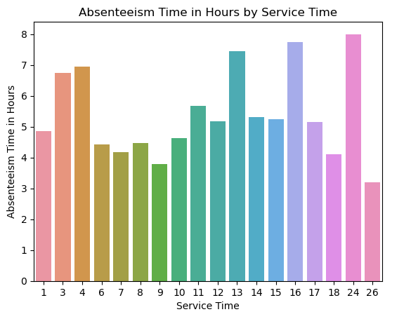
This is figure shows Absenteeism time in hours by service time employees who are 24,16,13 having highest absenteeism time in hours and similarly 26,9,7 having lowest absenteeism time in hours

Slide 6
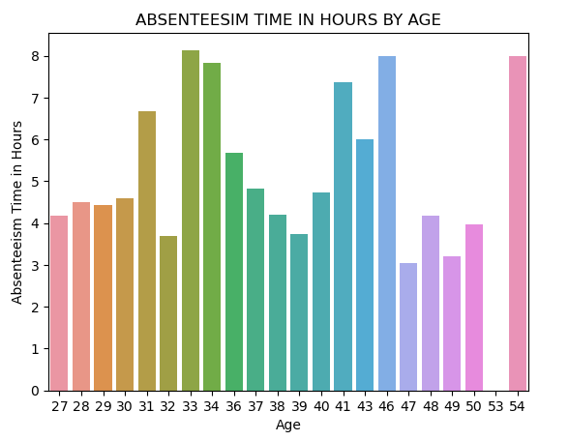
Figure shows absenteeism time in hours by age 54 aged peoples are having highest absenteeism time in hours and 47 and 32 aged peoples are having lowest absenteeism in hours.

Slide 7
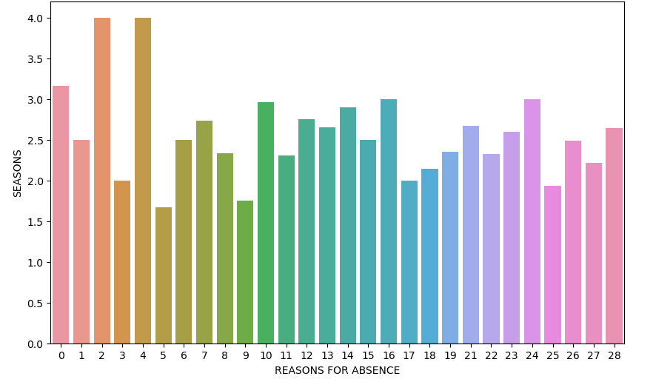
Seasons by Reasons for absence 2 and 4 reasons having highest seasons rate and similarly reason 5 having lowest season rates.

Slide 8
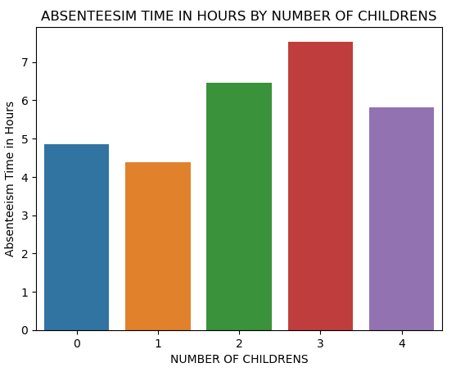
This figure shows absenteeism time in hours by number of childrens .Employees who are all having 2 and 3 childrens are having highest absenteeism time in hours and similarly 0,1 are having less absenteeism time in hours

Slide 9
Summary:
The project involved analyzing absenteeism data to identify key patterns and predictors of prolonged absenteeism.
Several models were developed to forecast absenteeism duration and classify employees at risk of high absenteeism.
Using K-Means clustering, employees were segmented into distinct groups based on absenteeism patterns for further insights.

Slide 10
Conclusion:
The predictive models demonstrated that absenteeism can be forecasted with reasonable accuracy using factors such as reason for absence, BMI, distance to work, and service time.
Classification models successfully identified high-risk employees based on their demographics and past absenteeism behavior.
Clustering analysis provided valuable insights into common absenteeism patterns, which can help HR departments in developing focused absenteeism management strategies.

Slide 11
BUSINESS IMPLEMENTATION OF ML MODEL:
Absenteeism Prediction: Implement predictive models to forecast absenteeism duration for new employees. This can help HR plan for coverage and manage workloads effectively.
High-Risk Employee Identification: Deploy classification models to flag employees who are more likely to have high absenteeism. Early intervention strategies can be employed to address the root causes and reduce absenteeism.
Clustering Insights: Use clustering results to segment employees and offer personalized wellness programs or incentives to reduce absenteeism in high-risk groups.

Slide 12
Limitations and Future Scope:
Limitations:
The dataset may have limited information on external factors influencing absenteeism (e.g., personal reasons, weather).
The model accuracy could be improved with additional features such as employee job satisfaction or performance ratings.
Future Scope:
Incorporating more diverse datasets from multiple organizations for better generalization.
Developing real-time absenteeism monitoring tools that can alert managers when certain absenteeism thresholds are exceeded.
Exploring additional machine learning models such as decision trees or ensemble methods to improve predictive power.

Slide 13
Thank You..!

