Slide 1
Data-Driven Analysis of Bird Strikes in Aviation: Identifying Patterns and Mitigation Strategies
Dataset:Birds Data
Name:MOHAN M
Batch Code:DA326S32

Slide 2
Problem Statement:
Bird strikes pose significant risks to aviation safety, leading to aircraft damage, flight delays, and in some cases, endangering lives. The challenge lies in developing effective strategies to mitigate these risks while balancing regulatory compliance and wildlife conservation efforts.
Objectives:
Identify Key Factors:
Analyze patterns in bird strikes based on aircraft type, altitude, and phase of flight.
Understand the impact of environmental conditions (e.g., cloud cover, precipitation) on bird strikes.
Evaluate the Impact:
Assess the extent of damage caused by bird strikes and their financial implications.
Examine the correlation between bird size and the severity of strikes.
Propose Mitigation Strategies:
Explore potential safety improvements and regulatory measures to reduce bird strikes.
Discuss the role of wildlife conservation in mitigating bird strikes.

Slide 3
Observations:
Altitude: Most bird strikes occur at altitudes below 1000 feet, particularly during approach and landing phases.
Aircraft Type: Commercial airplanes like B-737 and MD-80 are frequently involved in bird strikes.
Damage: While many strikes do not cause significant damage, certain cases, especially involving larger birds, have led to engine shutdowns and emergency landings.
Environmental Factors: Strikes often occur in clear weather conditions, suggesting birds may not be avoiding aircraft as effectively during such times.
Wildlife Size and Species: Smaller birds, such as European starlings and rock pigeons, are commonly struck, but larger birds like geese cause more significant damage.

Slide 4
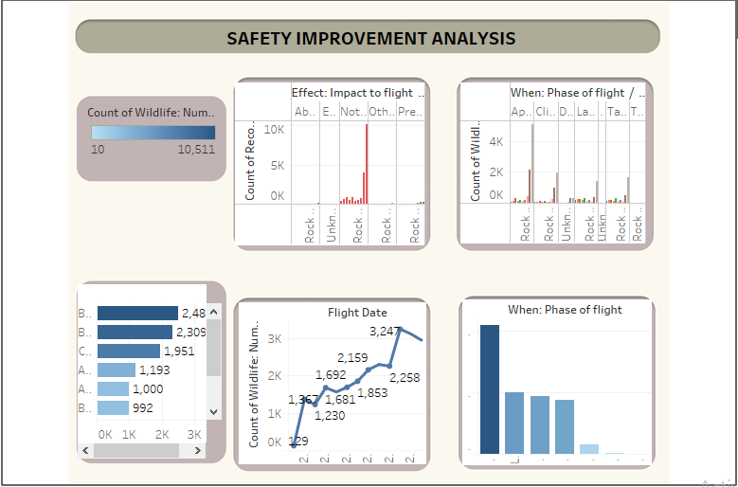
Safety Improvement Analysis:
impact of small bird strikes: most bird strikes involve small birds and usually don't cause much damage, thanks to advanced technologies. but sometimes, they can still lead to precautionary landings or flight cancellations.
high birdstrike risk during flight: bird strikes often happen during approach, landing, takeoff, and when the plane is climbing in altitude.

Slide 5
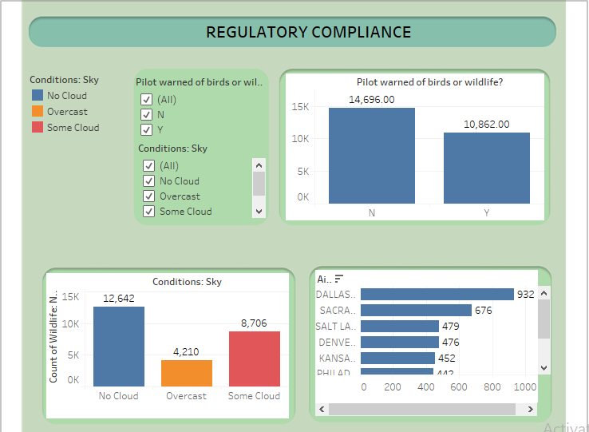
Regulatory compliance:
Aircraft Models Affected: The B-737-700 and B-737-300 planes are more likely to experience bird strikes.
Species Involved: Small and medium-sized birds, like European Starlings and Mourning Doves, are often involved in bird strikes. Many incidents involve birds that can't be identified.
Increasing Birdstrikes Over the Years: The number of bird strikes is going up, likely because there are more flights now.

Slide 6
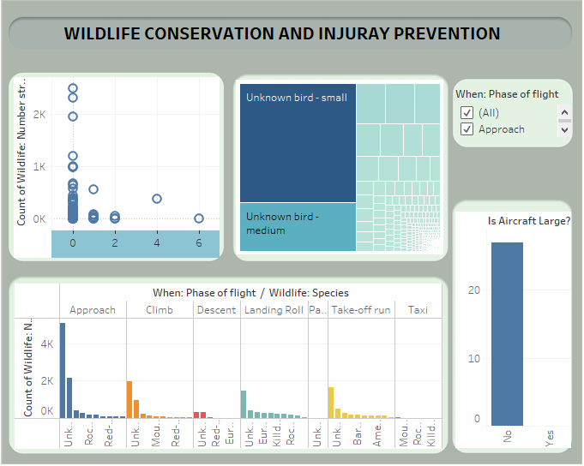
Wild Life conservation and injury preventation:
Injury Correlation: Small planes are more likely to cause injuries from bird strikes, while larger planes usually don't result in injuries.
Birdstrike and Injury Correlation: The more bird strikes there are, the more injuries tend to occur.
Preventive Measures: Installing high nets around runways or hangars might help prevent bird strikes.
Size of Birds Involved: Small and medium-sized birds are most often involved in bird strikes.
Impact on Flight Schedules: Most bird strikes don't affect flight schedules, but some do cause precautionary landings or aborted takeoffs.

Slide 7
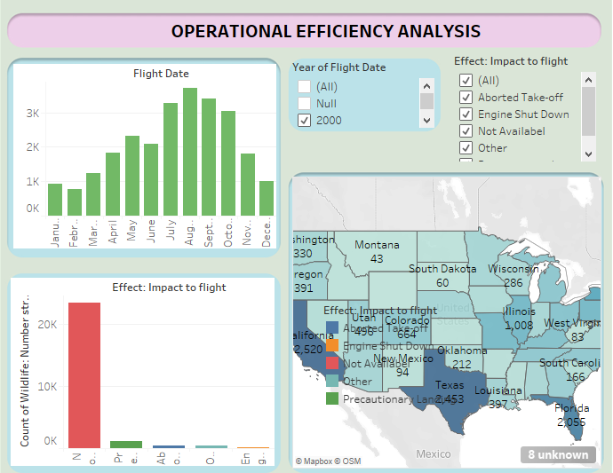
Operational Effeciency Analysis:
Regional Analysis: California, Texas, and Florida have the highest rates of bird strikes.
Seasonal Patterns: Bird strikes peak in July, August, and September, which matches the times when birds migrate.

Slide 8
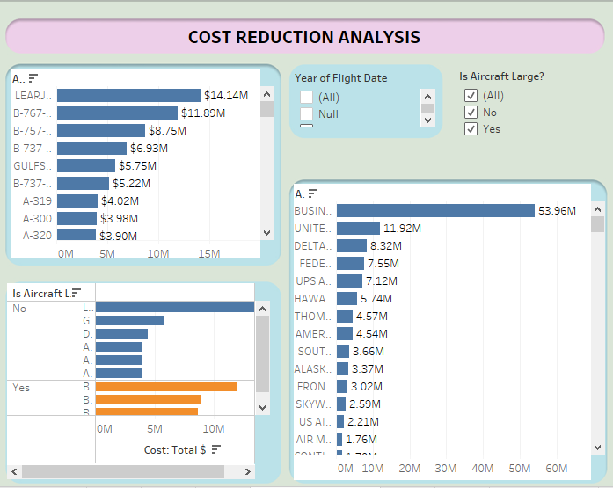
Cost Reduction Analysis:
Seasonal Patterns: Bird strikes are most common in July, August, and September, during bird migration periods.
Cost-Effective Measures: Using nets and scaring birds away from runways and hangars are suggested as affordable ways to prevent bird strikes.

Slide 9
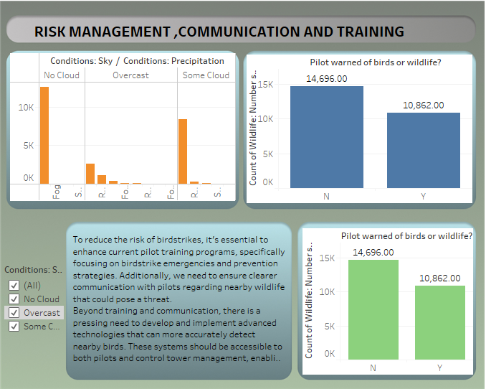
Risk Management,Communication And Training:
Overcast Conditions: Bird strikes are less common when it’s overcast, but it’s harder for both pilots and birds to navigate.
Pilot Warnings and Training: 47% of pilots received warnings about nearby wildlife. There’s a need for better training and communication systems to help pilots respond to these warnings.
Effectiveness of Current Training: Existing pilot training programs aren’t fully effective in handling bird strike situations.
Technological Improvements: There’s a need for better technology to detect birds and improve pilots' awareness and responses.

Slide 10
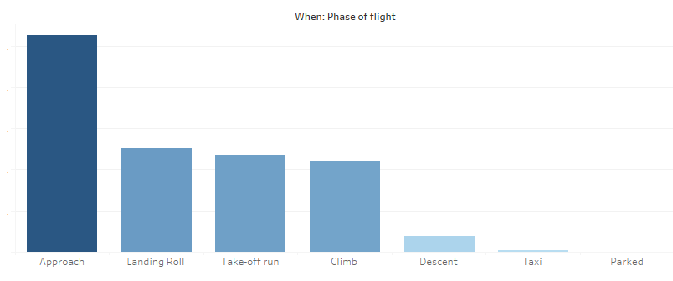
Count of Wildlife: Number struck for each When: Phase of flight. Color shows count of Wildlife: Number struck. The view is filtered on When: Phase of flight, which keeps 7 of 7 members.
Mostly approaching Planes were facing the Bird Strikes. Whereas Landings, Take-offs and climbing the altitude also have significant number of Bird-strikes in past.
Most of the time small birds strikes the plane and with developed technologies It does not creates that much of impact.
Most of the data we are seeing of bird strikes are not impacting on flight.
Whereas There are some times Flights got aborted and needed to take the Precautionary Landings.

Slide 11
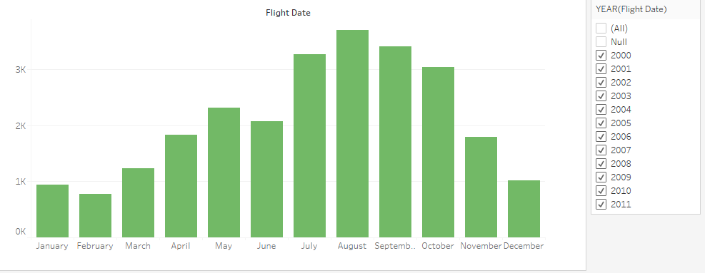
Count of Wildlife: Number struck for each Flight Date Month. The data is filtered on Effect: Impact to flight and Flight Date Year. The Effect: Impact to flight filter keeps Aborted Take-off, Engine Shut Down, Not Availabel, Other and Precautionary Landing. The Flight Date Year filter excludes Null.
As we can see, The Most of the bird strikes are occured in Month of July, August and September, as the birds Migration period comes in between this time.

Slide 12
Conclusion:
Reducing bird strikes is crucial for keeping aviation safe, efficient, and cost-effective. By using strategies that improve operations, cut costs, and strengthen risk management, communication, and training, the aviation industry can lower the risk of bird collisions. Airports, airlines, and regulators need to work together proactively to make lasting improvements in preventing and managing bird strikes.

Slide 13
Thank You..!

