Slide 1
Satellite/Aerial Image Retrieval
Mohan Jayaprakash – A20405567
Herick Jayesh Asmani – A20399752
Sharanheer Choudhari – A20398615

Slide 2
Goal:
Given the input of Latitude and Longitude
Automatically download aerial imagery (maximum resolution available) using the latitude/longitude bounding box and Bing Maps Tile System.
Stitching the individual images to get the final resulting satellite image.

Slide 3
Overview
Satellite imagery offers a huge amount of useful information in many specific domains including cartography, meteorology, geology, environment sciences or archeology.
Remote sensing images have however specificity that make usual visual features and algorithms failing: very high and heterogeneous resolutions, more textural and spectral contents and high visual ambiguity.
Techniques which can be used for Satellite image retrieval are:
Content-based image retrieval .
Modified Block Truncation Coding.
Pattern Generation For Texture.

Slide 4
Bing Map Tile System
Bing Maps maps the world using satellite images stitched together. As you can appreciate, these are terabytes of data we are talking about in the map processing.
To optimize performance these images are divided into tiles of 256×256 pixels each.
Bing Maps has the concept of zoom levels. There are 23 zoom levels where 1 displays the whole earth and 23 zooms at street level. When you zoom in or out at a different zoom level, different tiles (and hence satellite images) are displayed.
Tiles have their own coordinate system (a “Tile XY coordinate”) which can also be denoted as a single string called a quadkey.
t’s a conformal projection, which means that it preserves the shape of relatively small objects. This is especially important when showing aerial imagery, because we want to avoid distorting the shape of buildings. Square buildings should appear square, not rectangular.
It’s a cylindrical projection, which means that north and south are always straight up and down, and west and east are always straight left and right.

Slide 5
Image Stitching
Image stitching or photo stitching is the process of combining multiple photographic images with overlapping fields of view to produce a segmented panorama or high-resolution image.
Image stitching is done by detecting keypoints and matching them:
Detect keypoints
Match keypoints
Estimate homography with matched keypoints.
Project onto a surface and blend

Slide 6
Approach:
Convert the input latitude/longitude coordinates (in degrees) into pixel XY coordinates at a specified map size.
Convert pixel XY coordinates into tile XY coordinates of the tile containing the specified pixel.
Validate the tile values for X and Y coordinates. Proximity of points i.e. must not lie on the same tile.
Transform tiles into main diagonal form for convenience. Determine the bounding tiles with highest level of detail.
Converts tiles XY into a Quad Key and then download the images corresponding to the Quad Key save the bounding image names using hash function and stitch these images based on it.
The stitched final image is saved as the final image on the storage(Disk).

Slide 7
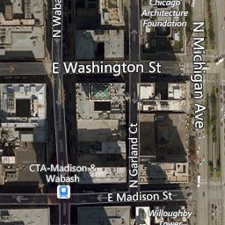
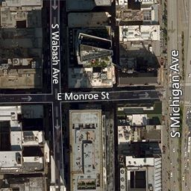
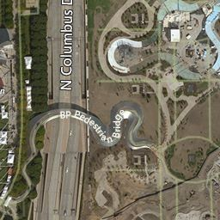
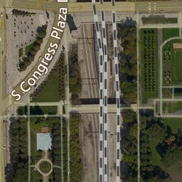
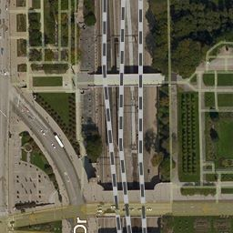
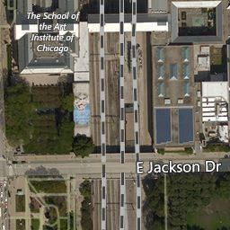
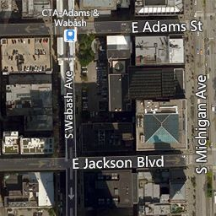
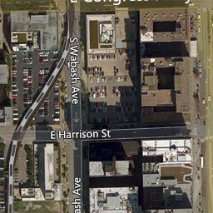
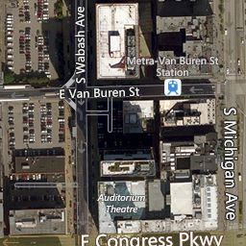
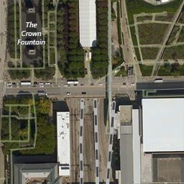
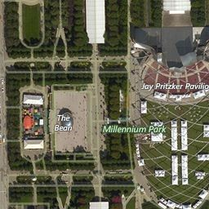
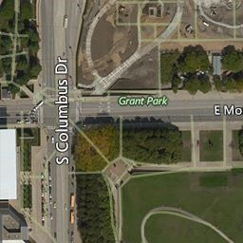
Output images (Before Stitching)

Slide 8
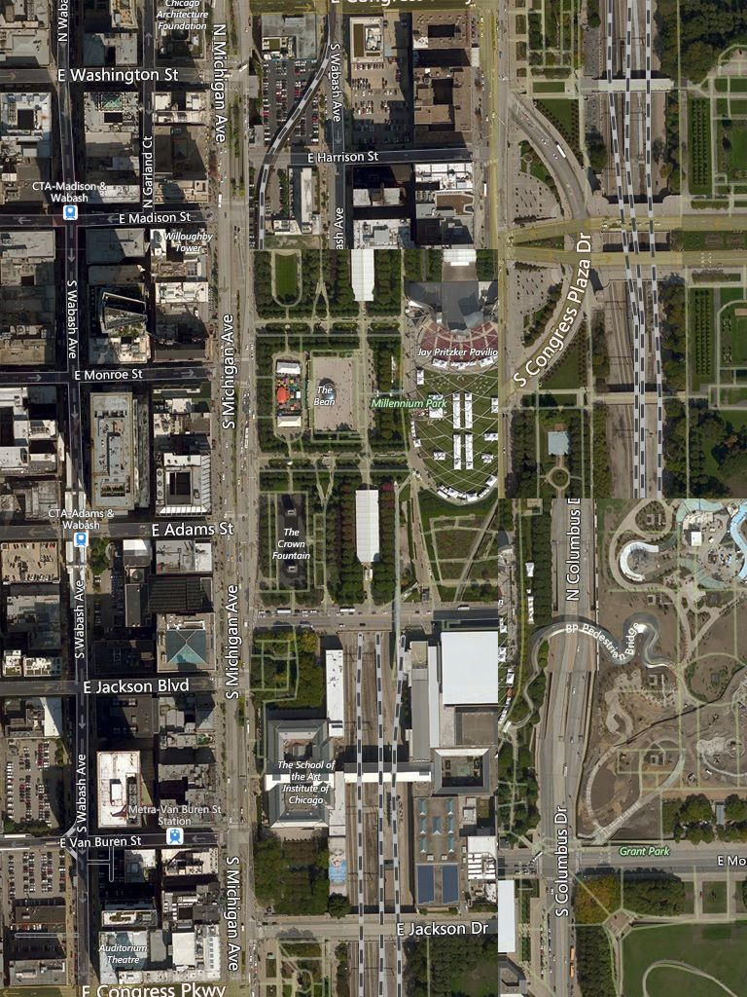
Output images (After Stitching)

Slide 9
Result
The source code is present in python file with the instructions to run the code in Readme file.
There are two files.
First file contains the source code for retrieving satellite images based on the coordinates
Second file contains the output images of the tested latitude and longitude.

Slide 10
References:
https://msdn.microsoft.com/en-us/library/bb259689.aspx
http://www.microimages.com/documentation/TechGuides/78BingStructure.pdf
https://courses.engr.illinois.edu/cs498dwh/fa2010/lectures/Lecture%2017%20-%20Photo%20Stitching.pdf

Slide 11
Thank you

