Slide 1
8-Bit ALU (Arithmetic Logic Unit)

Slide 2
PRESENTATION OVERVIEW
The project focuses on the design, implementation, simulation, and verification of an 8-bit Arithmetic Logic Unit using Verilog HDL.

Slide 3
OVERALL FLOW
RTL Design and Verification Flow
Development
Test Signed
Methodology
Add Features
Implement Self-
Operations
Problem Statement
Select the
Incorporate
Run the RTL Code
Checking
Verify the
Clearly articulate
appropriate
additional
Simulate the RTL
Add self-checking
correctness of
the problem to be
methodology for
functionalities to
design with the
mechanisms to the
signed arithmetic
solved
RTL development
the design
testbench
RTL design
operations
Main Objective
Write the RTL Code
Create Test
Examine Results
Generate Random
Sign-Off
Establish the
Implement the
Environment
Analyze the
Stimulus
Confirm that the
primary objective
design using
Build a testbench
simulation
Use random stimu-
RTL design meets
of the RTL design
Hardware
to verify the RTL
waveforms to
lus to uncover
all objectives
Description
design
identify issues
unexpected
Language
behavior

Slide 4
PROBLEM STATEMENT
To design and verify an 8-bit Arithmetic Logic Unit using Verilog HDL that performs multiple arithmetic and logical operations, generates appropriate status flags, and correctly handles signed arithmetic and overflow conditions.

Slide 5
MAIN OBJECTIVE
To design, implement, simulate, and verify an 8-bit ALU using Verilog HDL and ModelSim.

Slide 6
CORE DEFINITION AND ARCHITECTURE
What is an ALU?
An Arithmetic Logic Unit (ALU) is a combinational digital circuit that performs arithmetic and logical operations on binary data.
It is a fundamental component of a processor/datapath.

Slide 7
ALU Inputs
A → 8-bit input
B → 8-bit input
Opcode → 4-bit operation selector
ALU Outputs
Result → 8-bit operation result
Carry → Carry/no-borrow indication
Zero → Indicates zero result
Negative → Indicates negative result
Overflow → Indicates signed overflow

Slide 8
ARCHITECTURE
Input A [7:0]
Input B [7:0]
Opcode [3:0]
8-BIT ALU
Result [7:0]
Flags
C
Z
N
V
Carry Flag
Zero Flag
Negative Flag
Overflow Flag

Slide 9
DEVELOPMENT METHODOLOGY
Requirement Analysis
Basic RTL Design
Functional Expansion
Flag Implementation
Verification Development
Self-Checking
Random Testing
Signed Arithmetic
Simulation

Slide 10
DEVELOPMENT PROGRESS
Level | Development Stage | Main Achievement
Level 1 | Basic ALU | 4 basic operations
Level 2 | Multi-operation ALU | 11 operations
Level 3 | Status flags | Carry, Zero, Negative, Overflow
Level 4 | Self-Checking | Automatic PASS/FAIL verification
Level 5 | Advanced Testing | Directed + Random testing
Level 6 | Signed Arithmetic | Signed overflow handling

Slide 11
LEVELS OF IMPLEMENTATION
LEVEL 1 – BASIC 4-OPERATION ALU
DEFINITION
The first level implements the fundamental arithmetic and logical operations.
OBJECTIVE
To create a simple working 8-bit combinational ALU and verify its basic functionality.

Slide 12
OPERATIONS
ADD
SUB
AND
OR
IMPLEMENTATION
case (opcode)
2'b00: result = A + B;
2'b01: result = A - B;
2'b10: result = A & B;
2'b11: result = A | B;
endcase

Slide 13
LEVEL 2 – 11-Operation ALU
Definition
Level 2 expands the basic ALU to support 11 operations using a 4-bit opcode.
Objective
To increase the functional capability of the ALU.
Operations
1. ADD 4. OR 7. NAND 10. INC
2. SUB 5. XOR 8. NOR 11. DEC
3. AND 6. NOT 9. XNOR

Slide 14
IMPLEMENTATION
case (opcode)
4'b0000: result = A + B;
4'b0001: result = A - B;
4'b0010: result = A & B;
4'b0011: result = A | B;
4'b0100: result = A ^ B;
4'b0101: result = ~A;
4'b0110: result = ~(A & B);
4'b0111: result = ~(A | B);
4'b1000: result = ~(A ^ B);
4'b1001: result = A + 1;
4'b1010: result = A - 1;
endcase

Slide 15
LEVEL 3 – Status Flags
Definition
Level 3 introduces status flags that provide additional information about the ALU result.
Objective
To generate important processor-style status information.
Flags Added
Carry
Zero
Negative
Overflow

Slide 16
Flag Implementation
Carry
For addition:
carry = temp[8];
For subtraction:
carry = (A >= B);
Zero
if (result == 8'b00000000)
zero = 1'b1;
Negative
negative = result[7];

Slide 17
Overflow
Signed overflow is detected using the signs of the operands and result.
LEVEL 4 – Self-Checking Testbench
Definition
Level 4 introduces an automated verification environment that compares the ALU's actual outputs with expected outputs.
Objective
To eliminate manual waveform checking and automatically determine whether each test passes or fails.

Slide 18
Implementation
Developed a self-checking testbench to automatically verify the 8-bit ALU outputs.
Defined expected outputs and status flags including Result, Carry, Zero, Negative, and Overflow.
Implemented automatic comparison between the expected and actual ALU outputs.
Added PASS/FAIL counters to track the number of successful and failed test cases.
LEVEL 5 – Directed + Random Testing
Definition
Level 5 introduces two complementary verification techniques:
Directed testing
Random testing

Slide 19
Objective
To increase test coverage and identify unexpected functional errors.
Implementation
Implemented directed testing using predefined input combinations to verify all 11 ALU operations.
Implemented random testing by generating random 8-bit inputs and valid 4-bit opcodes.
Added 500 random test cases to improve functional coverage and test different input combinations.
Implemented self-checking verification by comparing the actual ALU output and flags with expected values.
Added PASS/FAIL counters to automatically display total tests, passed tests, failed tests, and overall verification status.

Slide 20
LEVEL 6 – Signed Arithmetic & Proper Overflow Handling
Definition
Level 6 is the advanced implementation stage, focusing on 8-bit signed two's-complement arithmetic and proper overflow detection.
Objective
To ensure that the ALU correctly handles signed values and identifies results outside the representable signed range.
Signed Range
For 8-bit two's-complement:
Minimum = -128
Maximum = +127

Slide 21
Implementation
Implemented signed arithmetic using 8-bit two’s complement representation with a range of −128 to +127.
Implemented proper overflow detection for signed addition, subtraction, increment, and decrement operations.
Implemented status flags — Carry (C), Zero (Z), Negative (N), and Overflow (V) — to indicate the ALU operation status.
Added boundary test cases such as 7F + 01, 80 - 01, 7F + 01, and 80 DEC to verify signed overflow conditions.
Combined directed, random, and self-checking verification to validate signed arithmetic and ensure reliable ALU operation.

Slide 22
VERIFICATION

Slide 23
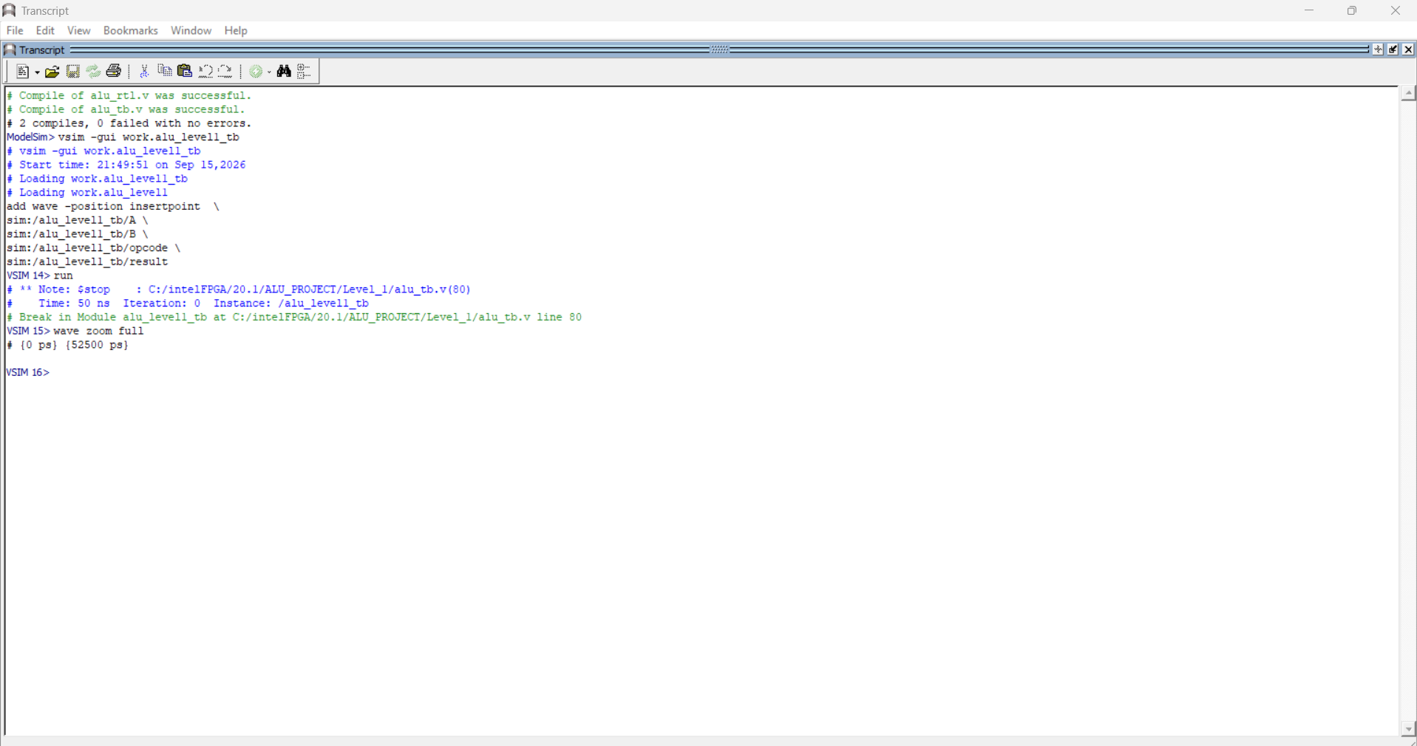
LEVEL 1 – BASIC 4-OPERATION ALU

Slide 24
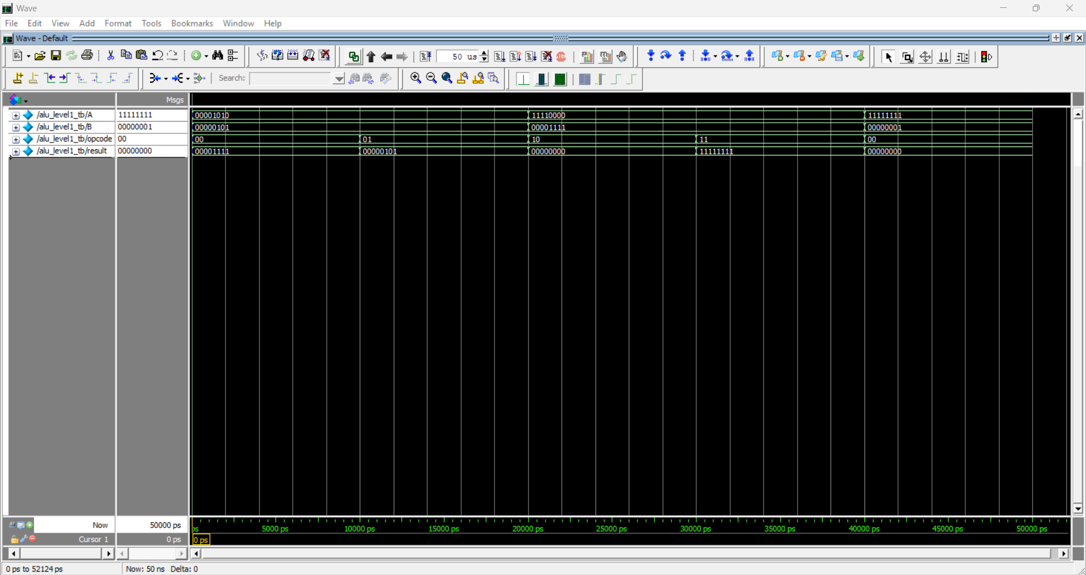
LEVEL 1 – BASIC 4-OPERATION ALU

Slide 25
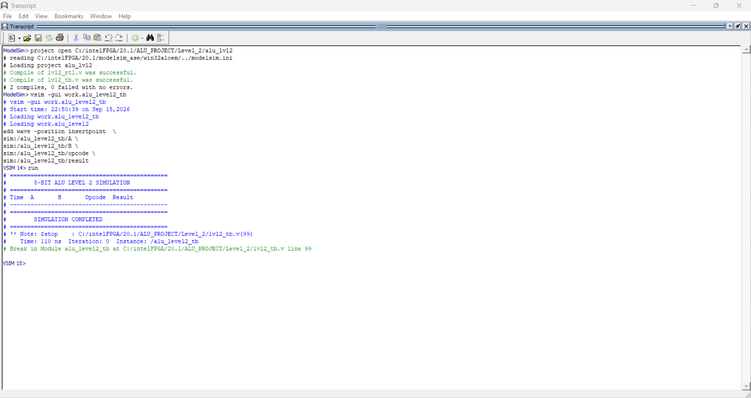
LEVEL 2 – 11-Operation ALU

Slide 26
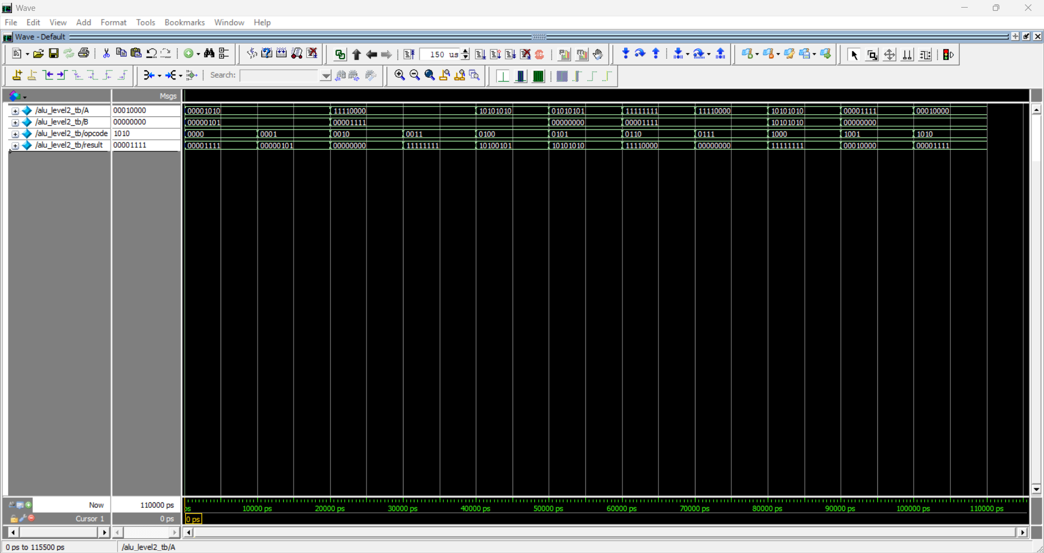
LEVEL 2 – 11-Operation ALU

Slide 27
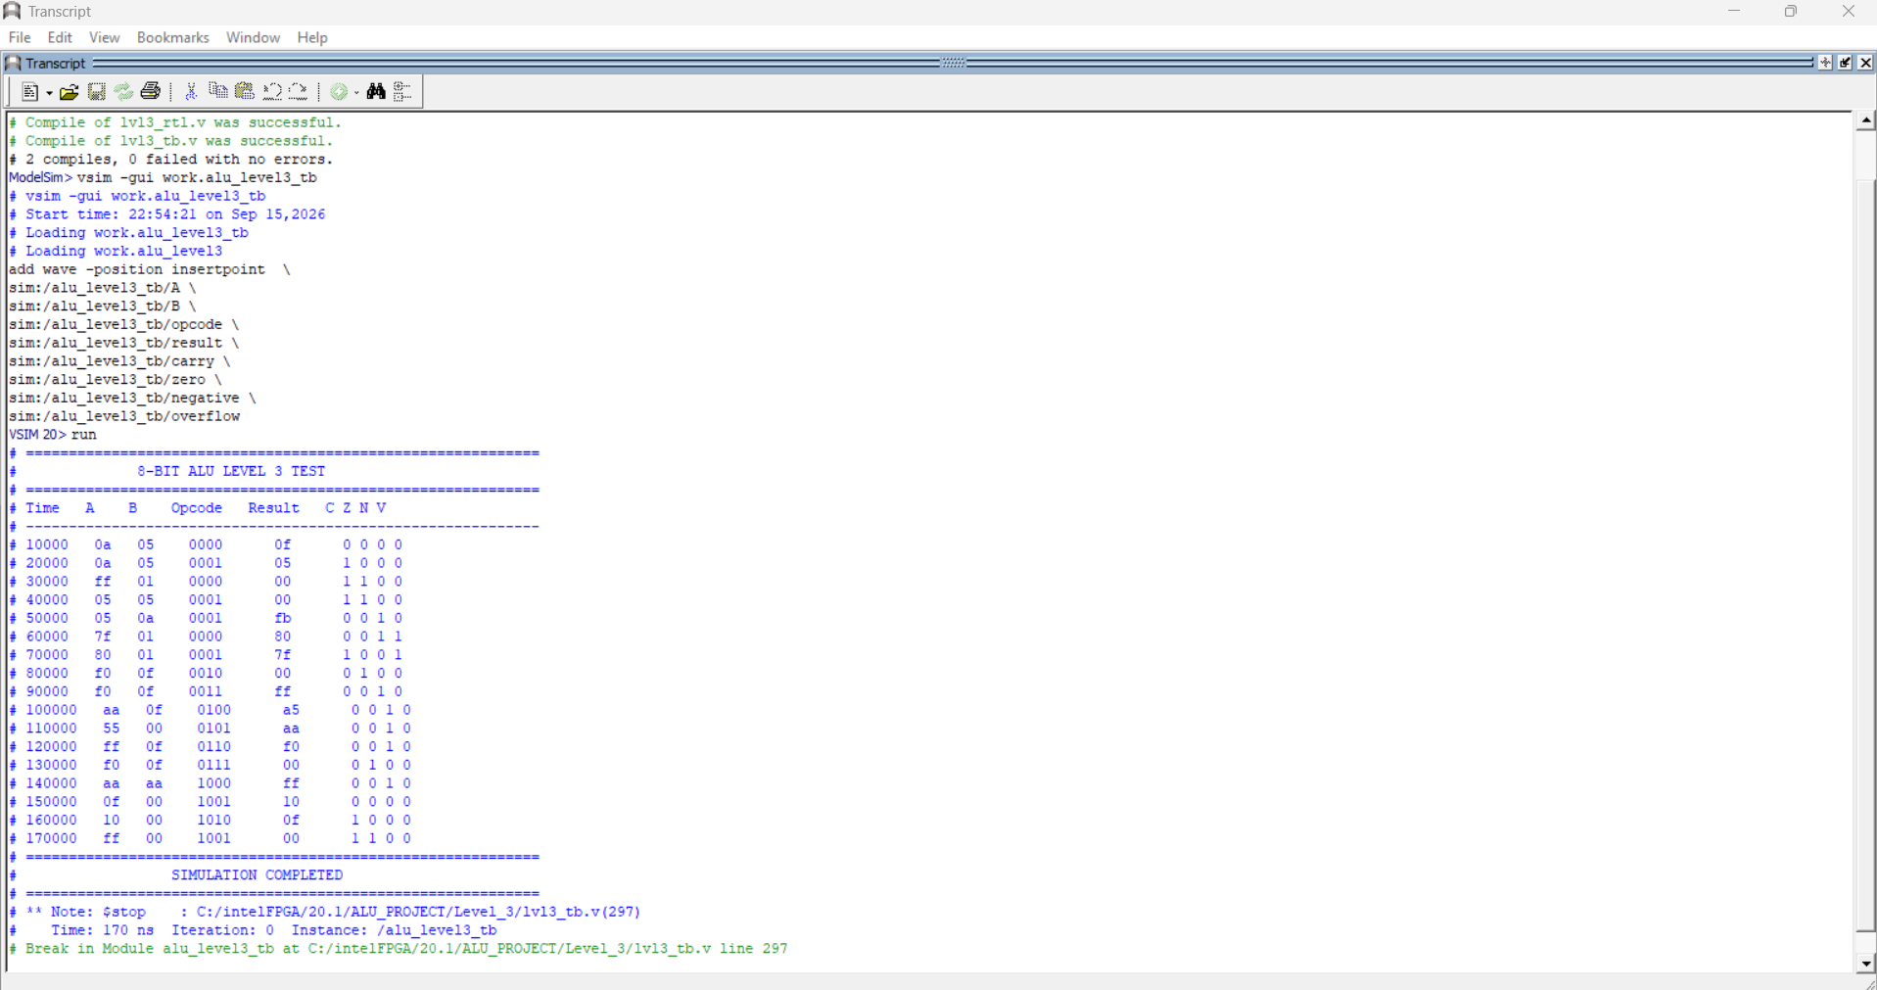
LEVEL 3 – Status Flags

Slide 28
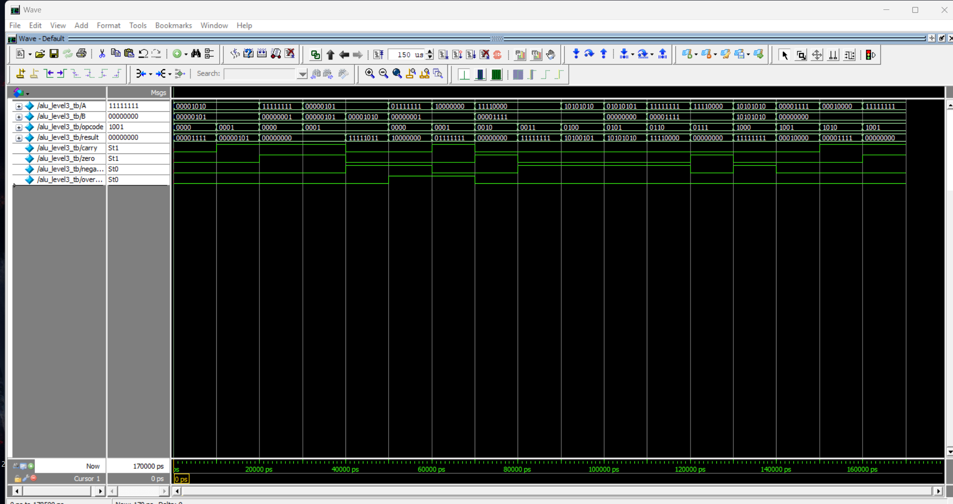
LEVEL 3 – Status Flags

Slide 29
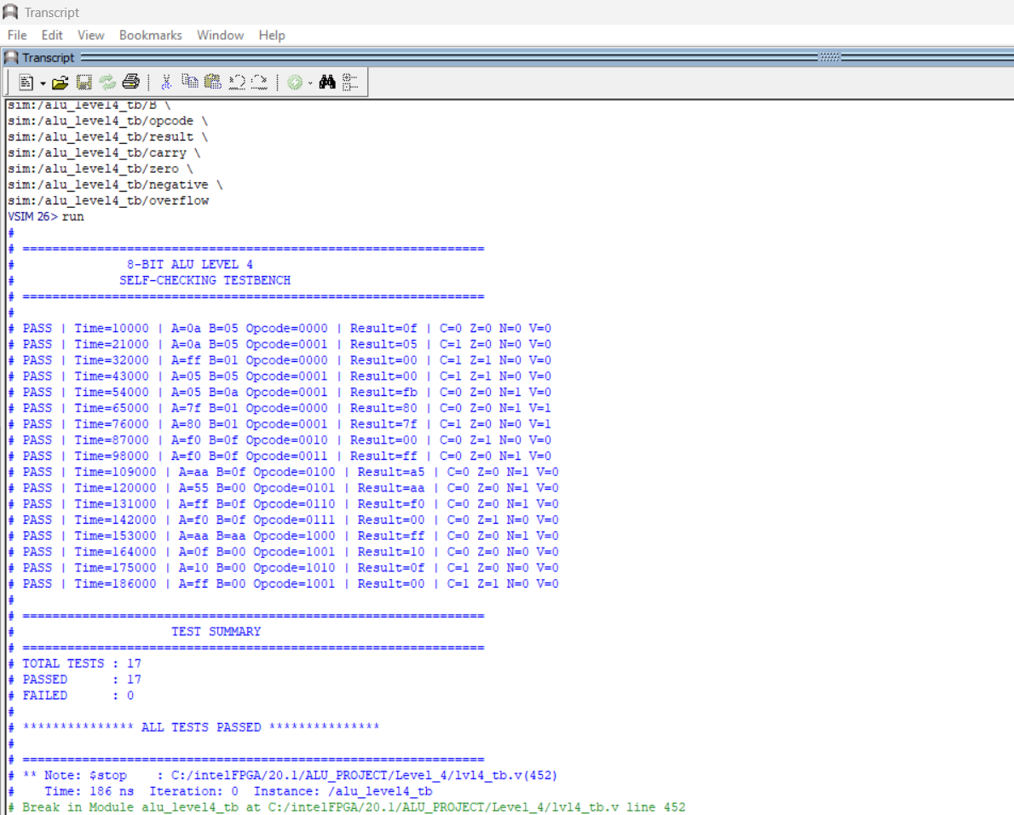
LEVEL 4 – Self-Checking Testbench

Slide 30
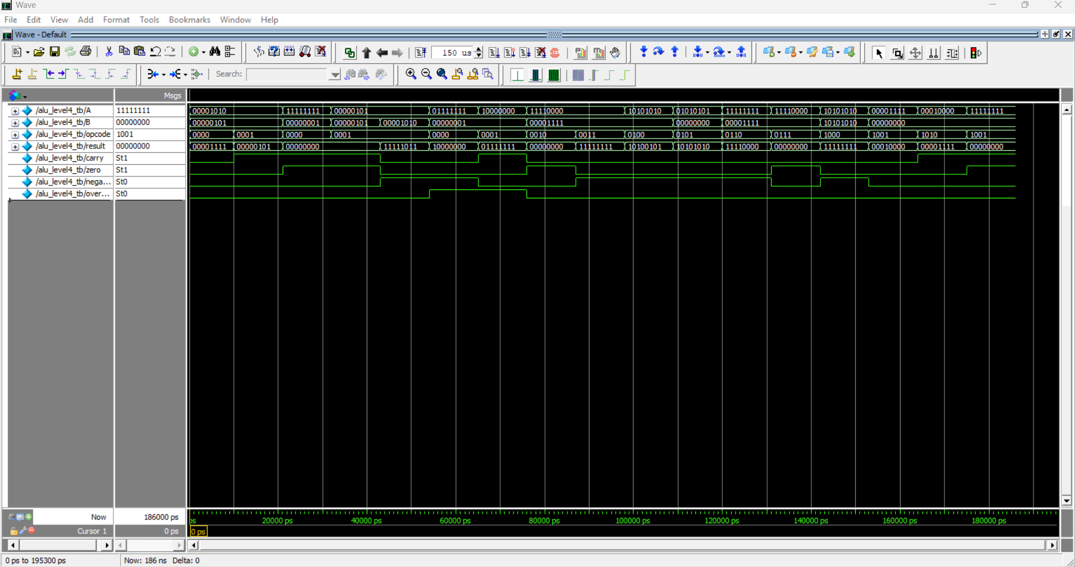
LEVEL 4 – Self-Checking Testbench

Slide 31
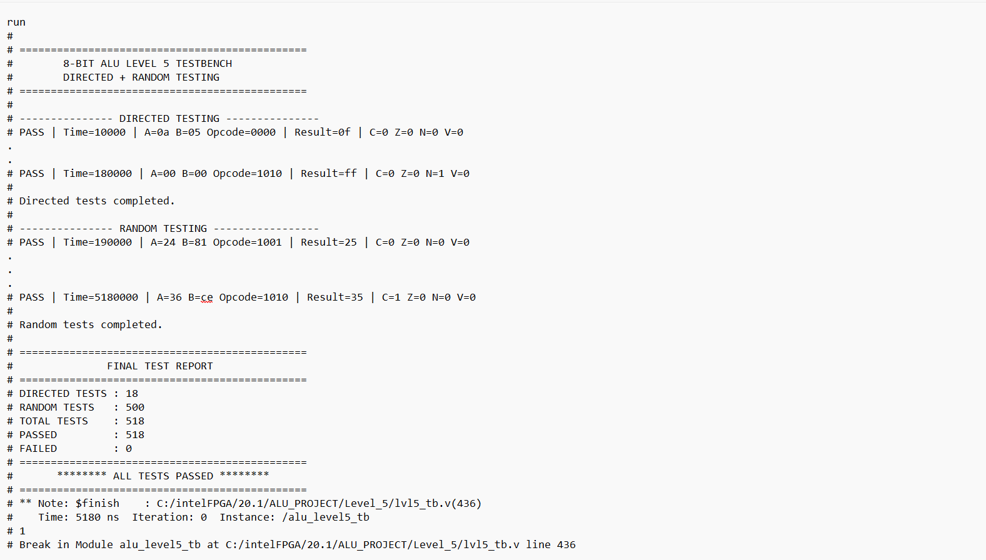
LEVEL 5 – Directed + Random Testing

Slide 32
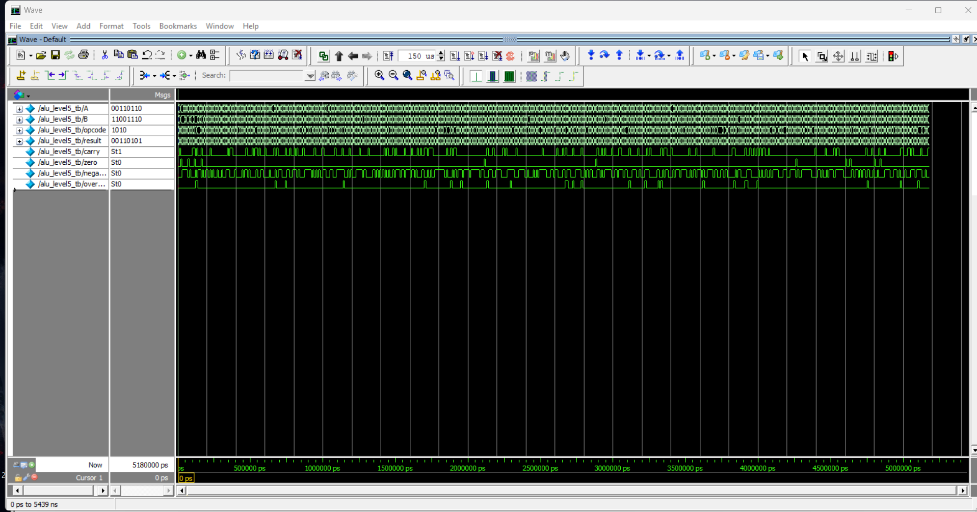
LEVEL 5 – Directed + Random Testing

Slide 33
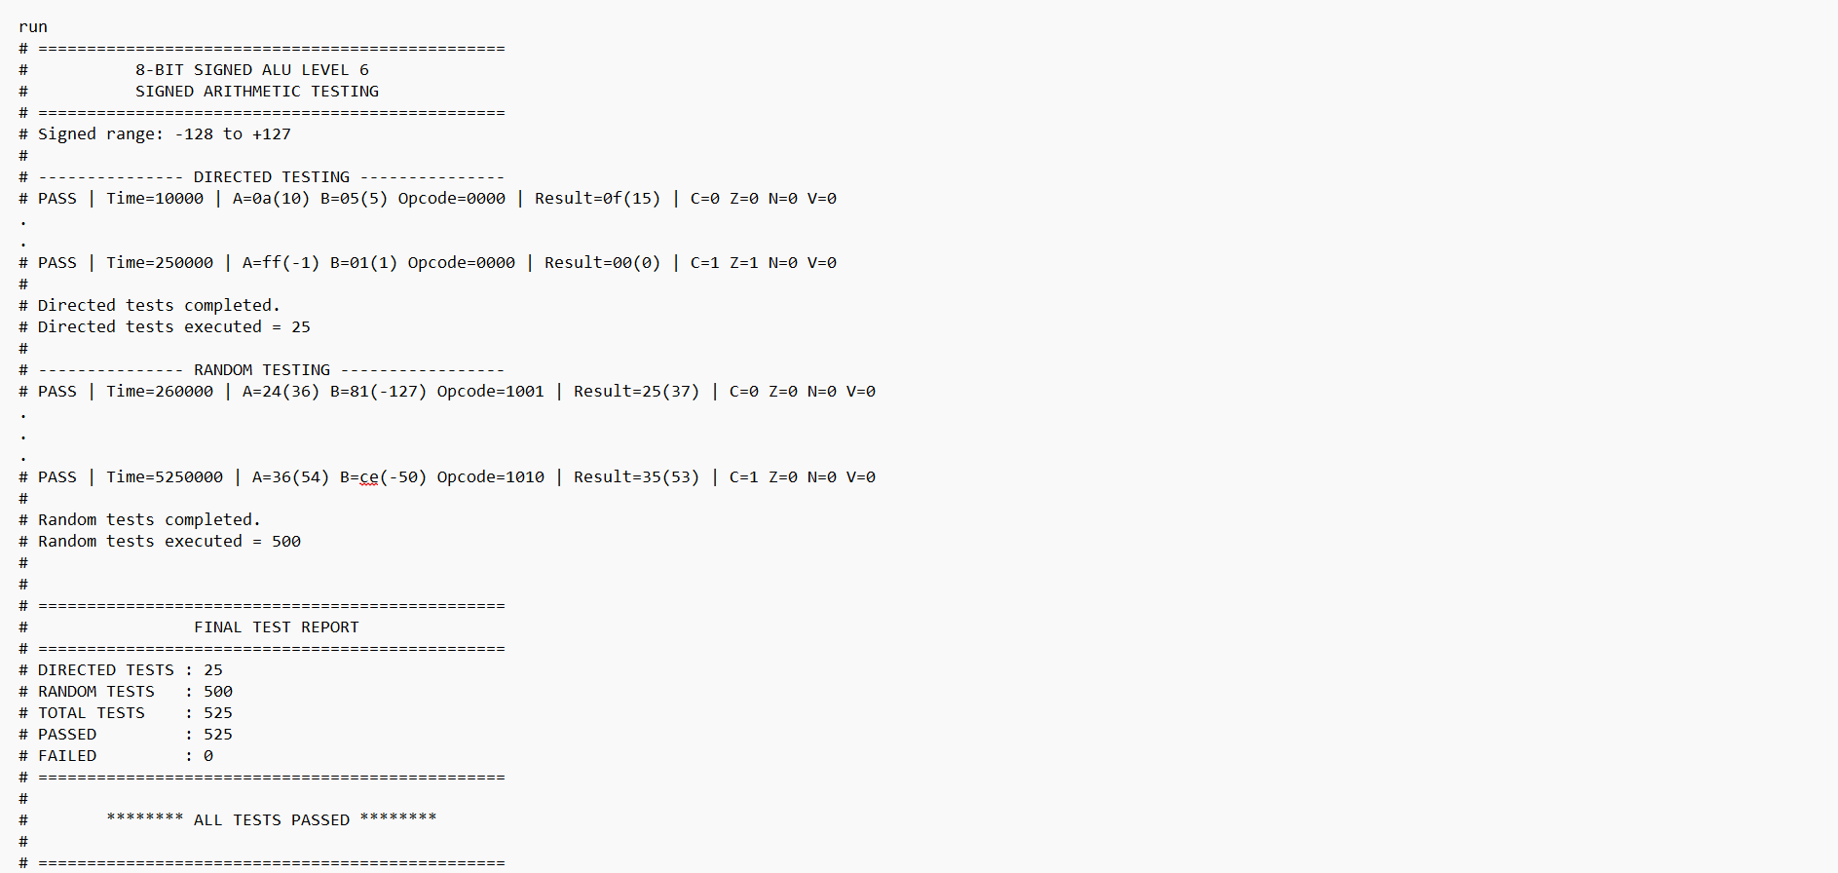
LEVEL 6 – Signed Arithmetic & Proper Overflow Handling

Slide 34
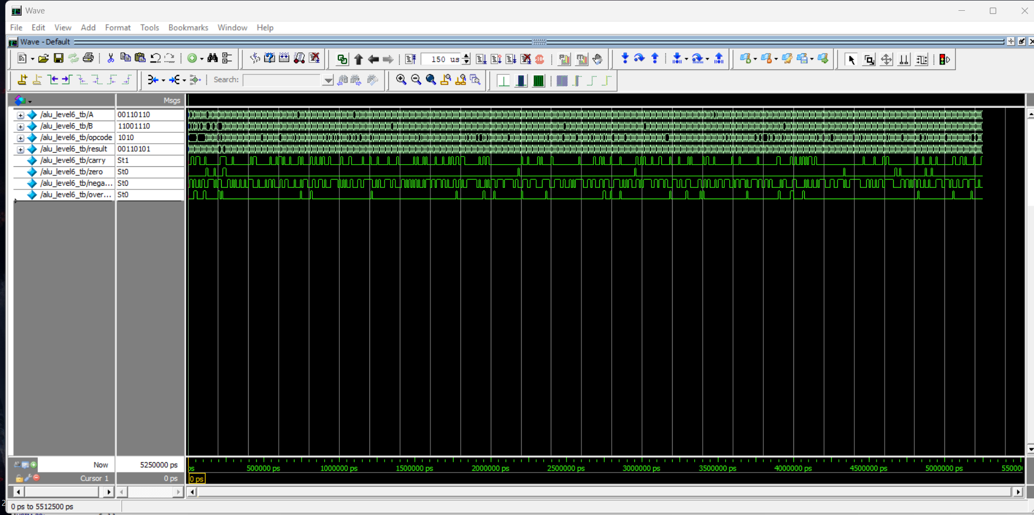
LEVEL 6 – Signed Arithmetic & Proper Overflow Handling

Slide 35
TOOL
HDL
Verilog
SIMULATOR
Modelsim intel FPGA Starter edition

Slide 36
RESULT
The project successfully demonstrates the progressive design and verification of an 8-bit ALU using Verilog HDL and ModelSim.
CONCLUTION
The project successfully demonstrates the progressive design and verification of an 8-bit ALU using Verilog HDL and ModelSim.

