Slide 1
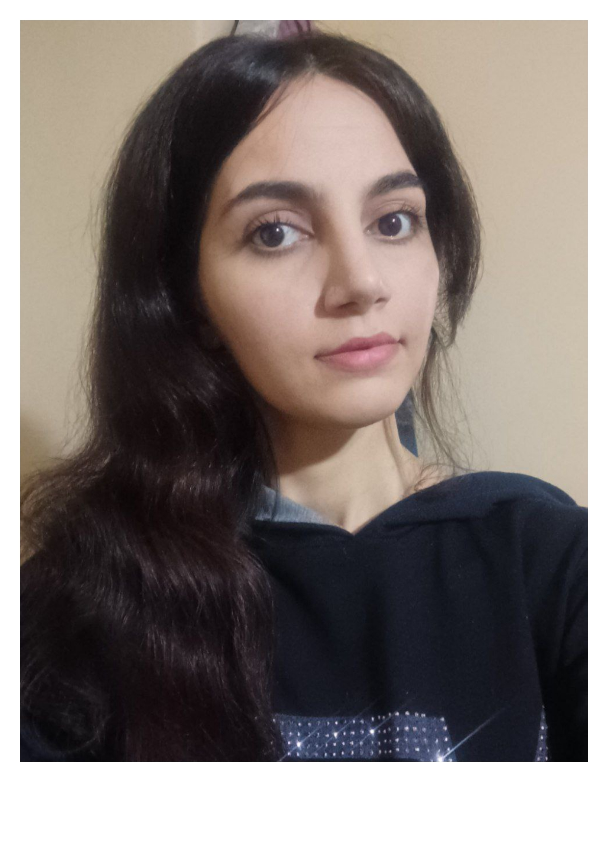
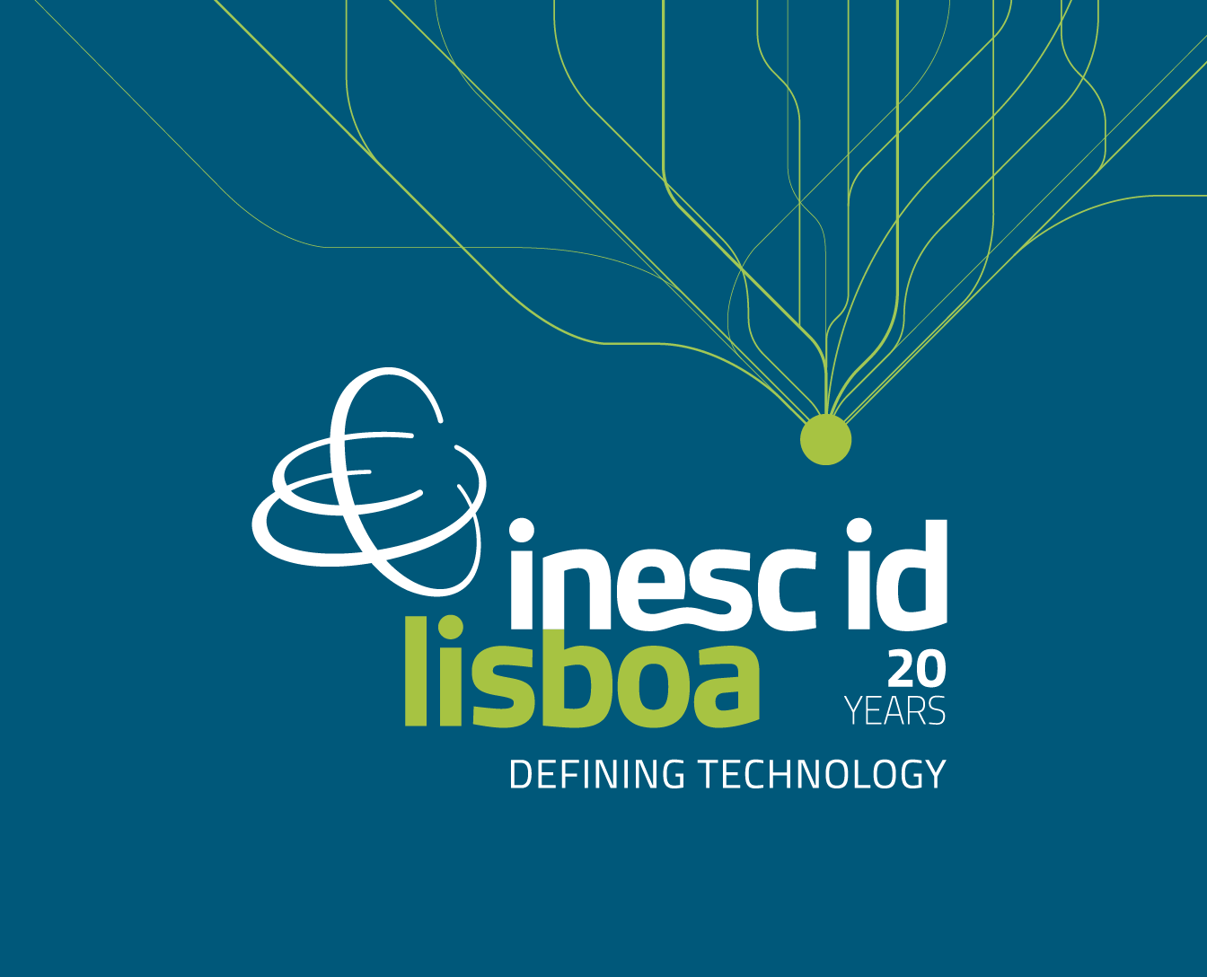

Research Topic
Integrating Graph Neural Networks and Topological Data Analysis for Phylogenetic Inference​
Background
M.Sc. in Mathematical Statistics
Research Topic Description:
Combining GNNs with persistent homology is a real, active research area.
Using topology to improve robustness is reasonable.
Mohanna Mousabeigi
PhD Student, Instituto Superior Técnico (IST)
Student ID :1115747
mohanna.mousabeigi@tecnico.ulisboa.pt
GitHub: Mohanna-Mb383 |
Supervisors
Prof. Alexandre Francisco (IST & INESC-ID Lisboa)
Prof. Cátia Vaz(ISEL & INESC-ID Lisboa)
Latest Work:
GNNs and transformers for bacterial phylogenetics, with emphasis on sequence encoding, axial/graph models, missing-data robustness, and generative ideas inspired by PHYLOVAE.

