Slide 1


Slide 2


Slide 3

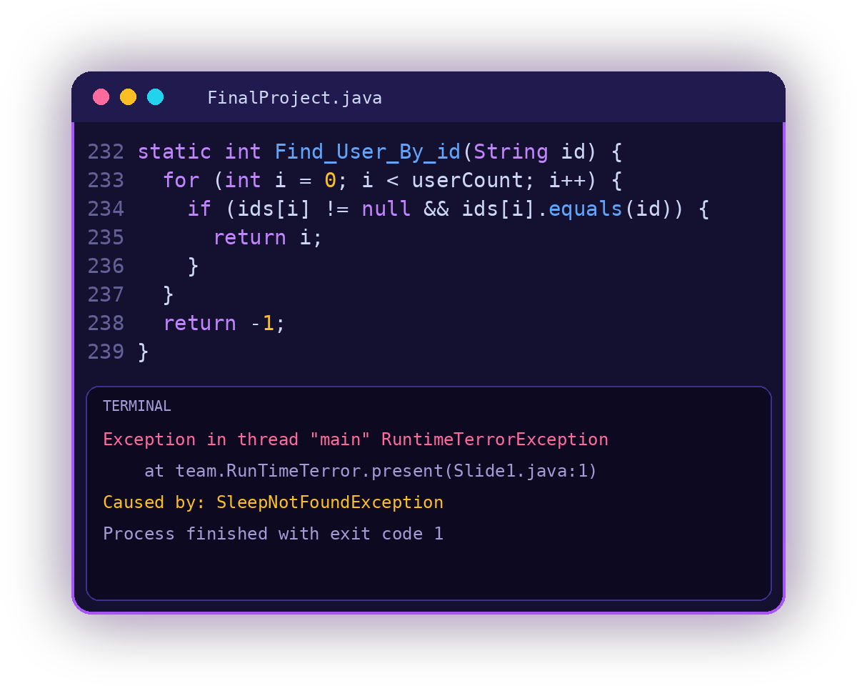
JAVA CONSOLE PROJECT
Quick Pay
Admin Panel for a Wallet App
TEAM
RunTime Terror
Disclaimer: it works on my machine!
Presented by: Team RunTime Terror
Mohannad Hamed
Hla Hamdy
Mohamed Ibrahim
Malak Ahmed

Slide 4
What is Quick Pay?
at QuickPay.idea(Slide2.java:2)
The idea
A small wallet app. Each user has money (a balance) in Egyptian pounds.
User: ahmed012
15960.6 EGP
Our part
Two roles. The user has a wallet with a balance. The admin manages the accounts of all users.
Account Status:
ACTIVE
The goal
Log in or sign up, check the balance, send money, save favourites. The admin can search, update, block and unblock users.

Slide 5
What does Quick Pay do?
at QuickPay.goal(Slide2.java:2)
Admin: users
Admin: control
Search a user by ID, name, email or phone. View all users or one user. Change a name, email or phone.
Show statistics: users, active, blocked, transactions and total transfers. See all transactions. Block or unblock an account.
SearchUser(), viewAllUsers()
showstatistics(), BlockAccount()
User: wallet
User: contacts and profile
Log in or sign up. Show the balance. Send money by phone number. See your own transaction history.
Add, remove and show favourites. Search a recipient by phone. View or update the profile. Log out.
showBalance(), transferMoney()
addfav(), searchRecipient()

Slide 6
What can the admin do?
at QuickPay.purpose(Slide3.java:3)
Search
Update
Find a user by ID, username, email or phone.
Change the name, email or phone. Email and phone must stay unique.
SearchUser()
updateUser()
View
Block / Unblock
See all users, or see one user.
Stop a bad account. Turn it on again later.
viewAllUsers()
BlockAccount()

Slide 7
How do we store the data?
at QuickPay.storage(Slide4.java:4)
index | ids[] | usernames[] | Emails[] | phone_numbers[] | balance[]
0 | 753489 | ahmed012 | ahmed_mohamed@gmail.com | 01036794460 | 1596060
1 | 992931 | amr_78 | amr_youssef@gmail.com | 01182173694 | 260015
2 | 758737 | joe818 | joe_yasser@gmail.com | 01266433666 | 150000
Same index = same user in every array.
Money is saved in piasters (100 piasters = 1 EGP). "1596060 / 100" = 15960.6 EGP.

Slide 8
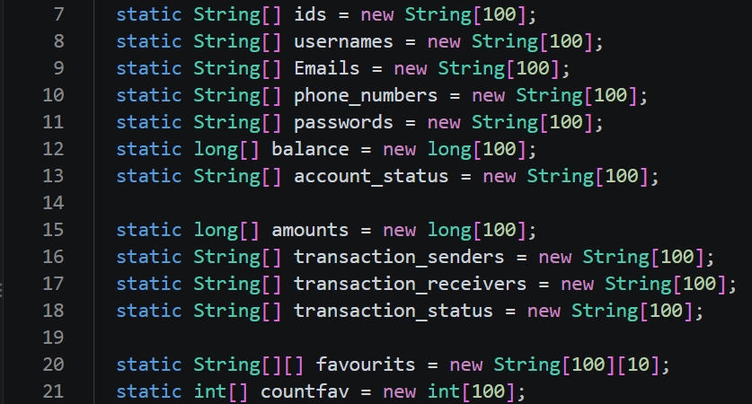
The arrays in the code
at FinalProject (FinalProject.java:5)
1
Lines 7-13
One array per user field. "balance" is "long": money in piasters.
2
Lines 15-18
Transaction arrays: amount, sender, receiver and status.
3
Lines 20-21
"favourits" is 2D: 10 favourites per user. "countfav" counts them.
All arrays have 100 slots. Same index = same user.

Slide 9
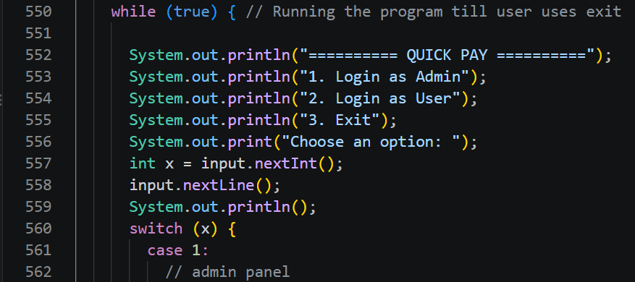
main(): the main menu
at FinalProject.main(FinalProject.java:516)
1
Line 550
The "while (true)" loop keeps the app running until the user chooses Exit.
2
Lines 552-556
Prints the Quick Pay menu: 1 Admin, 2 User, 3 Exit.
3
Lines 557-560
Reads the choice in "x". Then a "switch" opens the matching case.
Two roles, one menu: the Admin Panel and the User Panel.

Slide 10
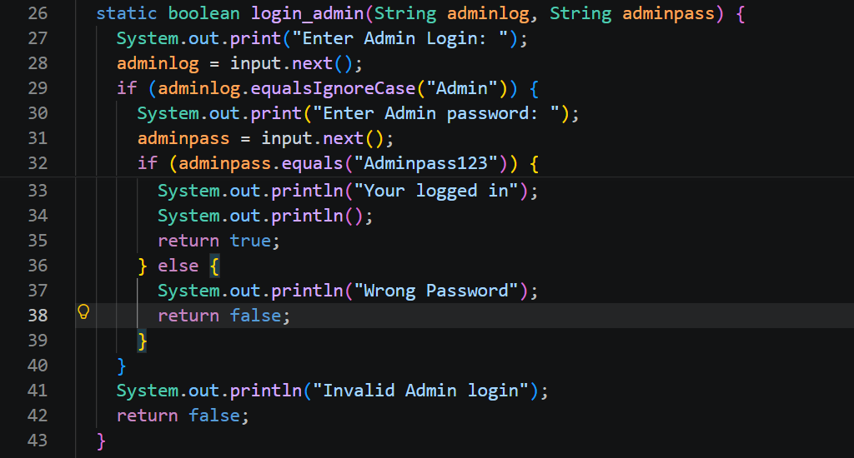
Admin login()
at FinalProject.login_admin(FinalProject.java:26)
1
Lines 27-28
Asks for the admin name and reads it with "input.next()".
2
Lines 29-35
If the name is "Admin" (case does not matter), it asks for the password. A correct password returns "true".
3
Lines 36-42
Wrong password or wrong name: print a message and return "false".
Only the correct admin name and password open the Admin Panel.

Slide 11
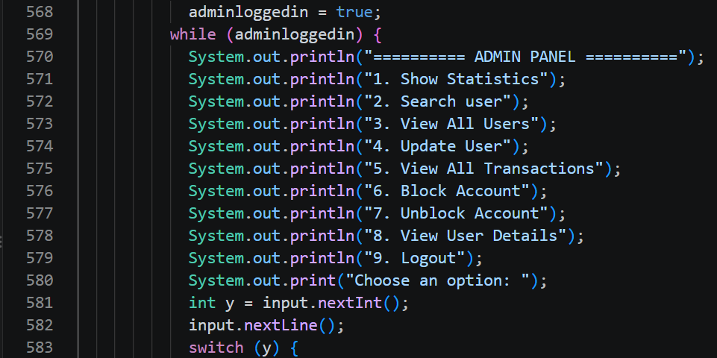
Admin Panel menu
at FinalProject.main(FinalProject.java:567)
1
Line 568
Once "login_admin()" is true, "adminloggedin" becomes true.
2
Lines 569-580
The loop prints the 9 admin options again and again until logout.
3
Lines 581-583
Reads the choice in "y". Each "case" calls one admin method.
Each menu number calls one method, like showstatistics().

Slide 12
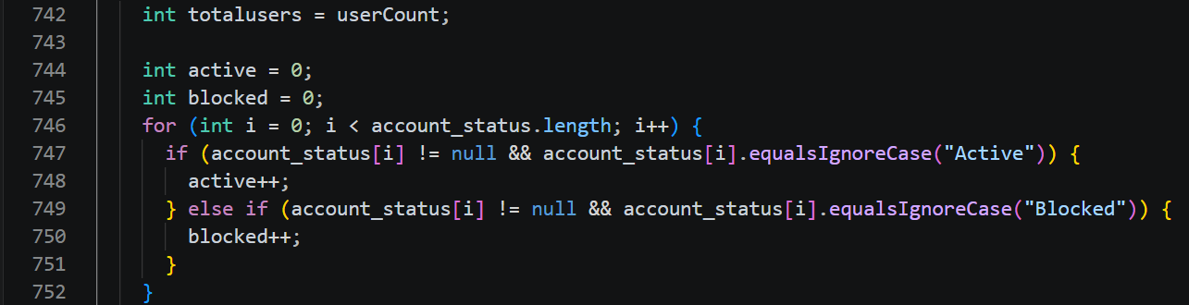
showStatistics(): count users
at FinalProject.showstatistics(FinalProject.java:741)
1
Lines 742-745
Counters "active" and "blocked" start at 0.
2
Lines 746-752
A "for" loop checks the "account_status" of every user.
Statistics are calculated from the real data.
3
Lines 747-750
"!= null" avoids errors. "equalsIgnoreCase()" counts Active and Blocked accounts.

Slide 13
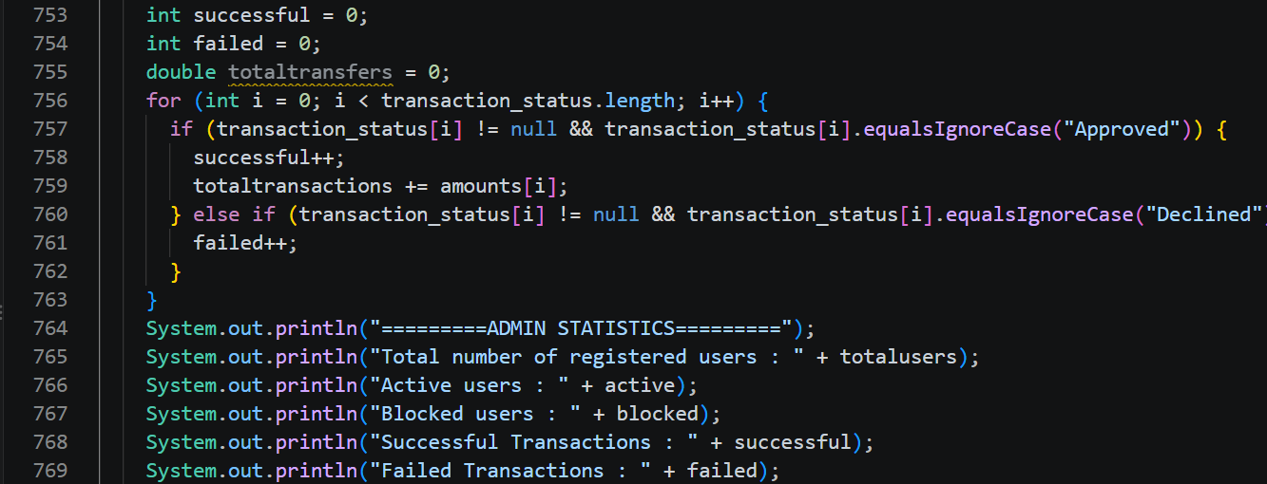
showStatistics(): transfers and report
at FinalProject.showstatistics(FinalProject.java:741)
1
Lines 753-755
Counters for successful and failed transactions, plus "totaltransfers".
2
Lines 756-763
Loops "transaction_status". "Approved" = successful (amount added). "Declined" = failed.
The admin sees the whole app at a glance.
3
Lines 764-771
Prints the admin report: users, active, blocked, successful, failed and total transfers.

Slide 14
Example: the admin searches for amr_78
at QuickPay.trace(Slide5.java:5)
1
Is there an ID "amr_78"? No. We get "-1".
Enter user ID, username, email, or phone:
amr_78
User ID: 992931
Username: amr_78
Email: amr_youssef@gmail.com
Phone: 01182173694
Balance: 2600.15 EGP
Account Status: ACTIVE
2
Is there a username "amr_78"? Yes! It is at "index = 1".
3
We stop here. We do not check email or phone.
4
"printUser(1)" prints all the data of this user.

Slide 15
How the search works
at QuickPay.search(Slide6.java:6)
The admin types one value. We try the methods in order, until one of them finds the user.
1) By ID
2) By username
3) Email or phone
4) Not found
Find_User_By_id
Find_User_By_Name
return -1;
Find_User_Email_OR_Phone
Compares the value with every ID.
The same, but for usernames. Upper or lower case does not matter.
Compares the value with every email and every phone number.
All 3 methods failed, so we print: User not found.
Example
Example
Example
Example
992931
-> index 1
AMR_78
-> index 1
01182173694
-> index 1
hello
-> -1

Slide 16
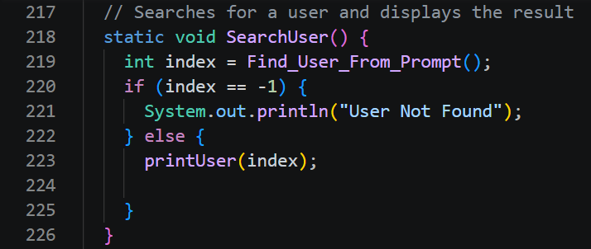
SearchUser(): the start
at FinalProject.SearchUser(FinalProject.java:218)
1
Line 219
Asks "Find_User_From_Prompt()" for the user's position.
2
Lines 220-221
If it returns "-1", we print: User Not Found.
3
Lines 222-223
Otherwise, "printUser(index)" shows the data.
SearchUser does not search by itself. It asks another method to do it.

Slide 17
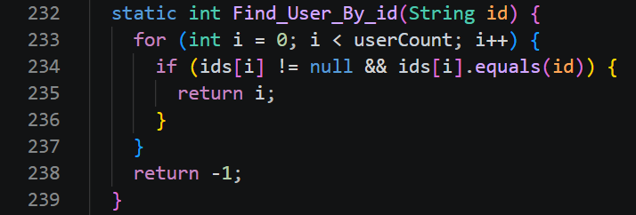
Search by ID
at FinalProject.Find_User_By_id(FinalProject.java:232)
1
Line 233: the loop
We check the users one by one, from "0" to "userCount - 1".
2
Line 234: safe check
We check "ids[i] != null" first, so the code does not crash on an empty slot.
It returns the user's position, or -1.
3
Lines 235 and 238
"return i" means we found it. "return -1" means we did not find it.

Slide 18
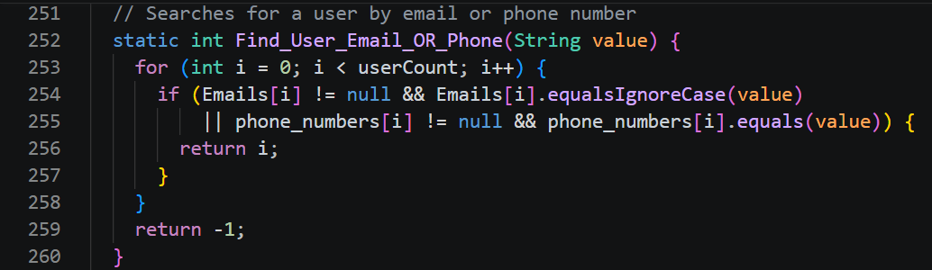
Search by email or phone
at FinalProject.Find_User_Email_OR_Phone(FinalProject.java:252)
1
Line 254: email
It matches even if the case is different (upper or lower).
2
Line 255: phone
"||" means OR: the email or the phone can match.
Same idea as the ID search: loop, check, return.
3
Why one method?
The admin types one value. We do not know if it is an email or a phone.

Slide 19
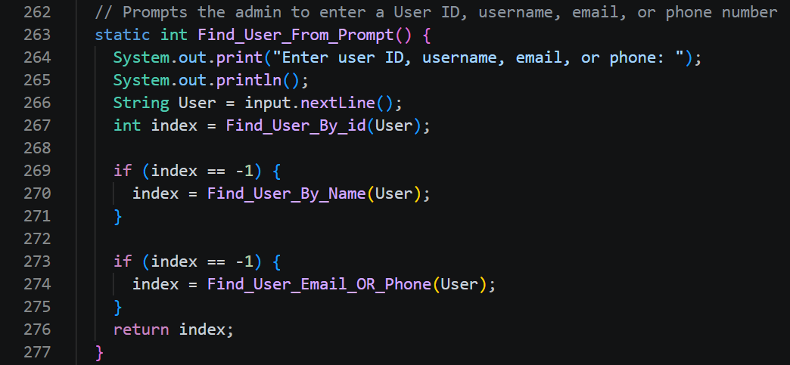
Find_User_From_Prompt()
at FinalProject.Find_User_From_Prompt(FinalProject.java:263)
1
Lines 264-266
We ask the admin, then read the answer with "input.nextLine()".
2
Lines 267-275
Try the ID first. Still "-1"? Try the name. Still "-1"? Try email or phone.
3
Line 276
Return the position, or "-1" if nothing matched.
All 5 admin actions use this method.

Slide 20
One method, many uses
at QuickPay.reuse(Slide11.java:11)
SearchUser()
updateUser()
BlockAccount()
Find_User_From_Prompt()
It asks the admin, tries ID, name, email or phone, and returns one position.
unblockAccount()
viewUserDetails()

Slide 21
Java ideas in this code
at QuickPay.concepts(Slide12.java:12)
static
return -1
ids[i] != null
a && b
These methods belong to the class, so main can call them directly.
An array has no position -1, so we use it to mean not found.
First check that the slot is not empty. This avoids a crash.
AND: true only if both sides are true.
equals
equalsIgnoreCase
a || b
isEmpty()
Same text and same letters. “Amr”, “amr”, and “AMR”
are all different.
Same text. Upper or lower case does not matter.
OR: true if the first or the second side is true.
Empty means the admin pressed Enter, so we skip this field.

Slide 22
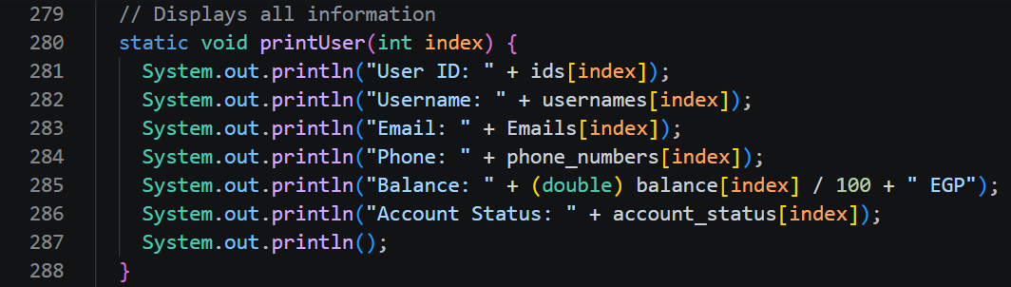
printUser(): show one user
at FinalProject.printUser(FinalProject.java:280)
1
Lines 281-284
Print the ID, username, email and phone of the user at "index".
2
Line 285
Money is in piasters. "/ 100" changes it to pounds. "(double)" keeps the decimals.
Written once, used in many places.
3
Lines 286-287
Print the status, then an empty line.

Slide 23
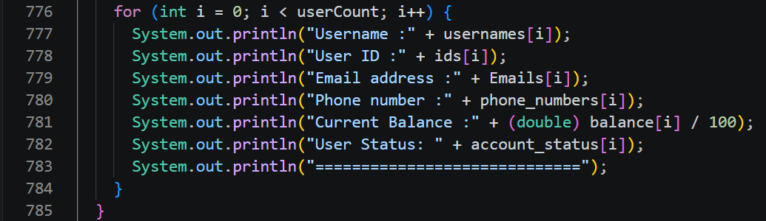
viewAllUsers()
at FinalProject.viewusers(FinalProject.java:774)
1
Line 776
Loops through the users from 0 up to "userCount".
2
Lines 777-782
Uses the same index "i" in every array to print one full user.
Same index = same user, so one loop prints everything.
3
Lines 783-785
Prints a separator line, then the loop and the method end.

Slide 24
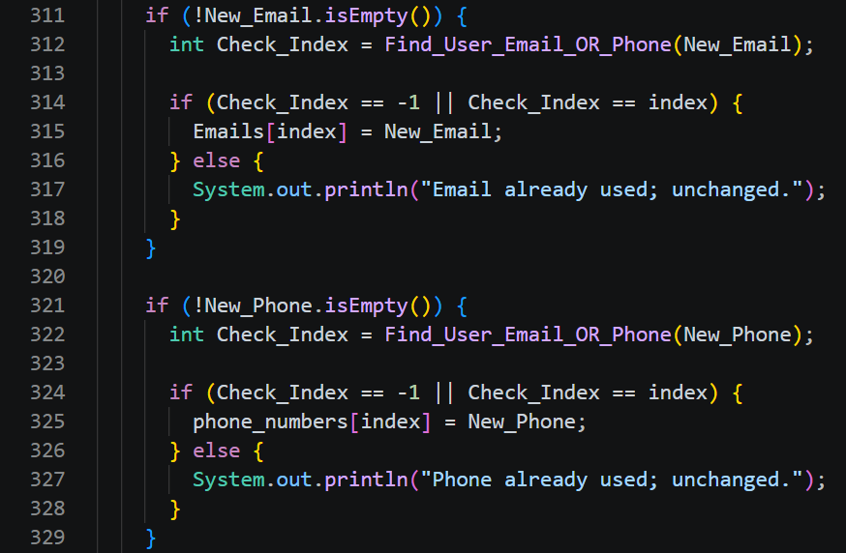
updateUser(): email and phone
at FinalProject.updateUser(FinalProject.java:290)
1
Lines 311-312: the email
If the admin typed a new email, we look for who already has it. "Check_Index" is that user's position, or "-1".
2
Line 314: can we save it?
Yes, if nobody has it ("-1") or if it already belongs to this same user ("index").
3
Lines 316-317: otherwise
We keep the old email and print: Email already used; unchanged.
4
Lines 321-329: the phone
The same steps, but for the phone number.

Slide 25
Demo: the email is already used
at QuickPay.demo(Slide15.java:15)
Enter user ID, username, email, or phone: amr_78
Enter new username (or press Enter to skip): amr_new
Enter new email (or press Enter to skip): joe_yasser@gmail.com
Enter new phone (or press Enter to skip): [Enter]
Email already used; unchanged.
User update finished.
New username
Saved right away.
Email of joe818
Rejected. The old email stays.
Phone: Enter
Skipped. Nothing changes.

Slide 26
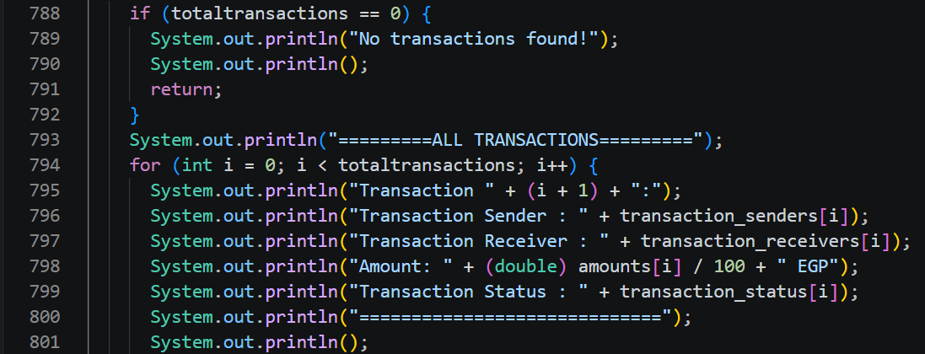
Admin: transaction history
at FinalProject.transactionhistory(FinalProject.java:787)
1
Lines 788-792
If "totaltransactions" is 0: print "No transactions found!" and exit with "return".
2
Lines 793-794
Prints the title, then loops from 0 up to "totaltransactions".
The admin sees every transaction of every user.
3
Lines 795-801
Prints the number ("i + 1"), sender, receiver, amount in EGP and status.

Slide 27
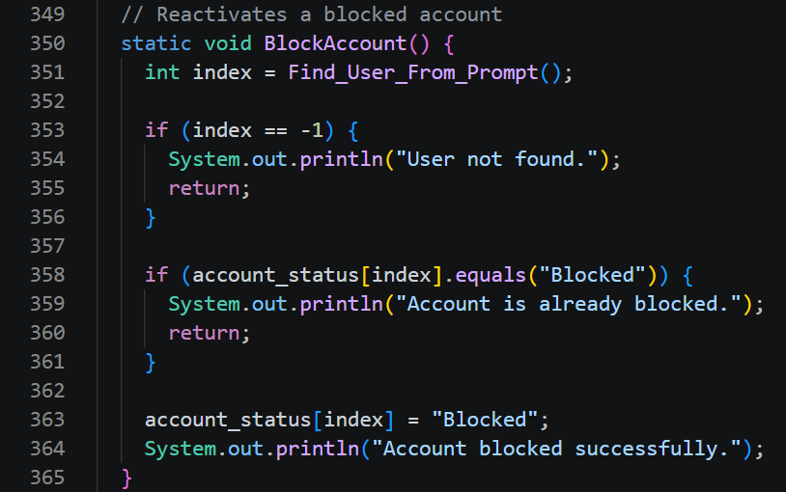
BlockAccount()
at FinalProject.BlockAccount(FinalProject.java:350)
1
Lines 351-356
Find the user. If it is "-1", print User not found and stop.
2
Lines 358-361
Is it already "Blocked"? Tell the admin and stop.
3
Lines 363-364
Change the status to "Blocked" and print a message.

Slide 28
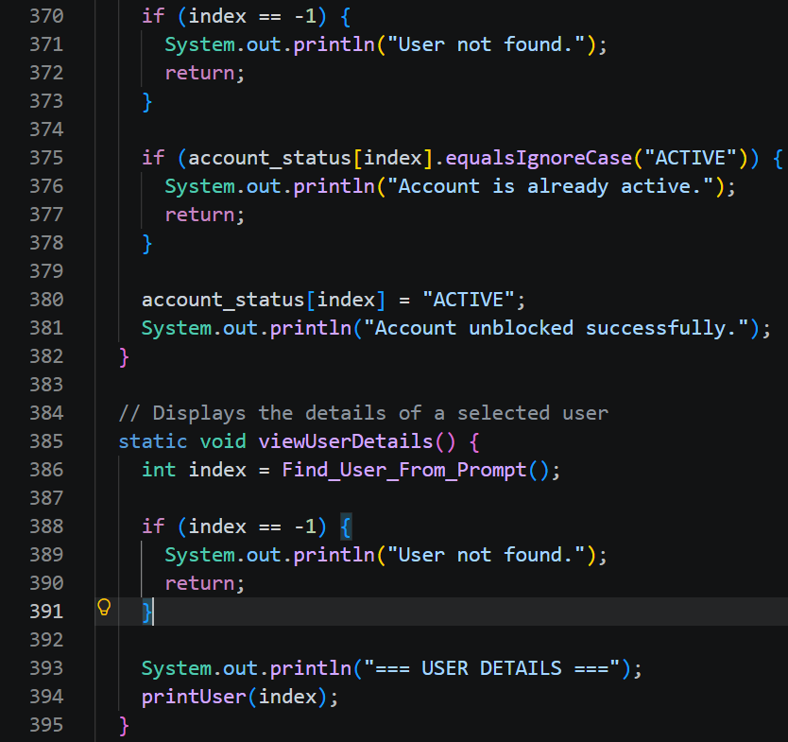
Unblock and view details
at FinalProject.unblockAccount(FinalProject.java:367)
1
Lines 375-378
Is it already "ACTIVE"? Then stop.
2
Lines 380-381
Change the status back to "ACTIVE".
3
Lines 385-394
"viewUserDetails" works the same way: find the user, check, then "printUser(index)".

Slide 29
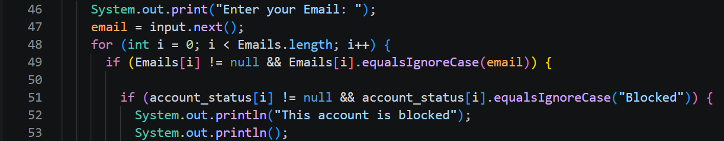
User login()
at FinalProject.login(FinalProject.java:45)
1
Lines 46-47
Asks for the email and reads it with "input.next()".
2
Lines 48-49
Loops over "Emails" to find the email. Upper or lower case does not matter.
A blocked account can never log in. A wrong password fails.
3
Lines 51-53
If the status is "Blocked", we print a message and stop.

Slide 30
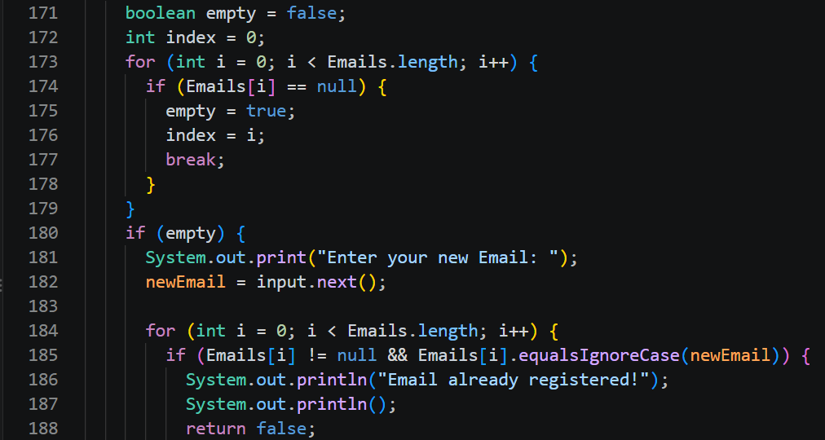
SignUp(): place and email
at FinalProject.SignUp(FinalProject.java:170)
1
Lines 173-179
Looks for the first empty slot ("null") in "Emails" and saves its index.
2
Lines 180-182
If there is a place, ask for the new email.
3
Lines 184-188
Checks the email is not used. If it is, print a message and "return false".
Every email is unique: two users can not share one.

Slide 31
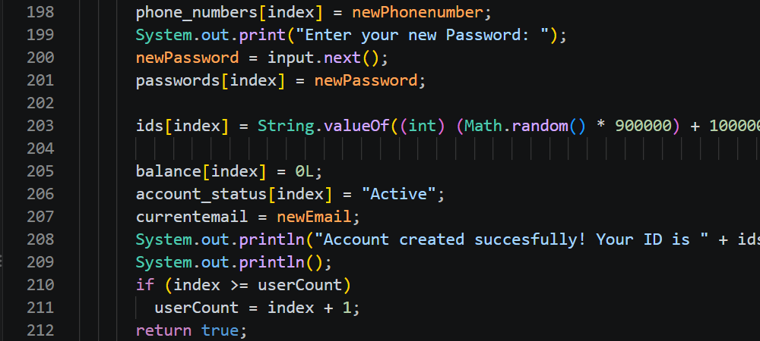
SignUp(): save the user
at FinalProject.SignUp(FinalProject.java:170)
1
Lines 198-201
Saves the phone number and the password at the same "index".
2
Line 203
Creates a random 6-digit ID with "Math.random()".
3
Lines 205-207
Balance starts at "0L", status is "Active".
A new account starts Active with 0 balance. If all 100 slots are used: "System Full".
4
Lines 208-212
Prints the new ID, updates "userCount", returns "true".

Slide 32
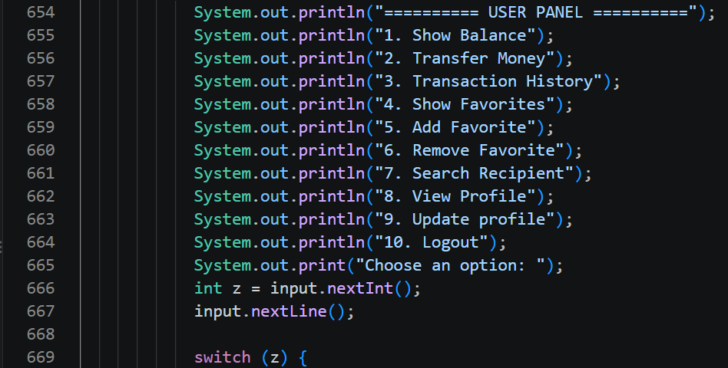
User Panel menu
at FinalProject.main(FinalProject.java:653)
1
Lines 654-665
The loop prints the 10 user options until logout.
2
Lines 666-667
Reads the choice in "z".
3
Lines 669-672
"switch (z)": each case calls one user method, like "showBalance".
The user menu works like the admin menu.

Slide 33
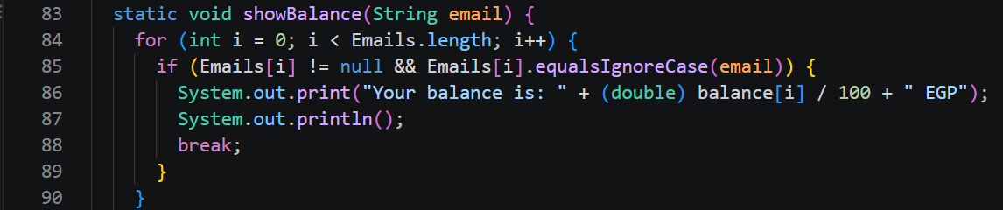
showBalance()
at FinalProject.showBalance(FinalProject.java:83)
1
Line 83
The method receives the logged-in email.
2
Lines 84-85
Loops until it finds this user in "Emails".
A user only sees his own balance.
3
Lines 86-88
Prints "balance[i] / 100" in EGP, then "break".

Slide 34
transferMoney(): how it works
at FinalProject.transferMoney(FinalProject.java:402)
Description
Processing
It lets a user send money to another user by using the receiver's phone number.
1 The sender enters the receiver's phone number. The system searches for that account.
2 If the account is found, the system checks that it is not blocked, and that the sender did not enter his own number.
3 When all checks are done, the system asks for the amount. It must be more than zero.
4 If the sender's balance is less than the amount, the transfer is declined.
5 If the balance is enough, the system takes the amount from the sender and adds it to the receiver. The transaction is saved.

Slide 35
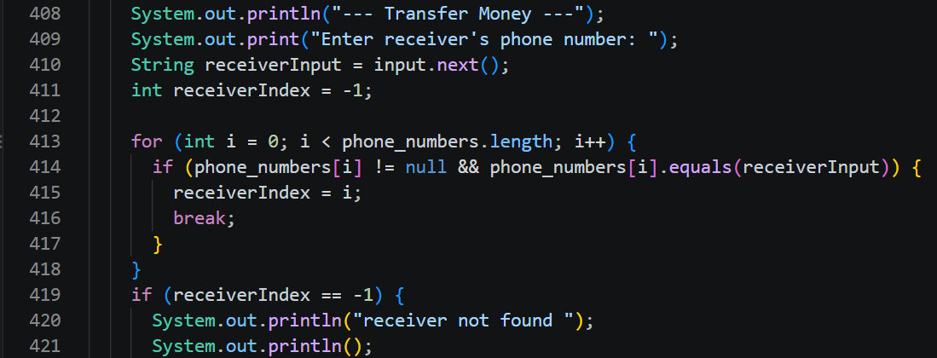
transferMoney(): find the receiver
at FinalProject.transferMoney(FinalProject.java:402)
1
Lines 409-411
Asks for the receiver phone number. "receiverIndex = -1" means not found yet.
2
Lines 413-418
Loops "phone_numbers". If one matches, we save its position and "break".
The user sends money to another user by phone number. First we find the receiver.
3
Lines 419-421
If it is still "-1", we print: receiver not found.

Slide 36
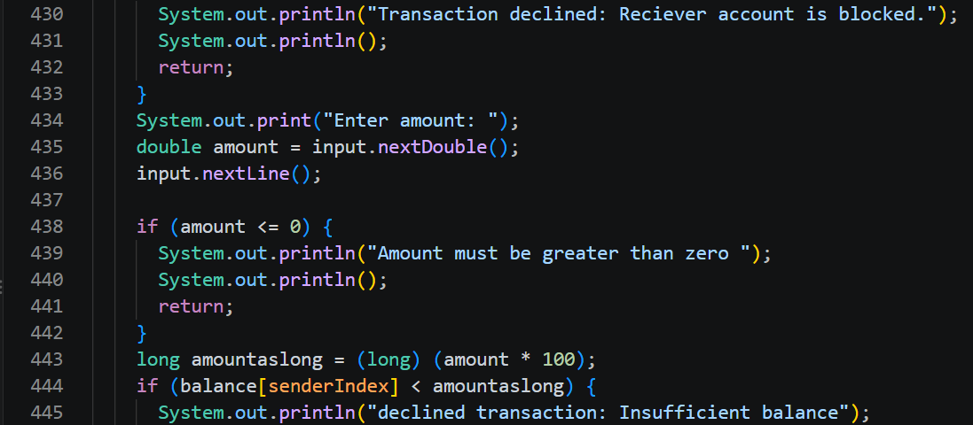
transferMoney(): checks
at FinalProject.transferMoney(FinalProject.java:402)
1
Lines 429-433
If the receiver account is "Blocked", the transfer is declined.
2
Lines 434-442
Reads the amount. If it is "<= 0", we stop.
3
Lines 443-445
Amount is saved as "long" piasters ("* 100"). Not enough balance: declined.
Every rule is checked before any money moves.

Slide 37
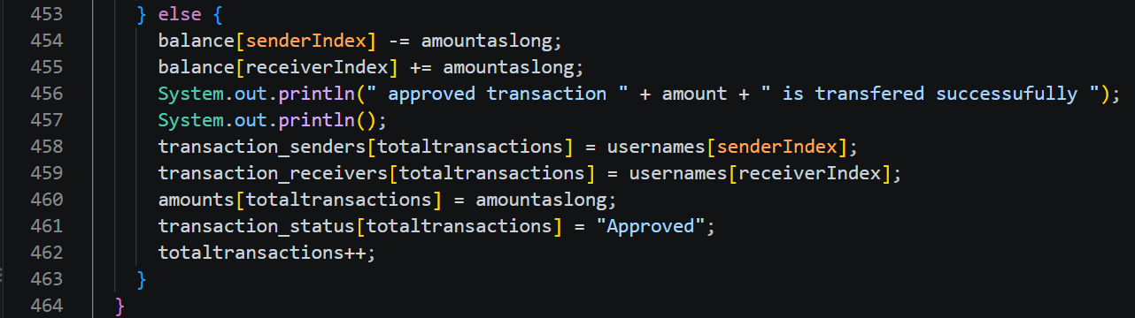
transferMoney(): approved
at FinalProject.transferMoney(FinalProject.java:402)
1
Lines 454-455
Sender balance goes down. Receiver balance goes up by the same amount.
2
Lines 456-457
Prints: approved transaction.
A declined transfer is also recorded, and no balance changes.
3
Lines 458-462
Saves sender, receiver, amount and "Approved". Then "totaltransactions++".

Slide 38
Money transfer rules
at FinalProject.transferMoney(FinalProject.java:402)
1
Rules 1-4
The checks: receiver exists, is not me, and both accounts are active.
1 Receiver must exist L419-423
2 Sender and receiver differ L424-428
3 Sender is active login L51-53
4 Receiver is active L429-433
5 Amount is more than 0 L438-442
6 Enough balance L444-453
7 Sender balance goes down L454
8 Receiver goes up, same amount L455
9 Every attempt is recorded L447-462
10 Failed: balances unchanged return, L452
2
Rules 5-6
Amount must be more than zero, and the sender must have enough money.
3
Rules 7-10
Update both balances. Record every attempt. Failed transfers change nothing.

Slide 39
Transaction history: how it works
at FinalProject.TransactionHistory(FinalProject.java:467)
Description
Processing
It shows all the transactions the logged-in user did before, with the data of each transaction.
1 The system loops through all the stored transactions.
2 It looks for records where the logged-in user is the sender or the receiver.
3 For each record found, it prints the sender and receiver usernames, the amount in EGP, and the status: Approved or Declined.
4 If there are no transactions, it prints a message that there is no transaction history.

Slide 40
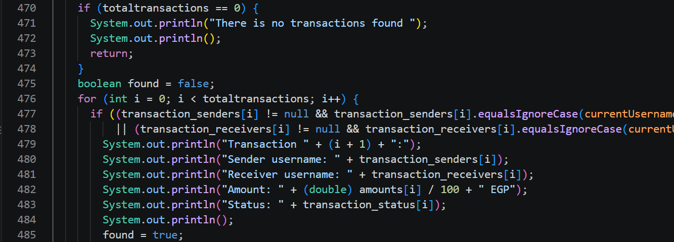
User: transaction history
at FinalProject.TransactionHistory(FinalProject.java:467)
1
Lines 470-474
If there are no transactions: print a message and "return".
2
Lines 476-478
Loops all transactions. Keeps only the ones where the user is the sender "or" the receiver.
Users see only their own transactions.
3
Lines 479-485
Prints number, sender, receiver, amount and status.

Slide 41
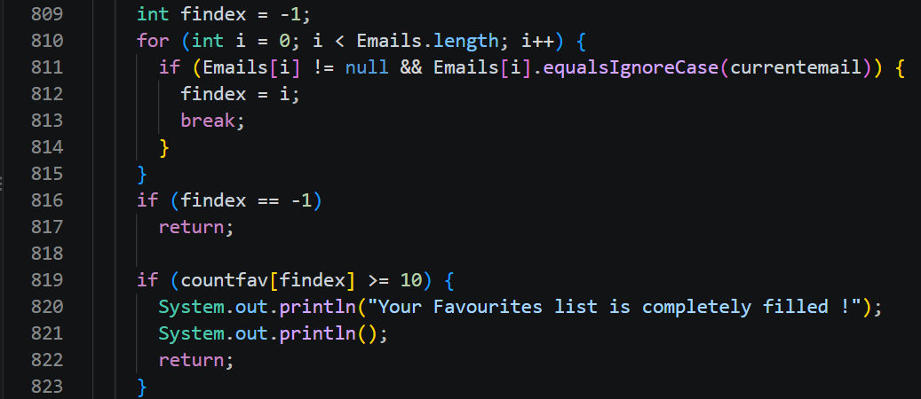
addFavorite(): checks
at FinalProject.addfav(FinalProject.java:807)
1
Lines 809-815
Searches the logged-in email in "Emails" and saves the index in "findex".
2
Lines 816-817
If "findex == -1", exit the method.
3
Lines 819-823
If the list is full (10 names), show a warning and exit.
The list holds up to 10 favourites per user.

Slide 42
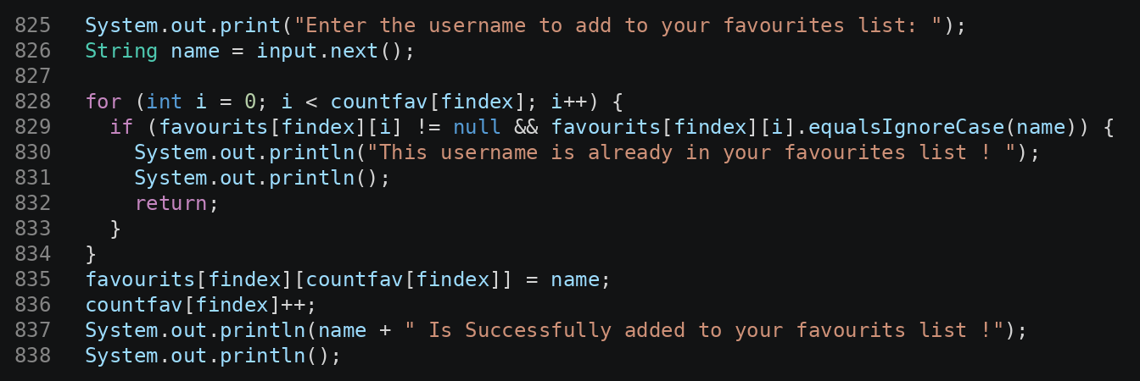
addFavorite(): add the name
at FinalProject.addfav(FinalProject.java:807)
1
Lines 825-826
Asks for the username to add.
2
Lines 828-834
Loops the favourites. Same name already there? Alert and stop.
No duplicate favourites are allowed.
3
Lines 835-838
Saves the name in "favourits[findex]", then "countfav[findex]++".

Slide 43
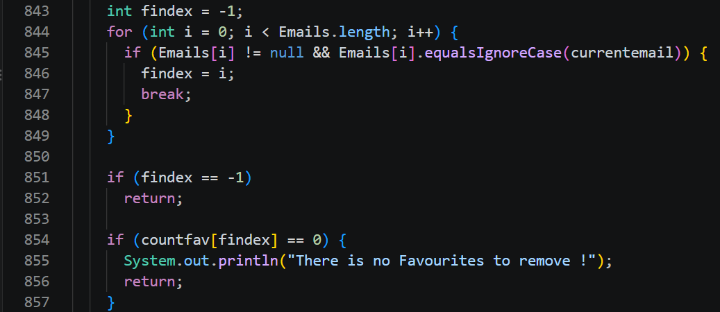
removeFavorite(): checks
at FinalProject.removefav(FinalProject.java:841)
1
Lines 843-849
Finds the logged-in user index "findex" in "Emails".
2
Lines 851-852
If the user is not found, exit.
3
Lines 854-857
If "countfav[findex] == 0": there is nothing to remove, so print an error and exit.
We can not remove from an empty list.

Slide 44
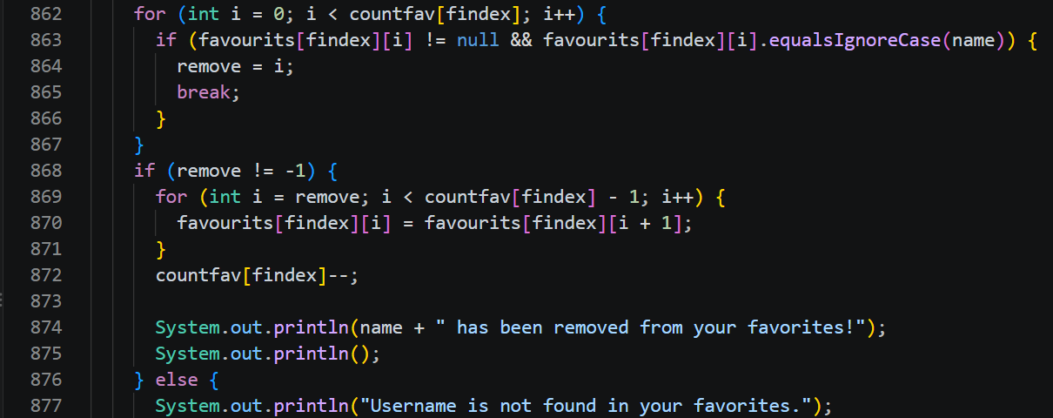
removeFavorite(): delete and shift
at FinalProject.removefav(FinalProject.java:841)
1
Lines 862-867
Asks for the username to remove, then loops the favourites to find it. "remove = i" saves its position.
2
Lines 868-872
If found, shift the next names one step left. Then "countfav[findex]--".
Shifting left closes the empty slot.
3
Lines 874-878
Prints a success message, or an error if the name is not in the list.

Slide 45
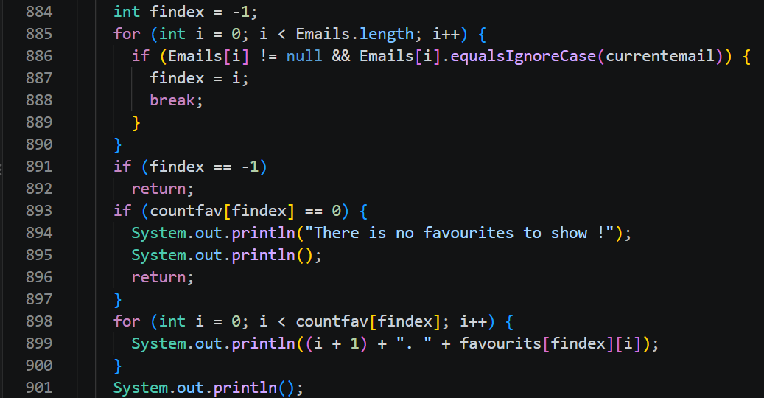
showFavorites()
at FinalProject.showfav(FinalProject.java:882)
1
Lines 884-890
Finds the logged-in user index "findex" with "equalsIgnoreCase()".
2
Lines 893-897
If "countfav[findex] == 0", print: There is no favourites to show.
3
Lines 898-901
Loops up to "countfav[findex]" and prints a numbered list ("i + 1").
Only the favourites of the logged-in user are shown.

Slide 46
searchRecipient(): how it works
at FinalProject.searchRecipient(FinalProject.java:493)
Description
Processing
It helps the sender confirm who the receiver is before making a transfer.
1 The user enters the receiver's phone number.
2 The system searches the phone_numbers array to see if the number belongs to a user.
3 If it is found, the system prints "Recipient Found" with the username and the phone number.
4 If it is not found, the system prints that no user has this phone number.

Slide 47
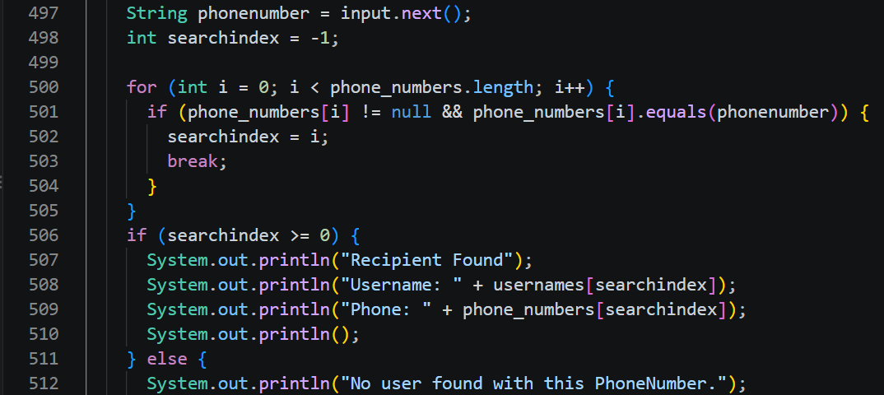
searchRecipient()
at FinalProject.searchRecipient(FinalProject.java:493)
1
Lines 497-498
Reads the phone number. "searchindex = -1" means not found yet.
2
Lines 500-505
Loops "phone_numbers" and saves the position of the match.
3
Lines 506-512
Found: print "Recipient Found" with username and phone. Else: no user found.
It shows the username and phone, so the sender can confirm the receiver before a transfer.

Slide 48
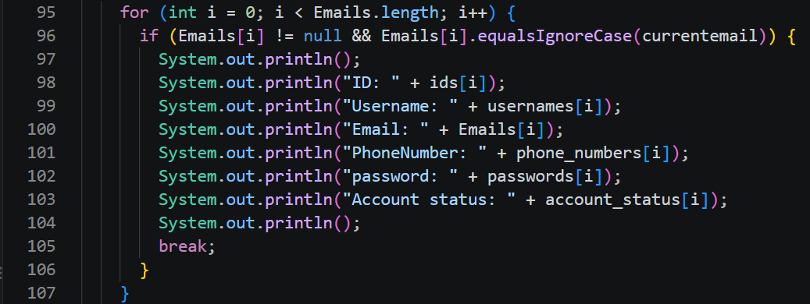
viewProfile()
at FinalProject.viewProfile(FinalProject.java:94)
1
Lines 95-96
Loops "Emails" to find the logged-in user ("currentemail").
2
Lines 98-103
Prints ID, username, email, phone, password and account status.
A user can only see his own profile.
3
Line 105
"break" stops the loop after the user is found.

Slide 49
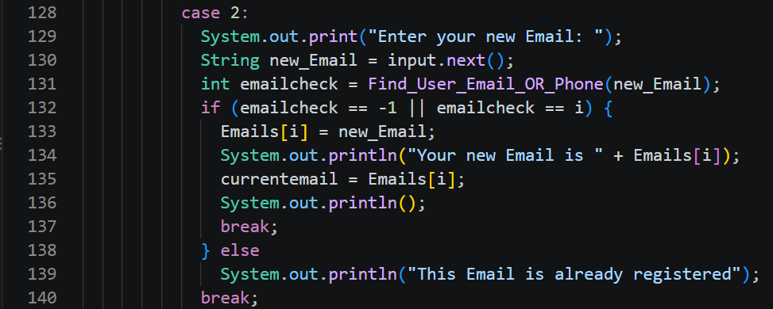
updateProfile(): the email
at FinalProject.updateProfile(FinalProject.java:110)
1
Lines 128-130
Case 2: asks for the new email.
2
Lines 131-132
"Find_User_Email_OR_Phone" finds who owns it. OK if nobody ("-1") or it is me ("i").
Only username, email, phone and password can change. Not balance, status or ID.
3
Lines 133-139
Saves the new email, or prints: already registered.

Slide 50
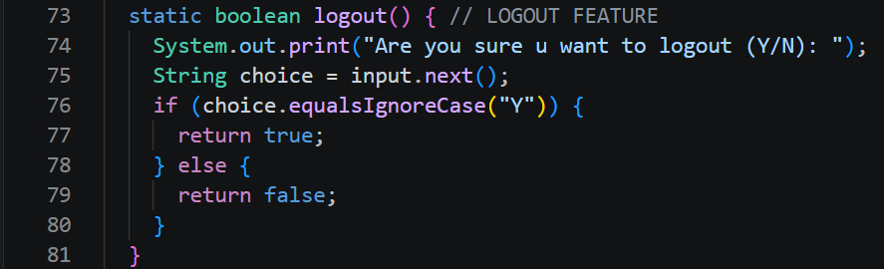
logout()
at FinalProject.logout(FinalProject.java:73)
1
Lines 74-75
Asks: Are you sure? and reads the answer.
2
Lines 76-77
If the answer is "Y", it returns "true".
On "true", main clears "currentemail" and goes back to the main menu.
3
Lines 78-80
Otherwise it returns "false" and the user stays logged in.

Slide 51


Slide 52
Thank You!
TEAM
RunTime Terror
After all this hard work, we deserve BONUS points... and the #1 spot !!!

