Slide 1
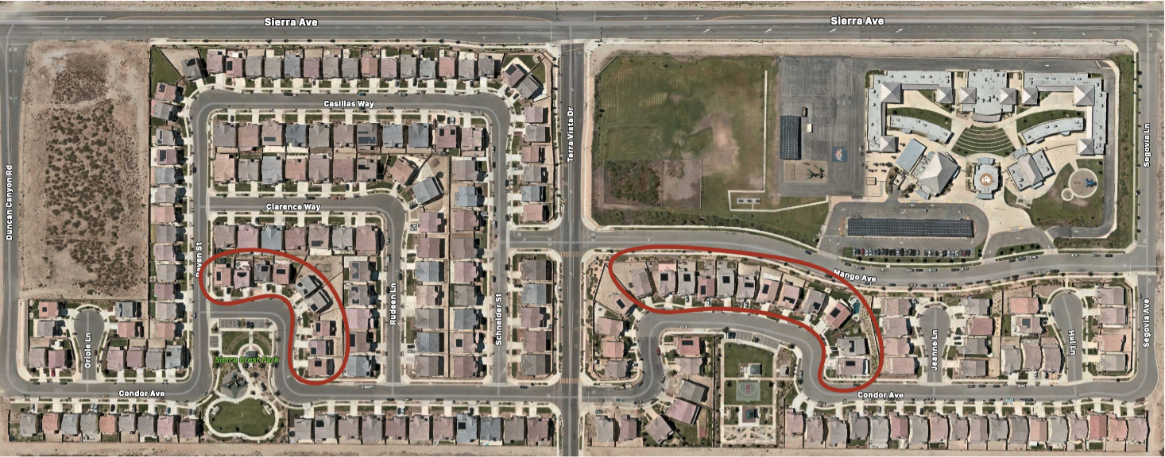
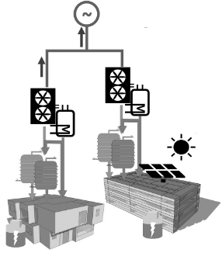
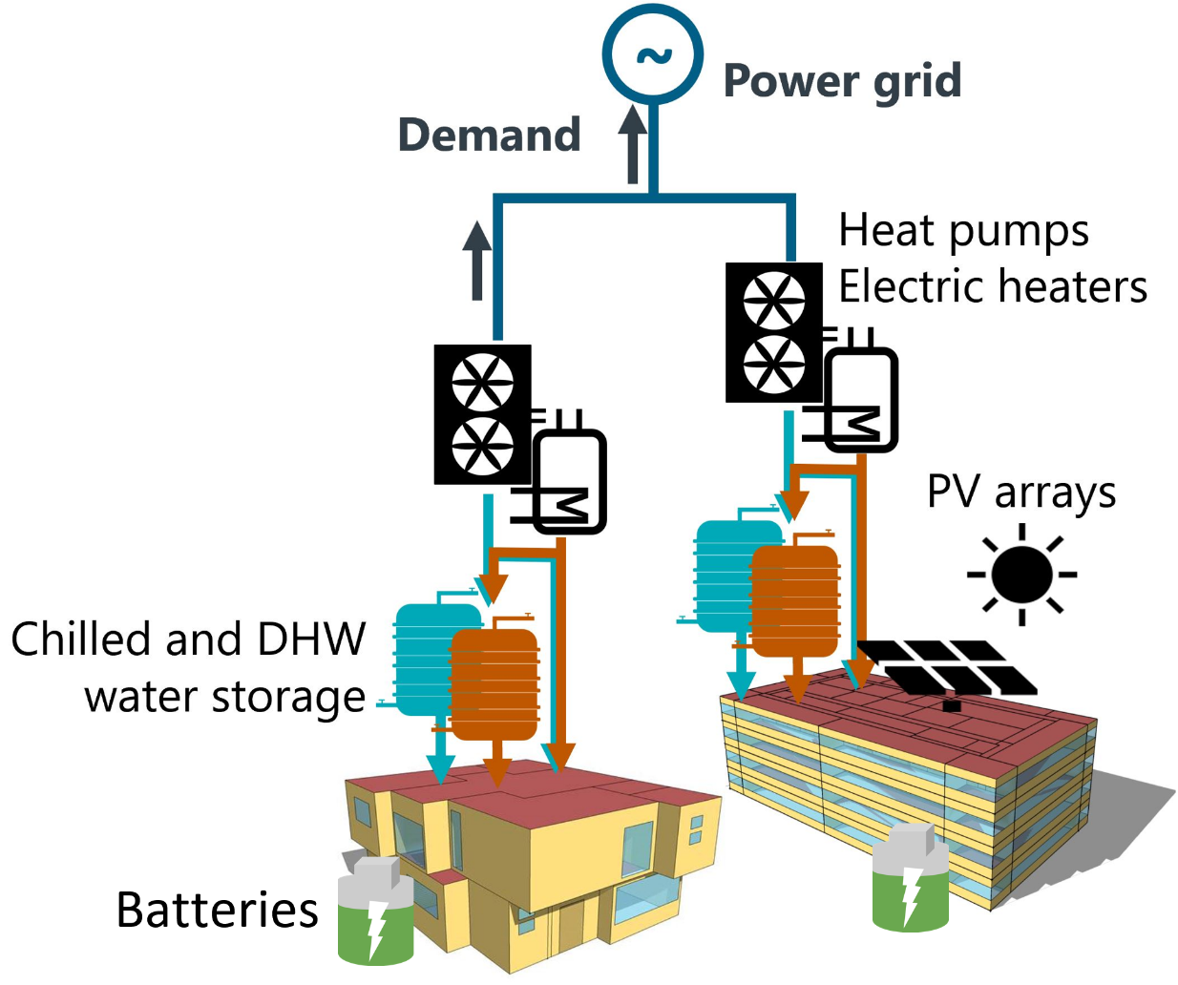
Real-World Grid-Interactive
Community
Database
Virtual Community
Environment
Control Agent
Preprocessing
Experiment Simulations
Select
Optimal
Control
Policies
Building loads
System specs.
Weather
Emission rate
Electricity rate
Baseline Calibration
State space design
Action space design
Reward design
Hyperparameter tuning
RL
MPC
RBC
Evaluation KPIs
Building
Systems
Baseline Agent
RL Agent
For each experiment, extract decision tree and compare to RL policy
Comparing RL solution to 3 ` baselines` - no-storage, RBC, and decision tree
Decision trees are comparable to SOO in buildings that can be easily deployed in BAS or HEMS
We have taken smart meter data -> virtual model -> discover optimal control using RL -> extract simplified control model -> deply in HEMS

Slide 2


Real-World Grid-Interactive Community
CityLearn
Real-World Grid-Interactive Community
CityLearn
Bldg. 1
Bldg. 2
Bldg. 3
Bldg. N
Target Bldg. 1
Target Bldg. 2
Target Bldg. 3
Source Bldg. 3
Agent
Agent
Agent
Agent
Agent
Agent
Agent
Agent
Policy
Policy

Slide 3
Source Bldg.

Slide 4
Target Bldg.

