Slide 1


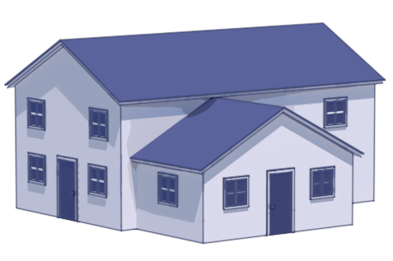
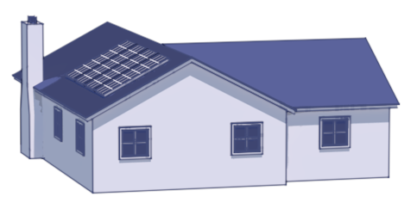
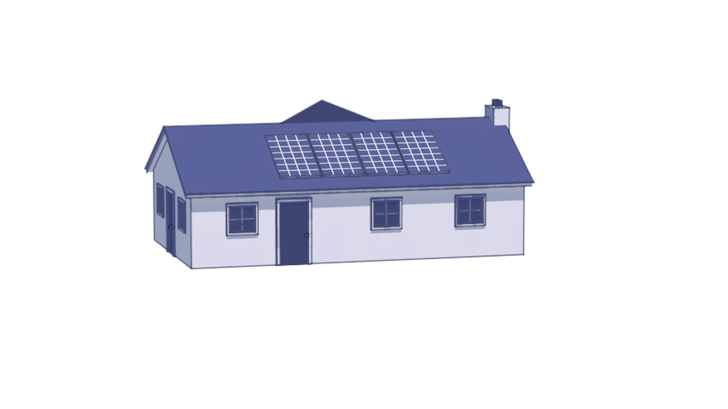



Neighborhood
CityLearn
Smart
Meter
Data
Building 1
Building 2
Building N
Building N
r_{t+1}
a_{t}
s_{t+1}
Agent
Agent
Agent
Agent
Transfer Learning
Transfer Learning
Online Deployment
Policy

Slide 3


Neighborhood
CityLearn
Smart
Meter
Data
r_{t+1}
a_{t}
s_{t+1}
Charge
/Discharge
Charge
/Discharge
Agent
Charge
/Discharge
Policy
Smart
Meter
Data
r_{t+1}
a_{t}
s_{t+1}
Agent
Charge
/Discharge
Charge
/Discharge
Charge
/Discharge
Policy

Slide 4
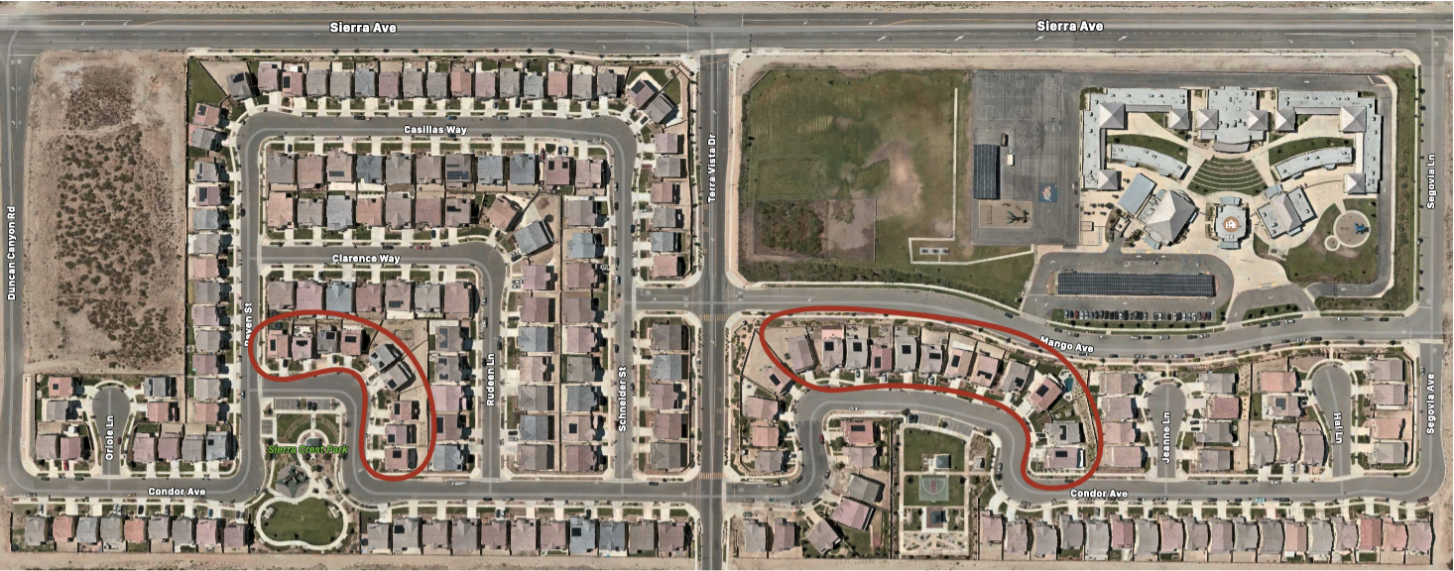

Slide 5


Grid-Interactive Community
CityLearn
Grid-Interactive Community
CityLearn
Bldg.
N=1
Bldg.
N=2
Bldg.
N=3
Bldg.
N
Bldg.
N=1
Bldg.
N=2
Bldg.
N=3
Bldg.
N=3
a_{t}
a_{t}
Agent
Agent
Agent
Agent
Agent
Agent
Agent
Agent
Policy
Policy

Slide 6
a_{t}
Policy
Agent

