Slide 1


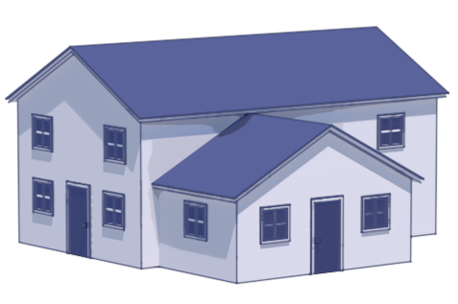
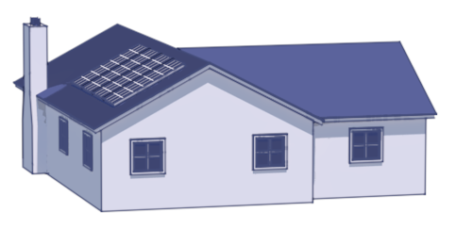
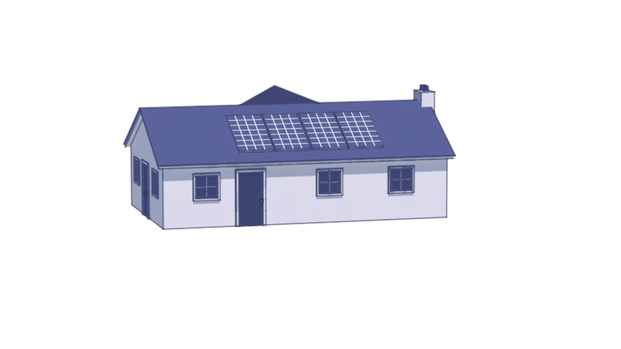



Neighborhood
CityLearn
Smart
Meter
Data
Building 1
Building 2
Building N
Building N
Systems Metadata
r_{t+1}
a_{t}
s_{t+1}
Agent
Agent
Agent
Agent
Deployment
Policy

Slide 3


Neighborhood
CityLearn
Smart
Meter
Data
r_{t+1}
a_{t}
s_{t+1}
Charge
/Discharge
Charge
/Discharge
Agent
Charge
/Discharge
Policy
Smart
Meter
Data
r_{t+1}
a_{t}
s_{t+1}
Agent
Charge
/Discharge
Charge
/Discharge
Charge
/Discharge
Policy

Slide 4
Data Collection
CityLearn Model
Preliminary Investigation
Experimentation
Analysis
Building model
Battery model
PV model
RBC model
RL Agent
Decision Tree
Model Validation (Battery controller referernce model)
Reward Design
Hyperparameter Tuning
State Selection
Building specific optimal policy
Transfer learning from limited spatial resolution
Transfer learning from limited temporal & spatial resolution
Comparison to baseline control
Transfer Learning quality
Policy Rule extraction
Building meters
Weather
Carbon intensity
Electricity rate
System specifications
For each experiment, extract decision tree and compare to RL policy
Comparing RL solution to 3 ` baselines` - no-storage, RBC, and decision tree
Decision trees are comparable to SOO in buildings that can be easily deployed in BAS or HEMS
We have taken smart meter data -> virtual model -> discover optimal control using RL -> extract simplified control model -> deply in HEMS

Slide 5
