Slide 1


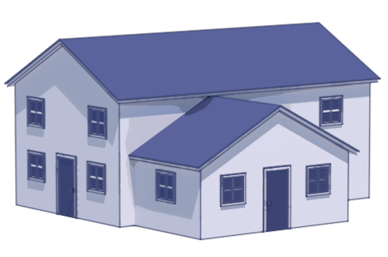
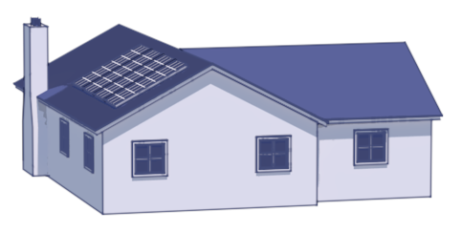
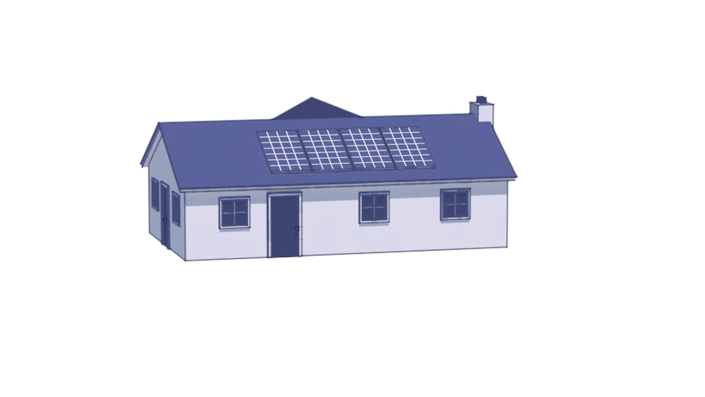



Neighborhood
CityLearn
Smart
Meter
Data
Building 1
Building 2
Building N
Building N
Systems Metadata
r_{t+1}
a_{t}
s_{t+1}
Agent
Agent
Agent
Agent
Deployment
Policy

Slide 3


Neighborhood
CityLearn
Smart
Meter
Data
r_{t+1}
a_{t}
s_{t+1}
Charge
/Discharge
Charge
/Discharge
Agent
Charge
/Discharge
Policy
Smart
Meter
Data
r_{t+1}
a_{t}
s_{t+1}
Agent
Charge
/Discharge
Charge
/Discharge
Charge
/Discharge
Policy

Slide 4
