Slide 1
LOGIN 360
MOHANPRASATH S

Slide 2
PROJECT TITTLE
TOPIC : SPOTIFY PLAYLIST ACCESS USING
WITH TERRAFORM CODE

Slide 3
RULES : -
TO RUN THE SPOTIFY PLAYLISTS
USING VS CODE
LOGIN YOUR SPOTIFY ACCOUNT
TO CREATE A APP TO CLICK IN YOUR SPOTIFY LOGIN ACOUNT
TO BASIC INFORMATION US TO FOLLOW US
ACCESS KEY & SECRTE KEY HELP US TO RUN THE CODE
RUN API KEY TO GENERATE

Slide 4
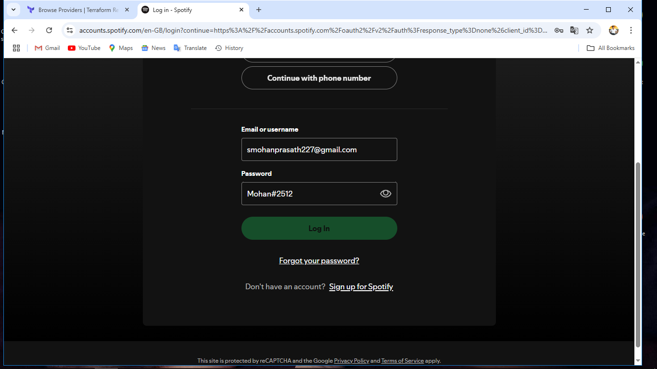
# LOGIN SPOTIFY ACCOUNT

Slide 5
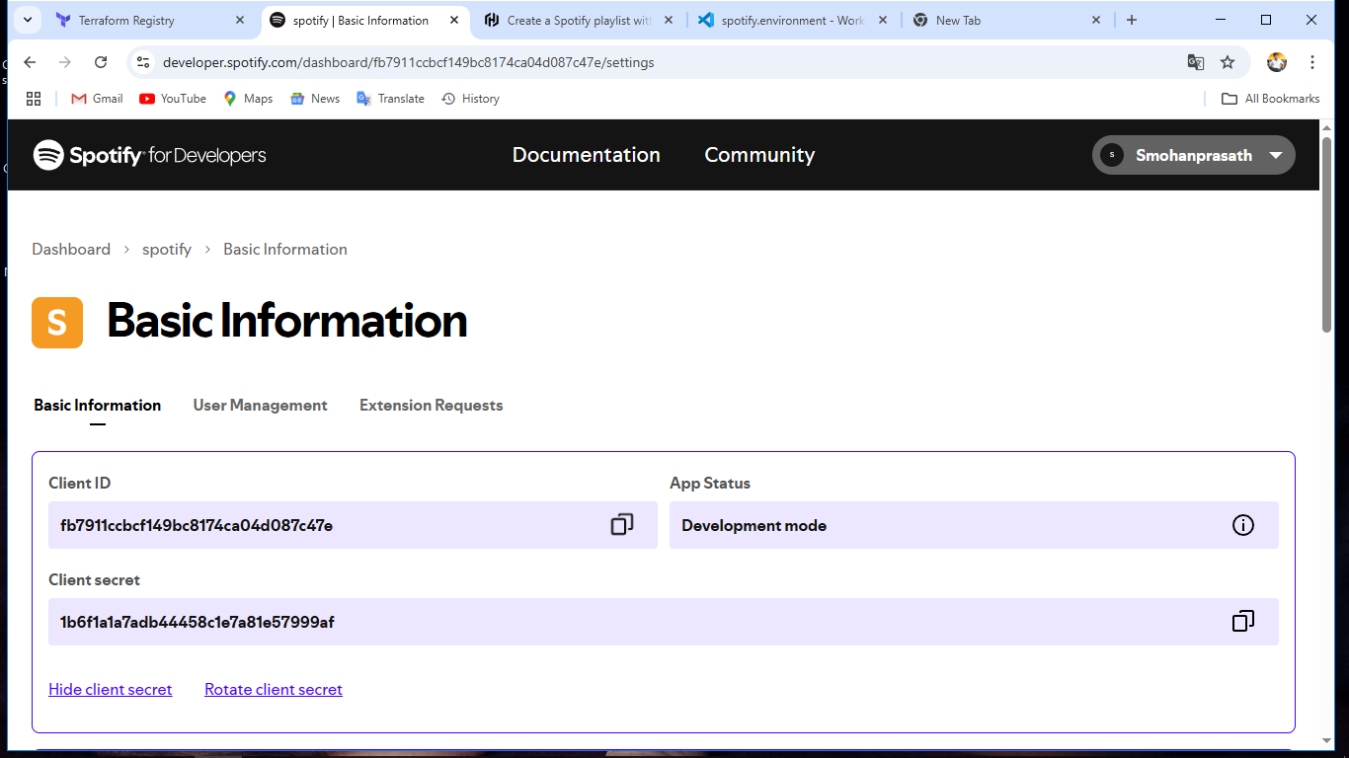
Access id && Client Secrete _ id

Slide 6
Visual Studio Code follow
main .tf file to create
variables.tf
.env file
terraform.tfvars
output.tf
all files in vs code

Slide 7
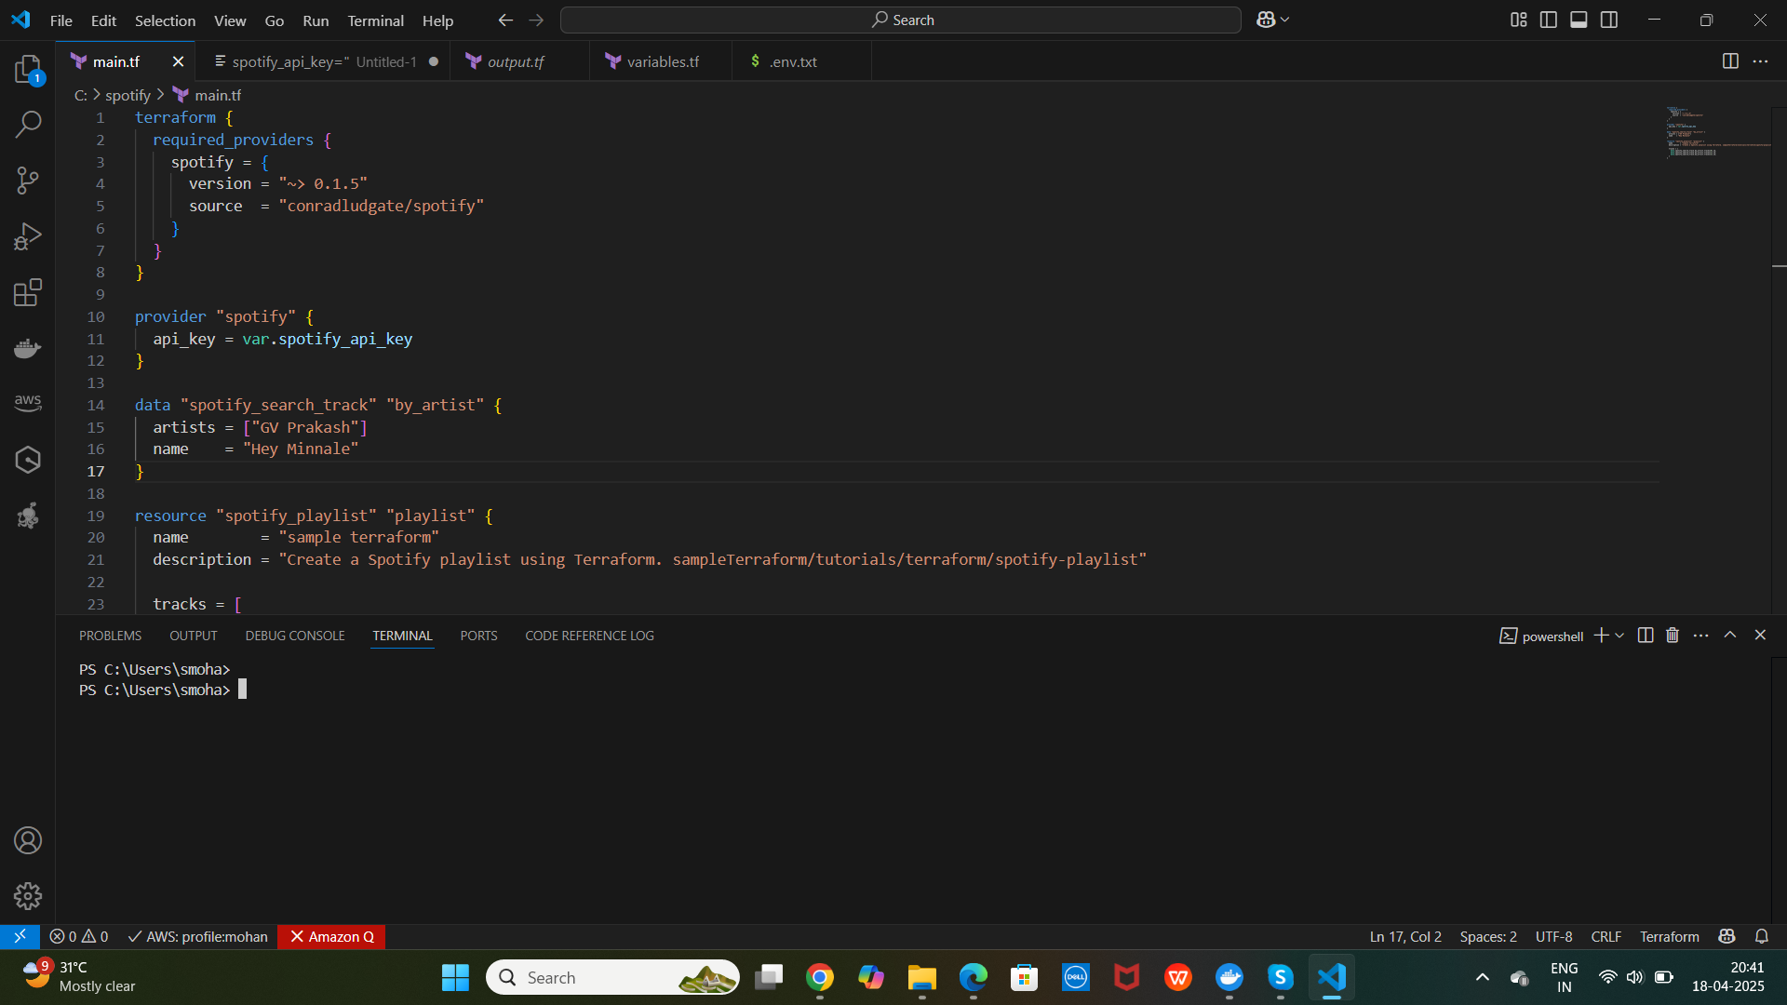
# main.tf (file)

Slide 8

# variables.tf

Slide 9

# output.tf

Slide 10
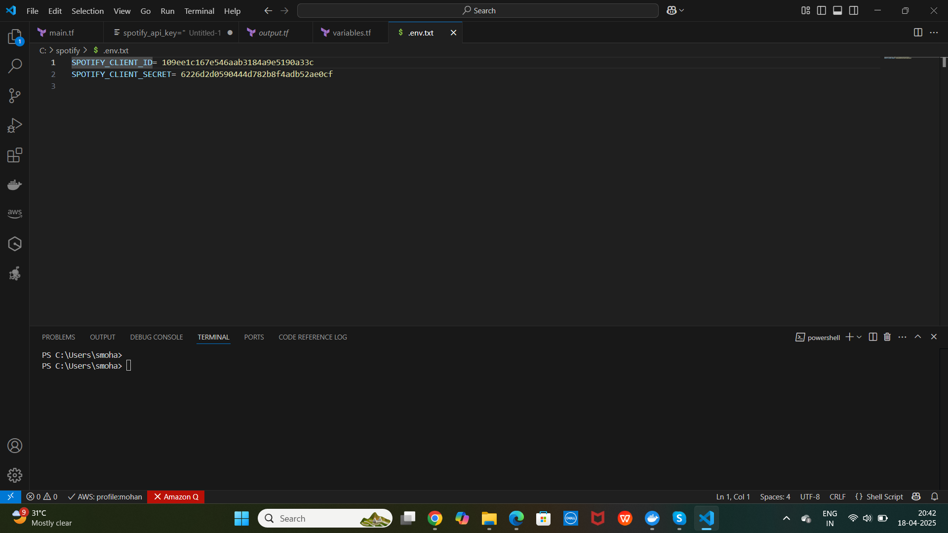
# .env file

Slide 11
API KEY GENERATE
docker run --rm -it -p 27228:27228 --env-file ./.env ghcr.io/conradludgate/spotify-auth-proxy
TO START THE DOCKER SERVER ON DESKTOP
TO RUN THE COMMANDS ON .ENV FILE ON VSCODE
TO BE SUCCESS SHOW [AUTHENTICATION URL] COPY TO YOUR BROWSER

Slide 12
# TERRAFORM COMMANDS
TERRAFORM INIT
TERRAFORM PLAN
TERRAFORM APPLY
SHOW OUTPUT COPY THE URL TO YOUR BROWSER

Slide 13
# OUTPUT
Outputs:
playlist_url = "https://open.spotify.com/playlist/40bGNifvqzwjO8gHDvhbB3"

Slide 14
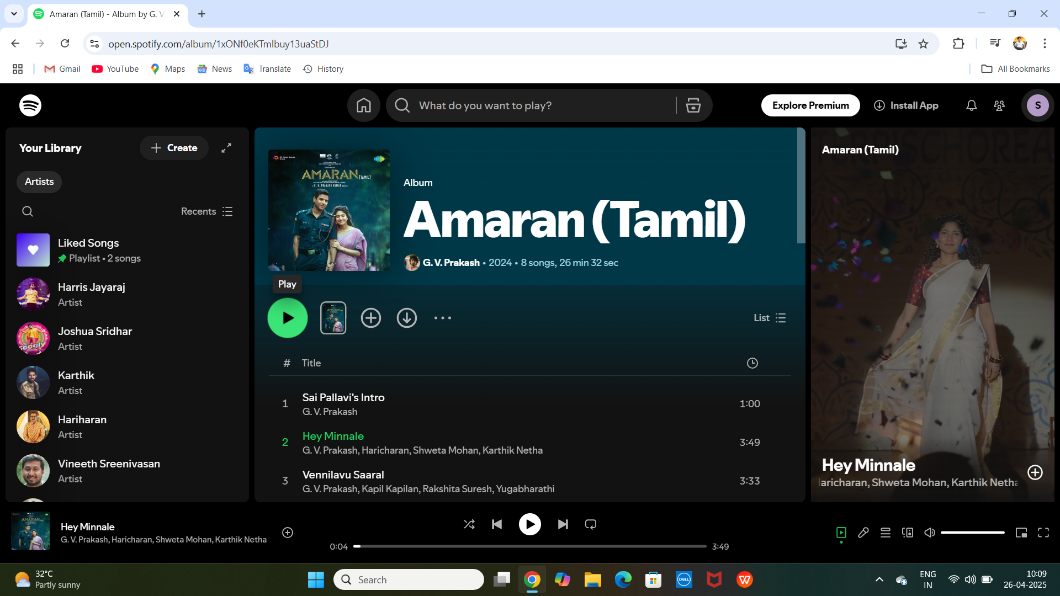
SHOW THE WEB PAGE PLAY THE SONG

