Slide 1
LOGIN 360
MOHANPRASATH S

Slide 2
RULES : -
TO RUN THE SPOTIFY PLAYLISTS
USING VS CODE
LOGIN YOUR SPOTIFY ACCOUNT
TO CREATE A APP TO CLICK IN YOUR SPOTIFY LOGIN ACOUNT
TO BASIC INFORMATION US TO FOLLOW US
ACCESS KEY & SECRTE KEY HELP US TO RUN THE CODE
RUN API KEY TO GENERATE

Slide 3
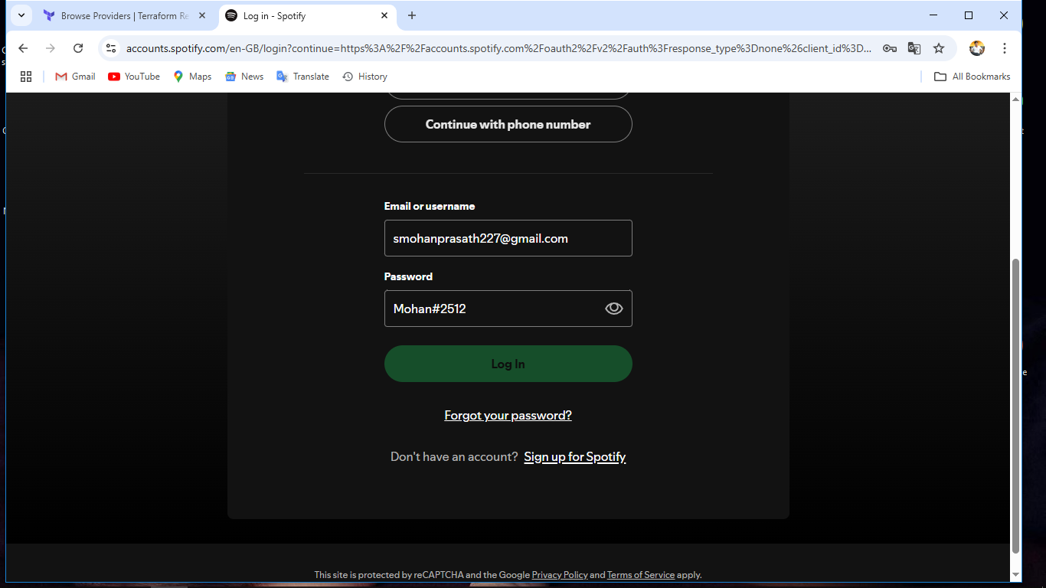
# LOGIN SPOTIFY ACCOUNT

Slide 4
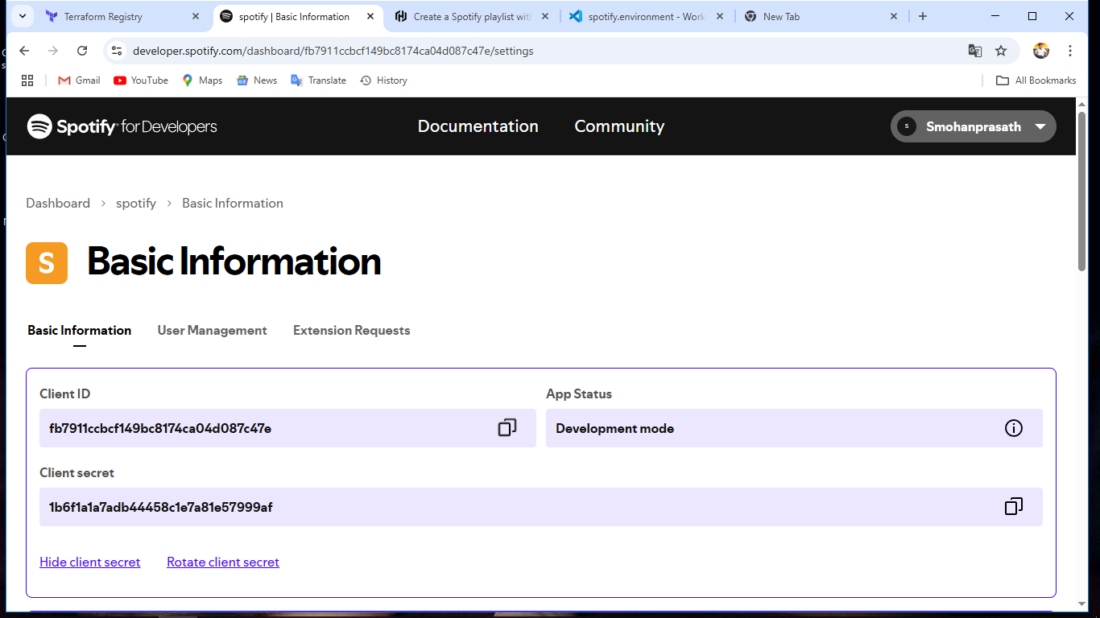
Access id && Client Secrete _ id

Slide 5
Visual Studio Code follow
main .tf file to create
variables.tf
.env file
terraform.tfvars
output.tf
all files in vs code

Slide 6
API KEY GENERATE
docker run --rm -it -p 27228:27228 --env-file ./.env ghcr.io/conradludgate/spotify-auth-proxy
TO START THE DOCKER SERVER ON DESKTOP
TO RUN THE COMMANDS ON .ENV FILE ON VSCODE
TO BE SUCCESS SHOW [AUTHENTICATION URL] COPY TO YOUR BROWSER

Slide 7
# TERRAFORM COMMANDS
TERRAFORM INIT
TERRAFORM PLAN
TERRAFORM APPLY
SHOW OUTPUT COPY THE URL TO YOUR BROWSER

Slide 8
# OUTPUT
Outputs:
playlist_url = "https://open.spotify.com/playlist/40bGNifvqzwjO8gHDvhbB3"

Slide 9
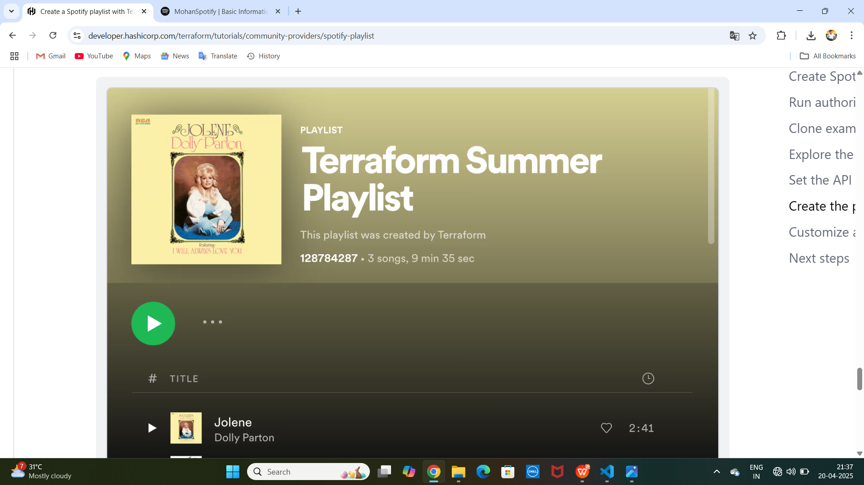
SHOW THE WEB PAGE PLAY THE SONG

