Slide 1
SPEECH-To-SPEECH TRANSLATOR
A Mini-Project by :
Harish P
Mohanragul G
Shevarthna M
Varsha K
Vinay Shrivatsan JT

Slide 2
INTRODUCTION
In a world with over 7,000 languages, communication across linguistic boundaries remains a challenge.
To overcome this challenge, a concept called Speech-to-speech arose which changed the entire scenario across the world to help people overcome the barriers set by their mother tongue.
Speech-to-speech translation is a powerful technology that allows spoken language in one tongue to be translated and spoken back in another — almost instantly.
By combining speech recognition, language translation, and text-to-speech synthesis, it enables real-time verbal communication between people who speak different languages.

Slide 3
PROBLEM STATEMENT
Pre-existing tools such as Google Translate, iTranslate Voice, Amazon Transcribe have been hugely helpful for the task of Speech-to-speech translation.
Inspired by the importance and the fascinating idea behind these tools, we aimed to create an application which would also serve to the people as a robust translation tool which could take any language as input and translate it to a different language according to the preference of the user.
The input can be given in 2 ways : Either it can be a pre existing recording which can be uploaded or the user can give a real time input using the Start Recording button.
Once the input is given, we can choose the Language to translate it to. For now, the current target languages that we have given are : [“Hindi”, “English”, “Tamil”, ”Spanish”, ”Japanese”, ”French”] .
The output will display the translated recording which suits the selected target language of the user.

Slide 4
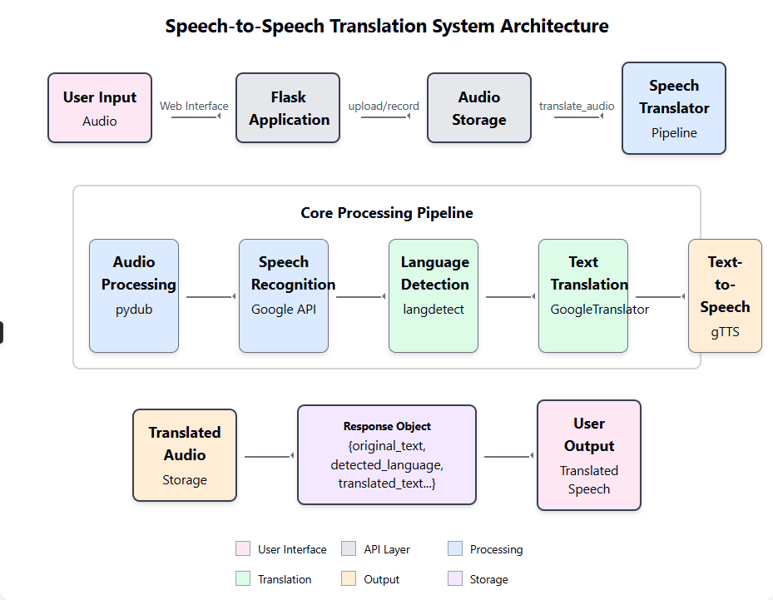
SYSTEM ARCHITECTURE

Slide 5
IMPLEMENTATION OVERVIEW
🎤 Audio Input
User uploads or records an audio file via the web interface.
Supported formats: WAV, MP3, OGG, FLAC, M4A.
🔁 Audio Conversion
pydub + ffmpeg used to convert audio to WAV format.
Ensures compatibility with the speech recognition engine.
🧠 Speech Recognition
Uses speech_recognition with Google Speech API.
Transcribes spoken audio into text.
Robust error handling for unclear or failed transcriptions.
🧭 Language Detection
langdetect automatically identifies the source language.
No need for manual input from the user.

Slide 6
BACKEND PROCESSING AND OUTPUT DELIVERY
5. 🌐 Translation Engine
Uses deep_translator.GoogleTranslator.
Automatically detects source language and translates to user-selected target language.
Supports dozens of language pairs.
6. 🗣️ Text-to-Speech Conversion
gTTS converts the translated text into natural-sounding speech.
Output is saved as an MP3 file, either temporarily or in a specified folder.
7. 🔄 Integration & Response
All modules are orchestrated through the process_speech() method.
Response includes:
Transcribed text
Detected language
Translated text
Target language
Translated speech file path
8. 💻 Frontend Interaction
Flask serves as the backend.
User sees translated audio and text in the browser.
Previous translations logged as session history.

Slide 7
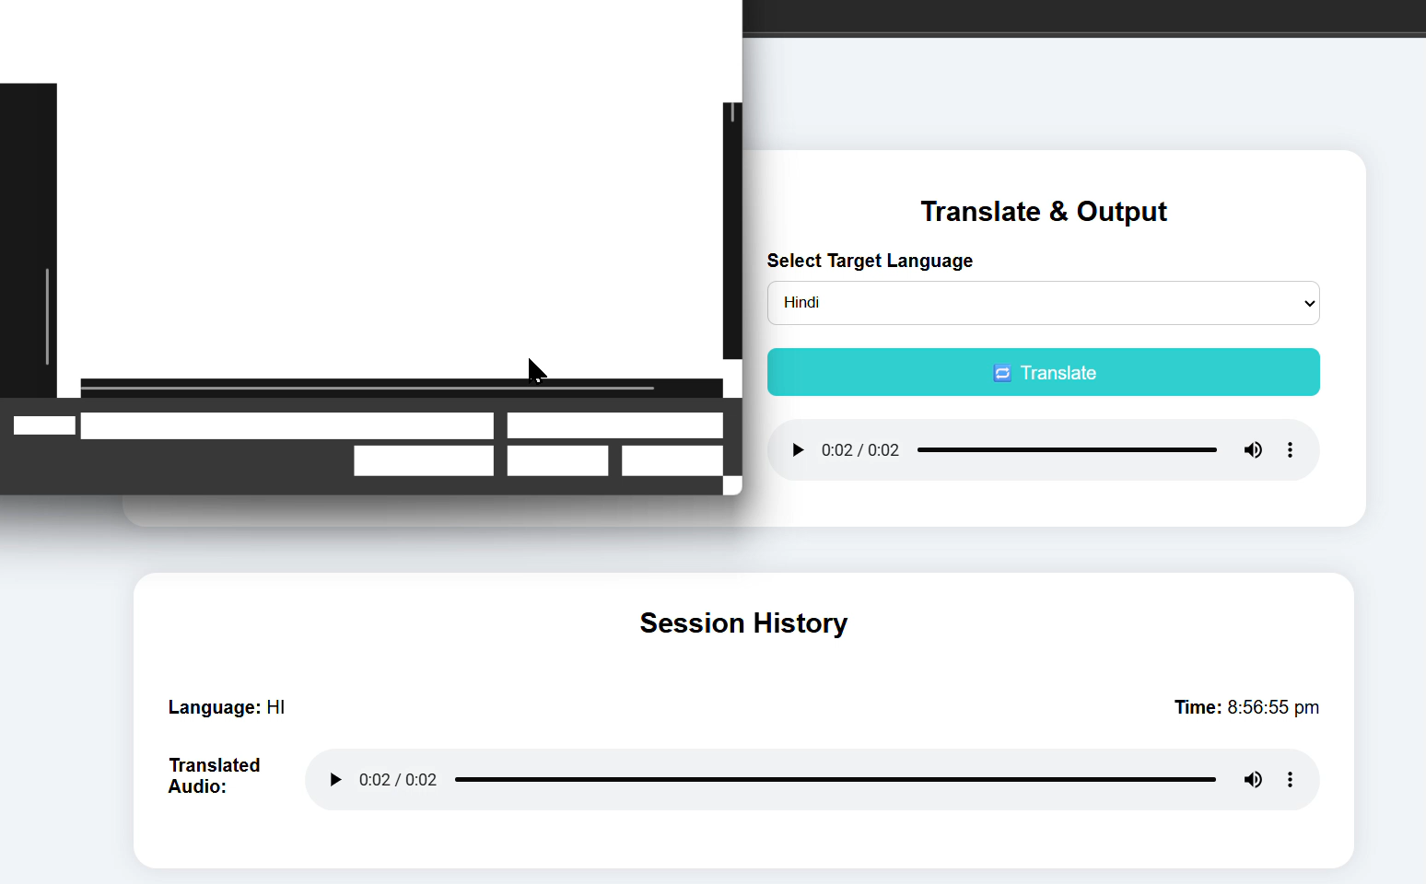
OUTPUT – USER UPLOAD

Slide 8
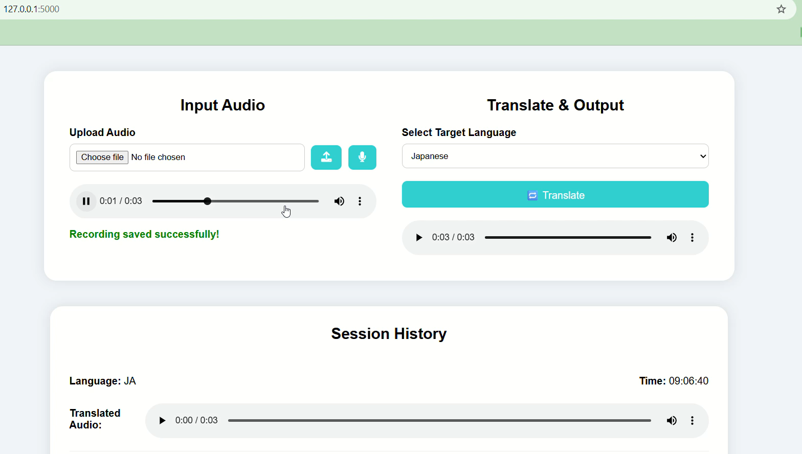
OUTPUT – REAL TIME INPUT

Slide 9
CONCLUSION
The Speech-to-Speech Translation System provides a seamless solution to bridge language gaps by combining cutting-edge technologies in a unified pipeline
Through efficient integration of speech recognition, language detection, machine translation, and text-to-speech synthesis, the system enables real-time, cross-lingual communication
This project showcases the practical potential of AI to foster inclusivity, global accessibility, and human-to-human understanding—empowering users to communicate effortlessly, regardless of the language they speak.

