Slide 1


ANDROID SURVEY APP
USING JETPACK COMPOSE
TEAM MEMBERS:
ARUNKUMAR. M - 715522243007
HARISH. P - 715522243019
MOHANRAGUL. G - 715522243030
VARSHA. K - 715522243058
VINAY SHRIVATSAN. J T - 715522243059

Slide 2
PROJECT OBJECTIVE
The objective of this project is to develop a user-friendly survey application using Android's Jetpack Compose framework.
This app will demonstrate effective UI design, efficient data management, and seamless user interaction.
It aims to provide users with a smooth experience for answering survey questions, while also showcasing text input, validation, and UI state management features of Jetpack Compose.
Demonstrate the use of declarative UI patterns in Jetpack Compose to simplify and streamline the development of interactive.
Ensure the survey app is accessible and responsive across different device types and screen sizes, following Android’s accessibility guidelines.

Slide 3
DESCRIPTION
This project is a Survey App built using Jetpack Compose, Android's modern UI toolkit, which allows developers to create dynamic, declarative UIs in a more intuitive way.
This sample app demonstrates key features of Android Compose, focusing on text input, validation, and UI state management.
The app allows users to respond to a series of survey questions, utilizing Compose’s flexible UI components to provide an engaging and user-friendly experience.
Users can register, log in, and navigate through the app seamlessly, with all data securely stored in a local database.
Input validation ensures the accuracy of responses, while UI state management guarantees smooth transitions between pages.
This project highlights best practices in UI design, data handling, and state management, making it an ideal starting point for developers looking to work with Android Compose in real-world applications.

Slide 4
FUNCTIONALITIES
User Registration and Login
Allows users to register and securely log in to the app.
Survey Question Input
Presents a series of questions to users in an easy-to-navigate interface, supporting text input fields for responses.
Validation
Implements validation checks to ensure required fields are filled in and input is in the correct format.
UI State Management
Manages UI state to ensure smooth transitions between different app states and screens.
Data Storage and Management
Stores user responses in a local database to ensure data persistence and allow the admin to access survey results.

Slide 5
ADDITIONAL REQUIREMENTS
Android Studio Setup:
Project setup in Android Studio with all necessary dependencies for Jetpack Compose.
Database Integration:
Integrate a local database (e.g., Room) for storing user responses.
Testing and Validation:
Ensure the app’s functionality through comprehensive testing of user input and state handling.
Documentation and User Guide:
Provide documentation for setting up and using the app, as well as a guide for extending the app with additional survey questions or data validation features.

Slide 6
CODE
AndroidManifest.xml
<?xml version="1.0" encoding="utf-8"?>
<manifest xmlns:android="http://schemas.android.com/apk/res/android"
xmlns:tools="http://schemas.android.com/tools">
<application
android:allowBackup="true"
android:dataExtractionRules="@xml/data_extraction_rules"
android:fullBackupContent="@xml/backup_rules"
android:icon="@mipmap/ic_launcher"
android:label="@string/app_name"
android:roundIcon="@mipmap/ic_launcher_round"
android:supportsRtl="true"
android:theme="@style/Theme.Jetsurvey"
tools:targetApi="31">
</manifest>
<activity
android:name=".MainActivity"
android:exported="true"
android:label="@string/app_name"
android:theme="@style/Theme.Jetsurvey">
<intent-filter>
<action android:name="android.intent.action.MAIN" />
<category android:name="android.intent.category.LAUNCHER" />
</intent-filter>
</activity>
<provider
android:name="androidx.core.content.FileProvider"
android:authorities="${applicationId}.fileprovider"
android:grantUriPermissions="true"
android:exported="false">
<meta-data
android:name="android.support.FILE_PROVIDER_PATHS"
android:resource="@xml/filepaths" />
</provider>
</application>
</manifest>

Slide 7
CODE
MainActivity.kt
package com.manasmalla.jetsurvey
import android.os.Bundle
import androidx.activity.compose.setContent
import androidx.appcompat.app.AppCompatActivity
import androidx.compose.foundation.layout.fillMaxSize
import androidx.compose.material3.MaterialTheme
import androidx.compose.material3.Surface
import androidx.compose.ui.Modifier
import androidx.core.view.WindowCompat
import com.manasmalla.jetsurvey.ui.JetsurveyApp
import com.manasmalla.jetsurvey.ui.theme.JetsurveyTheme
class MainActivity : AppCompatActivity() {
override fun onCreate(savedInstanceState: Bundle?) {
super.onCreate(savedInstanceState)
setContent {
WindowCompat.setDecorFitsSystemWindows(window, false)
JetsurveyTheme {
// A surface container using the 'background' color from the theme
Surface(
modifier = Modifier.fillMaxSize(),
color = MaterialTheme.colorScheme.background
) {
JetsurveyApp()
}
}
}
}
}

Slide 8
CODE
Questions.kt
package com.manasmalla.jetsurvey.data
import com.manasmalla.jetsurvey.R
val questions = listOf(
SurveyQuestion(
question = "In my free time I like to ...",
description = "Select all that apply.",
Options.MultipleChoice(
options = listOf(
"Read", "Work out", "Draw",
"Play video games", "Dance", "Watch Movies"
)
)
),
SurveyQuestion(
question = "Pick a Compose comic character",
description = "Select one.",
options = Options.SingleChoice(options = mapOf(
"Spark" to R.drawable.spark,
"Lenz" to R.drawable.lenz, "Frag" to R.drawable.frag
"Bug of Chaos" to R.drawable.bug_of_chaos,
))
),
SurveyQuestion(
question = "When was the last time you ordered takeaway because you couldn't be bothered to cook?",
description = "Select date.",
options = Options.DateChoice
),
SurveyQuestion(
question = "How do you feel about selfies?",
options = Options.SliderChoice(sliderOptions = listOf(
"Strongly Dislike", "Neutral", "Strongly Like"
))
),
SurveyQuestion(question = "Show off your selfie skills!", options = Options.ImageChoice))

Slide 9
CODE
SliderChoice.kt
package com.manasmalla.jetsurvey.ui.survey
import androidx.compose.foundation.layout.Arrangement
import androidx.compose.foundation.layout.Column
import androidx.compose.foundation.layout.Row
import androidx.compose.foundation.layout.fillMaxWidth
import androidx.compose.material3.MaterialTheme
import androidx.compose.material3.Slider
import androidx.compose.material3.Text
import androidx.compose.runtime.Composable
import androidx.compose.ui.Modifier
import androidx.compose.ui.text.style.TextAlign
import androidx.compose.ui.tooling.preview.Preview
import com.manasmalla.jetsurvey.data.Options
import com.manasmalla.jetsurvey.data.questions
import com.manasmalla.jetsurvey.ui.theme.JetsurveyTheme
@Composable
fun SliderChoice(value: Float = 0.5f, onValueChange: (Float)->Unit = {},
options: Options.SliderChoice, modifier: Modifier = Modifier) {
Column(modifier = modifier) {
Slider(value = value, onValueChange = onValueChange, steps = 3)
Row(modifier = Modifier.fillMaxWidth(), horizontalArrangement = Arrangement.SpaceBetween) {
options.sliderOptions.forEach {
Text(it, style = MaterialTheme.typography.labelSmall, textAlign = TextAlign.Center)
}
}
}
}
@Preview(showBackground = true)
@Composable
fun SliderChoicePreview() {
JetsurveyTheme {
SliderChoice(options = questions[3].options as Options.SliderChoice)
}
}

Slide 10
CODE
DateQuestion.kt
package com.manasmalla.jetsurvey.ui.survey
import android.content.res.Configuration
import androidx.compose.foundation.BorderStroke
import androidx.compose.foundation.layout.padding
import androidx.compose.material.icons.Icons
import androidx.compose.material.icons.rounded.ArrowDropDown
import androidx.compose.material3.ButtonDefaults
import androidx.compose.material3.Icon
import androidx.compose.material3.MaterialTheme
import androidx.compose.material3.OutlinedButton
import androidx.compose.material3.Text
import androidx.compose.runtime.Composable
import androidx.compose.ui.Modifier
import androidx.compose.ui.tooling.preview.Preview
import androidx.compose.ui.unit.dp
import com.manasmalla.jetsurvey.ui.theme.JetsurveyTheme
import com.manasmalla.jetsurvey.ui.theme.slightlyDeemphasizedAlpha
@Composable
fun DateQuestion(date: String, showDatePicker: () -> Unit = {}) {
OutlinedButton(
onClick = showDatePicker,
shape = MaterialTheme.shapes.small,
colors = ButtonDefaults.outlinedButtonColors(
contentColor = MaterialTheme.colorScheme.onSurface.copy(
slightlyDeemphasizedAlpha
)),
border = BorderStroke(1.dp, MaterialTheme.colorScheme.outline.copy(0.12f)),
modifier = Modifier.padding(16.dp)
) {
Text(text = date, modifier = Modifier
.weight(1f).padding(vertical = 16.dp),)
Icon(imageVector = Icons.Rounded.ArrowDropDown, contentDescription = "Expand")
}
}

Slide 11
CODE
FileQuestion.kt
@Composable
fun FileQuestion(modifier: Modifier = Modifier, imageUri: Uri? = null, onImageSelected: (Uri)->Unit = {}) {
val cameraLauncher = rememberLauncherForActivityResult(
contract = ActivityResultContracts.PickVisualMedia(),
onResult = { uri ->uri?.let { onImageSelected(it)}}
)
val context = LocalContext.current
Column(
modifier = modifier.aspectRatio(1f).border(
1.dp,
MaterialTheme.colorScheme.outline,
shape = MaterialTheme.shapes.small
)
.clickable { cameraLauncher.launch(PickVisualMediaRequest(ActivityResultContracts.PickVisualMedia.ImageOnly))
}
.padding(24.dp), horizontalAlignment = Alignment.CenterHorizontally
) {
if (imageUri != null) AsyncImage(
model = ImageRequest.Builder(LocalContext.current)
.data(imageUri).crossfade(true).build(),
contentDescription = null,
modifier = Modifier
.weight(1f).padding(24.dp).fillMaxSize().aspectRatio(1.2f)
.wrapContentSize(Alignment.Center
).clip(MaterialTheme.shapes.small), contentScale = ContentScale.Crop
) else
Image(
painterResource(id = R.drawable.ic_selfie_light),
contentDescription = "Add a selfie",
modifier = Modifier.weight(1f).fillMaxSize().wrapContentSize(
Alignment.Center)
)

Slide 12
CODE
FileQuestion.kt
@Composable
fun MultipleOptionsSection(
options: Options.MultipleChoice,
selectedOptions: MutableList<String>,
onOptionSelected: () -> Unit = {}
) {
options.options.forEach { option -> key(option) {
CheckboxRow(title = option, selected = selectedOptions.contains(option), onOptionSelected = {
if(selectedOptions.contains(option)) selectedOptions.remove(option) else selectedOptions.add(option)
onOptionSelected()
})}}
}
@Preview(showBackground = true)
@Composable
fun CheckboxRow(title: String = "Checbox Title", selected: Boolean = false, onOptionSelected: () -> Unit = {}) {
Surface(
modifier = Modifier .fillMaxWidth().padding(horizontal = 16.dp, vertical = 8.dp).clickable(onClick = onOptionSelected),
shape = MaterialTheme.shapes.small,
border = BorderStroke(
1.dp, if (selected) MaterialTheme.colorScheme.primary else MaterialTheme.colorScheme.outline),
color = if (selected) MaterialTheme.colorScheme.primaryContainer else MaterialTheme.colorScheme.surface
) {
Row(modifier = Modifier.fillMaxWidth().padding(16.dp),
verticalAlignment = Alignment.CenterVertically,
horizontalArrangement = Arrangement.SpaceBetween
) {
Text(text = title)
Checkbox(checked = selected,modifier = Modifier.padding(8.dp),
onCheckedChange = null)}
}
}

Slide 13
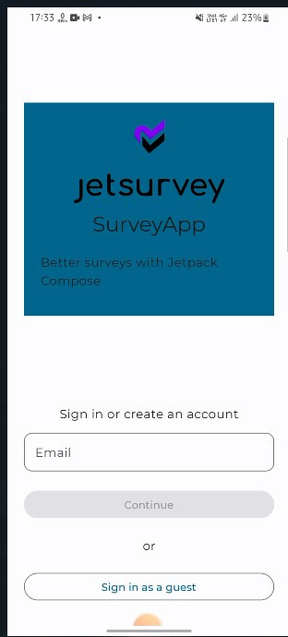
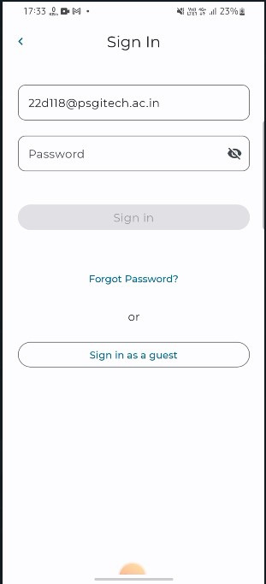
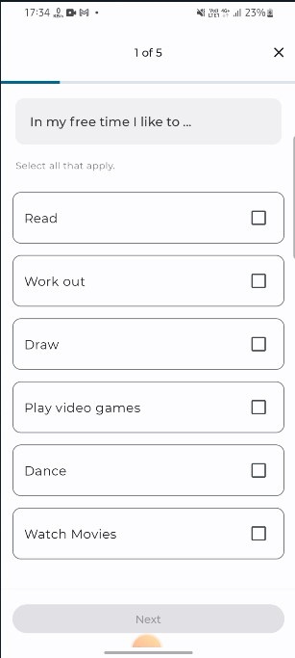
OUTPUT - SCREENSHOTS

Slide 14
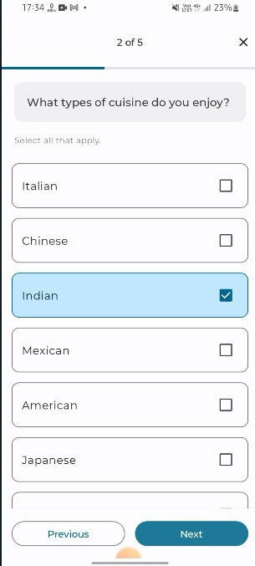
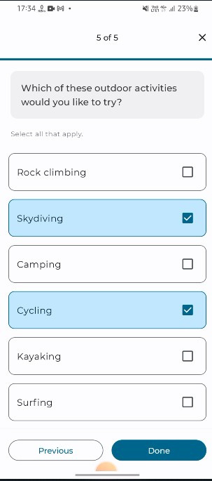
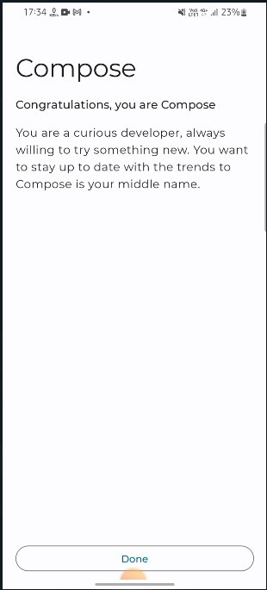
OUTPUT - SCREENSHOTS

