Slide 1






AIRLINE CUSTOMER SUPPORT BOT
THAT AI TEAM
Barathgiri C S
Mohanragul G
Karthikeyan S
Shevarthna M

Slide 2
PROBLEM DEFINITON
Identify customer request type early in interaction.
Classify customer utterance into predefined request categories. Enable confirmation feedback loop for improved accuracy.
Key Challenges:
Misclassification handling
Continuous learning from errors
Real-time performance (low latency)

Slide 3
OBJECTIVES
Automatically classify customer messages into request categories.
Reduce manual intervention.
Implement feedback-based model improvement.
Ensure fast response (low latency).
Maintain a database of incorrect classifications for retraining.

Slide 4
MODEL AND TRAINING PIPELINE
Model Used: DistilBERT
(lightweight transformer for text classification)
Training Data: Synthetic Customer chat transcripts categorized by request type.
Steps:
Data Preprocessing
Fine-tuning DistilBERT
Model Evaluation
Continuous retraining from incorrect classifications

Slide 5
CONFIRMATION MODULE LOGIC
Confidence LevelAction from Model
High (≥ Threshold)
Confirm top prediction with the user
Medium
Show the top 2 predictions for user confirmation
Low (≤ Threshold)
Mark as irrelevant → Restructure → Loop once
Human Intervention
Used when confirmation fails or is uncertain

Slide 6
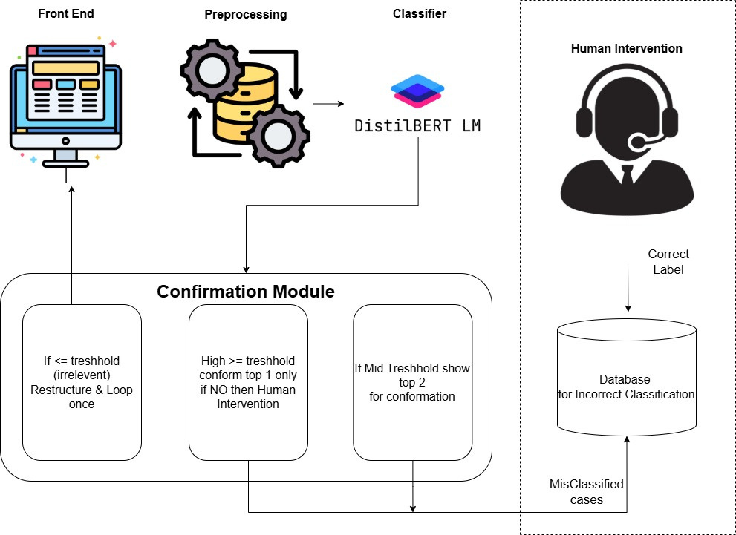
SYSTEM ARCHITECTURE

Slide 7
CONTINUOUS IMPROVEMENT LOOP
Human feedback integrated into the learning process
Incorrect prediction case and its correct label from human feedback → stored in the database
Periodic retraining improves accuracy
Continuous monitoring via performance metrics

Slide 8
EVALUATION METRICS
Accuracy – Overall correct classifications
Precision / Recall / F1 Score – For each request category
Latency – Time from input to response
User Feedback Accuracy – Agreement rate between bot and user

Slide 9
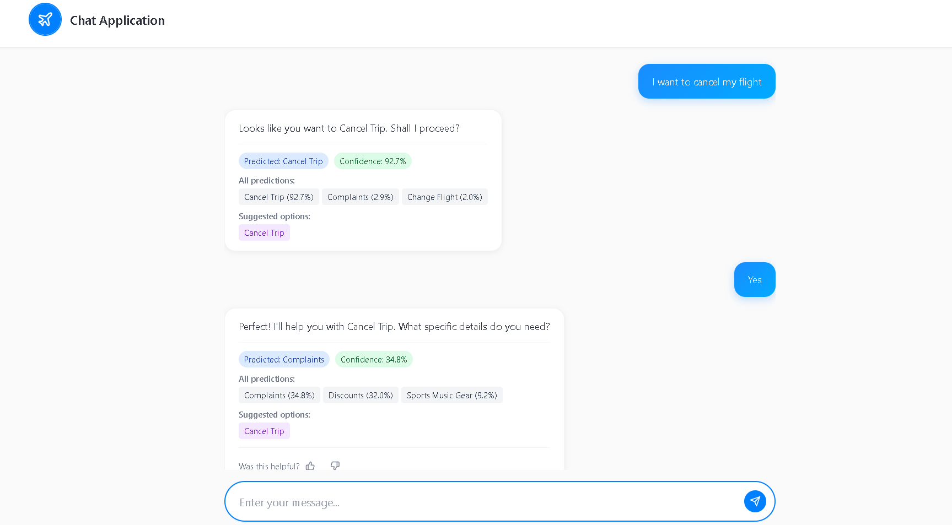
APPLICATION

Slide 10
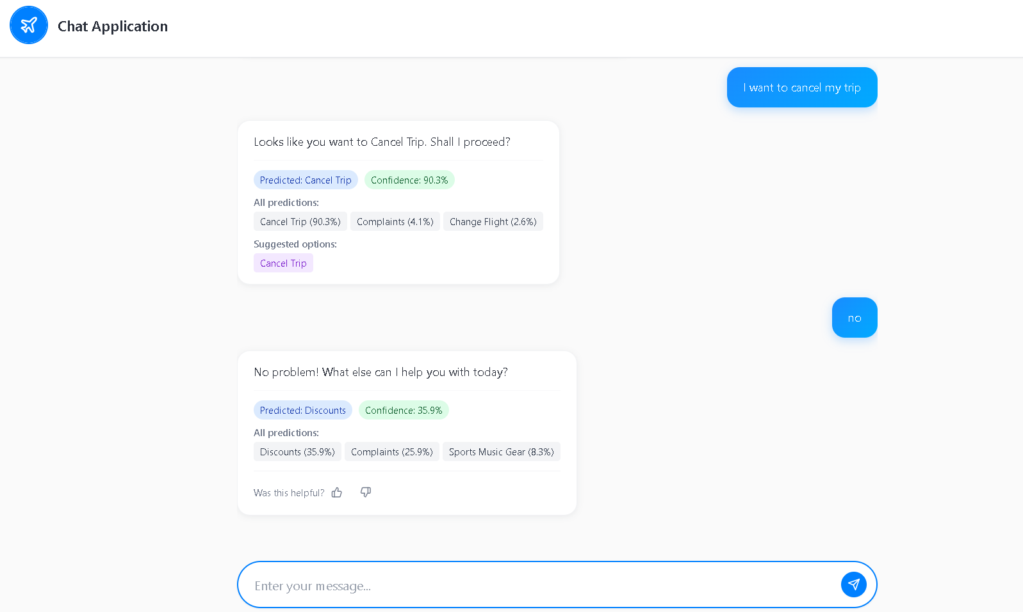
APPLICATION

Slide 11
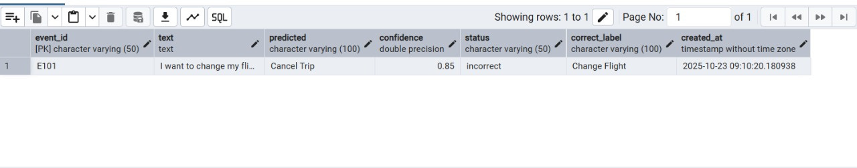
RETRAINING DATABASE

Slide 12
CONCLUSION
Our Airline Customer Support Bot successfully automates the classification of customer requests using a lightweight DistilBERT model, ensuring fast and accurate intent recognition.
By integrating a confirmation feedback loop and continuous learning pipeline, the system improves with each interaction, reducing human intervention and enhancing customer satisfaction.
The model achieves low latency while maintaining strong precision and recall across categories, demonstrating its suitability for real-time airline customer service.

