Slide 1
Predicting Apple Vision Pro Sales for the Next Year
Project-0
An Analysis Using Python and Machine Learning
Project by:
Anuvalu Mohan sai

Slide 2
OBjective of Project
Project-0
The main goal of this project is to predict the sales of the Apple Vision Pro headset for the upcoming year by analyzing historical sales data. The prediction will help in understanding future demand and assist in making informed decisions regarding inventory management, marketing strategies, and overall business planning
Importance of Sales Prediction in Business
Sales prediction is essential in business for making informed decisions and optimizing operations. Accurate forecasts help manage inventory, plan finances, and streamline supply chains. They guide marketing strategies, ensure efficient resource allocation, and enhance customer satisfaction. Sales predictions also aid in risk management, strategic decision-making, and performance evaluation. Additionally, they build investor confidence by demonstrating the company's growth potential. Overall, sales prediction is a vital tool for maintaining competitiveness and driving business success.

Slide 3
Python Libraries used
Project-0
Pandas: Data manipulation and analysis
2. NumPy: Numerical operations
3. Matplotlib: Plotting graphs and charts
4. Seaborn: Advanced data visualization
5. Scikit-learn: Machine learning algorithms and model evaluation
6.Fast- Api:

Slide 4
S T E P s
Project-0
STEP 1 | Data Preprocessing
STEP 2 | Data Visualization
STEP 3 | Machine Learning Model
STEP 4 | Future Sales Prediction

Slide 5

01- Data Preprocessing
Project-0
Loading the data using 'pandas'
Converting 'Date' to DateTime format
Extracting 'Month' and 'Year' from the 'Date' column
Selecting relevant columns for prediction

Slide 6
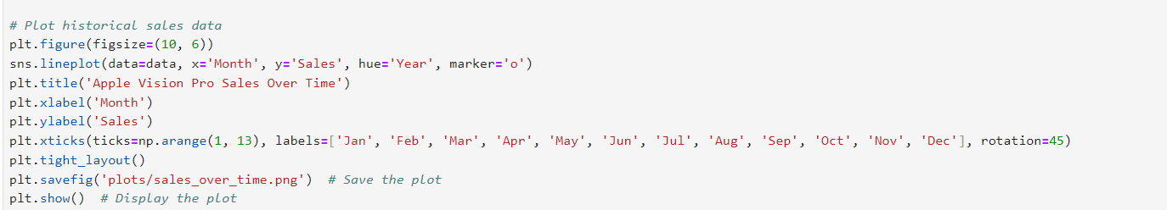
STEP – 02 Data Visualization
Project-0
Data visualization is the graphical representation of information and data using visual elements like charts, graphs, and maps. It provides a way to see and understand trends, patterns, and outliers in data by transforming complex datasets into intuitive, visual formats. This helps in better decision-making, making data more accessible, and revealing insights that might be missed in raw data. Data visualization is crucial in communicating data-driven insights clearly and effectively.
# Historical Sales Data Visualization, Plotting historical sales over time,
Using seaborn for line plots

Slide 7
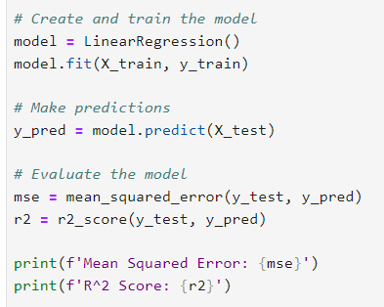
Step -03 Machine Learning
Project-0
Model Selection
Linear Regression is a statistical method used to model the relationship between a dependent variable and one or more independent variables. The goal is to find the linear equation that best predicts the dependent variable based on the independent variables.
Why Linear Regression?
Simplicity and Interpretability
Continuous Data
Baseline Model
Data Size and Complexity
Avoiding Overfitting
Ease of Implementation
Process
Splitting data into training and testing sets
Training the model on historical data
Evaluating model performance using metrics like Mean Squared Error (MSE) and R² Score

Slide 8
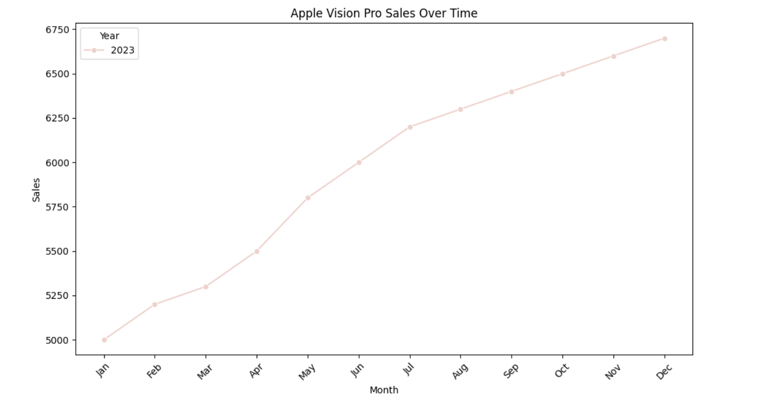
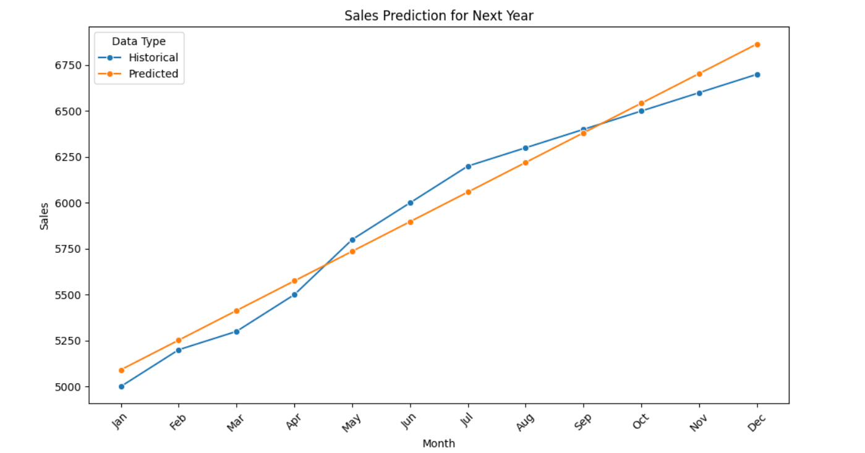
Step -04 Future Sales Prediction
The main goal of the future sales prediction in this project is to estimate the sales of the Apple Vision Pro for the upcoming period. By understanding past sales trends, we can make informed predictions about future sales, helping businesses make strategic decisions regarding production, inventory, marketing, and financial planning.
Apple Vision Pro 2023 Sales
Apple Vision Pro 2024 Sales

Slide 9
1. Informed Decision-making 2. Cost Efficiency 3. Simplicity And Ease Of Implementation 4. Visualization Of Trends 5. Scalability
Advantages
Disadvantage
Model Limitations
Sensitivity To Outliers
External Factors Not Considered
Limited To Historical Data
Static Assumptions

Slide 10
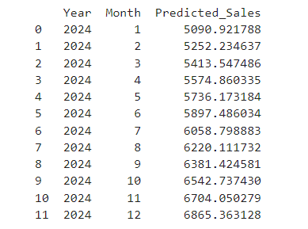
Conclusion and Future Work
Project-0
This project focuses on predicting future sales for a product, specifically the Apple Vision Pro, using linear regression. By leveraging historical sales data, the project aims to provide businesses with valuable insights into future sales trends, enabling better decision-making for inventory management, production planning, and budgeting.
Key Aspects of the Project
Data Collection and Processing
Data Visualization
Linear Regression Model
Sales Prediction
# 2024 Apple Vision Pro Predicted values

Slide 11
Thank
Project-0
YOU

