Slide 1

EvalTutor – AI-Powered
Multilingual Tutoring Evaluation
Platform
B.Tech Final Year Project Presentation | Academic Year 2025–2026
Student Details
Institutional Details
• Student Name: [MOHAN T]
• Register Number: [710024243701]
• Department: [B.tech- AI & DS]
• College Name: [ANNA UNIVERSITY REGIONAL CAMPUS]
• Guide: [Dr.Marikannu]
• Academic Year: 2025–2026

Slide 2
The Problem: AI Tutors Are Unmonitored & Unreliable
AI tutors now serve millions of students globally — yet there is zero pedagogical oversight on the content they generate. The consequences are serious and growing.
🚀 Explosive AI Adoption
🧠 Hallucinations Are Rampant
AI tutors serve millions of students globally, yet response quality remains entirely unchecked and unmonitored.
LLMs confidently generate incorrect facts, misleading students during critical learning phases with no warning.
⚠️ Dangerous Dependency
🌐 Language Barrier
Students copy AI answers without understanding — directly undermining conceptual learning and critical thinking.
Most AI tutors operate only in English, excluding 1.5 billion+ regional-language learners worldwide.
🔍 No Evaluation Layer
✅ EvalTutor Fills the Gap
There is currently zero pedagogical oversight or quality scoring on AI-generated tutoring content.
A real-time evaluation platform that monitors, scores, and continuously improves AI tutoring quality.

Slide 3
Objectives
EvalTutor is designed around five core objectives that together create a comprehensive, trustworthy AI tutoring ecosystem.
🛡️ Monitor AI Quality
🚩 Detect Hallucinations
🎯 Measure Dependency
Score every AI response for pedagogical accuracy, clarity, and educational value on a 0–100 scale.
Flag responses with high hallucination risk before students act on potentially incorrect information.
Track over-reliance on AI answers versus independent reasoning to promote genuine learning.
🌐 Multilingual Support
📈 Analytics Dashboard
Enable seamless tutoring in regional languages via automatic language detection and translation.
Provide students and educators with real-time learning insights, progress metrics, and weak topic identification.

Slide 4

How EvalTutor Works: End-to-End Workflow
A seamless 7-step pipeline transforms a student's question — in any language — into an evaluated, scored, and translated AI tutoring response delivered in real time.
Each step is automated and executes in milliseconds — the student experiences a seamless, real-time tutoring interaction while the evaluation engine works silently in the background to score every response.

Slide 5
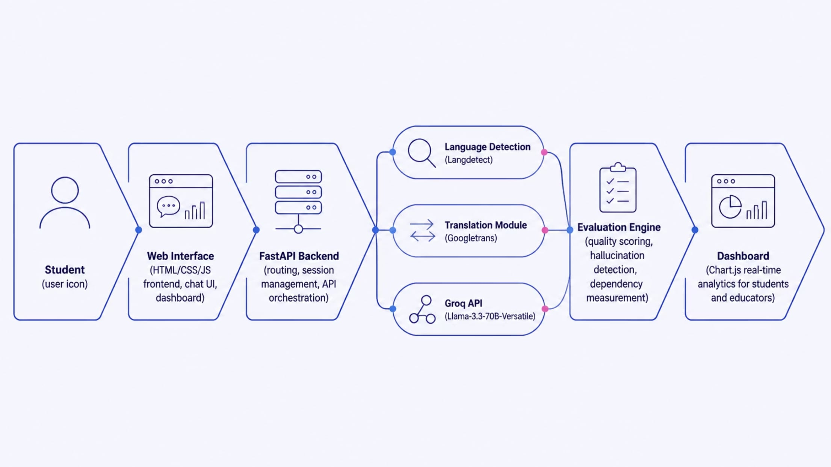
System Architecture
EvalTutor's architecture is modular and layered — each component is independently scalable and communicates through a FastAPI orchestration backbone.
Core Processing Modules
Evaluation & Output Layer
• Langdetect: Identifies input language in milliseconds
• Googletrans: Bridges regional languages ↔ English
• Groq Llama-3.3-70B: Generates pedagogically structured responses
• Evaluation Engine: Scores quality, detects hallucinations, measures dependency
• Dashboard: Chart.js-powered real-time analytics
• FastAPI: Handles all routing and session management

Slide 6
Technologies Used
EvalTutor is built on a modern, lightweight, and high-performance technology stack — each layer chosen for speed, accuracy, and developer productivity.
Layer Technology
Frontend HTML, CSS, JavaScript
Backend FastAPI, Python
AI Model Groq Llama-3.3-70B-Versatile
Translation Googletrans, Langdetect
Charts Chart.js
Prompt Engineering Structured JSON & Markdown
⚡ Ultra-Fast Inference
Groq's hardware-accelerated API delivers AI responses in milliseconds — enabling truly real-time tutoring interactions.
🐍 Python-First Stack
FastAPI and Python provide a clean, async-ready backend that integrates seamlessly with all AI and translation modules.
📊 Live Visualization
Chart.js renders dynamic, real-time analytics charts on the student dashboard after every single interaction.

Slide 7
Key Features
Seven tightly integrated features make EvalTutor a complete, end-to-end AI tutoring quality platform — not just a chatbot wrapper.
⚡ Live AI Chat
🌐 Multilingual Support
📊 Pedagogical Evaluation
Real-time tutoring powered by Groq's ultra-fast inference API with structured educational responses.
Auto-detects and responds in the student's native language — inclusive for 1.5B+ regional learners.
Every response scored against educational quality standards on a 0–100 scale in real time.
🚨 Hallucination Detection
🔗 Dependency Tracking
📈 Student Dashboard
Flags factually risky AI responses (Low / Medium / High) before they mislead students.
Monitors how often students rely on AI versus thinking independently — promoting genuine learning.
Personalized view of quality scores, weak topics, and learning progress over time.
🔄 Real-Time Analytics
Live charts and metrics updated after every single interaction using Chart.js visualizations.

Slide 8
Working Methodology: 10-Step Process
From question submission to dashboard update — EvalTutor's complete processing pipeline executes automatically in under two seconds per interaction.
01 Student Submits Question
Student types a question in any language via the chat interface.
02 Language Identification
Langdetect identifies the input language automatically.
03 Query Translation
Googletrans translates the query to English for AI processing.
04 AI Response Generation
Groq Llama-3.3 generates a structured, pedagogically sound AI response.
05 Response Translation Back
Response is translated back to the student's native language.
06 Evaluation Engine Analysis
Evaluation Engine analyzes response quality across multiple dimensions.
07 Quality Score Calculated
Quality Score is computed on a 0–100 scale using a multi-dimensional rubric.
08 Hallucination Risk Flagged
Hallucination Risk is classified as Low, Medium, or High per response.
09 Dependency Level Logged
Dependency Level is measured and recorded for the session.
10 Dashboard Updated
All metrics are pushed to the student dashboard in real time via Chart.js.

Slide 9
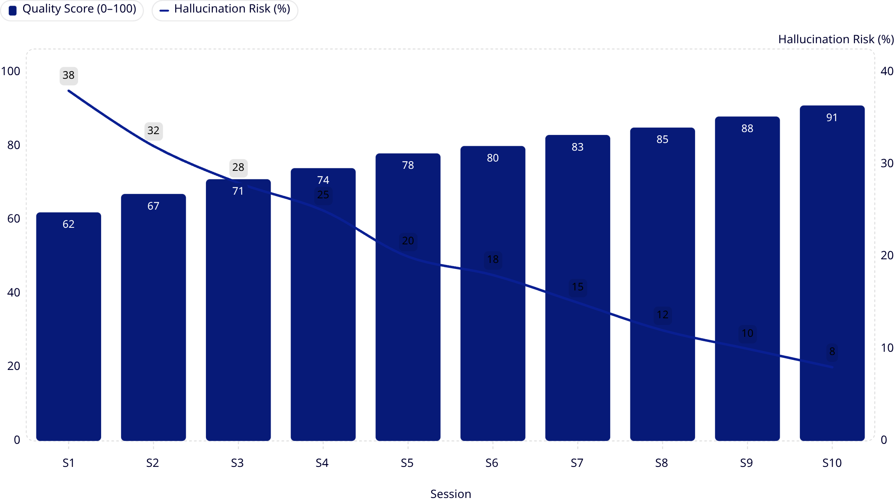
Results & Dashboard Insights
Across 10 sessions, EvalTutor demonstrates a clear and consistent improvement in AI tutoring quality — with Quality Scores rising from 62 → 91 and Hallucination Risk dropping from 38% → 8% as students engage more deeply with the platform.
91
Peak Quality Score
Achieved by Session 10 on the 0-100 scale.
8%
Hallucination Risk
Reduced from 38% at Session 1 (79% drop).
3
Evaluation Dimensions
Quality Score, Hallucination Risk, Dependency.

Slide 10
Challenges Faced & Solutions Implemented
Four significant engineering challenges were encountered and resolved during development — each solution strengthening the platform's robustness and accuracy.
Challenge Solution Implemented
Groq model deprecation mid-development Migrated to Llama-3.3-70B-Versatile — faster and more accurate than the deprecated model.
Translation accuracy for technical terms English-first middleware layer with context-aware prompts to preserve technical terminology.
Poor AI response formatting Prompt engineering with structured Markdown and JSON output templates for consistent formatting.
Measuring educational quality objectively AI-based evaluation engine with a multi-dimensional scoring rubric covering accuracy, clarity, and depth.
💡 Each challenge encountered during development directly informed a stronger, more production-ready architecture — making EvalTutor more resilient and accurate than originally designed.

Slide 11
Advantages & Future Scope
✅ Current Advantages
🚀 Future Scope
• Improves AI tutoring quality with real-time evaluation after every response.
• Detects and flags hallucinations before they mislead students.
• Encourages conceptual learning over answer copying.
• Reduces unhealthy student dependency on AI.
• Supports regional languages — inclusive for all learners.
• Provides actionable learning analytics for educators.
→ Voice-Based Tutoring — Speech-to-text integration for hands-free learning.
→ OCR Support — Handwritten question input via optical character recognition.
→ Mobile Application — Native iOS & Android apps for on-the-go learning.
→ LMS Integration — Moodle and Google Classroom compatibility.
→ Personalized AI Paths — Adaptive learning journeys per student profile.
→ Offline Multilingual Models — Low-connectivity region support.

