Slide 1
CO2201 CW4 Presentation – Group 12

Slide 2
Overview of the Purpose of the Project
Ed Borthwick eb430@student.le.ac.uk

Slide 3
Introduction to IBM SkillsBuild and Project Goals
IBM SkillsBuild is a free online learning platform that provides access to courses on emerging technologies such as AI, Cybersecurity, Blockchain etc.
It allows users to earn digital badges and certificates that show skills and expertise which can even be shared on platforms such as LinkedIn.
The main goal for our project was to enhance user engagement with IBM SkillsBuild through a gamified web application to make learning more enjoyable for users.

Slide 4
Importance of Gamification in Education
Gamification is the integration of game mechanics into non-game environments, like education, to enhance user engagement and motivation.
One study by Frontiers in Psychology found that college students in gamified classes performed 40% better than their lecture-based counterparts.
Gamification makes learning feel more rewarding and stimulating therefore encouraging people to continue learning which is important for rapidly changing industries.

Slide 5
Gamification Features Used in our Project
Some examples of gamification used in our project was a leaderboard, time trials, levelling system, daily wheel spins, being able to add friends etc.
We believe that we’ve achieved the goal of enhancing user engagement. This is because we have elements to retain users, such as daily wheel spin for extra points and weekly time trials to test your knowledge against others. Then we have elements to make the learning enjoyable such as a leaderboard and levelling system which helps provide fulfilment when completing courses.

Slide 6

Allocation of Work sj426@student.le.ac.uk
Sprint 1 :
How was the work allocated this sprint?
- Split through frontend + backend
What went well with this method?
- Working according to our strengths
What were the problems with this method if any?
Unfairness with the weight of work
Unorganized.

Slide 7
Allocation of Work sj426@student.le.ac.uk
Sprint 2 :
How was the work allocated differently for this sprint?
- Through user stories
What went well with the new method?
Efficiency and organization.
What were the problems with this method if any?
- Miscommunication and overriding work.

Slide 8
Allocation of Work sj426@student.le.ac.uk
Overall Summary:
What adjustments could be done to ensure problems won't occur in the future?
- Work on miscommunication
- High level commits

Slide 9
How Our Team Communicated
Mohammed A. Y. Abuharira
maya2@student.le.ac.uk

Slide 10

Communication Channels
Emails : First point of communication. Used to exchange:
Mobile Numbers
Documents i.e., slides, demo videos, etc.
Instant Messaging Platforms: Specifically, WhatsApp was our main communication channel. We used it for the following:
Planning meetings, demos, ..etc.
Quick exchanging of updates regarding issues, stories progress, etc.
Meetings: We had eight meetings in total, they were either in-person or virtual. In those we accomplished the following:
Completed essential scrum events.
Held brainstorming sessions to generate ideas.
Photos provided by Pexels

Slide 11
Successes in Communication
Participation: Active involvement in discussions, idea contribution, and supportive communication.
Timely Responses: Instant feedback, and quick answers to questions, and resolution of issues.
Respect and professionalism: Interactions between team members were respectful and professional.

Slide 12
Challenges in Communication
Consistency Issues
Lack of scheduling for weekly meetings led to absences that affected our communication.
Misinterpretations
Misunderstanding of messages and instructions resulted in issues with some user stories that affected our progress.
Lack of Trust in the Environment
Lack of trust in team environment resulted in a team member not asking for help from other team members when they faced issues with their tasks.

Slide 13

Lessons Learned
Clear Communication
With clear communication, teams need to make sure that roles, and responsibilities are communicated clearly to avoid any issues that can affect the team’s objectives.
Team Environment
Creating an environment where every team member feels safe to share their thoughts and collaborate with their team is essential for efficient communication.
Photos provided by Pexels

Slide 14
Scrum events – How did your group do these and were they successful?
Adam Pathan – ap833@student.le.ac.uk

Slide 15
Sprint Planning
Objectives?
Method of allocation?
Overall rating – 4/5

Slide 16
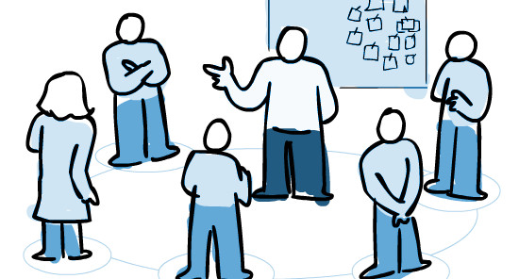
Daily Scrum
Didn’t do
Overall rating ?
Why?

Slide 17
Sprints
Both checks submitted on time
Sprint 1 much more organized than sprint 2
Scrum Masters?
Overall rating: 4/5

Slide 18

Non-technical skills we have developed: mna22@student.le.ac.uk
Communication
Teamwork
Leadership
Time management

Slide 19
Explaining a Technical Feature
Presented by Jack Partridge
jp589@student.le.ac.uk

Slide 20
DTOs - Structuring Marketplace Data
The market exists to allow users to trade and engage with other users to obtain better items and customisation of their experience with the application.
Here's a breakdown of the DTOs for the market:
ItemInfoDetail: Extends ItemListingDetail, adding fields for deeper market insights (lowest sell, highest buy, etc.).
ItemListingDetail: Contains core listing info: price, seller name, description, etc.
ListingSummary:
Summarised listing view for efficient overviews (itemName, quantity, minPrice).
Notes:
DTOs cleanly define the data exchanged between our backend and frontend. They separate display concerns from database entities. Note how ItemInfoDetail builds upon ItemListingDetail to provide additional details when needed.

Slide 21
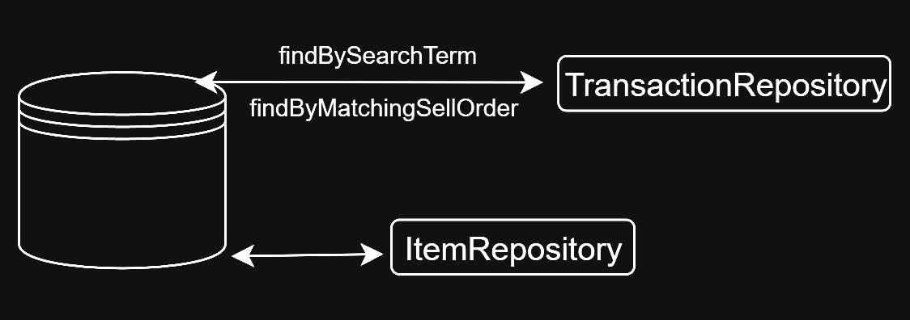
Spring Data JPA Repositories
TransactionRepository is responsible for handling core interactions with the Transaction Entity:
public class Transaction { public enum OrderType { BUY, SELL } public enum TransactionStatus { PENDING, COMPLETED, CANCELLED } private Long id; private OrderType orderType; private User buyer; private User seller; private Item item; private BigDecimal price; private int quantity; private TransactionStatus status; private Timestamp transactionDate; }
ItemRepository provides access to the item details.
Custom queries are used (as shown in the diagram) to streamline data retrieval.
Notes:
Spring Data JPA abstracts away much of the boilerplate database code. Emphasise the power of custom queries for implementing marketplace-specific logic.

Slide 22
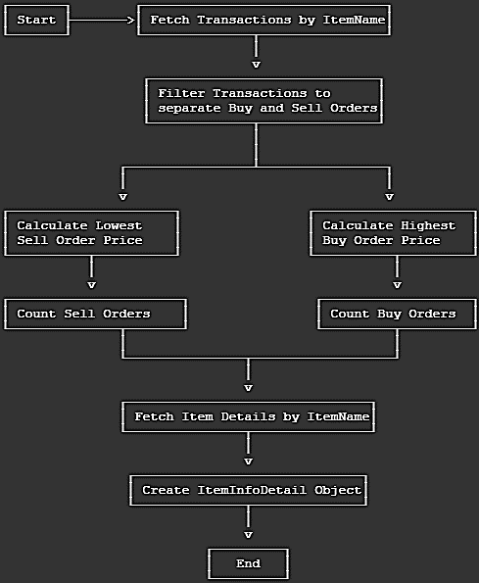
The Logic Behind the Listings
Here we can see the logic breakdown of the getItemInfoDetail function:
This function is responsible for fetching the relevant transactions for a requested item.
It efficiently calculates the lowest sell order and highest buy request using Java Streams.
It is also integrated with ItemRepository to pull in additional items.

Slide 23
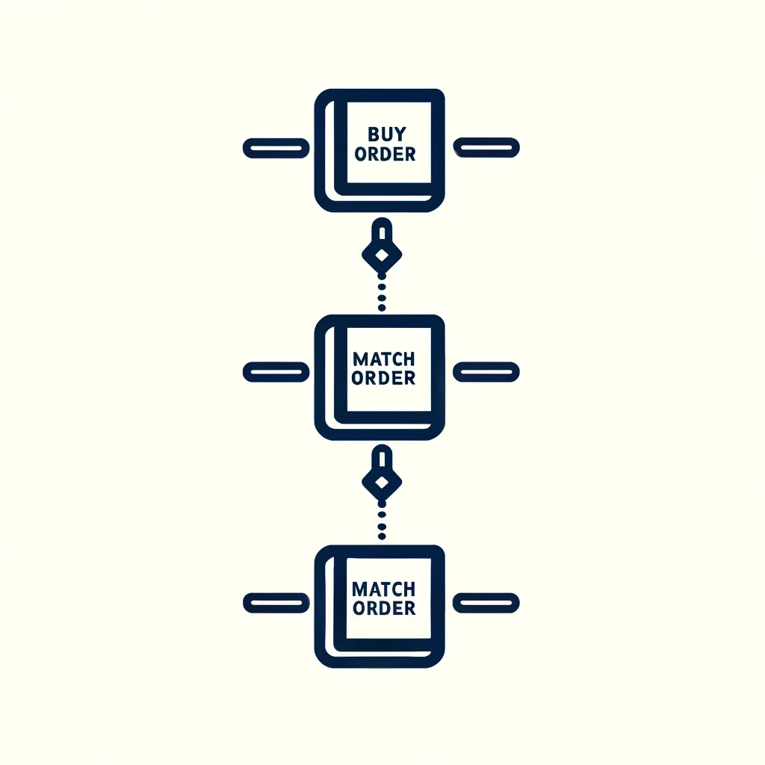


Executing a Transaction
This is where most of the logic of the market lies, as it must be able to handle accurate transaction records and exchanging of items and balances.
BUY ORDER
placeBuyOrder:
Performs balance checks to prevent invalid transactions.
Creates a new Transaction record in the database.
matchWithSellOrders: Attempts to match the buy order with compatible pending sell orders.
executeTransaction:
Updates UserItem records to reflect the exchange.
Handles the accurate transfer of funds.
Updates the transaction status from PENDING to COMPLETE
MATCHING
EXECUTION

Slide 24
JB931 slides Entity relations

Slide 25
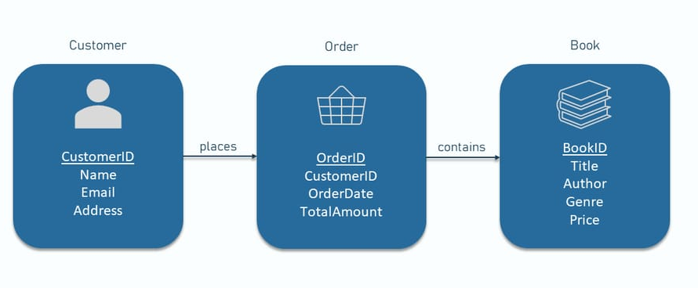
How Do The Objects In Our Project Interact?
That’s a hard question to answer! Thankfully, Entity Relationship Diagrams can help us visualise it, allowing us to understand the overall structure of the project.
It’s quite useful to have an ERD created at the start of the project, it allows you create a rough draft of the objects and methods. It’s also a lot easier to see how early could fit or not.
It’s also helpful to update the ERD during the project to reflect additions and changes made during development.

Slide 26
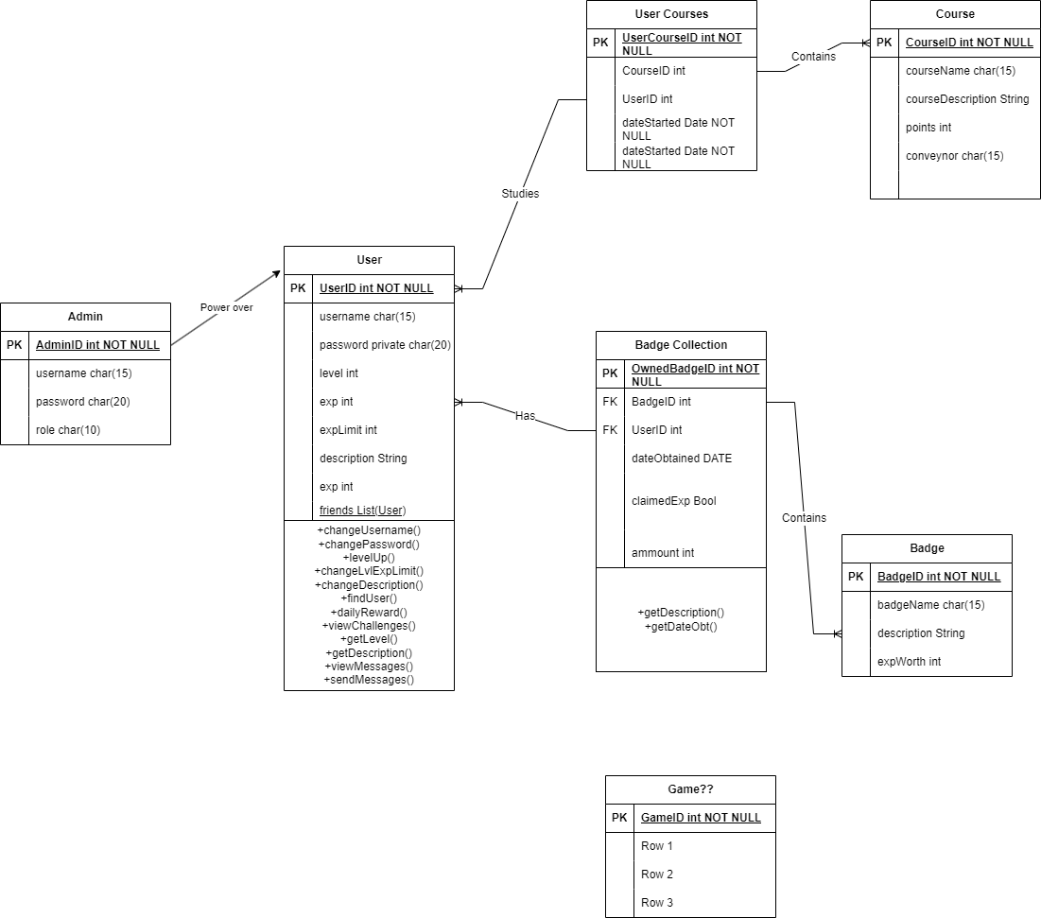
Our Entity Relationship diagram (ERD)
This ERD does not represent the final product here, the structure and features would change.
Quite a small scope; not much of the web application is covered or considered.
Admin entity was not implemented in the end, Role was instead.
The Game entity was transformed into the Time Trial feature (Multiple entities).
Entities that weren’t considered yet are not present in the ERD like the ones required for the Marketplace.

Slide 27
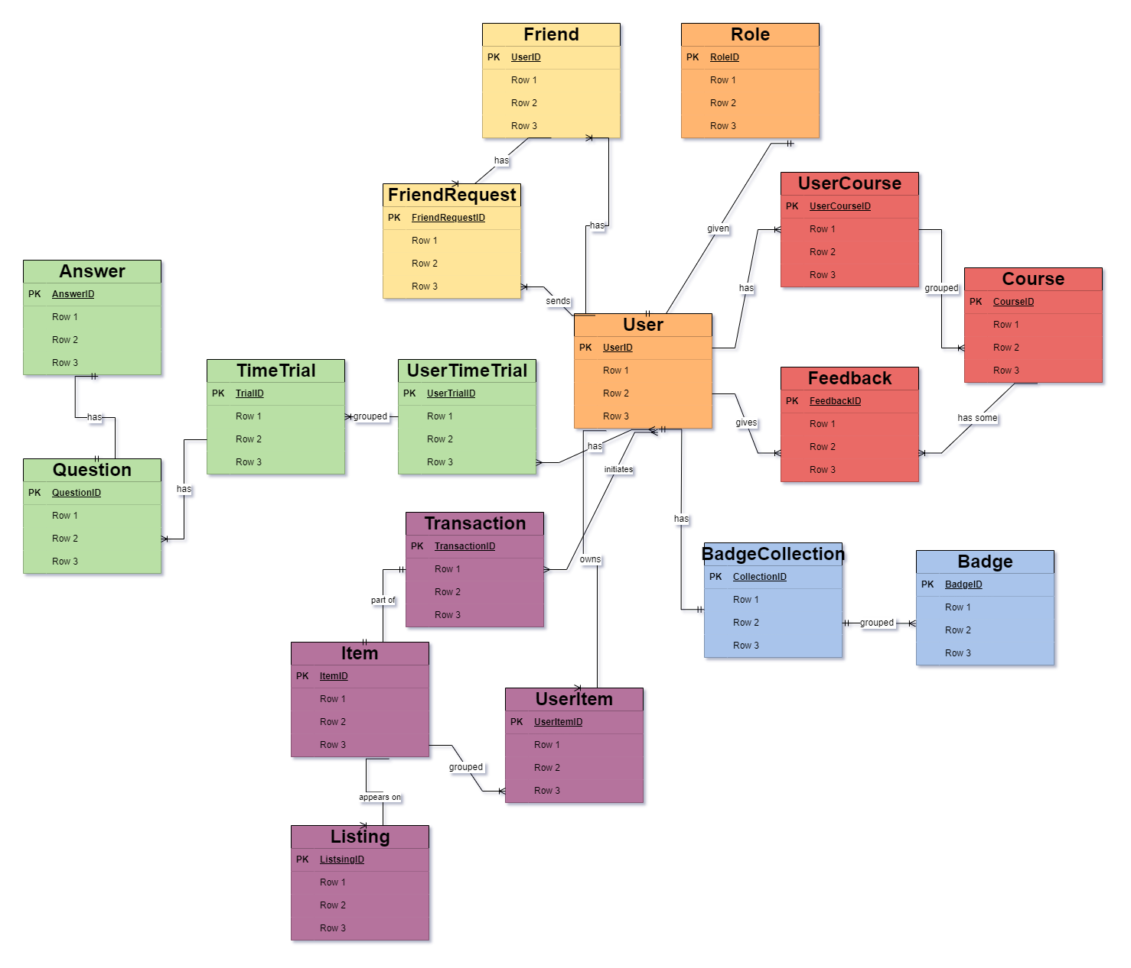
Our ERD (How I Would Change It)
Here is an ERD representing the final state of the project.
Updating the ERD as the project goes on.
The Course feature has an additional Feedback entity allowing more another relation to the User.
The Item and Time Trial features are here and fully realised.
The User is at the centre, all features and entities relate back to the them.

Slide 28
Entities Present In Each Page
Log In/Register pages
The User repository is accessed to check if the log in details match an encrypted entry.
The User repository is also accessed to check that there is no registry details already created to avoid repeated information.
Once the registration shows no errors, a new User is added to the repository.
Profile Page
A User’s details are taken and displayed on the Profile, so the repository must be accessed. As well as the BadgeCollection Entity information.
Friends are the same entity as a User (a self-relation) and their details can also be displayed on the Friends Profile page.
Friend Request entities can be created by sending Friend Requests from the page.
The Courses the User has interacted with (UserCourse) are displayed here.
A User’s parameters can be updated on this page too.
Courses
The Course repository is accessed to display the details of each course available (of course!).
The specific User’s courses (UserCourse) are checked to see which courses have been untouched, started or finished by the User. This status can also be updated.

Slide 29
Entities Present In Each Page
Marketplace
Listing entities are displayed and its one-to-many relationship with items means the items details are also displayed.
If an Item is purchased by the User, the Listing is deleted and a new UserItem is created (or if the User is the seller, it is also deleted).
During the buying and selling process, a Transaction entity is created for both the Buyer and Seller Users, the status of these transactions can also be updated.
Leaderboard
Specific User details are displayed in a leaderboard.
They are ordered in of User EXP high to low.
Time Trial Quiz
The contents of the quizzes, the questions and right and wrong answers are displayed.
The status of the UserTimeTrial is also updates after the quiz page is accessed and when the quiz is started.
Once the quiz is finished, the User’s EXP is updated based on how well they did and the status of the UserQuiz is updated.
Time Trials
Each Time Trial is displayed here, as well as whether the User has attempted it or not, as well as the attempts.
UserTimeTrial’s are created when a Time Trial is attempted.

Slide 30



Plans to take the project forward
Launch publicly on the internet
Secure a domain name and a reliable hosting service.
Ensure users data is protected and ensure handling of the increased traffic
Promote website through social media

Slide 31

Launch publicly on the internet
Secure a domain name and a reliable hosting service.
Ensure users data is protected and ensure handling of the increased traffic
Promote website through social media
Increased user engagement.
Higher course completion rates.
Bigger and more diverse user base to larger feedback loop
Plans to take the project forward

Slide 32
Launch publicly on the internet
Developing a mobile version
Increased user engagement.
Higher course completion rates.
Bigger and more diverse user base to larger feedback loop
Design and develop a mobile app that mirrors the functionality of the web platform.
Ensure the app is compatible across various devices and operating systems.
Integrate push notifications to engage users and encourage course completion.
Secure a domain name and a reliable hosting service.
Ensure users data is protected and ensure handling of the increased traffic
Promote website through social media

Slide 33

Launch publicly on the internet
Developing a mobile version
Design and develop a mobile app that mirrors the functionality of the web platform.
Ensure the app is compatible across various devices and operating systems.
Integrate push notifications to engage users and encourage course completion.
Enhanced user experience.
Increased daily active users.
Greater flexibility in how and when users engage with content.
Increased user engagement.
Higher course completion rates.
Bigger and more diverse user base to larger feedback loop

Slide 34
Expanding Course Offerings and Gamification Elements
Collaborate with educational experts to diversify and update course materials.
Introduce new gamification elements like more complex badge systems or competitive features (e.g., tournaments).
Regular updates and new features to keep the platform dynamic and engaging.
Developing a mobile version
Design and develop a mobile app that mirrors the functionality of the web platform.
Ensure the app is compatible across various devices and operating systems.
Integrate push notifications to engage users and encourage course completion.
Enhanced user experience.
Increased daily active users.
Greater flexibility in how and when users engage with content.

Slide 35

Expanding Course Offerings and Gamification Elements
Developing a mobile version
Collaborate with educational experts to diversify and update course materials.
Introduce new gamification elements like more complex badge systems or competitive features (e.g., tournaments).
Regular updates and new features to keep the platform dynamic and engaging.
Enhanced user experience.
Increased daily active users.
Greater flexibility in how and when users engage with content.
Stronger user retention.
Increased motivation among learners.
Higher user satisfaction and recommendations.

Slide 36
Securing partnerships
Expanding Course Offerings and Gamification Elements
Identify potential industry partners such as educational institutions and corporate entities.
Apply for grants and pitch to investors focusing on educational technology.
Leverage partnerships for content development and marketing.
Stronger user retention.
Increased motivation among learners.
Higher user satisfaction and recommendations.
Collaborate with educational experts to diversify and update course materials.
Introduce new gamification elements like more complex badge systems or competitive features (e.g., tournaments).
Regular updates and new features to keep the platform dynamic and engaging.

Slide 37

Securing partnerships
Expanding Course Offerings and Gamification Elements
Identify potential industry partners such as educational institutions and corporate entities.
Apply for grants and pitch to investors focusing on educational technology.
Leverage partnerships for content development and marketing.
Stronger user retention.
Increased motivation among learners.
Higher user satisfaction and recommendations.
More financial stability and resources to invest in further development.
Increased credibility and content authenticity.
Access to a wider network of potential users.

Slide 38
Securing partnerships
Identify potential industry partners such as educational institutions and corporate entities.
Apply for grants and pitch to investors focusing on educational technology.
Leverage partnerships for content development and marketing.
More financial stability and resources to invest in further development.
Increased credibility and content authenticity.
Access to a wider network of potential users.

