Slide 1
Addressing Youth Unemployment
in South Africa
NexTech Career App — AI-Powered Mobile Career Support
NexTech Group
Mohau Mphanya • Sive Mtengwana • Lesedi Ledwaba
Technopreneurship NTEC62110 | Sol Plaatje University | June 2026
1 / 18

Slide 2
INTRODUCTION
Crisis at a Glance
46.1%
~60%
4.8%
118K+
Youth Unemployed
Ages 15-24
Matric Grads Employed
Unfilled Tech Jobs
South Africa has one of the highest youth unemployment rates globally
Majority of young adults in this age bracket are without work
Only a fraction of recent matriculants find employment
Thousands of tech positions remain vacant due to skills gaps
⚠
Critical Levels
🌐
Digital Divide
🎯
Our Mission
Youth unemployment in South Africa has reached crisis levels, threatening social stability and economic growth for an entire generation.
Millions of young South Africans lack access to digital tools, professional networks, and career guidance needed to compete in the modern job market.
NexTech Career App bridges the gap between unemployed youth and career opportunities using AI-powered tools accessible on any mobile device.
NexTech Career App | Design Thinking Project
2 / 18

Slide 3
EMPATHISE — 5 MARKS
Our Research
Primary Research
Secondary Research
Key Findings
• 15 in-depth interviews with unemployed youth aged 18-35
• Recruitment agent insights from hiring processes
• Career counsellor perspectives on guidance gaps
• Focus groups in Kimberley township areas
• Stats SA quarterly labour force surveys
• News articles on youth employment crisis
• Social media sentiment analysis
• Academic research on SA job market barriers
• 87% don't know how to write a professional CV
• 92% have no interview preparation resources
• 73% rely solely on mobile phones for internet
• 65% find existing platforms confusing and overwhelming
"I know I can do the job, but I don't know how to show it on paper. Every time I apply online, I feel invisible."
— Thabo, 24, Kimberley
NexTech Career App | Design Thinking Project
3 / 18

Slide 4
EMPATHISE — 5 MARKS
Empathy Map
SAYS
THINKS
"I don't know how to write a CV"
"Online applications are too complicated"
"No one calls me back"
"I can't afford data to browse jobs"
"I'm not good enough"
"The system is rigged against me"
"Education didn't prepare me for this"
"I'll never escape unemployment"
DOES
FEELS
Applies to dozens of jobs with same CV
Asks friends for help with applications
Gives up after multiple rejections
Borrows money for internet café visits
Frustrated by constant rejection
Overwhelmed by complex processes
Hopeless about future prospects
Invisible to employers and systems
CRITICAL INSIGHT: The gap isn't motivation — it's access to professional tools and guidance that most job seekers take for granted.
NexTech Career App | Design Thinking Project
4 / 18

Slide 5
DATA & INSIGHTS
The Numbers Behind the Crisis
46.1%
73%
87%
92%
Youth Unemployment Rate
Mobile-Only Internet Users
Cannot Write Professional CVs
No Interview Preparation
Q1 2024 — among the highest globally. Over 4.9 million young South Africans are actively seeking work.
The majority of SA youth access the internet exclusively via mobile phones, making desktop-only solutions ineffective.
Our research found that the vast majority of young job seekers have never received CV writing guidance.
Almost all respondents reported zero access to interview coaching or mock interview resources.
NexTech Career App | Design Thinking Project
5 / 18

Slide 6
PROBLEM ANALYSIS
Understanding the Barriers
CORE PROBLEM
South African youth face a systemic barrier to employment: they lack access to professional career development tools, guidance, and resources that are essential for competing in the modern job market.
📄
Skills Presentation Gap
📱
Digital Access Divide
🎯
Guidance & Preparation Void
Youth cannot effectively present their skills and qualifications to employers. CVs are poorly structured and fail to highlight relevant competencies.
Desktop-only solutions exclude the 73% who rely solely on mobile. Data-heavy platforms are unusable on limited prepaid data bundles.
No access to interview coaching, career counselling, or professional mentorship. Young job seekers navigate the process entirely alone.
CRITICAL INSIGHT: These barriers are interconnected — solving one without addressing the others will not create meaningful change.
NexTech Career App | Design Thinking Project
6 / 18

Slide 7
DEFINE — 10 MARKS
Problem Statement
"Young South Africans aged 18-35 who are actively seeking employment lack accessible, mobile-friendly tools to create professional application materials, prepare for interviews, and navigate career pathways — resulting in systemic exclusion from the formal job market despite available opportunities."
FIVE WHYS — Root Cause Analysis
1. Why are youth unemployed?
→
They cannot effectively compete for available positions
2. Why can't they compete?
→
They lack professional CVs, cover letters, and interview skills
3. Why do they lack these?
→
No access to career guidance or professional development tools
4. Why no access?
→
Existing solutions are desktop-only, expensive, or data-heavy
5. Why mobile-only solutions fail?
→
The market has ignored mobile-first, data-light career tools for SA youth
7 / 18

Slide 8
USER PERSPECTIVE
Pain Points from the Ground
😤
😵
😰
📵
Application Fatigue
CV Blindness
Interview Anxiety
Digital Exclusion
"I've applied to over 100 jobs and heard back from none. It feels pointless to keep trying." — Sive, 22
"I don't know what employers want to see. My CV looks the same as everyone else's." — Naledi, 25
"I've never had a professional interview. When I finally got one, I froze completely." — Thabo, 24
"Everything wants a laptop. I only have my phone and R20 data that lasts 2 days." — Karabo, 21
KEY TAKEAWAY
Young South Africans are not lazy or unqualified — they are systematically underserved by existing career development infrastructure. A mobile-first, AI-powered solution can bridge this gap.
NexTech Career App | Design Thinking Project
8 / 18

Slide 9
CURRENT LANDSCAPE
Existing Solutions & Their Gaps
Existing Solutions
Key Limitations
LinkedIn
✕ Not Mobile-First
Professional networking platform — desktop-centric, data-heavy, Western-oriented
Desktop-only interfaces exclude 73% of the target audience
Indeed / CareerJunction
✕ No AI Guidance
Job search engines — focus on listing, not preparation or guidance
No personalised career advice or interview preparation tools
✕ Data-Heavy
Government Youth Programmes
High bandwidth requirements make them unusable on prepaid data
NYDA, YES Programme — limited reach, bureaucratic processes, no digital tools
✕ SA Context Ignored
No localisation for SA job market norms and requirements
NexTech Career App | Design Thinking Project
9 / 18

Slide 10
THE OPPORTUNITY
Where Others Fall Short, We Step In
📱
🇿🇦
💡
🤖
Mobile-First AI Career Tools
Localised for SA Market
Data-Light Architecture
AI-Powered Personalisation
Build professional CVs, cover letters, and prepare for interviews — all from a mobile phone with minimal data usage.
Designed specifically for South African job market norms, requirements, and the unique challenges faced by SA youth.
Optimised for low-bandwidth environments with offline capabilities. Works on R20 prepaid data bundles.
Intelligent resume analysis, interview coaching, and career pathway recommendations tailored to each user.
THE CRITICAL GAP
No existing solution combines mobile-first design, AI-powered career tools, data-light architecture, and South African localisation in a single, accessible platform. NexTech Career App fills this gap.
NexTech Career App | Design Thinking Project
10 / 18

Slide 11
IDEATE — 10 MARKS
5 Solutions Explored
DISCARDED
WhatsApp Chatbot
Limited formatting, no document generation, poor UX for complex tasks
CV tips via WhatsApp Bot
DISCARDED
Web-Only Portal
Excludes 73% mobile-only users, requires broadband connectivity
Full-featured desktop website
DISCARDED
Physical Workshop Series
Scalability issues, high cost, geographic limitations
In-person career bootcamps
DISCARDED
SMS-Based System
Too limited for CV generation, no multimedia, poor engagement
Career tips via text messages
SELECTED
NexTech Career App
Mobile-first, data-light, AI-powered, offline capable, SA-focused — addresses all identified barriers
AI-powered mobile career platform
NexTech Career App | Design Thinking Project
11 / 18

Slide 12
OUR SOLUTION
NexTech Career App
📄
✉️
🎤
Resume Builder
Cover Letter Generator
AI Interview Coach
AI-powered resume creation with professional templates, step-by-step guidance, and ATS optimisation. Build a standout CV in minutes.
Personalised cover letters tailored to each job application. AI analyses job descriptions and crafts targeted, compelling letters.
Practice interviews with AI-powered coaching. Get real-time feedback on answers, body language tips, and confidence-building exercises.
Mobile-First
Data-Light
AI-Powered
Accessible
AI-powered career support in your pocket — built for South African youth, by South African youth.
12 / 18

Slide 13
FEATURES
Detailed Feature Walkthrough
Resume Builder
Cover Letter Generator
AI Interview Coach
• AI-powered content suggestions based on job descriptions
• Professional templates optimised for ATS scanning
• Step-by-step guided CV creation process
• Real-time resume quality scoring and improvement tips
• Export to PDF directly from mobile device
• Multiple CV versions for different job applications
• AI analyses job postings to extract key requirements
• Personalised letters matching your experience and skills
• Professional tone and formatting automatically applied
• One-tap generation with manual edit option
• Saved templates for quick customisation
• Industry-specific language and keywords
• Voice-powered mock interview sessions
• Real-time AI feedback on responses
• Industry-specific interview question banks
• Body language and confidence coaching
• Recorded sessions for self-review
• Progressive difficulty levels to build confidence
NexTech Career App | Design Thinking Project
13 / 18

Slide 14
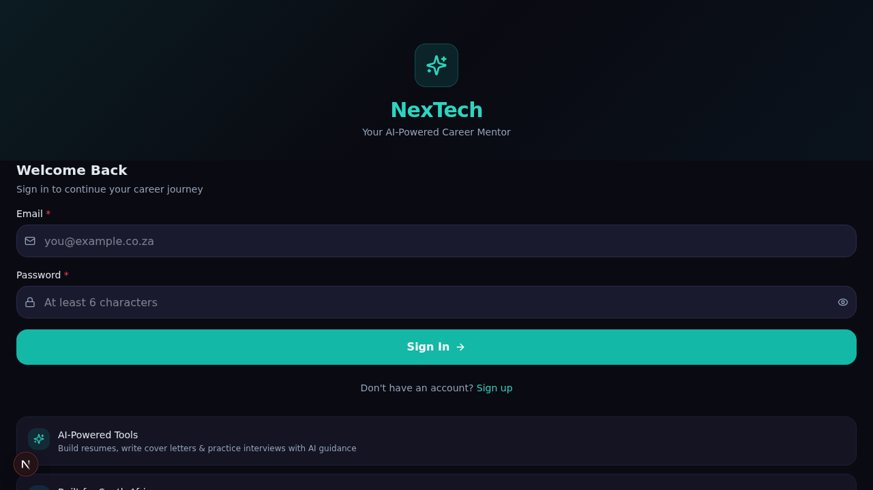
PROTOTYPE — 10 MARKS
Prototype & Technology
Technology Stack
App Dashboard
Frontend
Next.js 16 + React 19 + TypeScript
Styling
Tailwind CSS 4 + shadcn/ui
Backend
Next.js API Routes + Prisma ORM
AI Engine
OpenAI GPT-4 + Whisper ASR
Database
SQLite (data-light) via Prisma
Deployment
Vercel (CDN-optimised for SA)
User Flow
Design Principles
Sign Up → Onboarding → Dashboard → Choose Tool → Build/Prepare → Review → Export/Practice → Track Progress
• Mobile-First:
Every screen designed for thumb-friendly mobile use
• Data-Light:
Compressed assets, lazy loading, offline caching
Each step is optimised for mobile screens, minimal data usage, and intuitive navigation with progressive disclosure.
• Accessible:
WCAG 2.1 AA, screen reader support, high contrast
• Progressive:
Core features work offline, enhanced with connectivity
NexTech Career App | Design Thinking Project
14 / 18

Slide 15
COMPETITIVE ADVANTAGE
Why NexTech Wins
Current Systems
NexTech Career App
✕ Desktop-only interfaces
✓ Mobile-first design
✕ Data-heavy, requires broadband
✓ Data-light, works on prepaid
✕ No AI-powered guidance
✓ AI-powered career coaching
✕ Generic, not SA-localised
✓ Built for South African context
✕ No interview preparation
✓ Interview preparation built-in
✕ Expensive premium features
✓ Core features free to use
✕ Complex, overwhelming UX
✓ Simple, guided user experience
✕ No offline functionality
✓ Offline capability with caching
NexTech Career App | Design Thinking Project
15 / 18

Slide 16
TEST — 5 MARKS
CAHAU Feedback
"This is exactly what candidates need — most applicants fail because they don't know how to present themselves"
"The AI interview coach is remarkable — it simulates real interview pressure and gives constructive feedback"
— CAHAU Representative, Job Interview Board Member
— CAHAU Representative, Hiring Panel Member
"I would recommend this to every first-time job seeker I encounter"
"The resume analyser catches issues that even experienced candidates miss"
— CAHAU Representative, Recruitment Specialist
— CAHAU Representative, HR Professional
Improvements Made Based on Feedback:
✓ Added Data-Light Mode
✓ Simplified Navigation
✓ Added Onboarding Flow
16 / 18

Slide 17
CONCLUSION
Our Path Forward
📱
🎓
🌍
Accessible Technology
Empowered Youth
Systemic Impact
Mobile-first, data-light AI tools that work for every South African youth, regardless of device or connectivity.
Professional career development resources that transform job seekers from invisible applicants to confident candidates.
Bridging the gap between unemployment and opportunity at scale, creating lasting change in SA's employment landscape.
46.1%
73%
87%
100%
Youth Unemployment
Mobile-Only Users
Need CV Help
Our Commitment
OUR VISION
Every young South African deserves the tools to present their best self to employers. NexTech Career App makes that possible — one download at a time.
NexTech Career App | Design Thinking Project
17 / 18

Slide 18
Thank You
NexTech Group
Mohau Mphanya • Sive Mtengwana • Lesedi Ledwaba
Technopreneurship NTEC62110 | Sol Plaatje University | June 2026
Together, we can bridge the gap.
18 / 18

