Slide 1
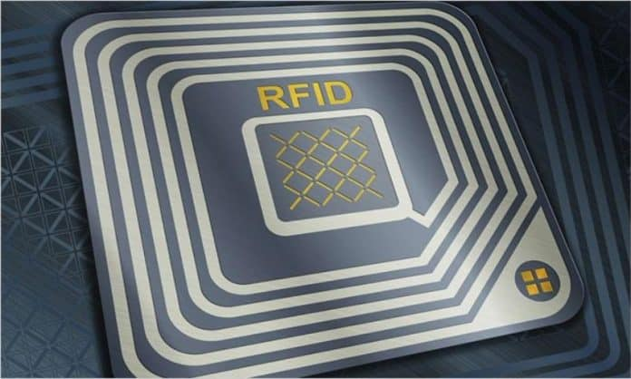
IOT BASED RFID ATTENDANCE SYSTEM

Slide 2

HELLO GUYS !
GROUP MEMBERS:
Ansari Mohammed Adeen : 03 / 211P046 Selot Kabir : 37 / 211P054
Siddique Mariyam: 51 / 211P0
Khan Hamza : 19 / 211P0
2

Slide 3
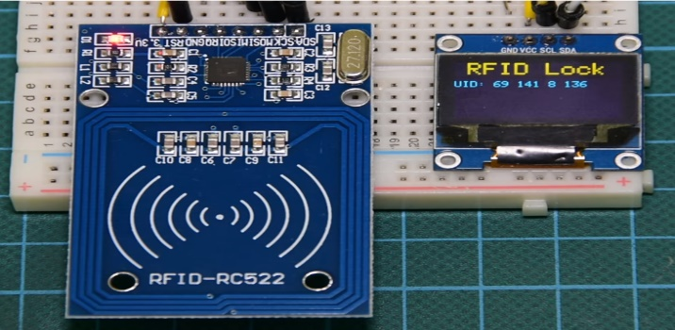
What is RFID?
RFID is an acronym for radio frequency identification
Radio Frequency Identification – or RFID – is used to automatically identify an object and capturing data about that object that has been stored in a small microchip tag and attached to the object.
The RFID tag has a built-in antenna that communicates to a scanning device that reads the data remotely.
RFID can be used to record and control the movement of assets and personnel. Each RFID tag has its own unique identifying number.

Slide 4
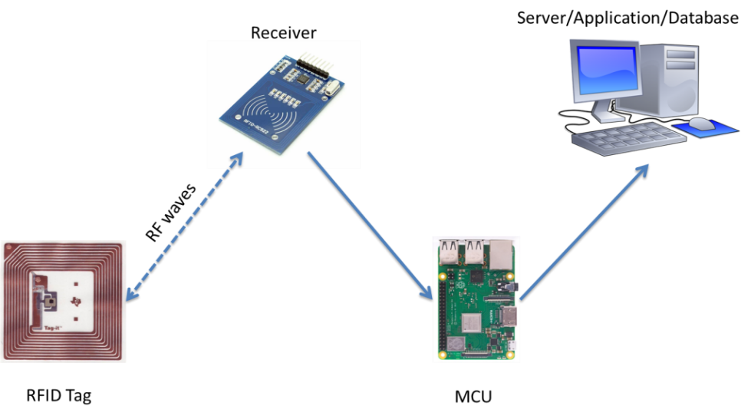
WORKING OF RFID:
Tags (or chips) consist of two parts:
Antennae
Processor/Storage
Receives signal from reader and gives a return signal with ID number.
Reader sends number to database or server.
This is all done using WEIGAND protocol.

Slide 5
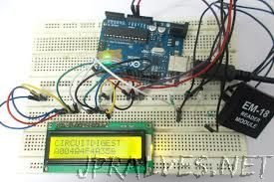
WHAT IS RFID ATTENDANCE SYSTEM?
Radio Frequency Identification (RFID) based attendance system is used to take attendance for students in school and workers.
Its ability to uniquely identify each person based on their RFID tag type of ID card make the process of taking the attendance easier, faster, and more secure as compared to the conventional method.
Students or workers only need to place their ID cards on the reader and their attendance will be taken immediately.
With the real- time clock capability of the system, attendance taken will be more accurate since the time for the attendance taken will be recorded.

Slide 6
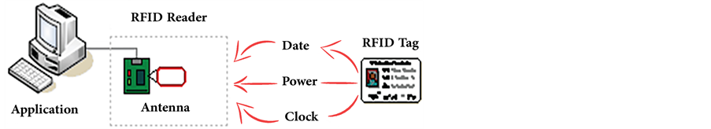
BLOCK DIAGRAM:

Slide 7
REQUIRED COMPONENTS:
NODEMCU ESP8266
MFRC522 RFID CARD MODULE
BUZZER
16*2 LCD DISPLAY
BREADBOARD
JUMPER WIRES
4

Slide 8
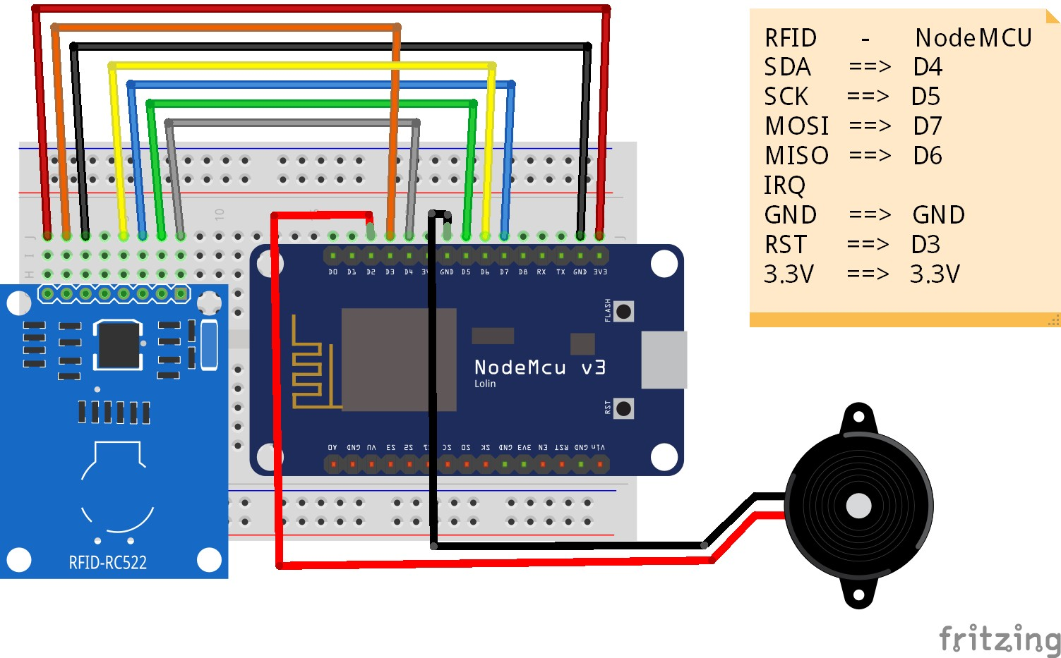
CIRCUIT:
Here We are going to connect Node MCU ESP8266 and RFID- RC522 with MYSQL Database. So for that first, we should connect our Node MCU ESP8266 Board with RFID Module. By using the RFID Module we are going to scan our RFID card and tag which are allowed or not. And by using our ESP8266 we are going to send that data to our google sheet, and also to MySQL server.

Slide 9
ADVANTAGES:
Proxy attendance can be caught .
Hard copy paper work of attendance sheets is reduced .
Data can be store long time compare to attendance sheets .
This system is fully automated and it does not require any human interaction
except setting the initial time setting .
LCD and PC interface both are provided with RFID based attendance
system . This gives benefit of viewing attendance on the spot on LCD or
remotely from computer .

Slide 10
LIMITATIONS:
➤ RFID attendance system is secured , but there is a chance of misusing
the cards . One person can give another person's attendance if he / she
had RFID card .
➤ If the card was swiped for more than once , there is a chance of giving
attendance for next days also if code is not written properly .

Slide 11
FUTURE SCOPE:
Range of the RFID reader can be increased , so the reader can detect the
tag from far distance .
RF TRANSRECEIVER module can be used for long distance
communication to transfer data .
The transferred data can be save and store in computer as a database using
specific software .
This attendance system's data base can be linked with college website
and can be shared and monitored by the student's parents .
We can send this data through internet to the user . So that user can access
it remotely via internet .
We can implement GSM technology

Slide 12
CONCLUSION :
Our goal is to develop a secure, portable and ready to deploy RFID-based attendance. The system provides a practical and efficient solution for monitoring student attendance on a large scale. The proposed attendance monitoring system uses the concept of IoT to log and fetch data on the server/cloud and make it available for the user anytime and anywhere. For future work, we would also like to give access to students about their attendance, so they can log in and check their attendance remotely. We would integrate the entire system with a mobile phone application so that all functionality is on the mobile itself.

Slide 13
THANK YOU!

