Slide 1

CYCLISTIC CASE STUDY
CONTACT PERSON: MOHD AQDAS
LAST UPDATED: SEPTEMBER 2022

Slide 2
EXECUTIVE SUMMARY
About the Company:- In 2016, Cyclistic launched a successful bike-share offering. Since then, the program has grown to a fleet of 5,824 bicycles that are geotracked and locked into a network of 692 stations across Chicago. The bikes can be unlocked from one station and returned to any other station in the system anytime.
PURPOSE:- To support or oppose the hypothesis, which is converting casual riders into annual members.
CHALLENGES:-
1- How do members and casual riders use Cyclistic differently?
2- Why would casual riders buy Cyclistic annual memberships?
3-How can Cyclistic use digital media to influence casual riders to become members?
ABOUT THE DATA:-
Data is collected from cyclistic website https://divvy-tripdata.s3.amazonaws.com/index.html
This analysis is done on the data of Year-2022.
This analysis is conducted in September, hence the available data is only for 8 months from
Jan2022-Aug2022.

Slide 3
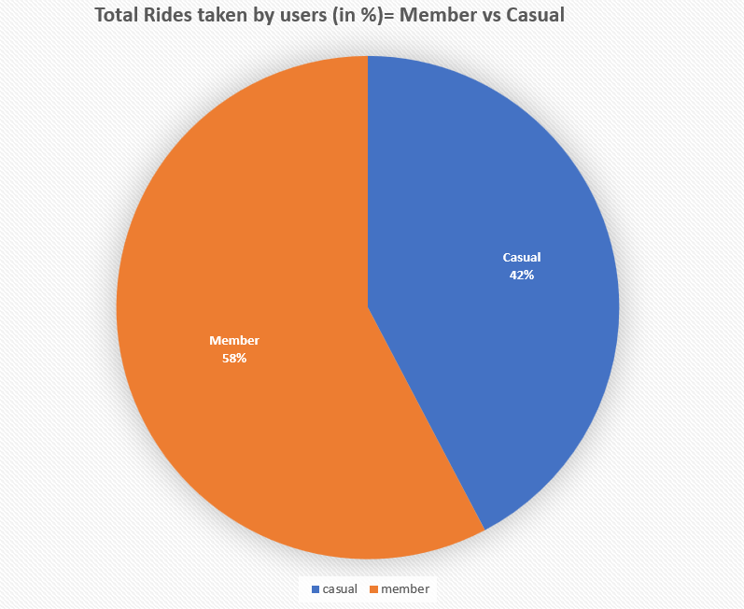
Total Rides comparison
Key Findings:
Members have taken 58% of total rides.
Casual riders have taken 42% of total rides.

Slide 4
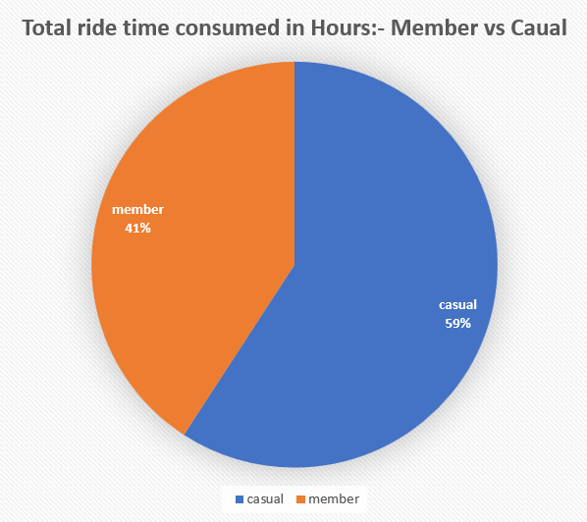
Total Ride time consumed comparison
Key Findings:
Members used cyclistic for 2,24,44,404 hrs which is 41% of the total time consumed.
Casual riders used cyclistic for 3,25,33,652 hrs which is 59% of the total time consumed.

Slide 5
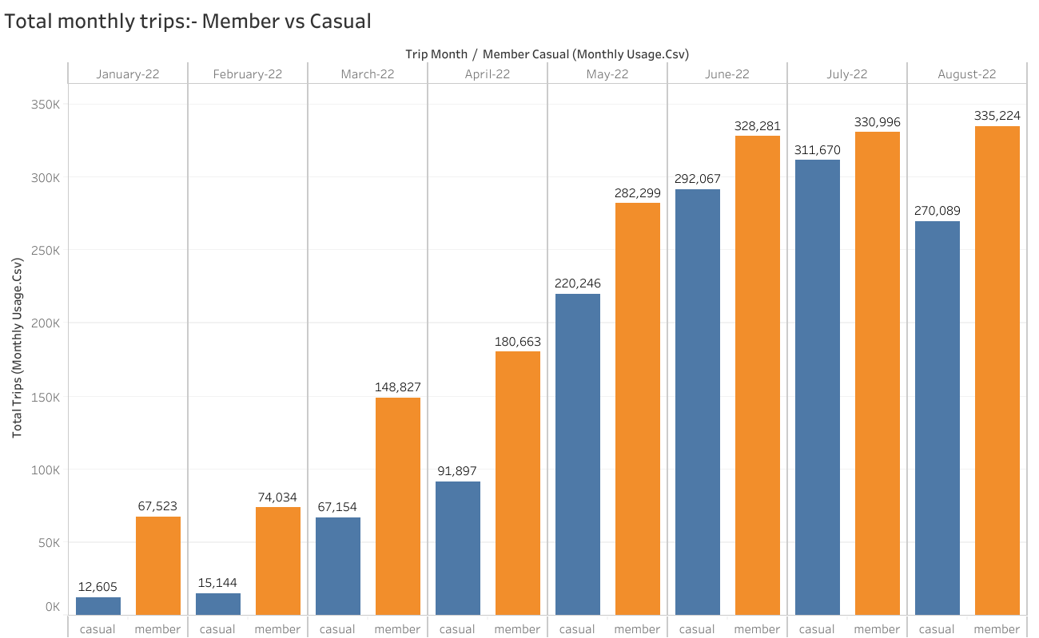
Total Monthly trips taken
Member’s peak
Casual’s Peak

Slide 6
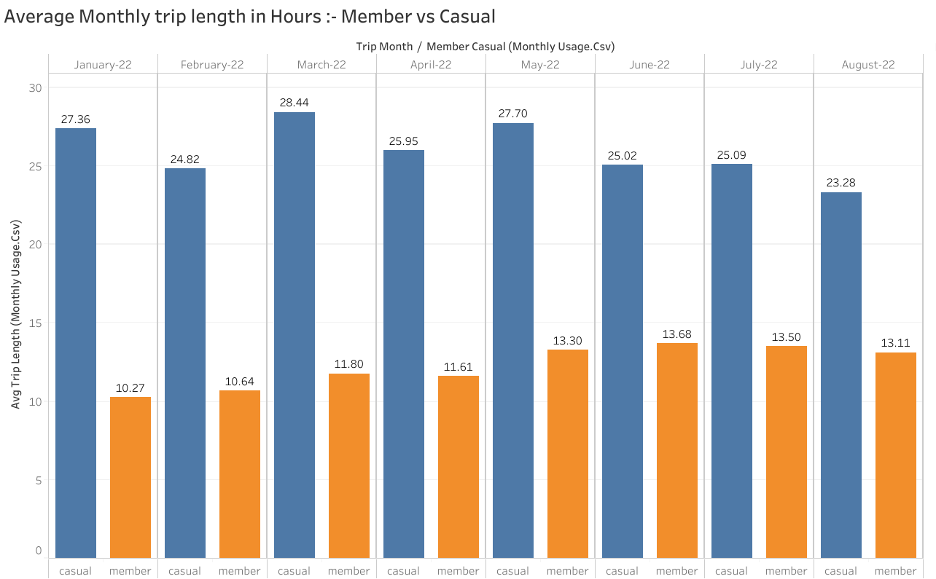
Average Monthly Trip time consumed
Casual’s peak
member’s peak

Slide 7
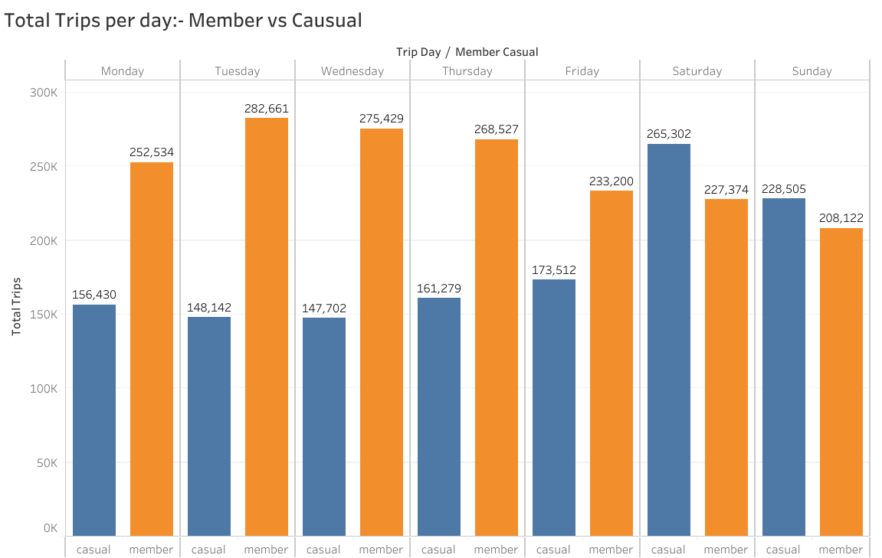
Total Trips started Every day in a Week
member’s peak
Casual’s peak

Slide 8
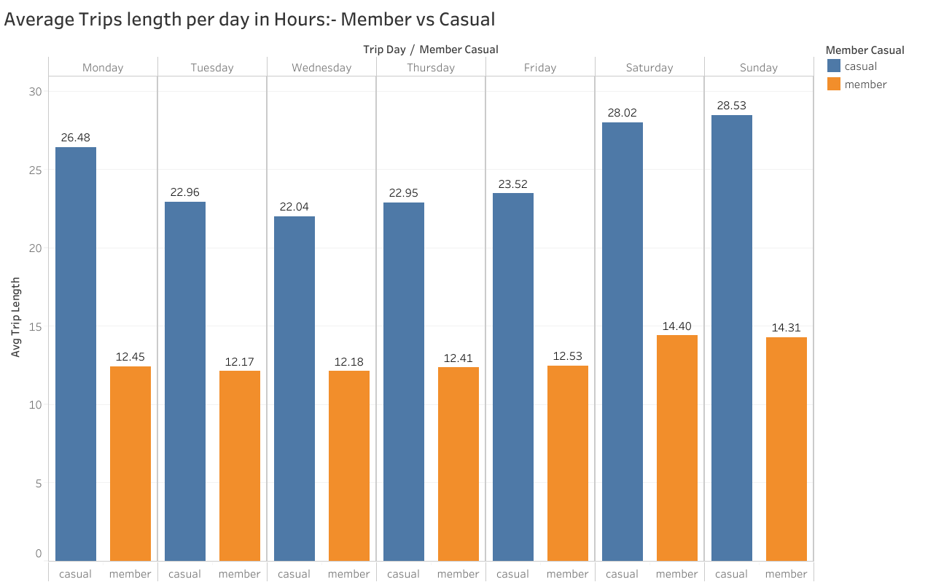
Average Weekly Trip time consumed
Casual’s peak
member’s peak

Slide 9
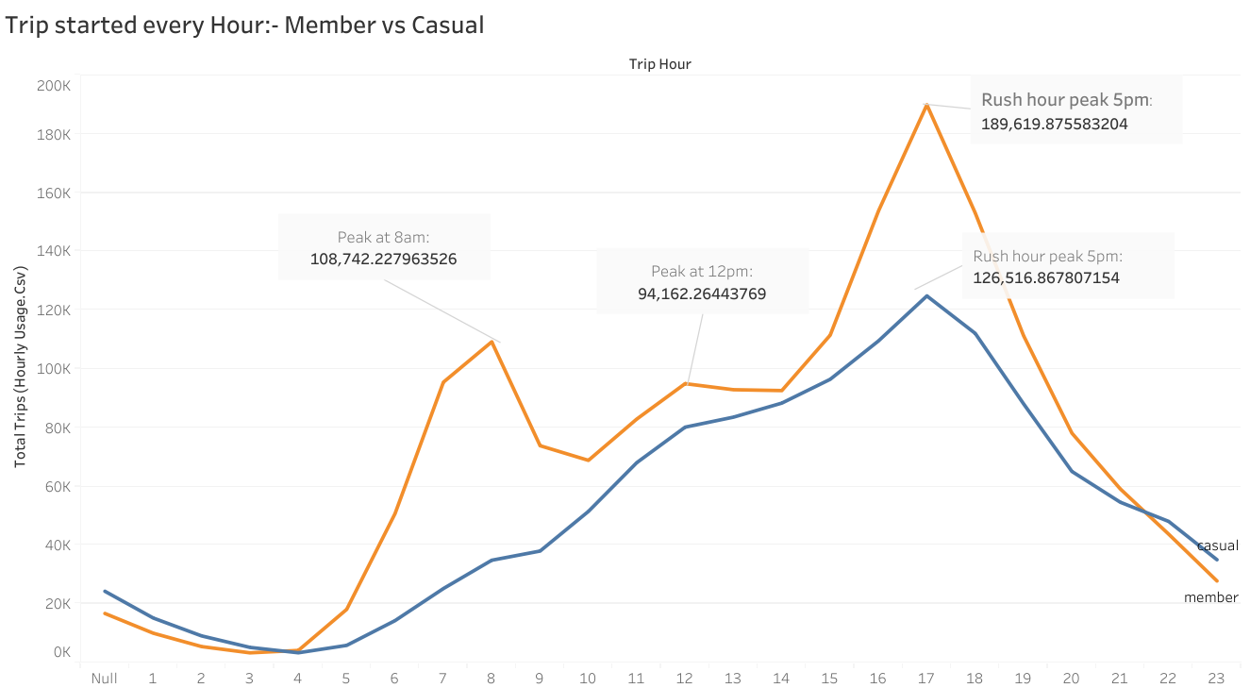
Total Trips Started every hour
OFFICE ENDS
OFFICE TIME
LUNCH

Slide 10
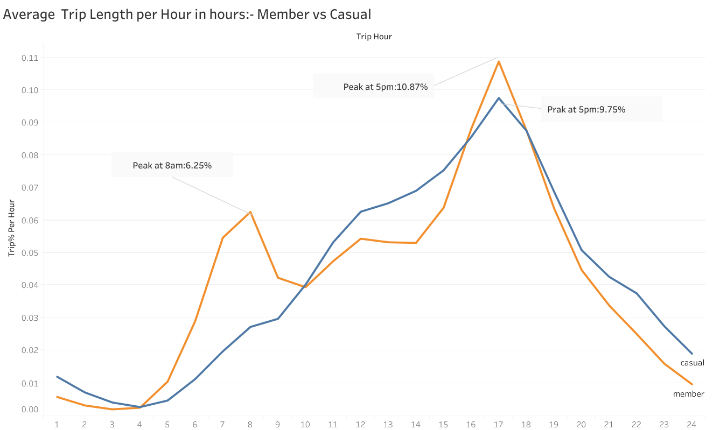
Average Hourly Trip time consumed
OFFICE TIME
OFFICE ENDS

Slide 11
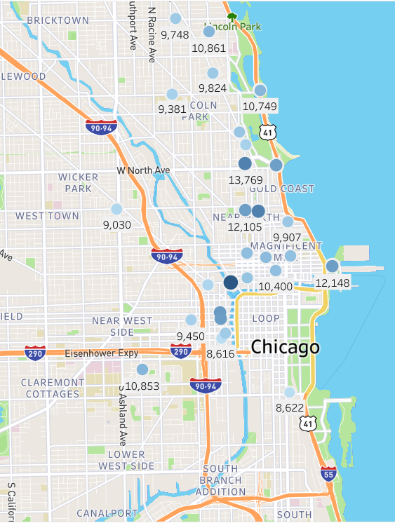




Top 30 stations used by Members
Top 30 stations used by Casual Riders
Key findings:-
Most used stations by Members are spread around the City.
Couple of stations are around the beach and river.

Slide 12
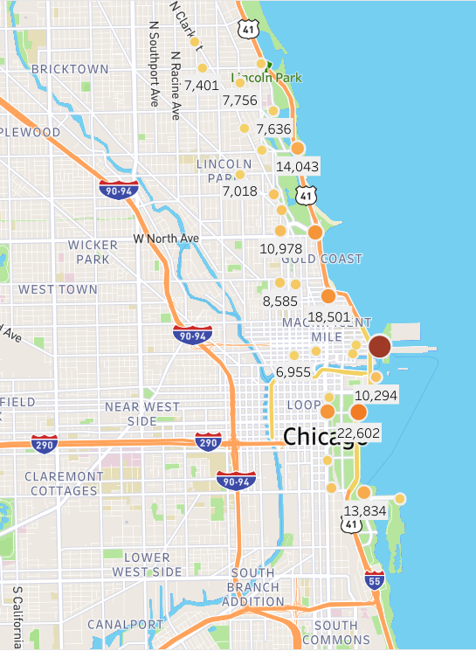




Top 30 stations used by Casual Riders
Top 30 stations used by Casual Riders
Key findings:-
Most used stations by Casual riders are around the Beach.
But some stations are in the city also with a decent amount of trips.

Slide 13
SUMMARY OF FINDINGS
The data lacks information, which decreased the accuracy of results.
It was quite tough to specify the difference between members and casual riders.
But, surprisingly we made some general differences in the user pattern of both riders.
Both users use cyclistic differently:-
Casual Riders- Most of the users use Cyclistic more for leisure and some use Cyclistic to commute to work each day.
Members- Most of them use Cyclistic to commute to work each day and some users use Cyclistic for leisure.

Slide 14
RECOMMENDATION
1- Recommendations:-
a.) Introduce time limit- As we saw earlier in the analysis that casual users take a lot more time during one trip.
So, we can impose a time limit on casual rides.
The time limit could be 24 hrs from the start time of a trip.
And the Membership will have no such boundaries.

Slide 15
RECOMMENDATION
b.) Introduce membership options – Introducing flexible membership options will help to encourage casual riders to purchase a membership.
Here we will use the decoy effect strategy in the pricing of membership options. We will divide the membership into three options- Quarterly, Halfyearly, and Annual membership.
And the pricing will be according to the decoy effect, like:- Quarterly-$25, Halfyearly$35, Annually-$50
As we saw in the analysis that casual user’s peak is in three months June, July, and August, so it would be the best time to convert them into Quarterly members or we can convert them into halfyearly and annual members by giving some exciting summer or spring seasonal offers.

Slide 16
RECOMMENDATION
c.)Using digital and print media– To impose our strategy of converting casual riders into members we have to start a marketing campaign to convert more casual riders possible into members.
Create Cyclistic Fitness and environment-related campaign on social media to encourage people to leave automobiles and use cycles to be fit, save the environment, and also save money by not spending on fuel.
As we saw the 30 most used stations by casual riders in our analysis. These stations are around the beach and bay side.
So we can target the area around these stations for our campaign to generate the highest value possible.

Slide 17
RECOMMENDATION
2- Recommendations:-
a.) Collect more data:-
There are only eight months of data available for 2022, wait till January 2023 for the to data get collected.
The data has to be collected with more details, so we can conduct a thorough analysis to make our results more accurate and conclusive.

Slide 18
RECOMMENDATION
b.) Make the problem more clear:- Try to ask some more questions to make the problem clear like:-
Why do casual riders use this option?
What need both users are fulfilling through Cyclistic?
Who are the users in both category? Like:- Students, Workers, etc.

Slide 19
RECOMMENDATION
c.) Conduct a Survey:- Try to conduct a survey. We already have 60 stations of both members which are the hot points to collect the data about both user types.
We can include the questions we defined in the last slide to get more specifics.
We have to collect the data about the demographics (age, location, sex, and annual income) of the user.
This survey will help a lot in conducting a good analysis and finding out more specific and meaningful trends. To increase the success rate of our marketing campaign.

Slide 20
CONCLUSION
We know that casual riders and members use Cyclistic differently but we don’t know the reason why they do so.
We have got some results but they do not have enough information which makes them less accurate or maybe Inaccurate.
With the lack of information it is very risky to move forward with our strategy.
I’ll propose to go with the second recommendation, which is to wait and collect more meaningful data to get some meaningful insights.

Slide 21
THANKS!
Any questions?
You can find me on LinkedIn & aqdas4211@gmail.com

