Slide 1
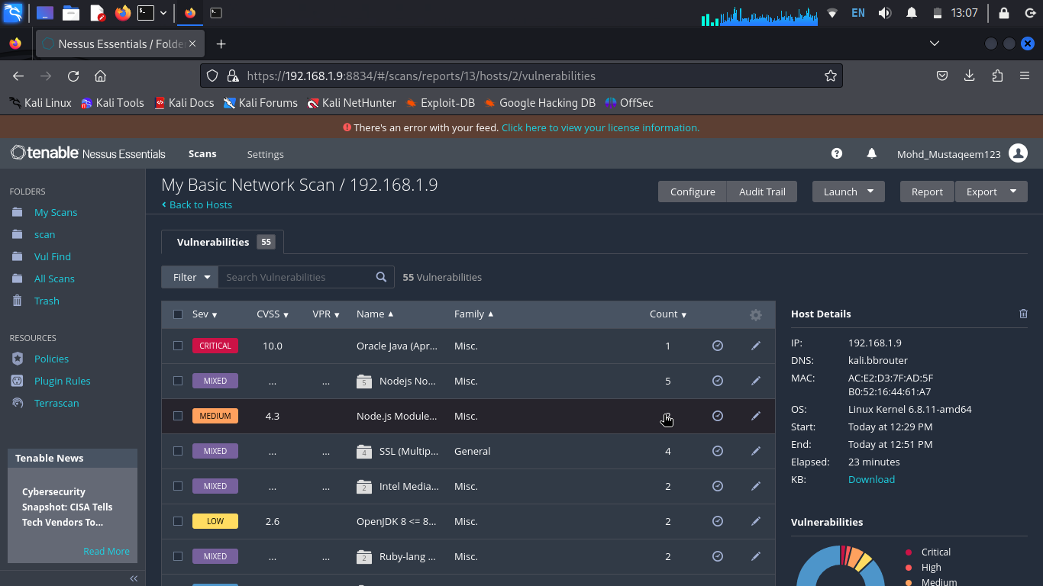

Slide 2
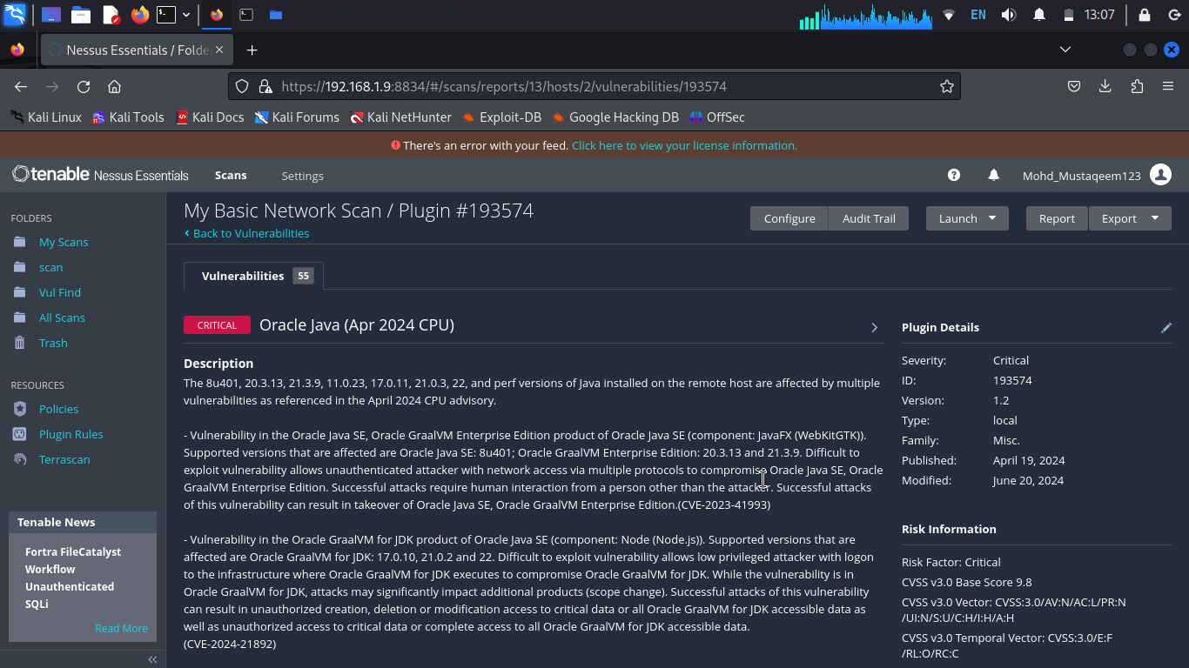

Slide 3
REPORT
Title: Found Critical Vulnerability
Domain: Vulnweb.com
Steps to Reproduce:
Visit https://127.0.0.1:8834/#/scans/folders/my-scans
Click on New Scan
Then Select Basic Network Scan
After Completing Scan i found Critical Vulnerability.
Prepare a report for it.
Impact: With the use of this vulnerability hacker can harm your system as well as steal important information. We Suggest to solve this vulnerability.
Mitigation: If you want to prevent your website from Critical Vulnerability then you can just take action of this.
POC including screenshot in the report are mention here.

