Slide 1
LOGISTIC REGRESSION

Slide 2
Logistic Regression
Form of regression that allows the prediction of discrete variables by a mix of continuous and discrete predictors.
Addresses the same questions that discriminant function analysis and multiple regression do but with no distributional assumptions on the predictors (the predictors do not have to be normally distributed, linearly related or have equal variance in each group)

Slide 3
Types of logistic regression
BINARY LOGISTIC REGRESSION
It is used when the dependent variable is dichotomous.
MULTINOMIAL LOGISTIC REGRESSION
It is used when the dependent or outcomes variable has more than two categories.

Slide 4
Binary logistic regression expression
BINARY
Y = Dependent Variables
ß˚ = Constant
ß₁ = Coefficient of variable X₁
X₁ = Independent Variables
E = Error Term

Slide 5
Logistic Regression
In logistic regression the outcome variable is binary, and the purpose of the analysis is to assess the effects of multiple explanatory variables, which can be numeric and/or categorical, on the outcome variable.

Slide 6
Requirements for Logistic Regression
The Following need to be specified:
An outcome variable with two possible categorical outcomes (1=success; 0=failure).
A way to estimate the probability P of the outcome variable.
A way of linking the outcome variable to the explanatory variables.
A way of estimating the coefficients of the regression equation, as well as their confidence intervals.
A way to test the goodness of fit of the regression model.

Slide 7
Measuring the Probability of Outcome
The probability of the outcome is measured by the odds of occurrence of an event.
If P is the probability of an event, then (1-P) is the probability of it not occurring.
Odds of success = P / 1-P

Slide 8
Stage 1: Objectives Of logistic regression
Identify the independent variable that impact in the dependent variable
Establishing classification system based on the logistic model for determining the group membership

Slide 9
Stage 2: RESEARCH DESIGN FOR LOGISTIC REGRESSION

Slide 10
1) REPRESENTATION OF THE BINARY DEPENDENT VARIABLE
Binary dependent variables (0, 1) have two possible outcomes (e.g., success & failure) Success (y = 1); failure (y = 0).
Goal is to estimate or predict the likelihood of success or failure, conditional on a set of independent variables.

Slide 11
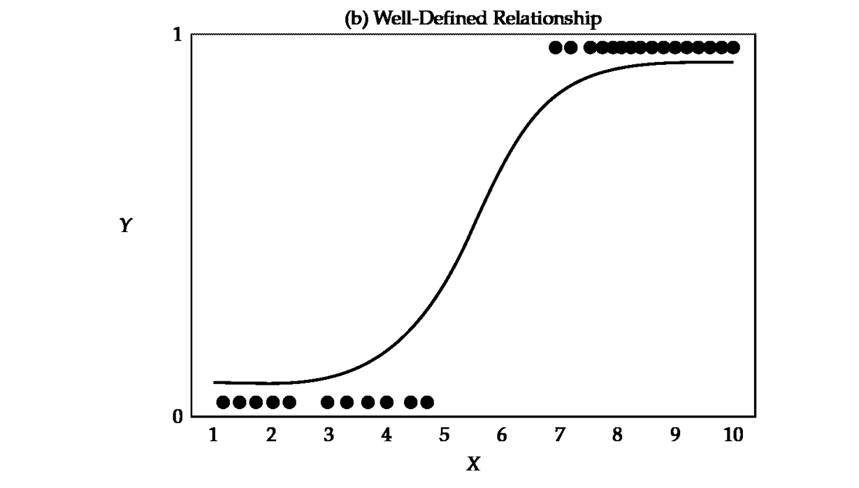
2.USE OF THE LOGISTIC CURVE

Slide 12
3. SAMPLE SIZE
Very small samples have so much sampling errors.
Very large sample size decreases the chances of errors.
Logistic requires larger sample size than multiple regression.
Hosmer and Lamshow recommended sample size greater than 400.

Slide 13
SAMPLE SIZE PER CATEGORY OF THE INDEPENDENT VARIABLE
The recommended sample size for each group is at least 10 observations per estimated parameters.

Slide 14
Stage 3: ASSUMPTIONS
No assumptions about the distributions of the predictor variables.
Predictors do not have to be normally distributed
Does not have to be linearly related.
Does not have to have equal variance within each group.

Slide 15
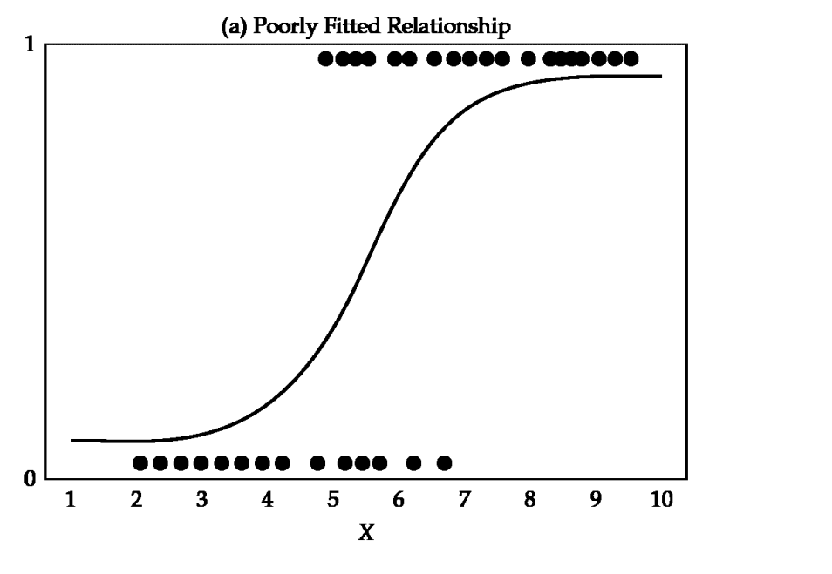
. Transforming the dependent variable
S-shaped
Range (0-1)

Slide 16
What is p?
p = probability (or proportion)

Slide 17
What is p?
p = probability (or proportion)
The lower bound is 0, and the upper bound is 1.
Probability of success: Pr(y = 1) = p
Probability of failure: Pr(y = 0) = 1 – p

Slide 18
What is the p of success or failure?
 | Failure | Success | Total
 | 1 - p | p | (1 - p) + p = 1

Slide 19
What is the p of success or failure?
 | Failure | Success | Total
 | 250 | 750 | = 1000

Slide 20
What is the p of success or failure?
 | Failure | Success | Total
 | 250/1000 | 750/1000 | = 1000/1000

Slide 21
What is the p of success?
 | Failure | Success | Total
 | .25 | .75 | 1

Slide 22
What is the p of success?
 | Failure | Success | Total
 | .25 = 1 - p | .75 = p | 1 = (1 - p) + p

Slide 23
What are odds?
Odds are related to probabilities
The odds of an event occurring is the ratio of the probability of that event occurring to the probability of the event not occurring.
Odds of success = p of success divided by p of failure
omega (ω) = p/(1-p)

Slide 24
What are the odds of success?
 | Failure | Success | Total
 | .25 = (1 - p) | .75 = p | 1 = (1 - p) + p
omega (ω) = p/(1-p)
ω = .75/ (1 - .75)
ω = .75/.25 = 3

Slide 25
What is an odds ratio?
The odds ratio compares the odds of success for one group to another group.
Theta (θ) = ωgroupA = pA/(1-pA)
ωgroupB pB/(1-pB)

Slide 26
4. Estimating the coefficients
It uses the logit transformation.
The logistics transformation can be interpreted as the logarithm of the odds of success vs. failure.

Slide 27
Stage 5 interpretation of the results

Slide 28
SPSS

Slide 29
(Binary) Logistic Regression or “Logit”
Selects regression coefficient to force predicted values for Y to be between (0,1)
Produces S-shaped regression predictions rather than straight line
Selects these coefficient through “Maximum Likelihood” estimation technique

Slide 30
Picture of Logistic Regression
Y
1
Logistic Regression
(non-linear slope coefficient)
Points on regression line represent predicted probabilities
For Y for each value of X
0
X

