Slide 1
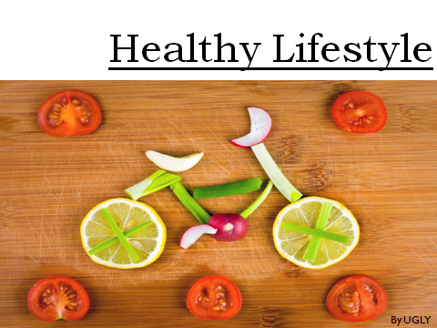

Slide 2
What is healthy lifestyle?
Healthy lifestyle is basically a term, which means adopting all the healthcare activity in your daily life. In order to become habitual of it.
Being healthy means following a healthy diet, regular workout and other healthcare activity.
A healthy balance diet includes daily consumption of at least a small portion of the all six major food groups.
A person should exercise at least thrice in a week to keep the body fit and healthy.

Slide 3
Why healthy lifestyle ?
Healthy lifestyle is the only way to avoid the chances of any chronic diseases like(cancer, diabetes and heart disease).
And if you are already suffering from any unremitting disease then it will help you to reduce the risk of that disease.
The true face of this life is each time what you eat will make an impact on your health, either good or bad.
The choices we make today will be responsible to moderate our future.

Slide 4

What is a healthy lifestyle?
As WHO (World Health Organization) define healthy lifestyle is that focuses on incorporating the eight aspects of wellbeing into one’s life (emotional, environmental, financial, intellectual, occupational, physical, social and spiritual).

Slide 5
Why be healthy?
To live longer
To thrive not just survive
Have more energy
Avoid disease and illness
Keep medical costs down
Look and feel better
Better mental care
Better lifestyle

Slide 6
Physical
Activity
Healthy
Eating
HEALTHY
LIVING
Mental Emotional Health
Healthy
Environ-ments
Avoiding House-hold Toxins

Slide 7








Food Comparison
HEALTHY FOOD
Good Choice
FAST
FOOD
Bad Choice

Slide 8
Nutrient Chart :
Form(contain)
For
Carbohydrates
Bread, pasta, cereals, fruits, vegetables (potatoes, cabbage)
Give energy
Protein
Meat, fish, nuts, cheese, milk
Helps your body grow and b healthy and give your energy
Fat
Milk, cheese, butter, meat
Give your energy
Fiber
Fruits, vegetables, beans, nuts, brown, bread
Fills your stomach when you are hungry
Vitamins A,B,C,D
Fresh fruits and vegetables
Help your body be healthy
Minerals
Fresh fruits and vegetables
Help your body be healthy
Calcium(Ca)
Dairy products (milk, cheese)
Strengthens your bones, help your heart work
Iron(Fe)
Pomegranates, green apples, liver, meat
Help your blood be better

Slide 9
Eat fresh
1
Skip rest days
Make a plan
2
Take the easy way
Cook for yourself
3
Get down on yourself
Enjoy your fitness
4
Forget to reward yourself
Be kind to yourself
5
Treat health like a quick fix
DON’T
DO’s
Enjoy your meal plan
6
Sacrifice a full night of sleep
Balance food & fitness
7
Take emotion out on your body
Drink 8-10 cups of water
8
Get bogged down with numbers
Focus on lifestyle changes
9
Rely on packaged processed foods
Fill your diet with vegetables
10
Give up - ever

Slide 10
Benefits of Healthy Living
Healthy living improves body posture.
01
It spreads happiness.
02
Enhances energy level.
03
Make you feel younger.
04
Improves your metabolism.
05
Increase endurance and longevity.
06

Slide 11
Always consult your doctor
Do a check up
Plan your food
Keep it simple
Vary your food
Useful Tips
Start your day with a healthy breakfast
Eat small regular healthy snacks
Drink plenty of water
Eat more healthy carbohydrates
Eat protein with every meal

Slide 12
10 Tips for Better Living
Empty Calories (Processed Foods)
0
Hour of Exercise or Reading
1
Litters of Water
2
Cups of Green Tea or Green Juice
3
4
Mental & Stretch Breaks
Things your Grateful for
5
6
Am Meditation
Minutes of Laughter
7
8
Hours of Sleep
Pm Time to Sleep
9
10
Thousand Steps Daily

Slide 13


World Health Day
World Health Day is celebrated by the people all across the world every year on 7th April.
Under the leadership of World Health Organization (WHO).
To draw the mass people attention towards the importance of global health.

Slide 14
Thank You

