Slide 1
HEALTH AND WELLNESS
ALLAN SINGH
NURSING LECTURER
TMCON

Slide 2
TABLE OF CONTENTS
01
02
HEALTH
WELLNESS
COMPONENTS OF HEALTH
COMPONENTS OF WELLNESS

Slide 3
HEALTH

Slide 4
Health is a state of complete physical, mental and social well-being and not only the absence of disease and infirmity. Health can be promoted by encouraging healthful activities, such as regular physical exercise and adequate sleep, and by reducing or avoiding unhealthful activities or situations.
Some factors affecting health are due to individual choices, such as whether to engage in a high-risk behavior, while others are due to structural causes, such as whether the society is arranged in a way that makes it easier or harder for people to get necessary healthcare services. Still other factors are beyond both individual and group choices.

Slide 5
COMPONENTS
OF HEALTH

Slide 6
COMPONENTS OF HEALTH
EMOTIONAL/SOCIAL HEALTH
MENTAL
HEALTH
PHYSICAL
HEALTH

Slide 7
PHYSICAL HEALTH
You are able to carry out every day tasks without becoming overly tired. A healthy diet, regular exercise, adequate sleep, and proper medical and dental care are all important for physical health.
MENTAL HEALTH
The state of being comfortable with yourself, with others, and with your surroundings. When you are mentally healthy your mind is alert, you learn from mistakes, and recognize achievement.
EMOTIONAL/SOCIAL HEALTH
An individual is emotionally healthy, when the feelings experienced are appropriate responses to the event.
An individual is socially healthy when he/she has loving relationships, respect the rights of others and give and accept help.

Slide 8
WELLNESS

Slide 9
WELLNESS
An active process through which people become aware of, and make choices toward, a more successful existence
Wellness is considered a conscious, self-directed and evolving process of achieving full potential.
Wellness is multidimensional and holistic, encompassing lifestyle, mental and spiritual well-being, and the environment.
Wellness is positive and affirming.

Slide 10
COMPONENTS OF WELLNESS
PHYSICAL
WELLNESS
MENTAL
WELLNESS
EMOTIONAL
WELLNESS
SOCIAL
WELLNESS
SPIRITUAL
WELLNESS

Slide 11
PHYSICAL WELLNESS
The physical component of wellness involves the ability to carry out daily tasks, develop cardio respiratory and muscular fitness, maintain adequate nutrition, healthy body fat level, get adequate sleep and avoiding alcohol, drugs or tobacco.
MENTAL WELLNESS
Mental Wellness involves the ability to learn and use information effectively for personal, family, and career development.
EMOTIONAL WELLNESS
Emotional Wellness is the ability to control stress and to express emotions appropriately and comfortably.
SOCIAL WELLNESS
The social component of wellness means having the ability to interact successfully with people and one's personal environment.
SPIRITUAL WELLNESS
The spiritual component of wellness provides meaning and direction in life and enables you to grow, learn, and meet new challenges..

Slide 12
Vocabulary
Health—the combination of physical, mental/emotional, and social well-being
Spiritual Health—a deep-seated sense of meaning and purpose in life
Wellness—an overall state of well-being or total health
Chronic Disease—an ongoing condition or illness

Slide 13

The Health Triangle
3 Elements:
Physical Health
Mental/Emotional Health
Social Health

Slide 14
Health v. Wellness
Health is the combination of physical, mental/emotional, and social well-being
Wellness is keeping a balance among the three components of health

Slide 15
Keeping a Balance
Wellness comes from making decisions and practicing behaviors that are based on sound health knowledge and healthful attitudes

Slide 16
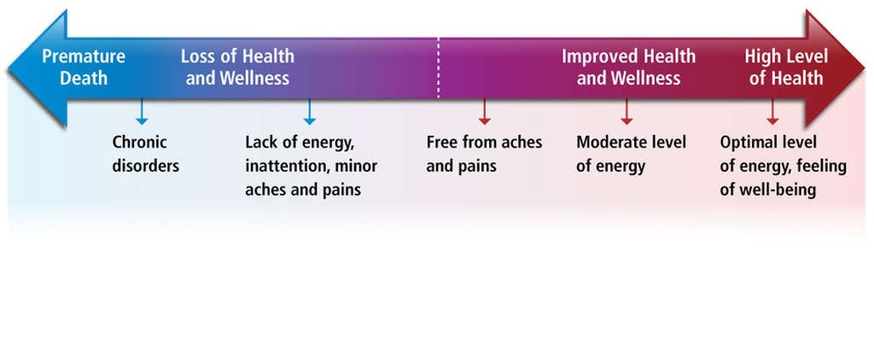
The Health Continuum
Your health and wellness are ALWAYS changing
Your health can be measured on a sliding scale
Hint: Be able to label the health continuum diagram ☺

Slide 17
THANK YOU!

