Slide 1

IT-Ticket Classification using LLM.
Presented By:
Amulya Potluri
Owais Shaikh
Ashutosh Joshi
Guided by: Dr . Unal Sakoglu

Slide 2
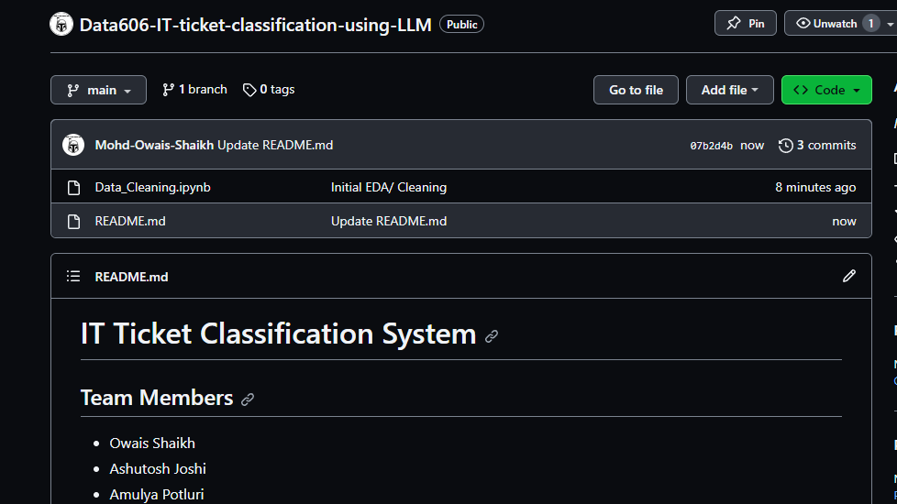
Links for Dataset and Code
Kaggle Dataset Link:
https://www.kaggle.com/datasets/venkatasubramanian/automatic-ticket-classification
Kaggle ID: kaggle.com/owaisshaikh0611
Github Link:
https://github.com/Mohd-Owais-Shaikh/Data606-IT-ticket-classification-using-LLM

Slide 3
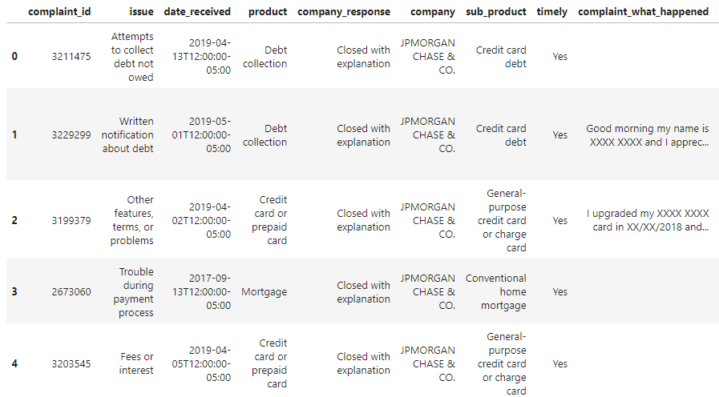
Initial Dataset
Shape:78,313 records and 11 features
Target Variable: 'Product'
Number of classes in target Variable: 17
Null values in Target Variable/ Major Feature > 0
Dataset Link : https://www.kaggle.com/datasets/venkatasubramanian/automatic-ticket-classification

Slide 4
Literature survey
S. S. Kulkarni [1] used 10742 records and 18 classes in target variable
Techniques
Logistic regression, KNN, MNB, and SVM
Accuracy
LR, KNN, Random-Forest and SVM are respectively 84.50%, 69.24%, 70.1% and 88.22% respectively

Slide 5
ULMFiT by Howard.J.
•He used six widely-studied datasets, used three common text classification tasks: sentiment analysis, question classification, and topic classification [2].
•The process of fine-tuning a language model using ULMFiT involves three stages:
Pretraining
FineTuning
Classification.

Slide 6
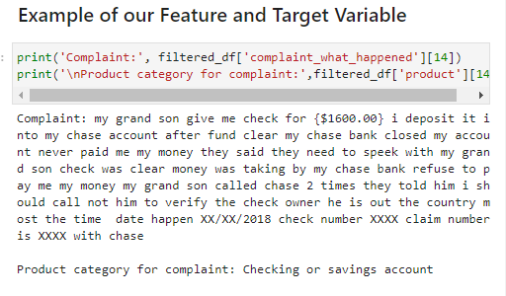
Data Cleaning
Sanity Checks:
Null Values in the Data: 0
Removed blank complaint values.
Total complaints after removing blank values: 21,072

Slide 7
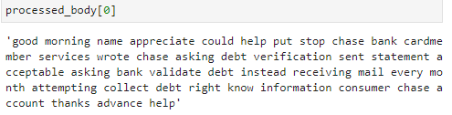
Data Preprocessing
Split each individual word into a token.
Convert all tokens to lowercase.
Removing Punctuations
Removing Stopwords; “you, he, she, in, a, has, etc.”

Slide 8
Dimensionality reduction and Vectorization
To convert our feature into numerical vectors, we used two approaches.
SelectKBest method
It selects the ‘K’ best features from our data to reduce dimensionality.
K values ranging from 50,000 to 1,000 were tested.
However, the accuracy of the model did not significantly improve.
TF-IDF Vectorization
TFIDF (Term Frequency-Inverse Document Frequency) measures word importance.
TFIDF can result in high-dimensional data with large vocabularies.
TSVD (TruncatedSVD) helps in reducing the dimensionality of the data.
TSVD is particularly useful for clustering and semisupervised learning.

Slide 9
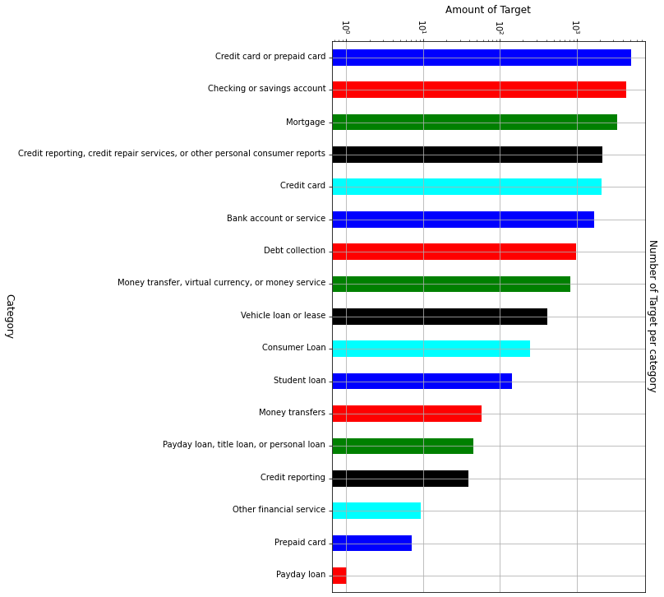
Target variable has 17 classes.
We will need Multi-Class Classification Algorithm.
Models Planned:
Random Forest
Logistic Regression
Large Language Model (BERT)

Slide 10
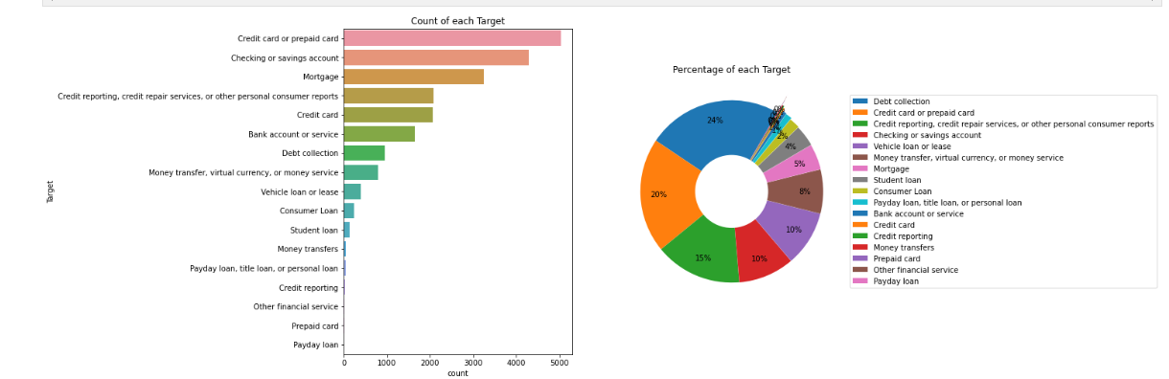
Data Distribution

Slide 11
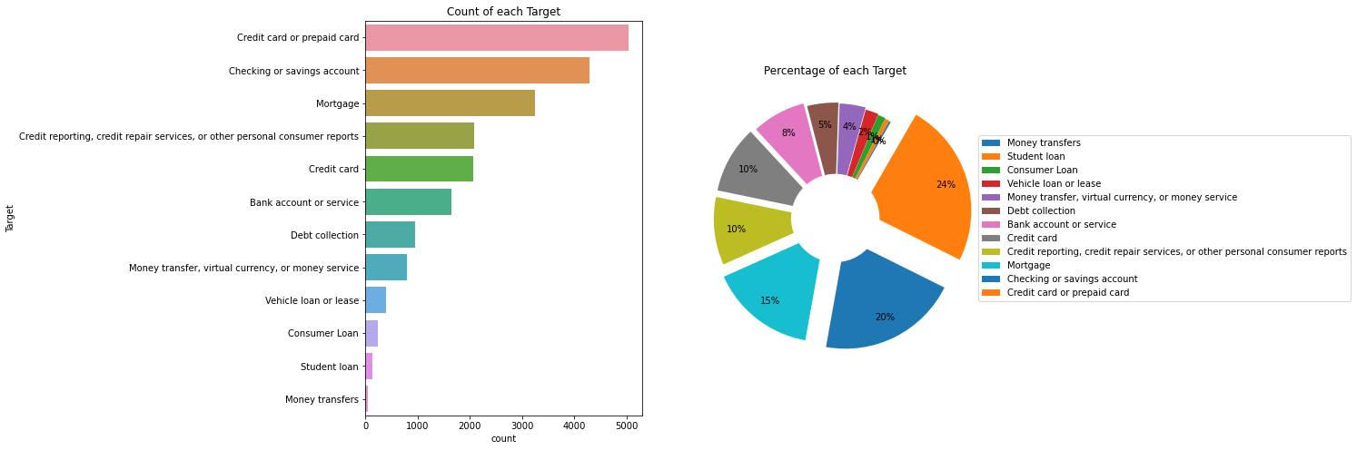
Data Distribution after category reduction
Notes:
Entered text
- Since it is text data, each word is a feature, each complaint has unnecessary features, which might not be relevant for classification model.
- We tried using SelectKBest method from sklearn, along with chi2 as the scoring function, to select k values for selecting best features, ranging in [50000 -> 1000]. This did not improve the accuracy of the model in a significant way.
- TF-IDF (Term Frequency-Inverse Document Frequency) is a numerical statistic that reflects how important a word is to a document in a collection or corpus. However, TF-IDF can result in high-dimensional data, especially when dealing with large vocabularies, and this is where TSVD comes in.
- TSVD can be particularly useful for clustering and semi-supervised learning tasks. Clustering algorithms, such as K-means or hierarchical clustering, can struggle with high-dimensional data due to the curse of dimensionality, and reducing the dimensionality of the data with TSVD can lead to better performance.

Slide 12
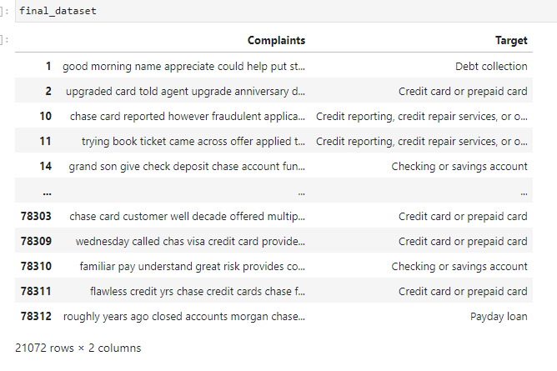
Final Dataset:
Feature: 21,072 Complaints
Number of classes in target Variable: 17
Null values in Target Variable/ Major Feature: 0

Slide 13
Modeling the Data before LLM.
We are going to use Logistic Regression and Random-Forest Classification for our multi-class classification model
Model Parameters
Train-Test split of 80-20 respectively, random state enabled to evenly distribute data in train and test datasets.
After basic training, we’re going to implement 5-fold Cross validation and Grid-Search CV to create a Hyper Parameter tuned model for better performance.
Notes:
Entered text
- Since it is text data, each word is a feature, each complaint has unnecessary features, which might not be relevant for classification model.
- We tried using SelectKBest method from sklearn, along with chi2 as the scoring function, to select k values for selecting best features, ranging in [50000 -> 1000]. This did not improve the accuracy of the model in a significant way.
- TF-IDF (Term Frequency-Inverse Document Frequency) is a numerical statistic that reflects how important a word is to a document in a collection or corpus. However, TF-IDF can result in high-dimensional data, especially when dealing with large vocabularies, and this is where TSVD comes in.
- TSVD can be particularly useful for clustering and semi-supervised learning tasks. Clustering algorithms, such as K-means or hierarchical clustering, can struggle with high-dimensional data due to the curse of dimensionality, and reducing the dimensionality of the data with TSVD can lead to better performance.

Slide 14
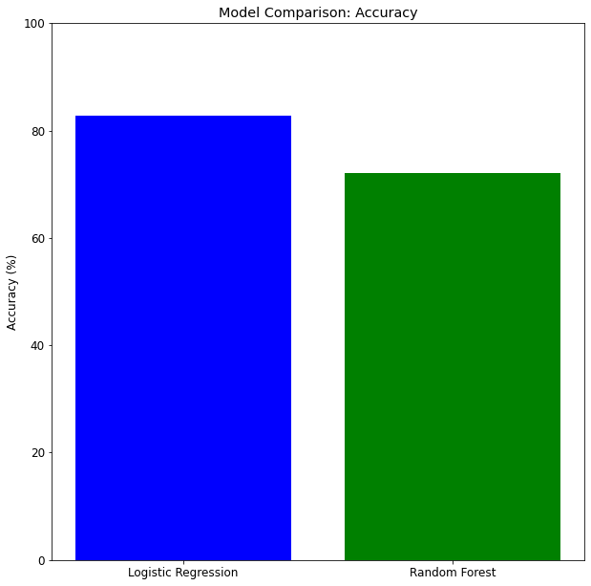
We’re using Accuracy for our performance metric, as used by SS.Kulkarni [1] for comparative study of models for Multi-Class problem.
Accuracy Comparison with our Literature Survey.
Our Accuracy.
Logistic Regression: 82.80 %
Random Forest: 74 %
Accuracy in SS.Kulkarni’s Model.
Logistic Regression: 84.50 %
Random Forest: 70 %

Slide 15
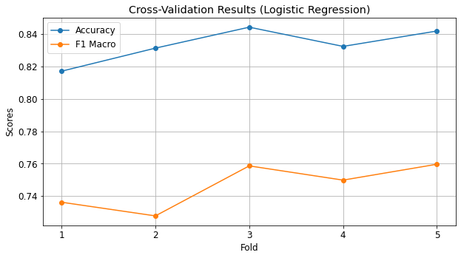
5-fold Cross- validation was performed to detect overfitting and best-fitting pattern.
There was no considerable difference seen in the five folds.
Grid-Search CV was performed on the logistic regression model.
Best Parameters: 'C': 1, 'penalty': 'l1'
Training Accuracy after Hyper-Parameter tuning: 84%

Slide 16
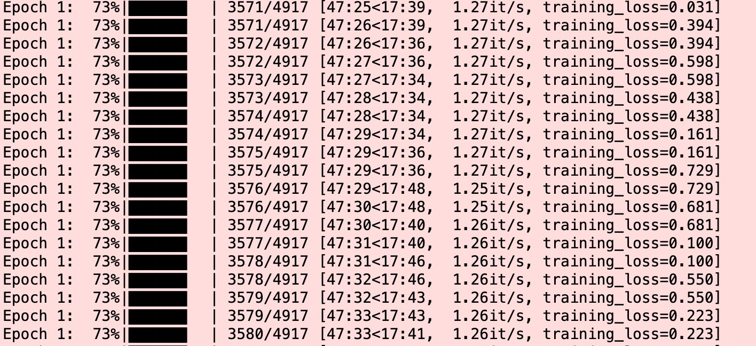
Training on High-end machine
The high-end computing infrastructure showcases exceptional performance, surpassing the standard workspace by an impressive 20-fold margin.
Leveraging this advanced computing power has led to a substantial reduction in model training time.
Previously, the training process required a substantial 11 hours to complete a mere 5 epochs.
The efficiency gains are evident in the streamlined execution of computational tasks, allowing for quicker turnaround times in model development and experimentation.

Slide 17
References:
[1]. Paramesh, Ramya, Shreedhara. "Classifying the Unstructured IT Service Desk Tickets Using Ensemble of Classifiers".(2018). IEEE. https://arxiv.org/pdf/2103.15822
[2]. Jeremy Howard, Sebastian Ruder. (2018). "Universal Language Model Fine-tuning for Text Classification". ArXiv. https://arxiv.org/pdf/1801.06146.pdf [3].
[3]. https://monkeylearn.com/blog/ticket-classification-with-ai/

Slide 18


Slide 19
Thank You

