Slide 1

Retail Sales Analytics Report
A comprehensive performance overview covering $2.3M in sales, 5,009 orders, and 793 customers — with actionable insights to drive growth.

Slide 2
Executive Summary
The retail business generated $2,297,200.86 in total sales from 5,009 unique orders placed by 793 customers. The company earned a total profit of $286,397.02, with an average order value of $458.61. Overall, the business is profitable, but profitability varies significantly across products, discounts, and regions, indicating opportunities for optimization.
$2.3M
$286K
5,009
Total Sales
Total Profit
Total Orders
793
$458
Total Customers
Avg Order Value

Slide 3
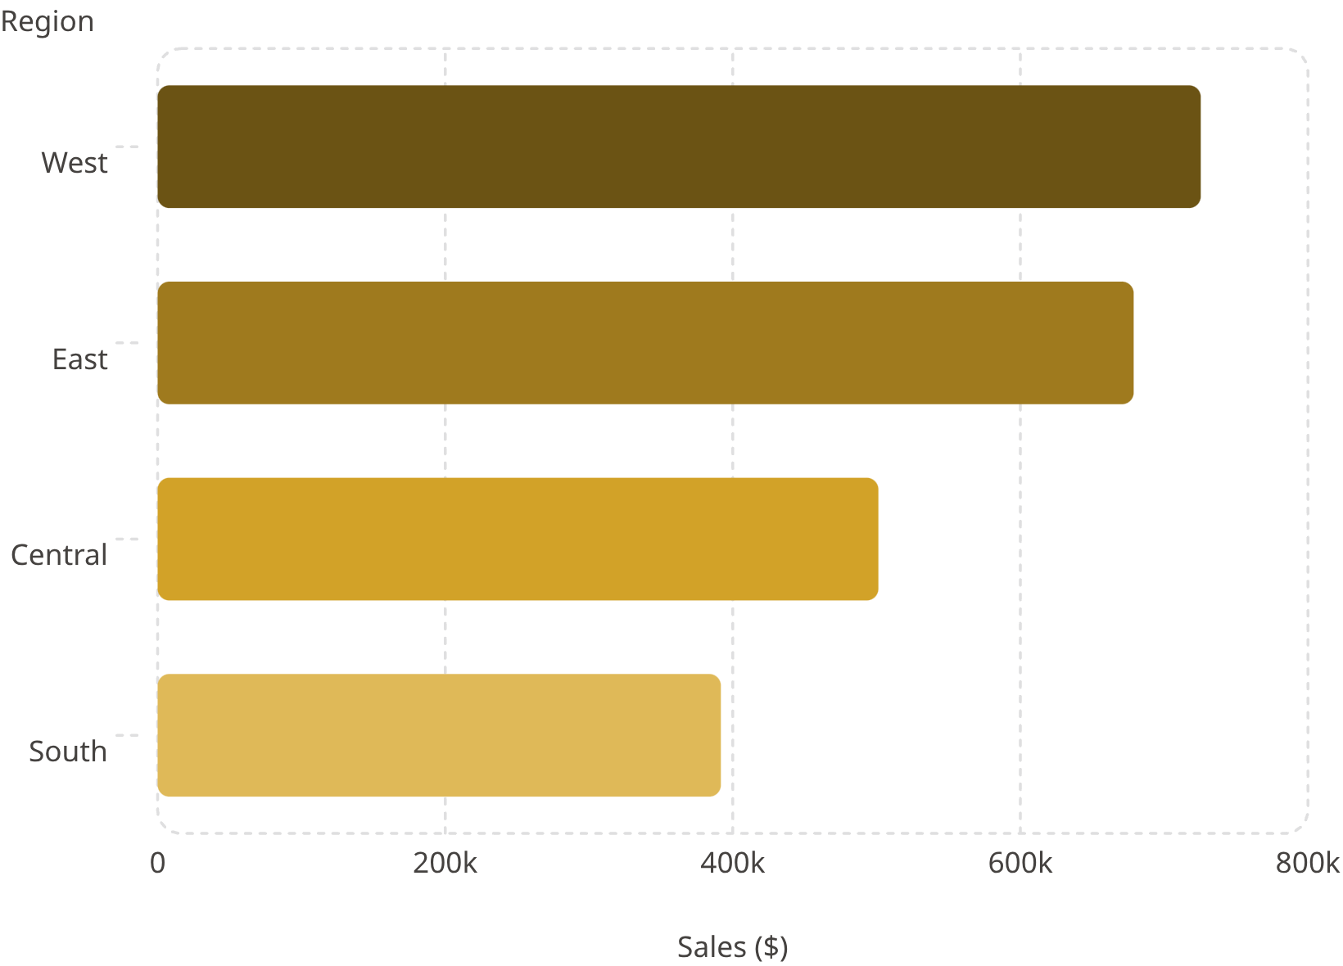
Regional Performance
Key Regional Insights
West leads with $725,457.82 — the strongest market by sales
East also performs well and could be a candidate for additional investment
Central and South may benefit from region-specific marketing or product strategies
The South recorded the lowest sales ($391,721.91), suggesting room for growth through targeted marketing or expansion
The gap between West and South indicates uneven regional performance

Slide 4
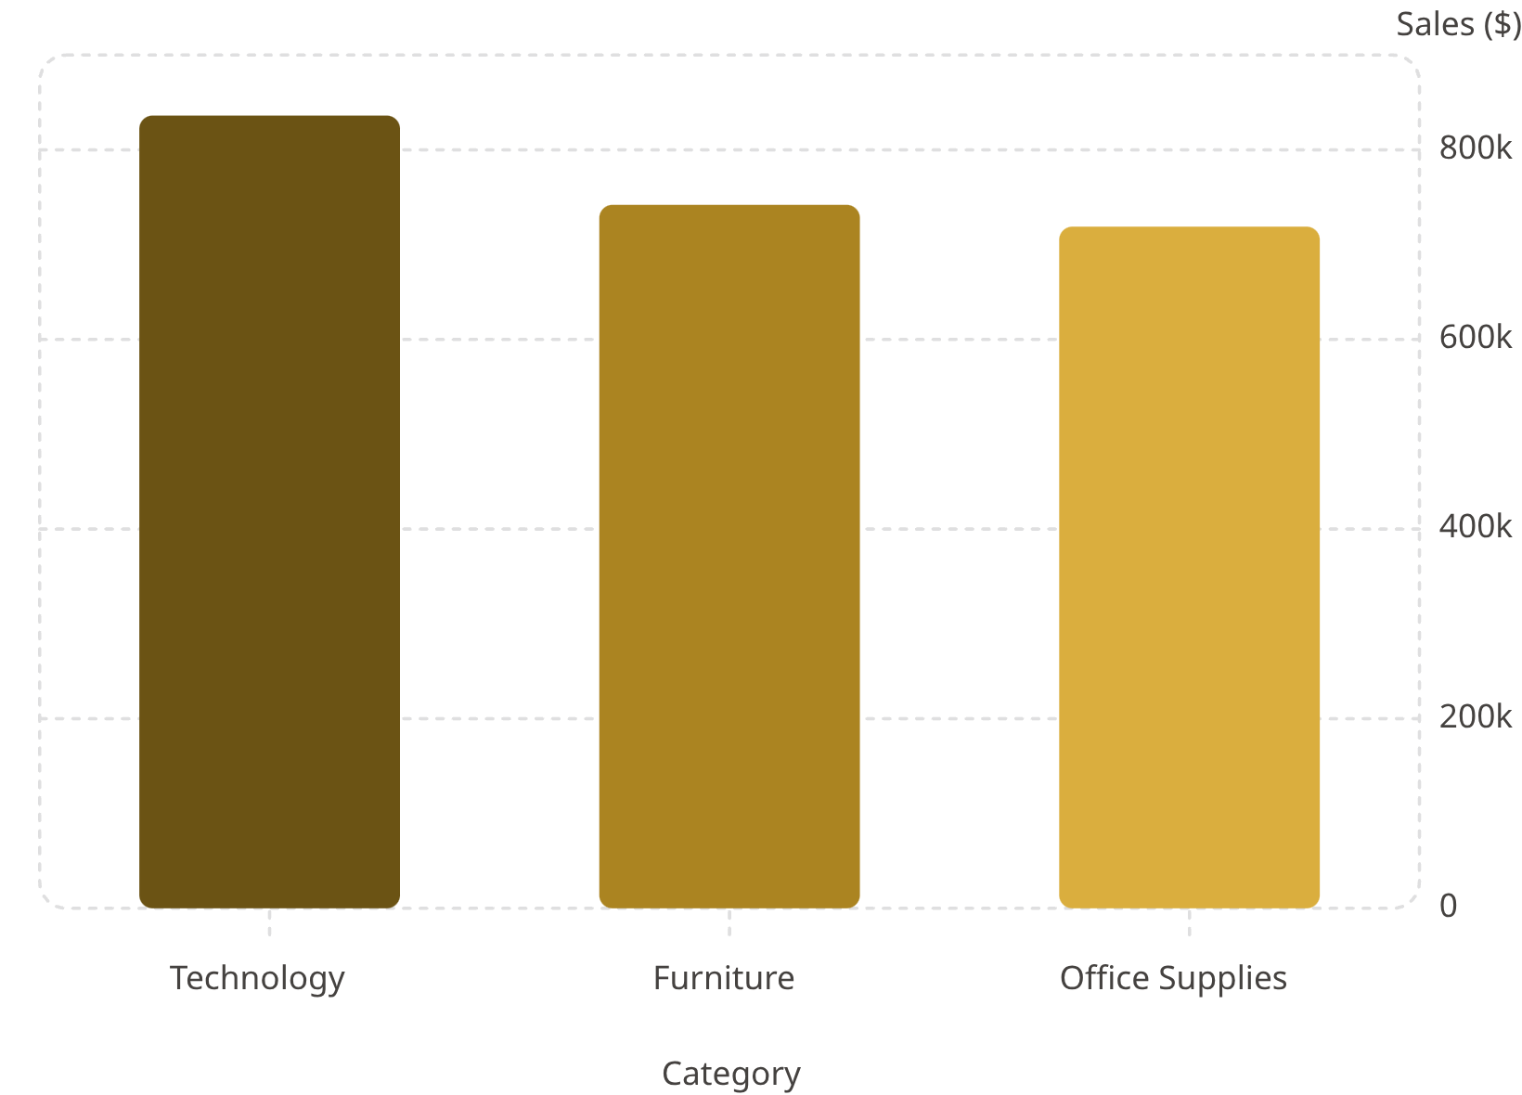
Category Performance
Category Insights
Technology is the highest revenue-generating category at $836,154.03 — it should remain a strategic focus
Furniture ($741,999.80) and Office Supplies ($719,047.03) contribute similar sales, providing a diversified revenue base
High-value office equipment contributes significantly to overall revenue
Product performance analysis can help optimize inventory and product placement

Slide 5

Top Customers
Sean Miller
Tamara Chand
Raymond Buch
$25,043.05 in sales
$19,052.22 in sales
$15,117.34 in sales
Tom Ashbrook
Adrian Barton
$14,595.62 in sales
$14,473.57 in sales
A small group of customers contributes disproportionately to revenue. Loyalty programs and personalized engagement for these high-value customers could increase retention and lifetime value.

Slide 6
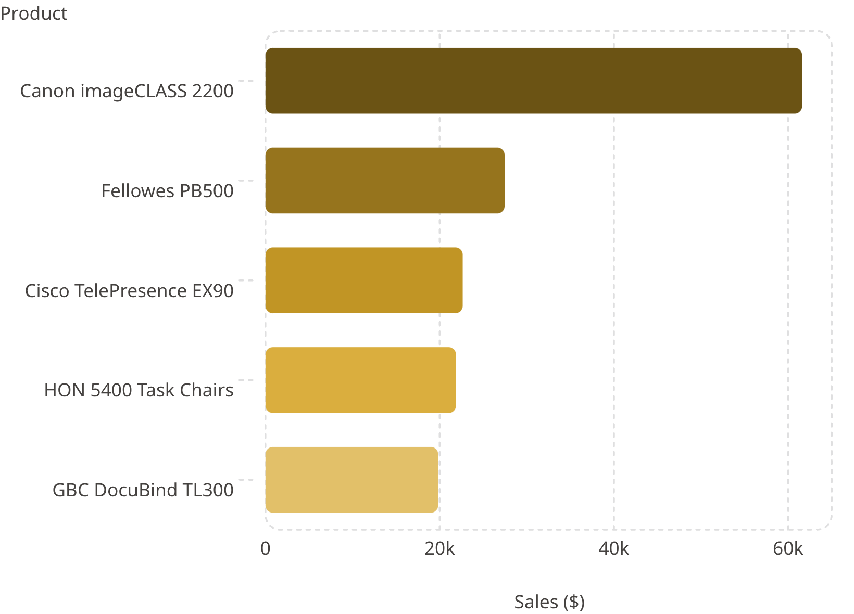
Best-Selling Products
Product Insights
The Canon imageCLASS 2200 Advanced Copier dominates at $61,599.82 — the top-performing product by a large margin
These top products should receive priority in inventory planning and marketing

Slide 7
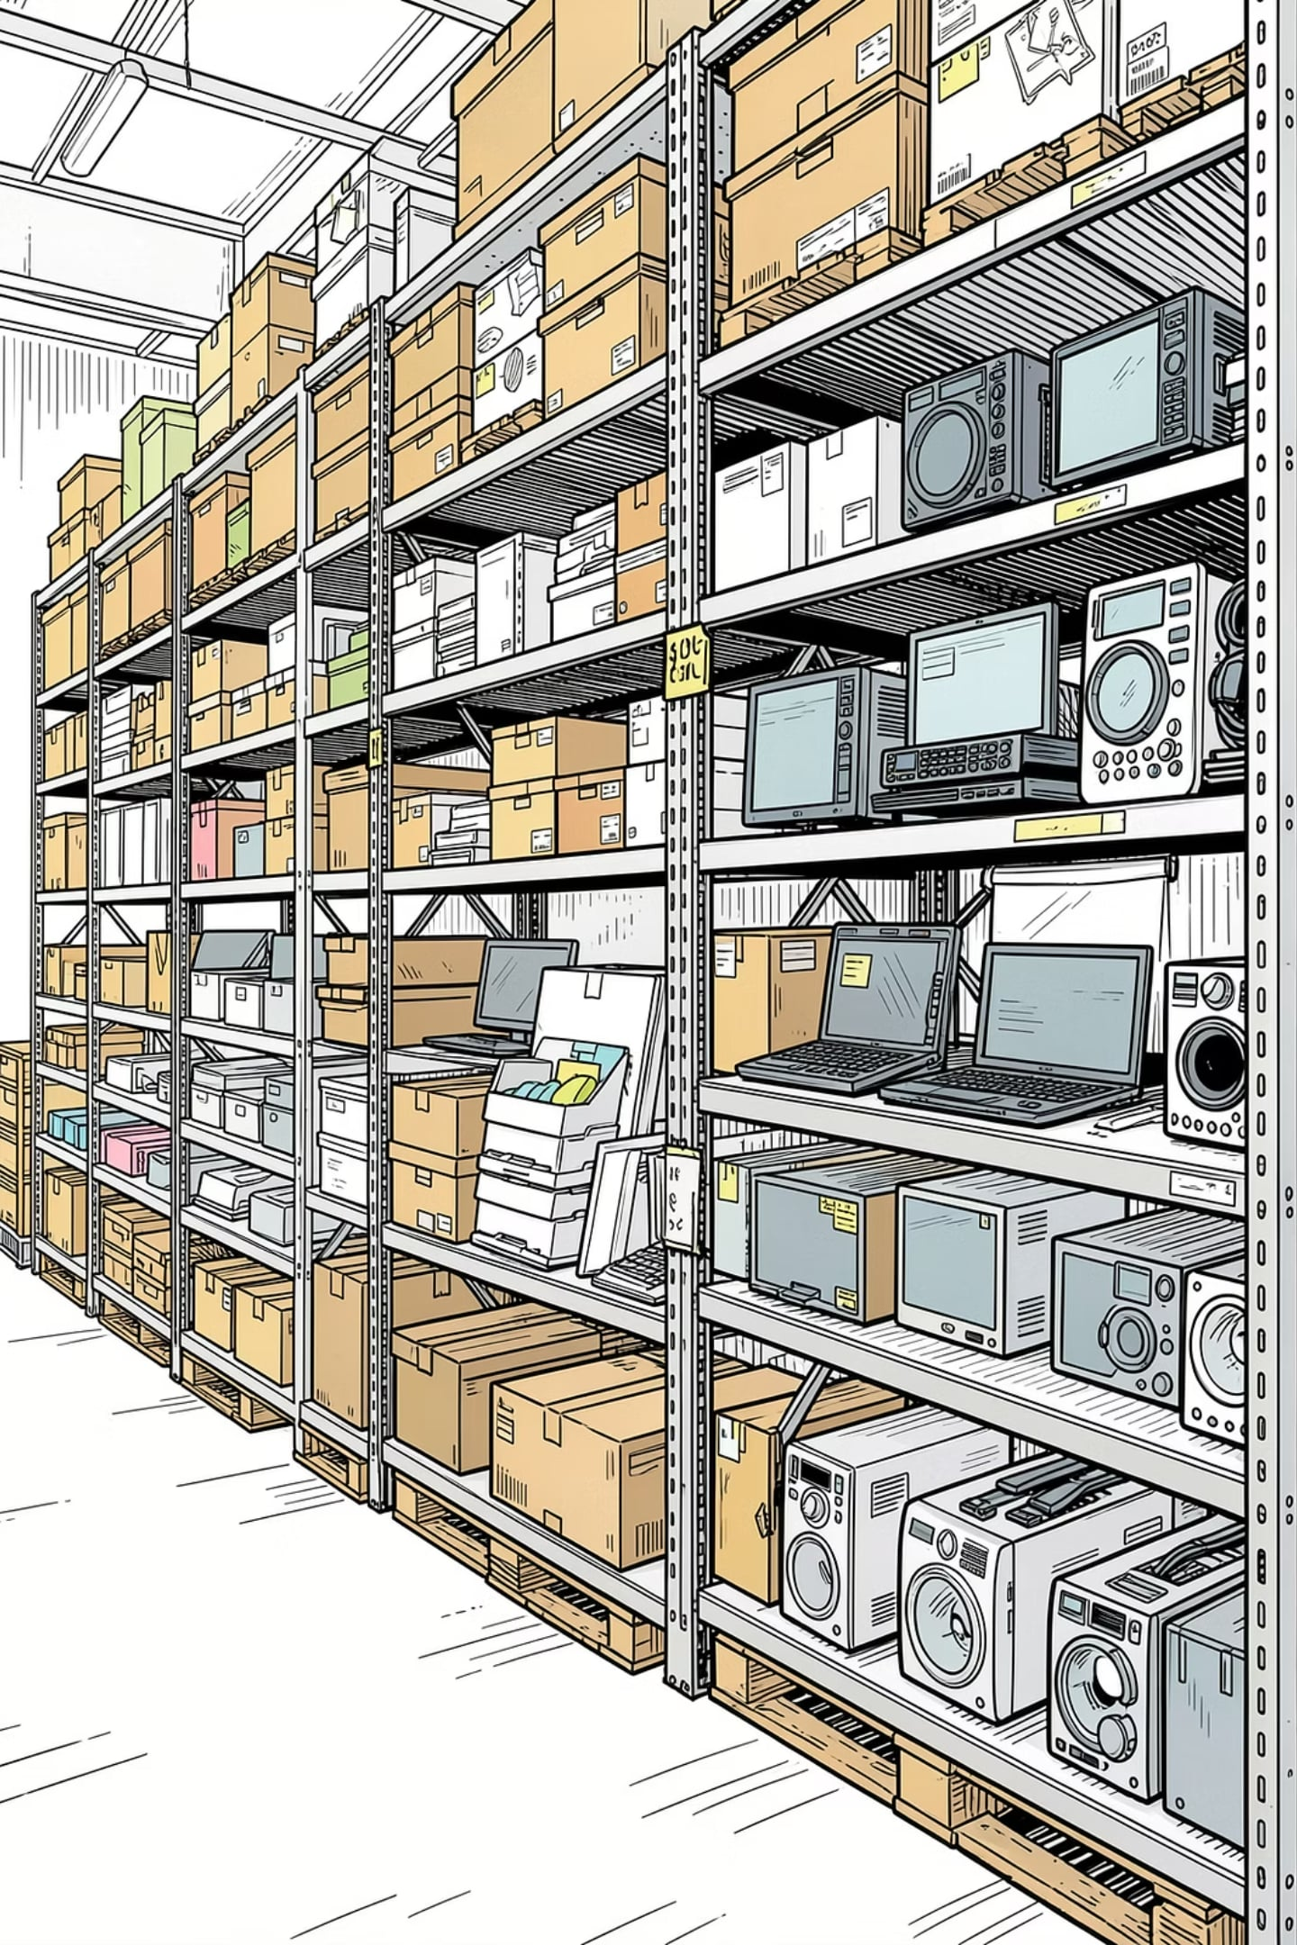
Sales Trend & Seasonality
📈 Peak Month
🎄 Holiday Effect
November 2014 recorded the highest monthly sales at $112,326.47
Sales appear to peak during the holiday season. Promotional campaigns in Q4 are likely to generate the highest returns.
📦 Inventory Planning
Inventory should be increased before November to meet demand.

Slide 8
Customer & Product Insights
Customer Insights
Product Insights
793 unique customers generated over 5,000 orders
Average order value of $458.61 indicates customers often purchase multiple items or higher-value products
High-value customers present opportunities for targeted promotions and loyalty programs
Technology is the strongest-performing category
High-value office equipment contributes significantly to overall revenue
Product performance analysis can help optimize inventory and product placement

Slide 9
Business Recommendations
01
02
Invest in Technology
Strengthen the South Region
Increase investment in the Technology category — it generates the highest revenue.
Improve regional balance through targeted marketing and expansion in the South.
03
04
Retain High-Value Customers
Plan for Q4 Demand
Deploy loyalty programs and personalized offers for top-spending customers.
Maintain sufficient inventory for top-selling products before the November sales peak.
05
06
Optimize Pricing & Discounts
Tailor Regional Campaigns
Review discount strategies to ensure they do not unnecessarily reduce profitability.
Use regional performance data to tailor sales campaigns and product offerings.

Slide 10

Conclusion
This analysis shows a healthy retail business with $2.30 million in sales and $286 thousand in profit. Revenue is driven primarily by the Technology category and the West region, while customer spending is concentrated among a relatively small number of high-value customers.
Profitable
Seasonal Peak
$286K profit on $2.3M sales
November demand requires inventory planning
Growth Opportunity
South region and customer retention
By focusing on profitable products, strengthening lower-performing regions, and retaining valuable customers, the business can further improve revenue growth and profitability.

