Slide 1
Mohamed Afri
Final Project
3/21/2024 Annual Review

Slide 2
Rock vs Mine Prediction
3/21/2024 Annual Review

Slide 3


AGENDA Welcome to our exploration of advanced technology in Rock vs. Mine Prediction using Logistic Regression. We embark on this journey with an Introduction, outlining the Problem Statement and offering a concise Project Overview. Transitioning to our Solution segment, we delve into the architecture and methodologies applied in our predictive system. Moving forward, we delve into Model Building, revealing the logistic regression framework and techniques employed to train our model. Finally, in the Predictive System segment, we showcase the practical application of our solution. Join us as we advance towards more accurate and efficient rock vs. mine classification solutions.
3/21/2024 Annual Review

Slide 4

PROBLEM STATEMENT In domains like underwater navigation and defense, accurately distinguishing between rocks and mines using SONAR data is critical. Manual analysis is time-consuming and prone to errors. Developing an automated solution for rock vs. mine classification can significantly enhance operational efficiency and ensure safety.
3/21/2024 Annual Review

Slide 5

PROJECT OVERVIEW Our project aims to optimize underwater navigation and defense systems by developing an intelligent system capable of autonomously classifying SONAR data into "rock" or "mine" categories. By harnessing the power of logistic regression, we strive to create a solution that not only improves classification accuracy but also enhances operational efficiency.
3/21/2024 Annual Review

Slide 6

WHO ARE THE END USERS? Defense: Navy and defense agencies can utilize our solution to enhance underwater threat detection and navigation safety. Marine Exploration: Companies engaged in marine exploration and research can leverage our technology for accurate identification of underwater objects. Commercial Shipping: Shipping companies can employ our system to mitigate collision risks and ensure safe navigation in marine environments.
3/21/2024 Annual Review

Slide 7

YOUR SOLUTION AND ITS VALUE PROPOSITION
Our solution leverages Logistic Regression to analyze SONAR data and classify it into "rock" or "mine" categories. The model is trained on a dataset comprising SONAR signals corresponding to rocks and mines, enabling it to accurately differentiate between the two.
Accuracy: Achieves high accuracy rates in classifying SONAR data into rocks and mines.
Efficiency: Automates the classification process, saving time and resources.
Applicability: Applicable across various domains including defense, marine exploration, and commercial shipping.
Real-time Detection: Provides real-time analysis, enabling swift responses to potential threats.
3/21/2024 Annual Review

Slide 8

THE WOW IN YOUR SOLUTION Data Preprocessing Excellence: Thorough data preprocessing ensures dataset integrity and enhances model performance, with data split into training and validation sets. Logistic Regression Optimization: Fine-tuning of hyperparameters and regularization techniques optimize model performance and robustness. Scalability and Adaptability: Modular design facilitates easy customization and integration into diverse environments, promising scalability and adaptability.
3/21/2024 Annual Review

Slide 9
MODELLING
Data Preparation: Utilize dataset of SONAR signals corresponding to rocks and mines. Preprocess data and split for training/validation.
Model Architecture: Implement Logistic Regression model using scikit-learn for classification.
Training and Evaluation: Train model, evaluate on validation set, visualize performance metrics.
Predictive System Development: Develop data preprocessing pipeline, implement prediction. Deploy system for real-time rock vs. mine classification.
Tech stack used: Technology used: Scikit-learn for Logistic Regression implementation. NumPy for data handling. Matplotlib for visualization.
3/21/2024 Annual Review

Slide 10
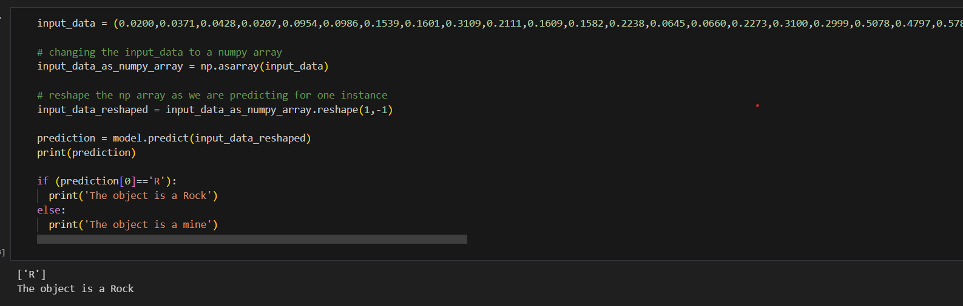
RESULTS
Demo Link
3/21/2024 Annual Review

Slide 11
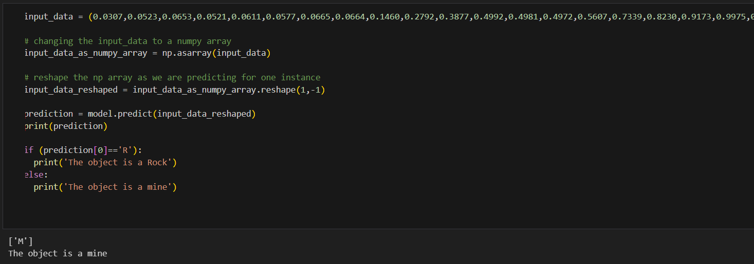
RESULTS
Demo Link
3/21/2024 Annual Review

