Slide 1
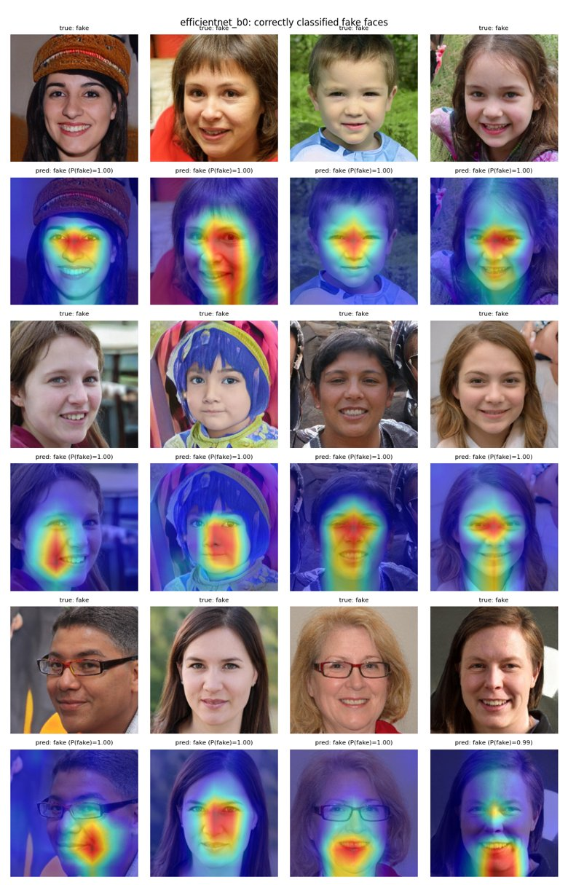
MACHINE LEARNING · SEMESTER 5
99.84%
Deepfake
Detection
test accuracy
1.0000
ROC-AUC
Real vs StyleGAN-generated faces with transfer learning and Grad-CAM
33
errors / 20,000
Mohd Shaan
Submitted to Dr. Prakash
October 2026
140k
face images

Slide 2
INTRODUCTION
Problem and motivation
• Deepfakes: images or videos generated by deep networks that look authentic.
• Entire-face synthesis: StyleGAN creates faces of people who do not exist — used for fake profiles, fraud and disinformation.
• Humans can't tell: real and generated faces look the same to the eye.
• Our task: binary classification — given one face image, predict REAL or FAKE with a probability P(fake).
Objectives
1. Clean, verified data pipeline + EDA
2. Fine-tune EfficientNet-B0 and ResNet-18
3. Rigorous test-set evaluation + error analysis
4. Explain decisions with Grad-CAM
5. Streamlit demo + out-of-distribution test
Deepfake Detection · Real vs StyleGAN Faces
2

Slide 3
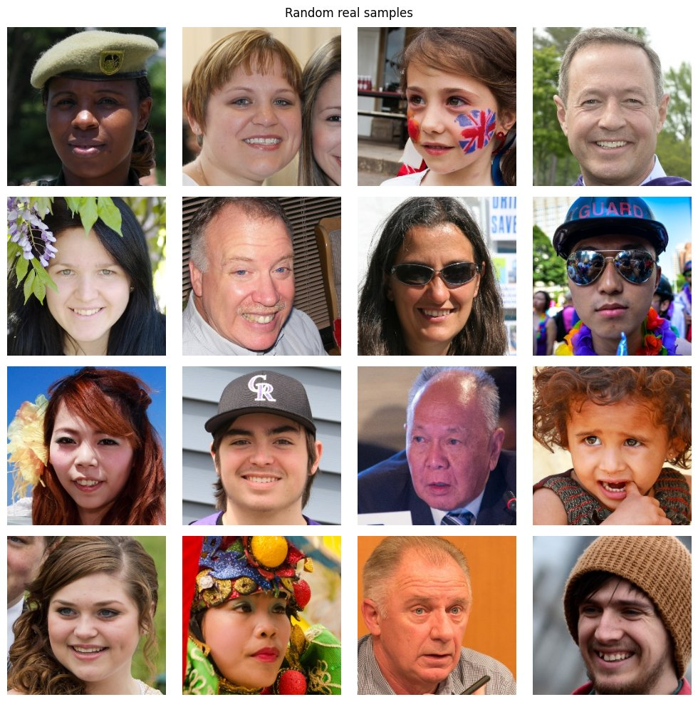
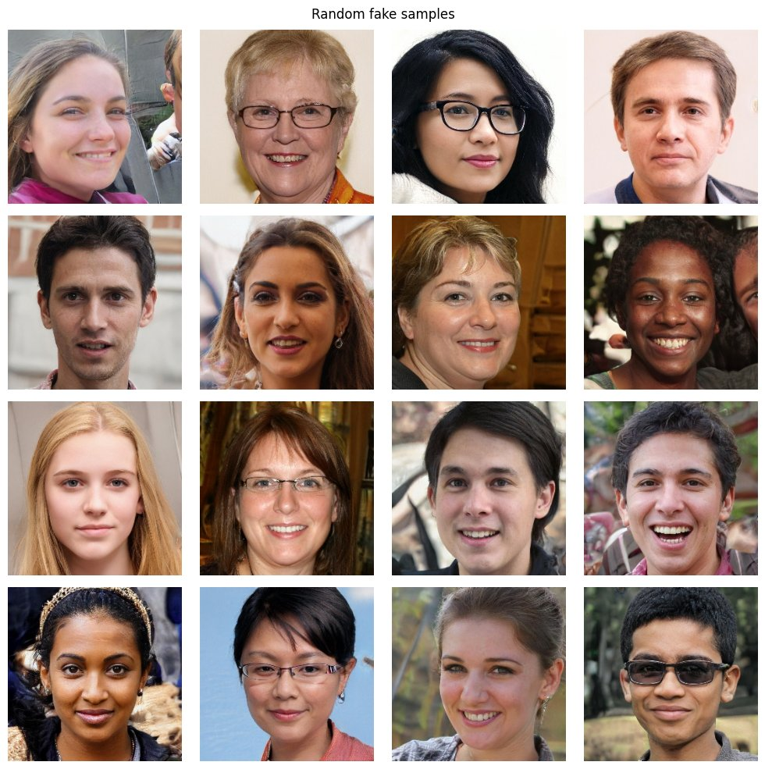
DATA
Dataset: 140k Real and Fake Faces
Split | Real | Fake | Total
train | 50,000 | 50,000 | 100,000
valid | 10,000 | 10,000 | 20,000
test | 10,000 | 10,000 | 20,000
• Real: 70k FFHQ photographs (Flickr)
• Fake: 70k StyleGAN images
• 256×256, face-aligned, perfectly balanced
• Predefined splits used as-is → no data leakage; test set used once
real (FFHQ)
fake (StyleGAN)
Deepfake Detection · Real vs StyleGAN Faces
3

Slide 4
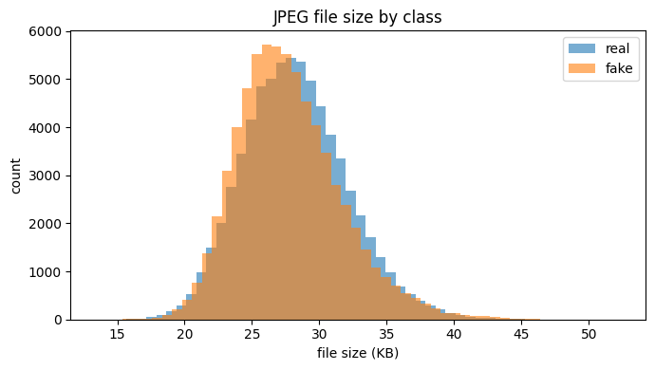
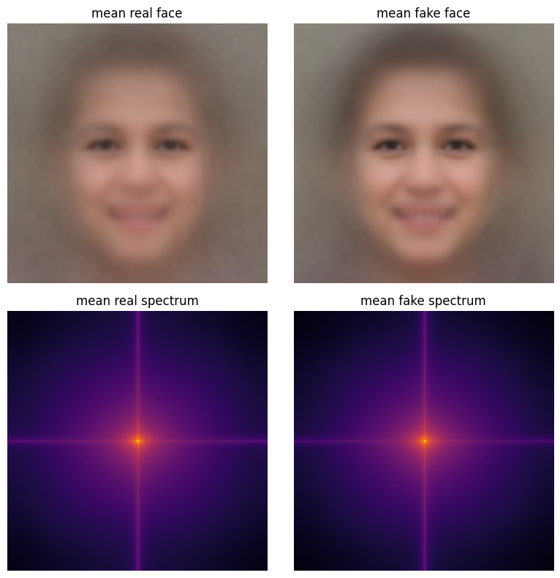
DATA
Exploratory data analysis — clean data, no shortcuts
• 0 corrupted files
• 0 exact duplicates (MD5)
• 50/50 balance in every split
• All 256×256 RGB
• No compression shortcut (Δ ≈ 0.5 KB)
• Spectra nearly identical → signal is subtle and local → CNN
JPEG file size per class — almost full overlap
• Full scan of all 140,000 images on Kaggle (≈17 min)
• Mean fake face is sharper → StyleGAN faces more uniform in pose
mean face and mean Fourier spectrum
Deepfake Detection · Real vs StyleGAN Faces
4

Slide 5
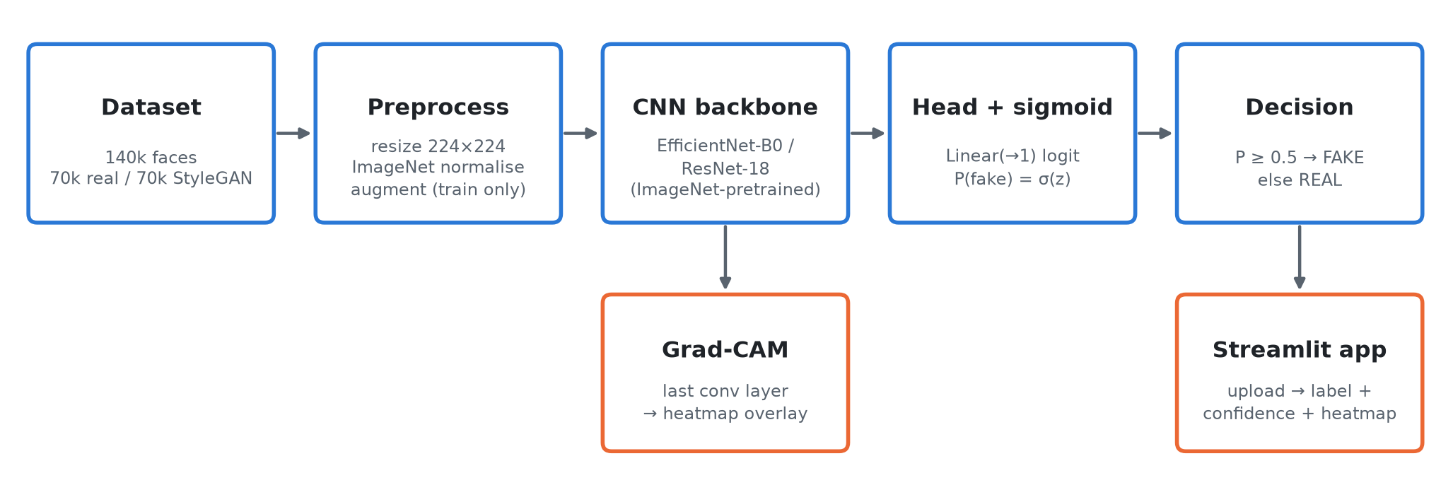
METHODOLOGY
Pipeline and implementation
Module | dataset.py | eda.py | model.py | train.py | evaluate.py | gradcam.py | app.py
Role | load, resize, augment | data checks | backbones + head | 2-phase training | metrics + errors | heatmaps | Streamlit demo
Built module by module · one commit + one theory document per module · trained on Kaggle (Tesla T4) · reproducible notebooks
Deepfake Detection · Real vs StyleGAN Faces
5

Slide 6
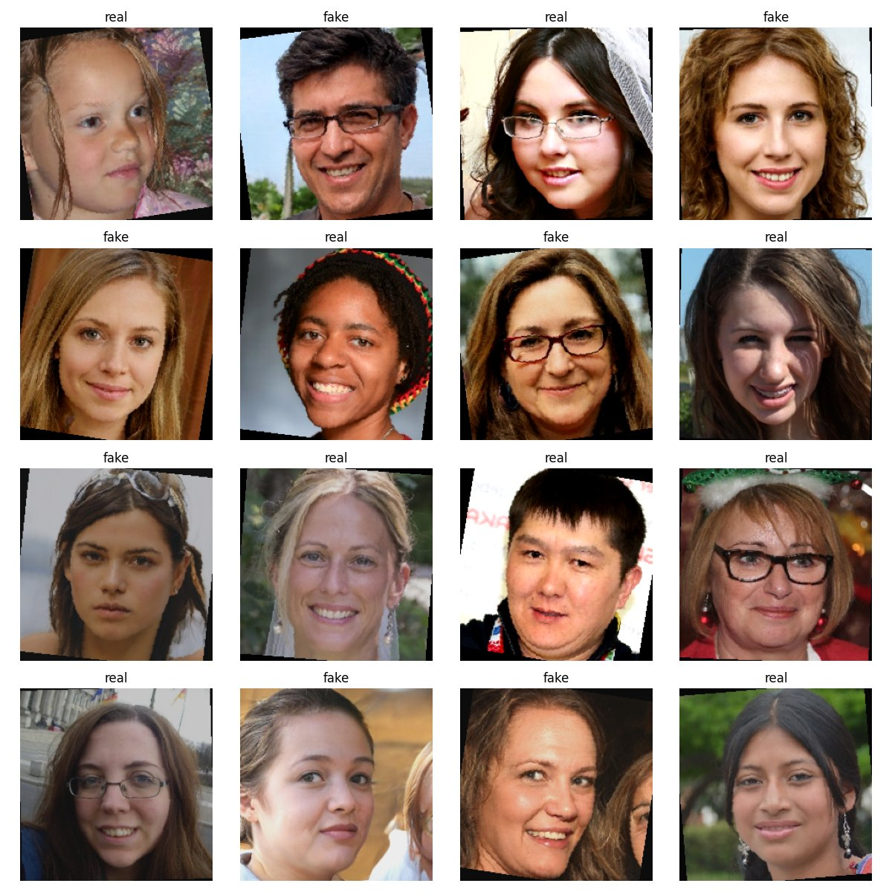
METHODOLOGY
Preprocessing and augmentation
Step | What | Why
Resize | 224 × 224 | pretraining resolution; 23% cheaper than 256²
Normalise | ImageNet mean / std | match the input distribution of pretrained filters
Flip | horizontal, p = 0.5 | a mirrored face is still real/fake
Rotate | ± 10° | natural head tilt
Colour jitter | brightness / contrast ± 20% | lighting variety, no colour shortcut
Valid / test | resize + normalise only | deterministic, true distribution
No blur or JPEG augmentation — it could erase the high-frequency GAN artifacts we want the model to learn.
training batch after augmentation
Deepfake Detection · Real vs StyleGAN Faces
6

Slide 7
METHODOLOGY
Two ImageNet-pretrained CNNs
 | EfficientNet-B0 (primary) | ResNet-18 (comparison)
Key idea | compound scaling; MBConv + squeeze-and-excitation | residual connections y = F(x) + x
Parameters | 4.0 M | 11.2 M
Compute | ≈ 0.39 GFLOPs / image | ≈ 1.8 GFLOPs / image
New head | Linear(1280 → 1) | Linear(512 → 1)
Grad-CAM layer | features[-1] (1280 × 7 × 7) | layer4[-1] (512 × 7 × 7)
• Transfer learning: early layers already detect edges and textures — only adapt the later layers (fast, accurate, less over-fitting).
• Single logit: P(fake) = σ(z) — equivalent to a 2-class softmax, trained with BCEWithLogitsLoss.
Deepfake Detection · Real vs StyleGAN Faces
7

Slide 8
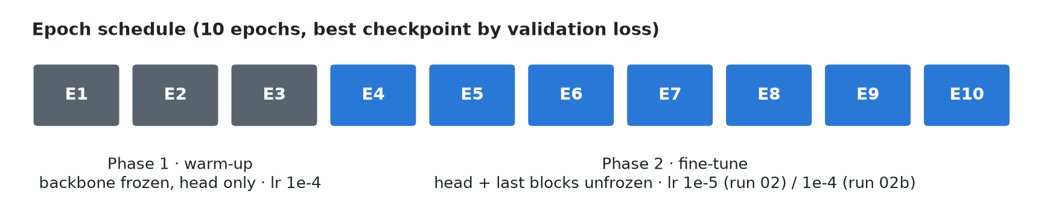
TRAINING
Two-phase transfer learning
• Phase 1 — warm-up: backbone frozen, only the random new head learns (lr 1e-4).
• Phase 2 — fine-tune: unfreeze the last blocks with a new optimiser; small lr avoids destroying pretrained features.
• Frozen BatchNorm kept in eval mode so its ImageNet statistics stay fixed.
Configuration | Phase-2 trainable | Share
EfficientNet, 2 blocks (run 02) | 1.13 M | 28%
EfficientNet, 4 blocks (run 02b) | 3.70 M | 92%
ResNet-18, layer3 + layer4 | 10.49 M | 94%
Deepfake Detection · Real vs StyleGAN Faces
8

Slide 9
TRAINING
Loss, optimiser and checkpointing
BCE with logits
Adam
BCE = −[ y·log p + (1−y)·log(1−p) ]
confident mistakes cost the most; sigmoid fused into the loss for stability
momentum + per-parameter adaptive step size
lr 1e-4 (head) → 1e-5 / 1e-4 (fine-tune)
ReduceLROnPlateau
Best checkpoint
halve the lr when validation loss stops improving for 1 epoch
save weights whenever validation loss hits a new minimum — early stopping; resumable _last.pth every epoch
Deepfake Detection · Real vs StyleGAN Faces
9

Slide 10
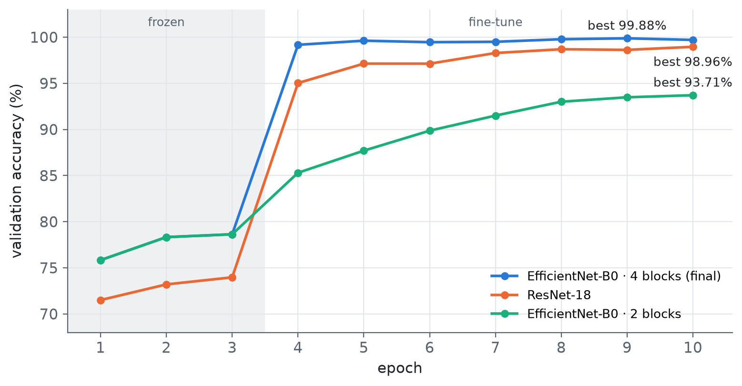
RESULTS
Training results — validation accuracy
• Frozen phase plateaus < 80% — ImageNet features alone are not enough.
• Fine-tuning jumps immediately (78.6% → 99.2% for EfficientNet at epoch 4).
• No over-fitting: train and validation stay close.
• Best: EfficientNet-B0 99.88% · ResNet-18 98.96%.
• ≈ 7 min / epoch on a Kaggle Tesla T4.
Deepfake Detection · Real vs StyleGAN Faces
10

Slide 11
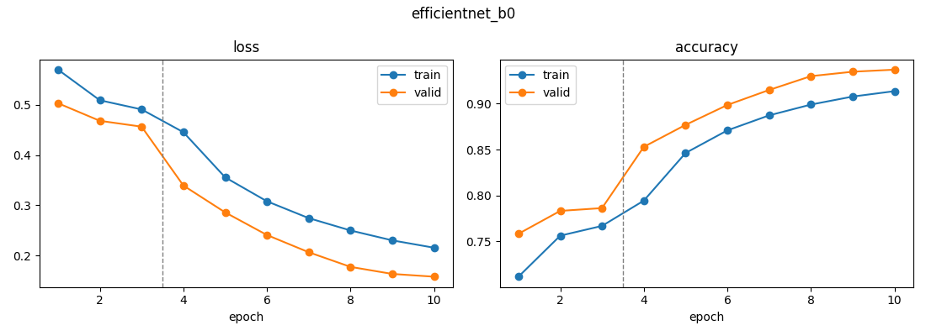
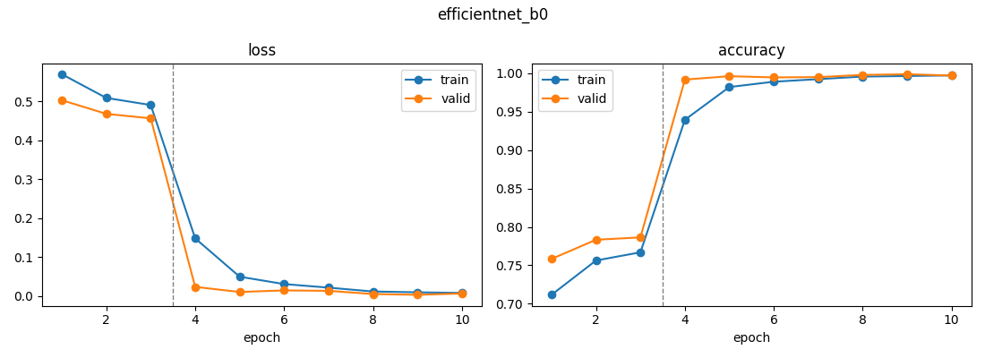
RESULTS
Ablation: how much of the network to fine-tune
run 02 · 2 blocks, lr 1e-5 → 93.71% (under-fitting)
run 02b · 4 blocks, lr 1e-4 → 99.88%
Lesson: the share of the network that is fine-tuned mattered more than the architecture. With comparable trainable share (92% vs 94%), EfficientNet-B0 beats ResNet-18 with ~3× fewer parameters.
Deepfake Detection · Real vs StyleGAN Faces
11

Slide 12
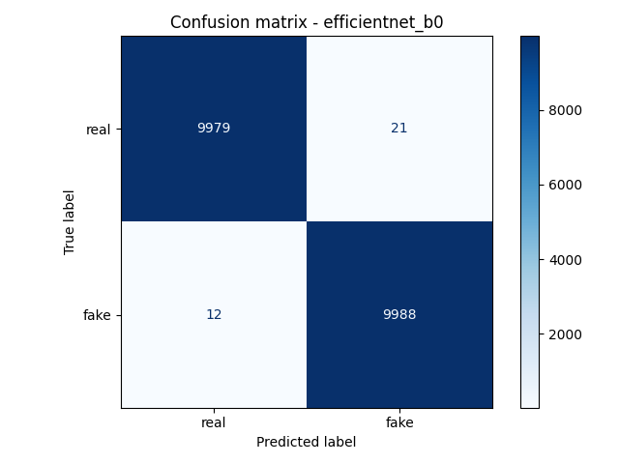
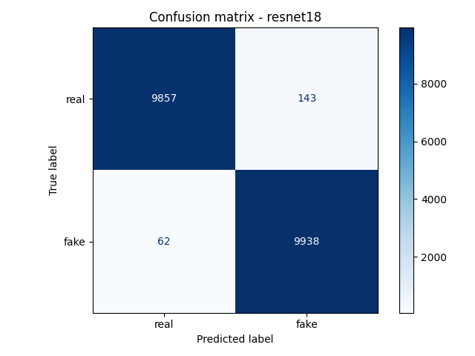
RESULTS
Test-set results (20,000 unseen images)
Model | Accuracy | Precision | Recall | F1 | ROC-AUC | Errors
EfficientNet-B0 (final) | 99.84% | 99.79% | 99.88% | 99.84% | 1.0000 | 33
ResNet-18 | 98.98% | 98.58% | 99.38% | 98.98% | 0.9994 | 205
• Test ≈ validation → no over-fitting
• 6× fewer errors for EfficientNet
• More false positives than false negatives (21 vs 12)
EfficientNet-B0
ResNet-18
Deepfake Detection · Real vs StyleGAN Faces
12

Slide 13
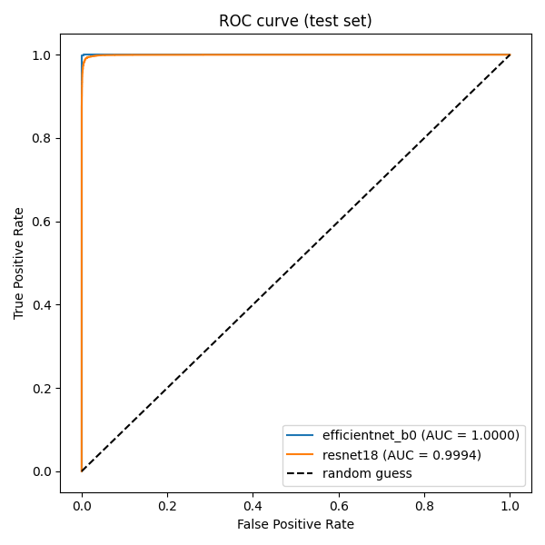
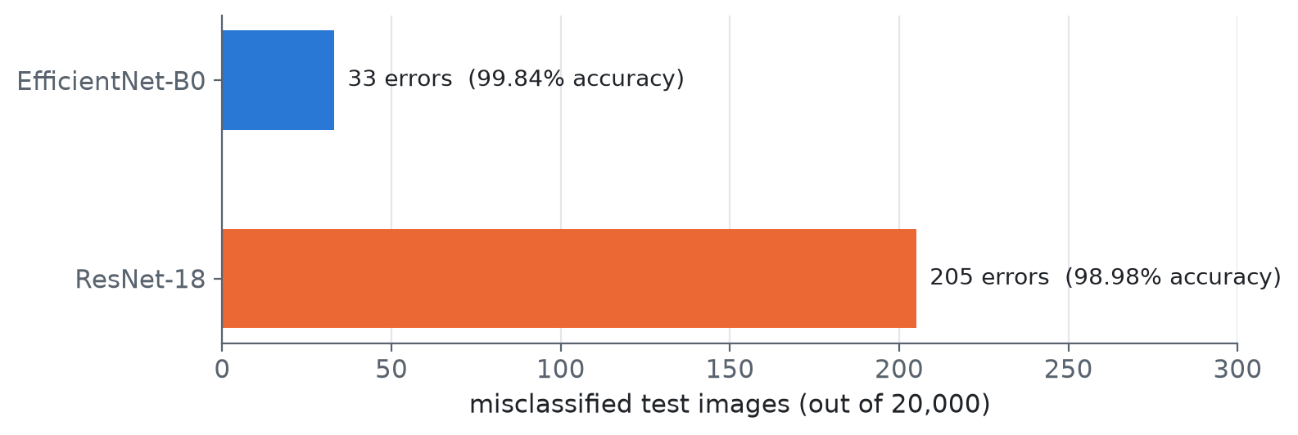
RESULTS
ROC curve and error count
AUC ≈ 1.000: almost every fake gets a higher P(fake) than almost every real photo — the result does not depend on the 0.5 threshold.
Deepfake Detection · Real vs StyleGAN Faces
13

Slide 14
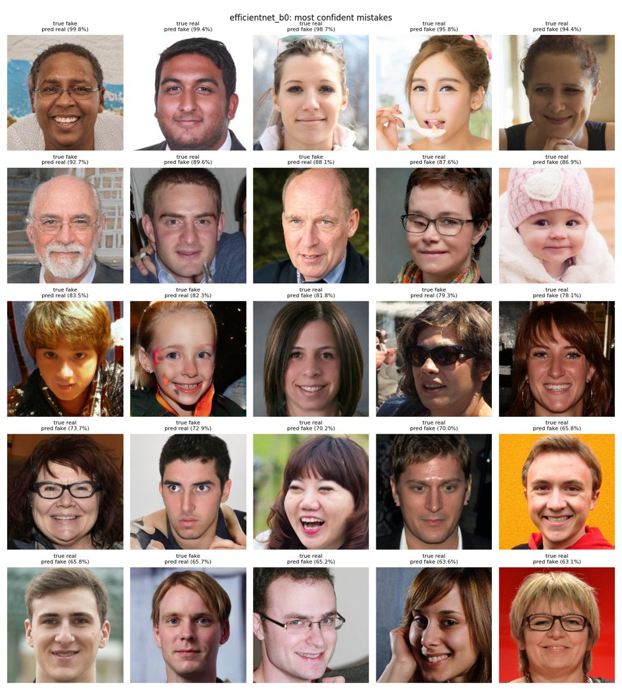
RESULTS
Error analysis — the most confident mistakes
• Real → fake (false positives): studio-like portraits — plain background, smooth or retouched skin, make-up, flash, symmetric frontal pose. Real photos that look as “clean” as StyleGAN.
• Fake → real (false negatives): busy realistic backgrounds or clothing, unusual lighting, sunglasses, face paint — StyleGAN artifacts less visible.
• Most errors have moderate confidence (65–90%); only a few exceed 95%.
Deepfake Detection · Real vs StyleGAN Faces
14

Slide 15
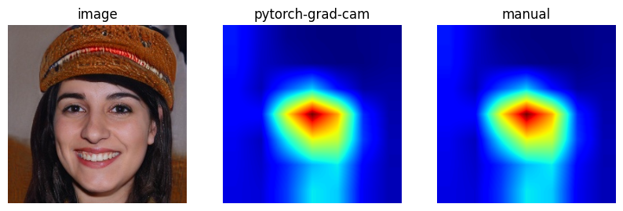
EXPLAINABILITY
Explainability: how Grad-CAM works
• 1. Forward pass: keep the feature maps Aᵏ of the last conv layer (7 × 7).
• 2. Backward pass: gradients of the score y w.r.t. Aᵏ (y = z for fake, −z for real).
• 3. Weights: αₖ = global average of the gradients.
• 4. Heatmap: ReLU( Σₖ αₖ Aᵏ ), upsample to 224 × 224, overlay.
• Why the last conv layer: most class-specific features, still spatial.
Our hand-written Grad-CAM matches the pytorch-grad-cam library: correlation 0.99999999.
Deepfake Detection · Real vs StyleGAN Faces
15

Slide 16
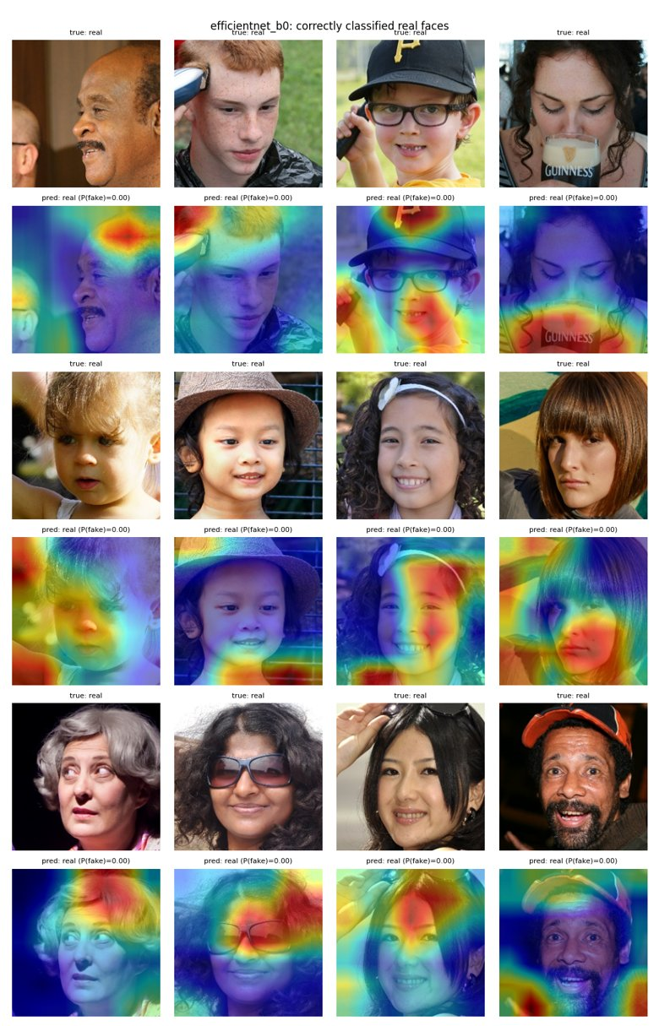
EXPLAINABILITY
Grad-CAM findings — where the model looks
• Fakes: tight, central attention — between the eyes, nose bridge, mouth/teeth, where generator artifacts concentrate.
• Real photos: spread over hair, background, hats, hands and objects — natural camera detail StyleGAN renders poorly.
• Errors follow the same logic: real→fake errors get face-centred attention; fake→real errors look at realistic backgrounds.
• No trivial shortcut (border, watermark) — but the cues are specific to StyleGAN’s aligned faces.
correct fakes
correct reals
Deepfake Detection · Real vs StyleGAN Faces
16

Slide 17
DEPLOYMENT
Demo app and out-of-distribution test
Upload face image
Resize + normalise
EfficientNet-B0
REAL / FAKE + confidence
Grad-CAM overlay
• streamlit run app.py — plain interface: upload → predict → show result.
• ≈ 1 s per image including Grad-CAM, on a laptop CPU.
• Model cached with @st.cache_resource.
Out-of-distribution test
3 face images generated with ChatGPT
→ all predicted REAL with ≈100% confidence
The model learned StyleGAN’s fingerprint, not “fakeness” in general.
Deepfake Detection · Real vs StyleGAN Faces
17

Slide 18
DISCUSSION
Discussion
Is 99.8% over-fitting? No.
Train 99.72% · validation 99.88% · test 99.84% — within 0.2% on 40,000 images never trained on.
Accuracy is high because the task is narrow: one generator (StyleGAN) with a consistent fingerprint, all faces aligned.
Why does it fail on ChatGPT images?
1. Different generator → different fingerprint
2. Only two classes → “real” means “not StyleGAN”
3. Larger, un-aligned images → different input statistics
4. Networks are over-confident outside their training data
Deepfake Detection · Real vs StyleGAN Faces
18

Slide 19
DISCUSSION
Limitations
Limitation | Consequence
Single generator (StyleGAN) in training | fails on other generators — shown with ChatGPT images
Aligned 256 px FFHQ-style faces only | arbitrary photos are out of distribution; no face detector in the app
No robustness tests | JPEG re-compression, resizing, blur, screenshots may erase the fingerprint
Uncalibrated confidence | high confidence on unfamiliar inputs; no “unknown” option
Coarse 7 × 7 Grad-CAM | shows roughly where, not which artifact
Still images only | no temporal cues for video deepfakes / face swaps
Deepfake Detection · Real vs StyleGAN Faces
19

Slide 20
NEXT STEPS
Future work and extensions
Multi-generator data
General features
Frequency branch
add StyleGAN2/3 + diffusion fakes (Stable Diffusion, Midjourney, DALL·E); leave-one-generator-out evaluation
frozen CLIP/ViT features + linear probe (Ojha et al., 2023)
two-stream RGB + Fourier model for up-sampling artifacts
Robustness
Face detection + calibration
Video and scale
train with JPEG, blur, resize, noise augmentation
MTCNN/RetinaFace in the app; temperature scaling and an “uncertain” output
FaceForensics++/DFDC with temporal models; ONNX + REST API deployment
Deepfake Detection · Real vs StyleGAN Faces
20

Slide 21
SUMMARY
Conclusion
• Complete pipeline: verified data → two-phase transfer learning → rigorous evaluation → Grad-CAM → demo app.
• EfficientNet-B0: 99.84% test accuracy, ROC-AUC 1.0000, 33 errors in 20,000 — 6× fewer than ResNet-18 with 3× fewer parameters.
• Fine-tuning depth matters: 28% → 92% of weights trained took EfficientNet from 93.7% to 99.9%.
• Interpretable: inner-face artifacts for fakes, natural context for real photos.
• Key lesson: near-perfect accuracy on one generator ≠ a general deepfake detector.
Thank you
Questions?
github.com/Mohd2Shaan/
Deepfake-Detection-Project
Deepfake Detection · Real vs StyleGAN Faces
21

