Slide 1
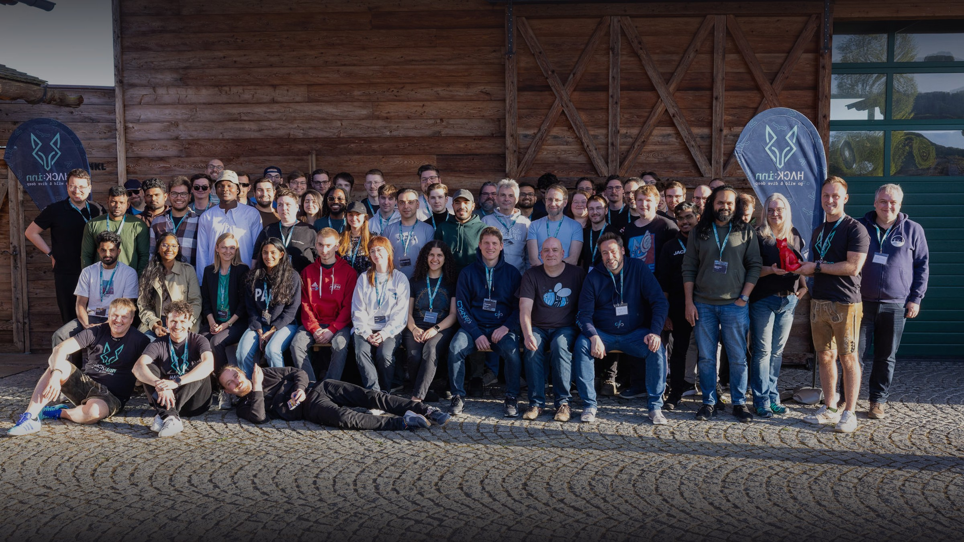
FACULTY BOARD BRIEFING · 16.06.2026
Entrepreneurship
in ECRI.
PREPARED BY
FOR
MEETING
Mohammad Abu-Rezeq
ECRI, Unit 01
Prof. Dr. Dominik Boehler
Faculty Board
16 June 2026 · 14:00
THD · ZFE
01 / 10

Slide 2
AGENDA
Agenda
A short briefing on the state of ECRI founder coaching: who we are working with, how we reach them, the numbers, and what we need to grow.
01
Teams
Active student ventures
S. 03
02
The founder network
Founders, talent and mentors joining
S. 04
03
Formats and resources
How we reach and support founders
S. 06
04
The room at GreG
Our ECRIative Space, in use and in numbers
S. 07
05
Activities and KPIs
The current term in figures
S. 08
06
What we need
Call to action for the faculty
S. 09
THD · ZFE
02 / 10

Slide 3
01 · RESULTS
The teams · Results
ACTIVE
L
ACTIVE
K
AT GREG
I
Lucas Barrios
Ksenia Vinogradova
Ibrahim Lawal
DIGITAL HEALTH · BRAZIL
ANIMAL HEALTH
CULTURE CART
A prescription service for the Brazilian market.
An app to manage dental hygiene for horses, with a co-founder.
Founder of Culture Cart, based at the GreG Founding Center.
ACTIVE
S
ACTIVE
H
IN THE PIPELINE
+
Samson Olawole
Hazel D'couto
More teams to add
CCD SUITE · B2B SAAS
GESVIA · DIGITAL HEALTH
TO BE CONFIRMED
AI business management platform for modern agencies, nine integrated modules from CRM to finance.
A digital health platform that turns complicated hospital forms into simple, engaging experiences for patients.
Further active teams to be confirmed before the board meeting.
THD · ZFE
03 / 10

Slide 4
02 · NETWORK
The founder · network
ECRI founders are part of a growing matching network. Students with ideas, talent looking to join a team, and mentors find each other in one place.
FOUNDERS WITH IDEAS
Students bringing a startup concept and looking for a team.
TALENT LOOKING TO JOIN
Skilled students who want to join an existing startup.
MENTORS
Experienced advisors supporting the teams as they grow.
THD · ZFE
04 / 10

Slide 5
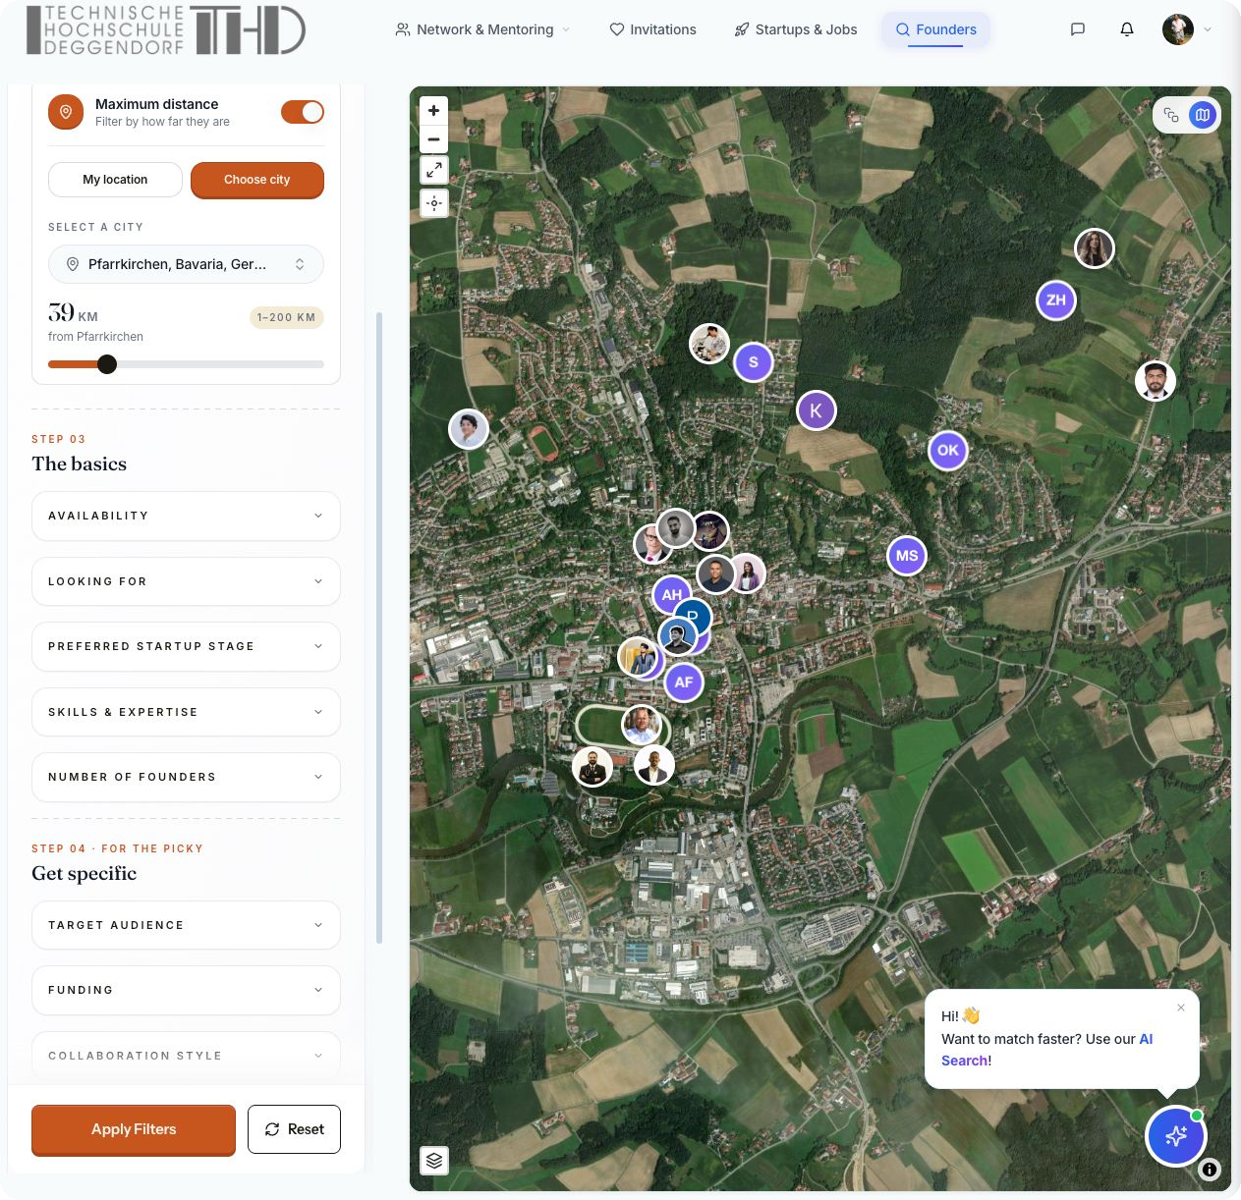
02 · NETWORK
The network · mapped
Every pin is a person in our matching platform — founders, talent and mentors across the region, finding each other in one place.
FOUNDERS WITH IDEAS
bringing a concept, looking for a team
TALENT LOOKING TO JOIN
skilled students joining a startup
MENTORS
experienced advisors supporting teams
THD · ZFE
05 / 10

Slide 6
03 · FORMATS
Formats · and resources
Three ways we reach and support founders — from first contact to a place to build.
A
B
C
ACCESS
TEACHING
SPACE
Office hours
Entrepreneurship class
Room at GreG
Weekly walk-in slot, EC 2.11, Tuesdays 13:00 to 15:00. The first checkpoint of the founder pipeline.
Introduces students to startup thinking and channels interested founders into coaching.
Workspace and meeting point at the GreG Founding Center — detailed on the next slide.
THD · ZFE
06 / 10

Slide 7
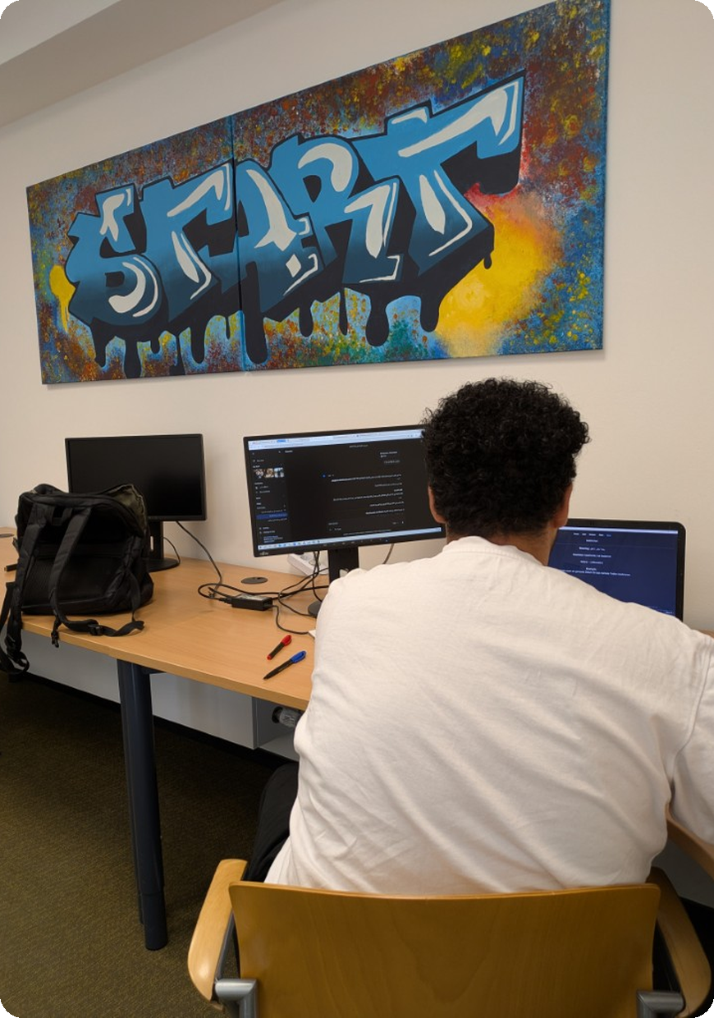
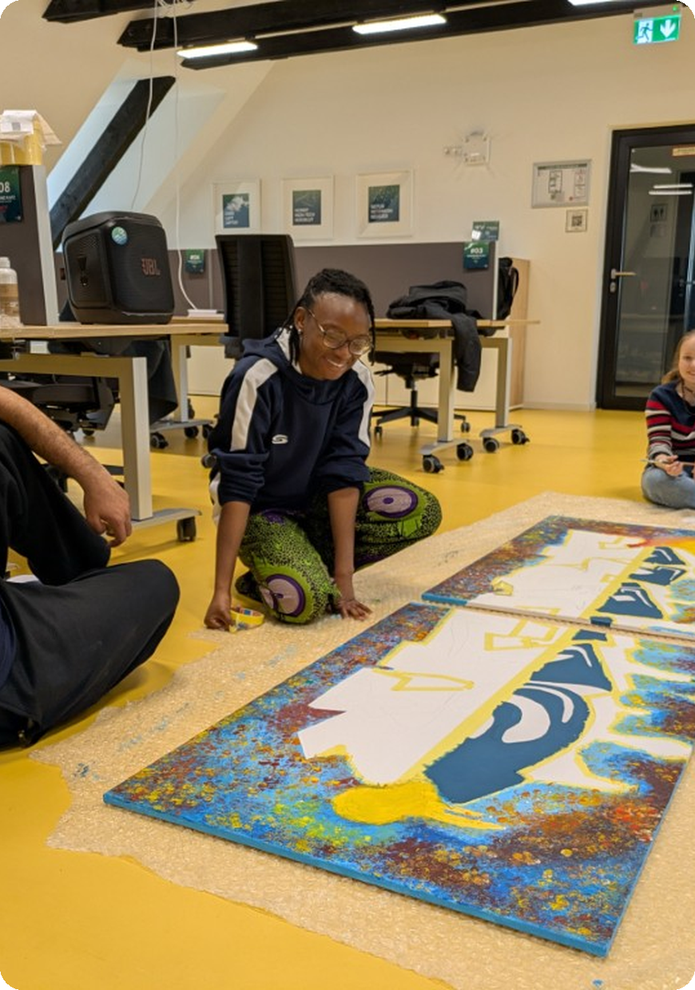
04 · THE SPACE
The room · at GreG
Our shared ECRIative Space at the GreG Founding Center — used by 2 to 7 people every weekday for projects, group work and individual focus.
“
The room proves itself for us as a founding centre — well used almost every day, with an exceptionally warm and productive atmosphere. The partnership it builds between the university and the centre is highly valuable.
— GreG Founding Center
2–7
people on-site every weekday
Mon–Fri, average usage
WHY IT MATTERS
Early contact with future founders
A deeper THD ↔ GreG partnership
A smoother path into the founding ecosystem
THD · ZFE
07 / 10

Slide 8
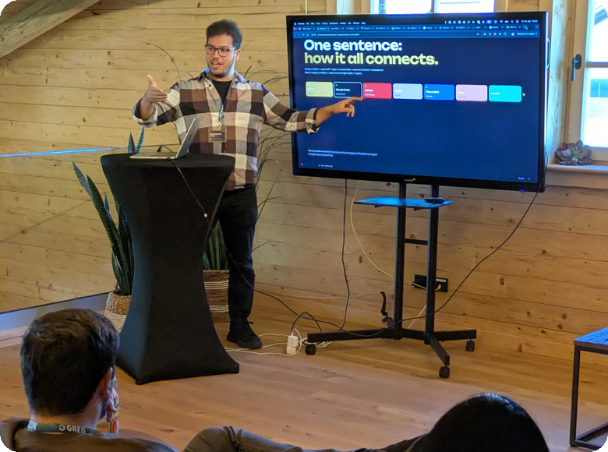

05 · FIGURES
Activities · and KPIs
The current term on one slide. Individual talks and class visits are rolled up into a single outreach figure.
300+
7
27
2
STUDENTS REACHED
TALKS & LECTURES
1:1 COACHING
WORKSHOPS
outreach this term
3 more planned
students, Unit 01
3 expected
THD · ZFE
08 / 10

Slide 9
06 · CALL TO ACTION
What we need · and where next
WHAT WE NEED FROM COLLEAGUES
WHERE WE GO FROM HERE
How the faculty can help us grow
The direction from here
Refer student founders to office hours and the entrepreneurship class.
Grow the number of active teams term over term.
Offer short slots in lectures to reach students early.
Move the funnel from estimate to measurement, including GreG room usage.
Resource the room at GreG — power strips, desk lamps, a few more chairs and a plant.
Track people reached, projects built and teams since 2022.
Open doors to industry partners and follow-on funding.
Turn more early conversations into funded ventures.
THD · ZFE
09 / 10

Slide 10

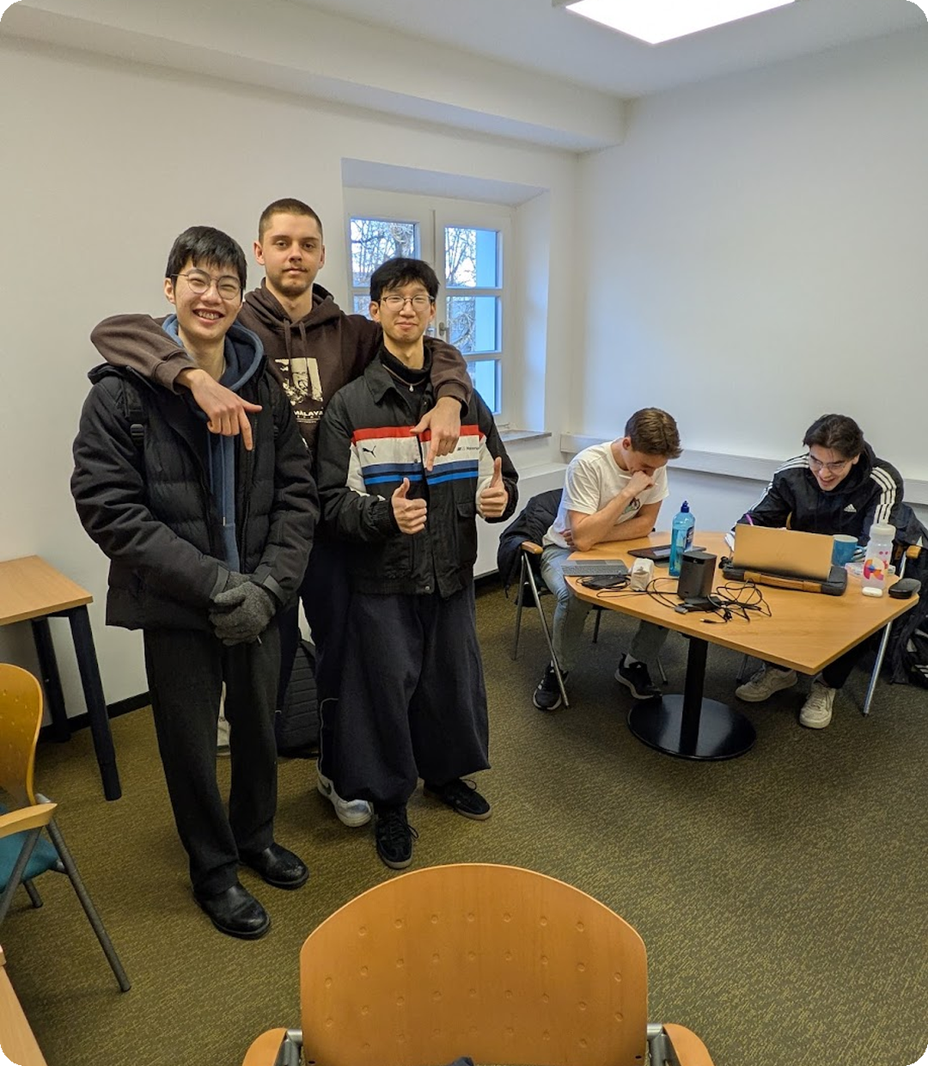
FACULTY BOARD · 16.06.2026
Let's grow this
together.
What do you need from us, and what can we ask of you?
CONTACT
Mohammad Abu-Rezeq, Unit 01
EMAIL
mohammad.abu-rezeq@th-deg.de
OFFICE HOURS
EC 2.11, Tuesdays 13:00 to 15:00
10 / 10

