Slide 1
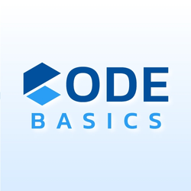




Provide Insights to Management in
CONSUMER GOODS
Domain
BY: MOHD AKIF

Slide 2
TABLE OF CONTENTS
1
INTRODUCTION
2
PROBLEM STATEMENT
3
AD-HOC REQUESTS
4
KEYNOTE

Slide 3
INTRODUCTION
Atliq Hardwares (imaginary company) is one of the leading computer hardware producers in India and well expanded in other countries too.

Slide 4
PROBLEM STATEMENT
The management has observed a deficiency in obtaining sufficient insights for making quick and smart data-informed decisions.
So, they have initiated ad-hoc requests, tasking the data analytics team with generating insights to address this gap.

Slide 5
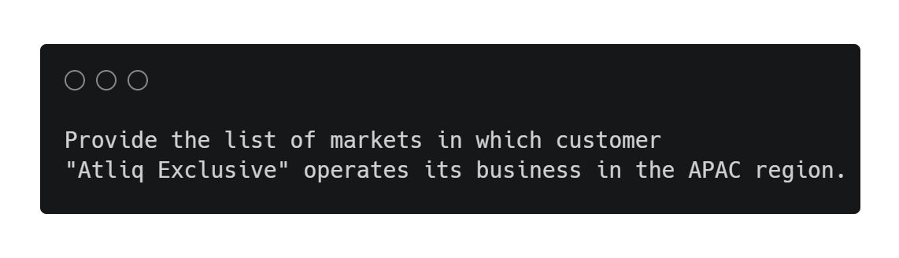
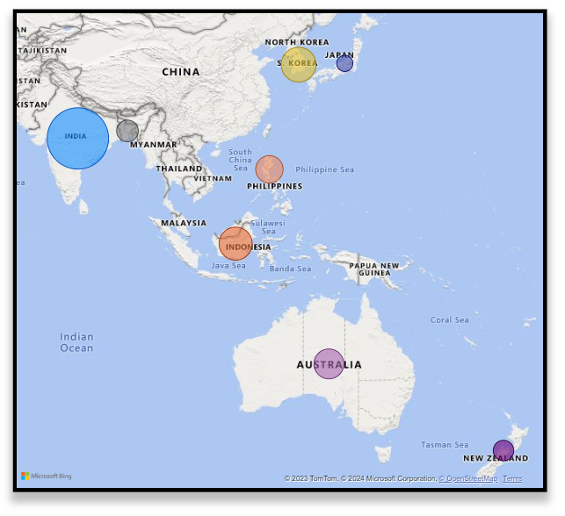
AD-HOC REQUESTS
1
2
3
4
5
India leads Atliq Exclusive's Gross Sales in the Asia Pacific region, followed by South Korea, Indonesia, and Australia among eight countries.
6
7
8
9
10

Slide 6
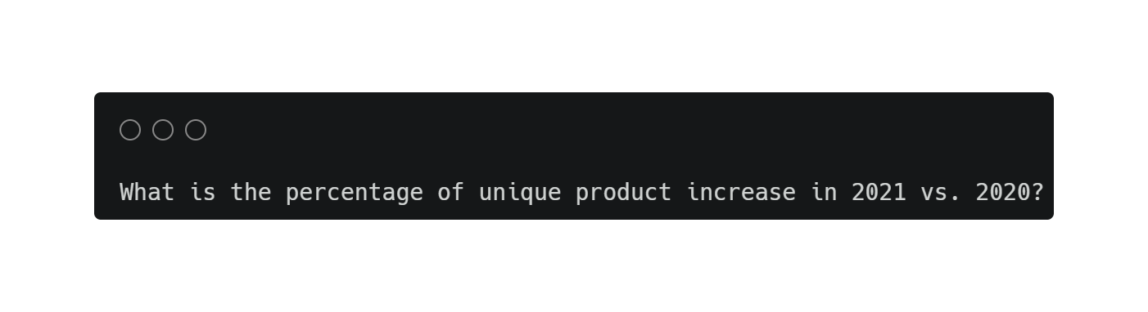
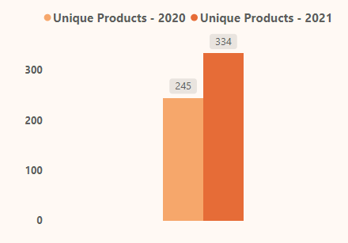

AD-HOC REQUESTS
1
2
3
4
5
6
7
8
We experienced a significant increase in the number of unique products in 2021, with a notable growth of 36.33% compared to the previous year.
The growth indicates that the market may be responsive to the company's products.
9
10

Slide 7
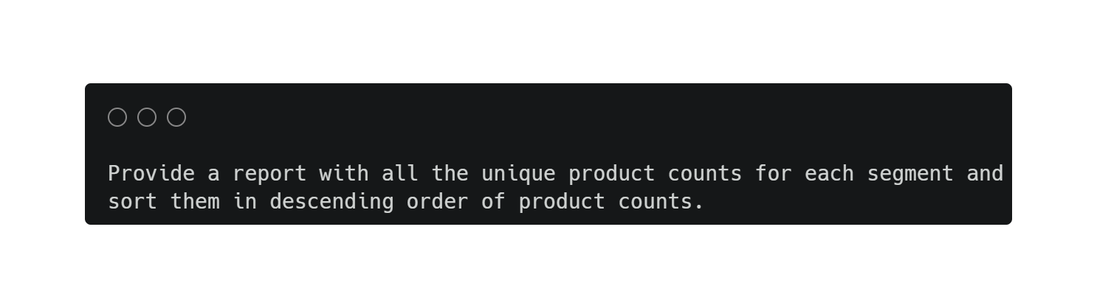
AD-HOC REQUESTS
1
2
3
4
Segment | Product Count
Notebook | 129
Accessories | 116
Peripherals | 84
Desktop | 32
Storage | 27
Networking | 9
5
Notebook and Accessories segments had more unique products as compared to other segments.
6
7
8
9
10

Slide 8
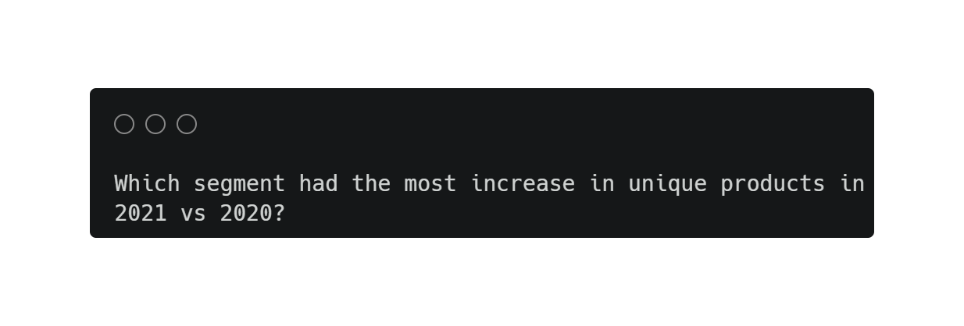
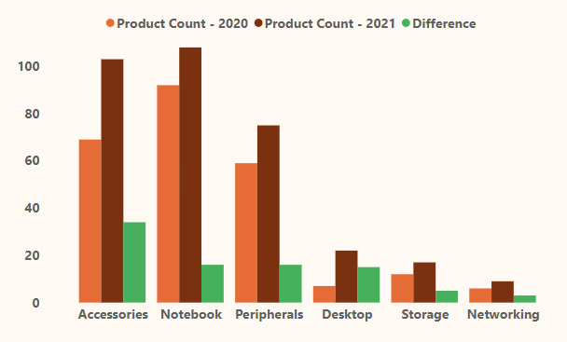
AD-HOC REQUESTS
1
2
3
Segment | Product Count - 2020 | Product Count - 2021 | Difference
Accessories | 69 | 130 | 34
Notebook | 92 | 108 | 16
Peripherals | 59 | 75 | 16
Desktop | 7 | 22 | 15
Storage | 12 | 17 | 5
Networking | 6 | 9 | 3
4
5
6
7
8
9
Accessories had the most increase in the number of unique products in 2021 as compared to other segments.
10

Slide 9
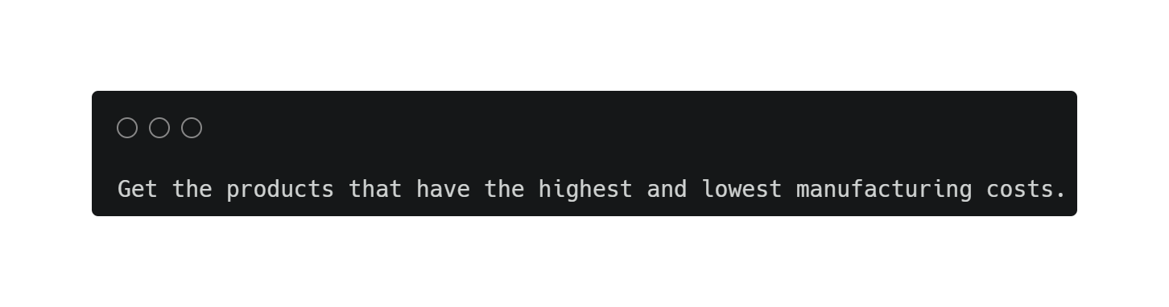
AD-HOC REQUESTS
1
2
3
$240.5364
Highest Manufacturing Cost
$0.8920
Lowest Manufacturing Cost
4
5
Product Code | Product | Manufacturing Cost
A6120110206 | AQ HOME Allin1 Gen 2 | $240.5364
A2118150101 | AQ Master wired x1 Ms | $0.8920
6
7
8
9
The product AQ Home Allin1 Gen 2 (A6120110206) had the highest manufacturing cost while AQ Master wired x1 Ms (A2118150101) had the lowest manufacturing cost.
10

Slide 10
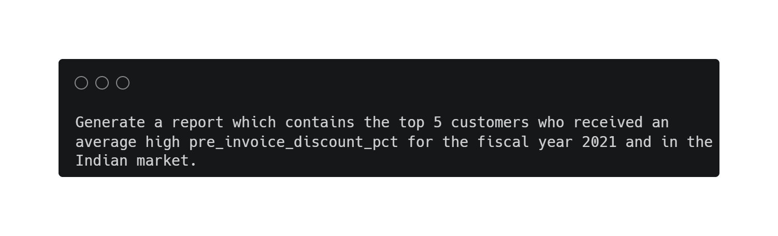
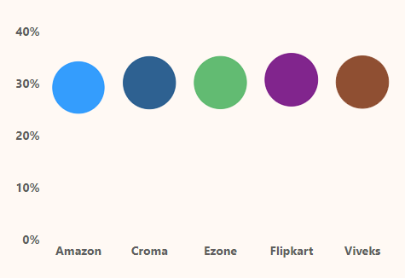
AD-HOC REQUESTS
1
2
3
4
Customer Code | Customer | Avg Discount %
90002009 | Flipkart | 30.83%
90002006 | Viveks | 30.38%
90002003 | Ezone | 30.28%
90002002 | Croma | 30.25%
90002016 | Amazon | 29.33%
5
6
7
8
9
10
In the top 5 customers, Flipkart had the highest avg discount %, i.e., 30.83% while Amazon had the lowest avg discount %, i.e., 29.33%.

Slide 11
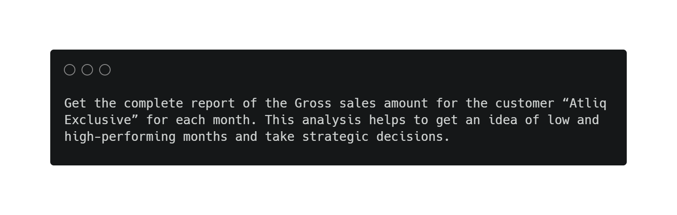
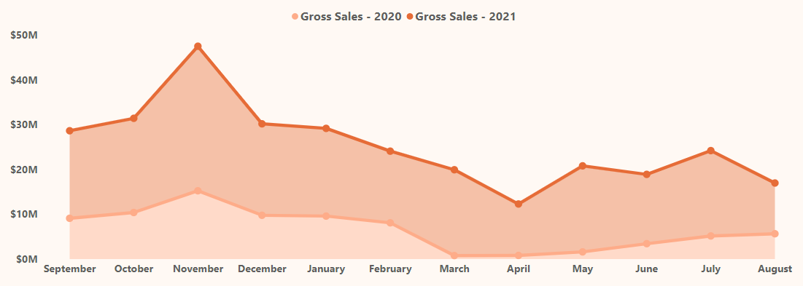
AD-HOC REQUESTS
1
2
3
4
5
6
7
8
9
10
In 2020, November was the high performing month while March was its vice-versa.
In 2021, November was the high performing month while April was its vice-versa.

Slide 12
AD-HOC REQUESTS
1
2
3
Month | Year | Gross Sales Amount
September | 2020 | 9.09M
October | 2020 | 10.38M
November | 2020 | 15.23M
December | 2020 | 9.76M
January | 2020 | 9.58M
February | 2020 | 8.08M
March | 2020 | 0.77M
April | 2020 | 0.80M
May | 2020 | 1.59M
June | 2020 | 3.43M
July | 2020 | 5.15M
August | 2020 | 5.64M
Total |  | 79.5M
Month | Year | Gross Sales Amount
September | 2021 | 19.53M
October | 2021 | 21.02M
November | 2021 | 32.25M
December | 2021 | 20.41M
January | 2021 | 19.57M
February | 2021 | 15.99M
March | 2021 | 19.15M
April | 2021 | 11.48M
May | 2021 | 19.20M
June | 2021 | 15.46M
July | 2021 | 19.04M
August | 2021 | 11.32M
Total |  | 224.42M
4
5
6
7
8
9
10

Slide 13
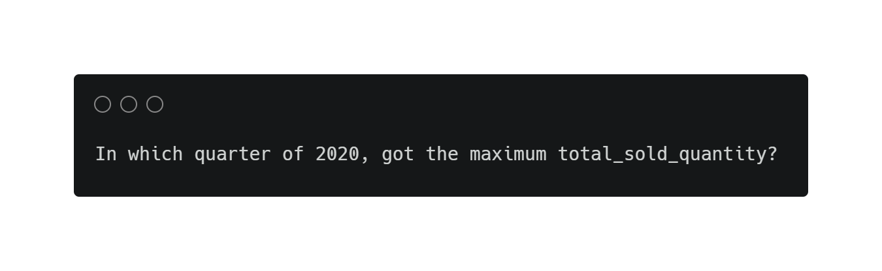
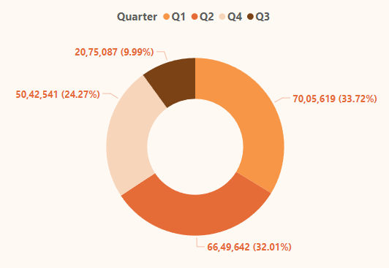
AD-HOC REQUESTS
1
2
3
4
Quarter | Total Quantity Sold
Q1 | 70,05,619
Q2 | 66,49,642
Q3 | 50,42,541
Q4 | 20,75,087
5
70,05,619
Q1
6
7
8
9
10
The maximum quantity was sold in Q1 while the minimum quantity was sold in Q4.

Slide 14
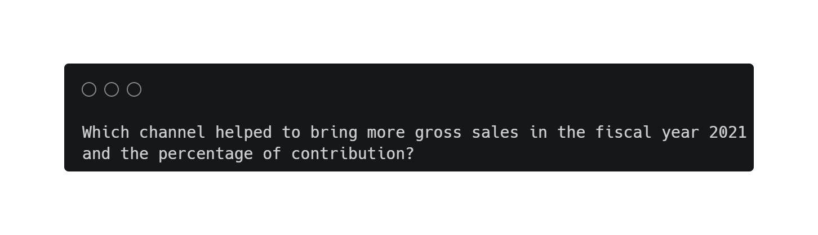
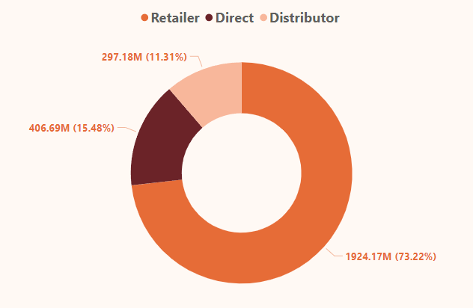
AD-HOC REQUESTS
1
2
3
4
Channel | Gross Sales | Contribution %
Retailer | 1924.17M | 73.22%
Direct | 406.69M | 15.48%
Distributor | 297.18M | 11.31%
5
6
7
8
9
The channel Retailer helped to bring more gross sales in the fiscal year 2021 and its contribution is 73.22%.
10

Slide 15
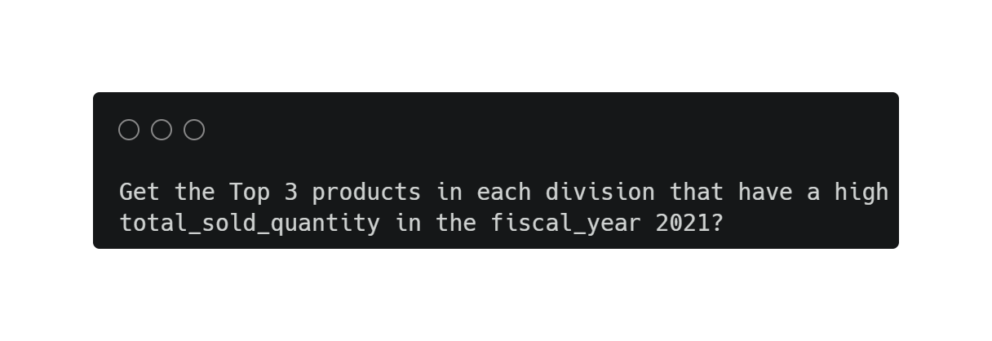
AD-HOC REQUESTS
1
2
3
Division | Product Code | Product & Variant | Total Sold Quantity
N & S | A6720160103 | AQ Pen Drive 2 IN 1 (Premium) | 7,01,373
N & S | A6818160202 | AQ Pen Drive DRC (Plus) | 6,88,003
N & S | A6819160203 | AQ Pen Drive DRC (Premium) | 6,76,245
P & A | A2319150302 | AQ Gamers Ms (Standard 2) | 4,28,498
P & A | A2520150501 | AQ Maxima Ms (Standard 1) | 4,19,865
P & A | A2520150504 | AQ Maxima Ms (Plus 2) | 4,19,471
PC | A4218110202 | AQ Digit (Standard Blue) | 17,434
PC | A4319110306 | AQ Velocity (Plus Red) | 17,280
PC | A4218110208 | AQ Digit (Premium Misty Green) | 17,275
4
5
6
7
8
9
10
Each division, a product (different variant) stands out, appearing twice among the top three products.

Slide 16
KEYNOTE
Gross Sales Performance:
India led the Asia Pacific region in gross sales, with notable contributions from South Korea, Indonesia, and Australia among eight countries
The Retailer channel significantly contributes 73.22% to gross sales in fiscal year 2021.
Atliq Exclusive generated highest gross sales in November (2020 & 2021) and lowest in March (2020) & April (2021).
Segments Performance:
Atliq Hardware witnessed a robust 89 new products in 2021, reflecting positive market response.
Accessories segment stand out with a higher number of new products, also experiencing the most significant increase in 2021.
Quantity Sold:
Q1 dominates in terms of quantity sold.

Slide 17
KEYNOTE
Customer Dynamics:
On average, the top 5 customers (Flipkart, Viveks, Ezone, Croma & Amazon) received discounts of around 30%. This indicates a consistent pricing strategy, likely aimed at offering competitive prices and ensuring customer satisfaction.

Slide 18
THANK YOU

