Slide 1
Copycat Simon's Symphony
Repeat the Beat, Master the Treat!
Notes:
Hello everyone, I'm Sayed Mohamed.
Today, I'm excited to present my Game, 'Copycat Symon Says,'

Slide 2
Overview
Demo
Planning
Development
Technical Details
Challenges
Testing
Future Improvements
Notes:
I will take you through this game development process.
And here is how im gonna do it But before diving into that, let's get a look into the game
Let's dive into the journey of 'Copycat Symon Says' and explore how it evolved into the app it is today

Slide 3
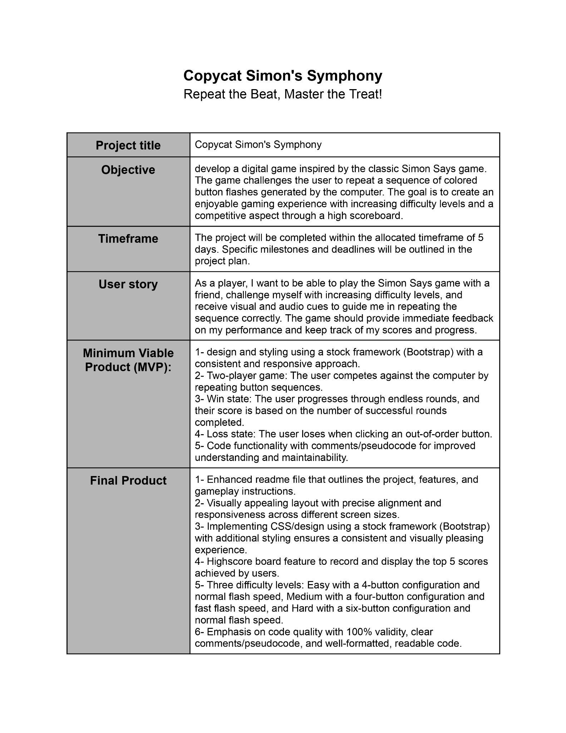
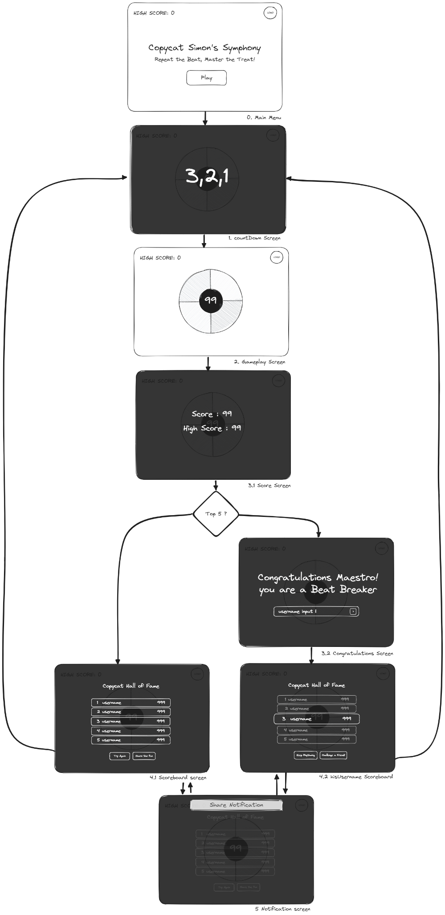
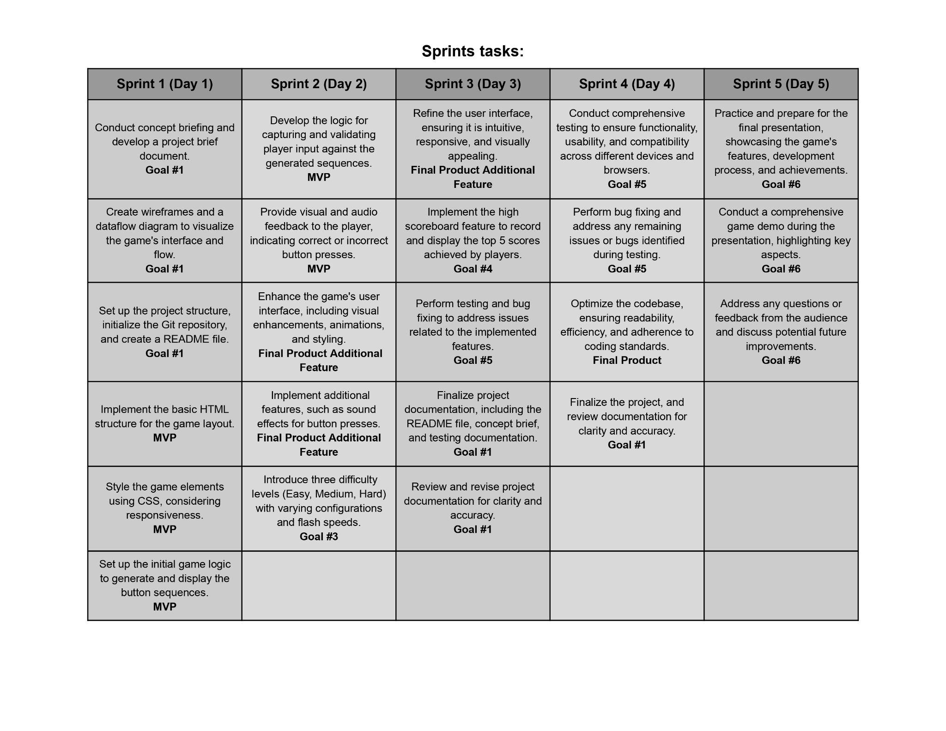
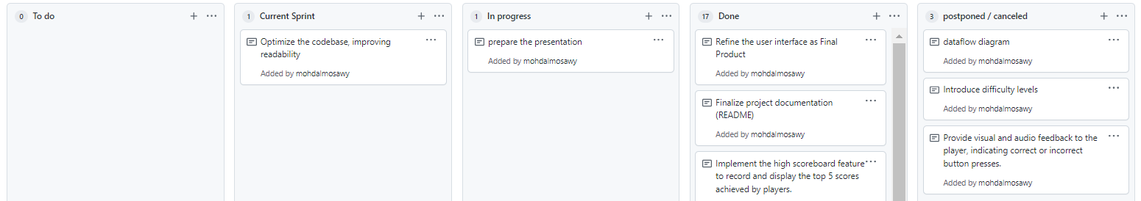
Planning
Brief
Sprints Goals and Tasks
Wireframes
Kanban
Notes:
By reaching this day, You already know that Developing an app can get very complicated.
However, it is a fact that planning can reduce project failures for developers.
I planned my way to develop this project, and I created a bunch of documents regarding the planning phase
These some of them
you can find the full documents in the readme file.

Slide 4
Development
The Game Concept
Interesting Commands
document.execCommand('copy')
parseInt()
.slice()
setTimeout(() => {.....}, 000)
s.forEach(element => { })
topScores.sort((a, b) =>)
JSON.parse() localStorage.getItem("") JSON.stringify()
Challenges Encountered
Notes:
The core idea of the game that we have two arrays where the computer generate one randomly and the user must follow the same generated seq, we are comparing between these two arrays, and whenever the user failed to repeat the array the game ends These are some of lines i faced during the development: document.execCommand('copy'): Used to perform the copy command.
parseInt(): Utilized for converting a string to an integer.
.slice(): Employed to extract a portion of an array.
setTimeout(() => {.....}, 000): Used to introduce a delay in executing a specific code block.
s.forEach(element => { });: Employed to iterate over the elements of an array.
topScores.sort((a, b) =>);: Utilized to sort an array, considering custom comparison logic. JSON.parse(): This function is used to parse a JSON string, converting it into a JavaScript object for further manipulation or usage.
localStorage.getItem(""): This code is employed to retrieve a value from the web browser's local storage based on a specific key.
JSON.stringify(): This method is used to convert a JavaScript object into a JSON string, allowing for easy storage or transmission of data.
Challenges Encountered : actually it's a full of challenges project, i faced the hardest part in troubleshooting, re-figure out what each line does, here is where pseudo code and commands helps

Slide 5
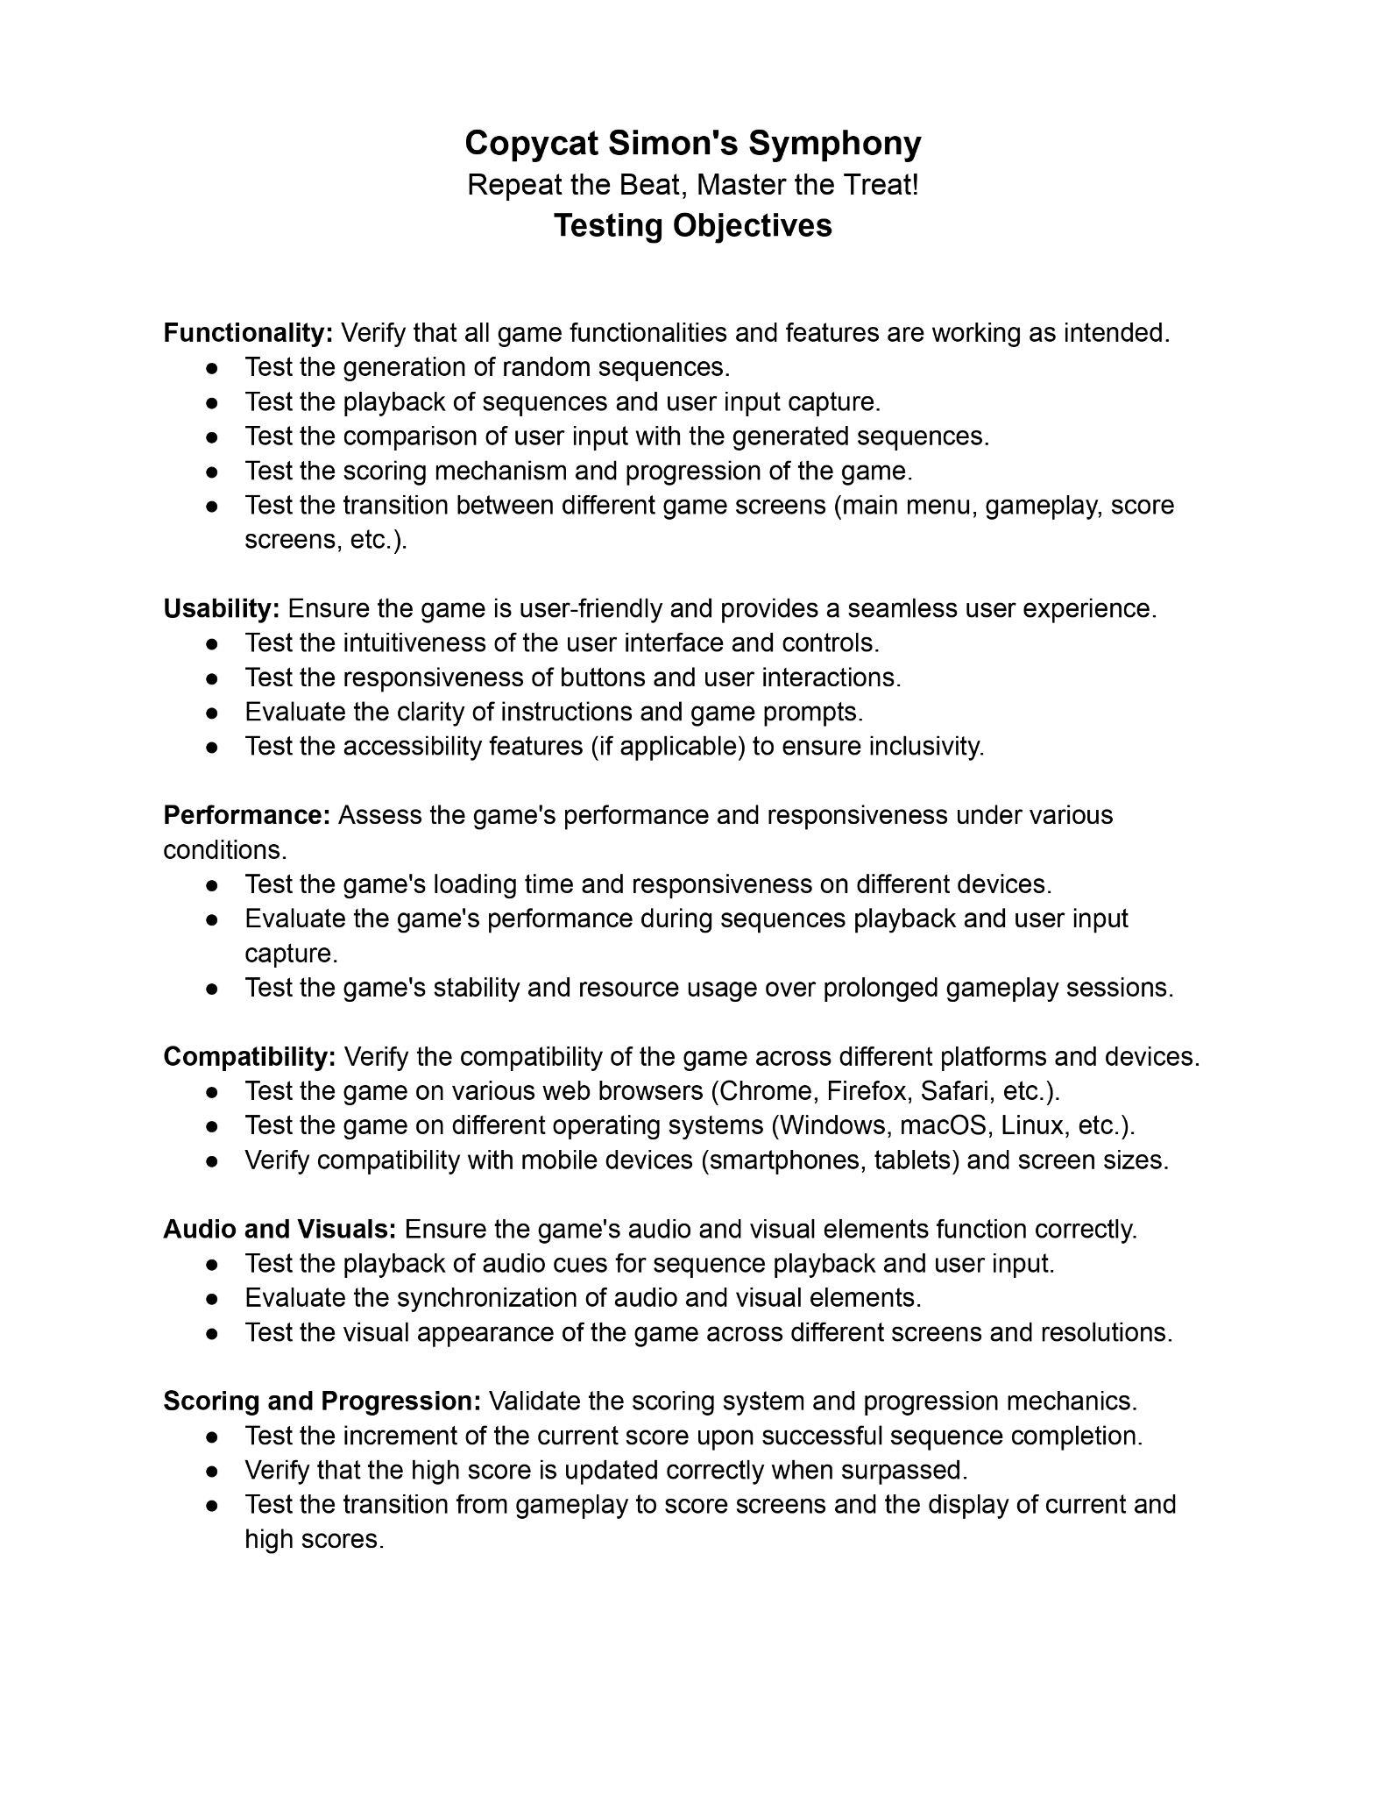
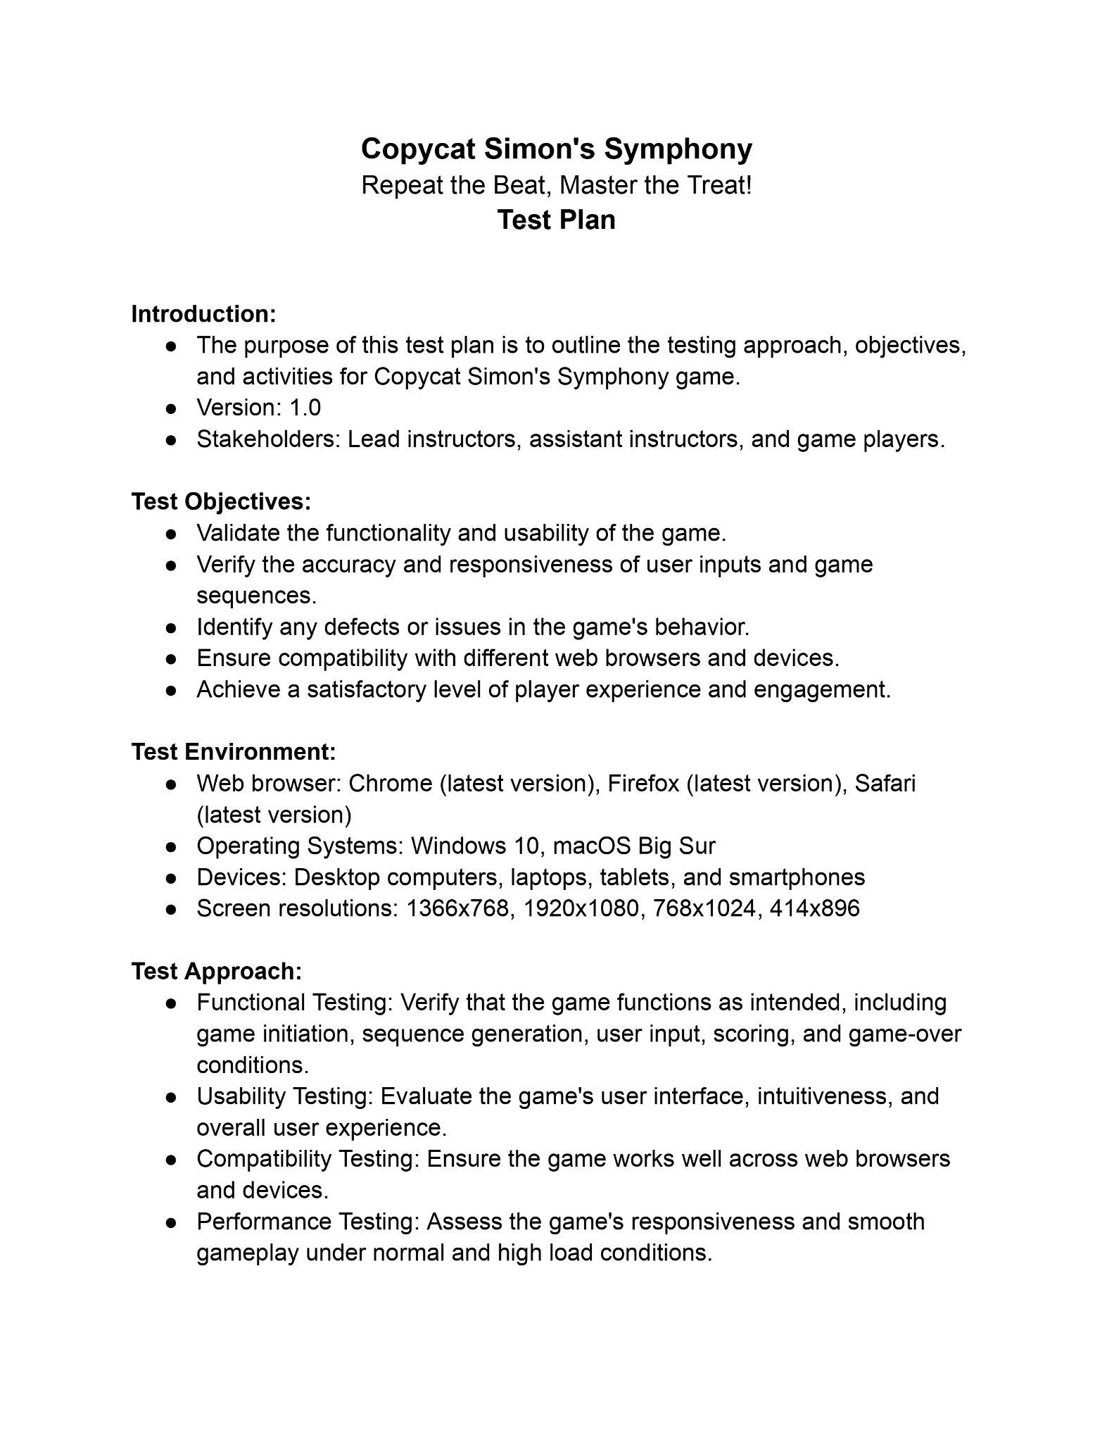
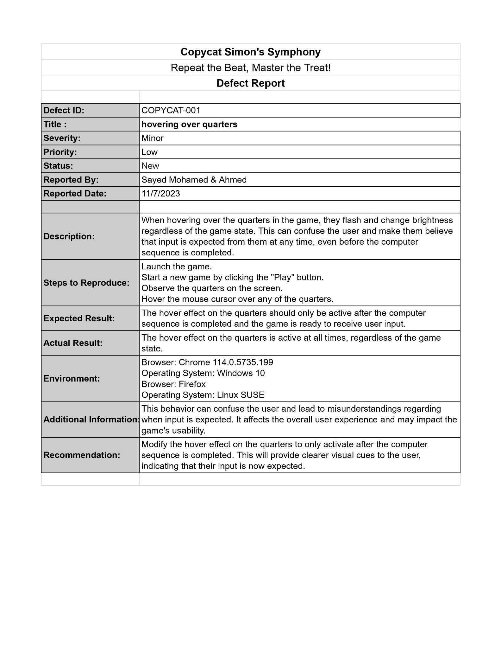
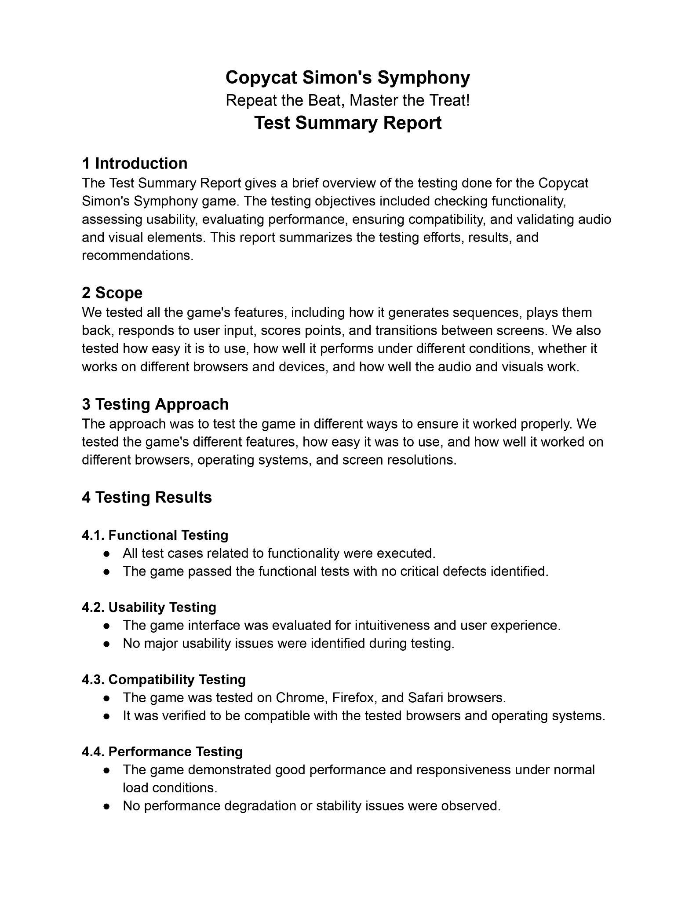
Testing
Objectives
Plan
Defect Report
Summary report
Notes:
While software testing may be outside the project's scope
I have a personal interest in software testing and tried to follow a structured approach.
I created various testing documents, including these
You can find them as well on the readme file

Slide 6
Future Improvements
Providing Visual and Audio Feedback
Customized Score Screen for the Winner
Difficulty Levels
Time limit
Notes:
While the app is functional, there's always room for improvement.
I planned some of these ideas but i postponed them during the development due to the time limitation
I would like to invite to to try the game and provide me with you feedback

Slide 7
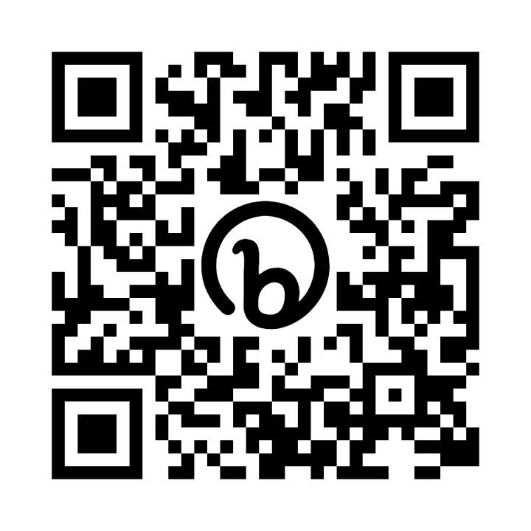
https://bit.ly/SEI5-P1-Sayed
Notes:
i'm happy to answer any questions you may have about 'Copycat Symon Says' or the development process

