Slide 1
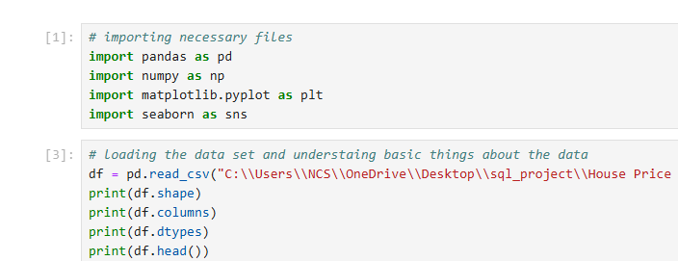
Task-4 ->House Price Prediction

Slide 2
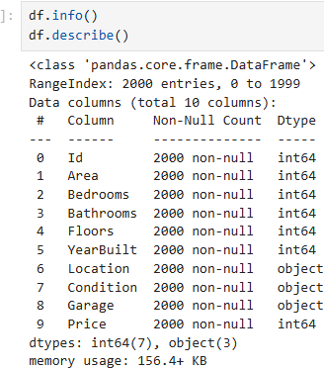
Basic understanding

Slide 3
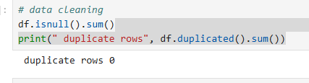
Basic Cleaning

Slide 4
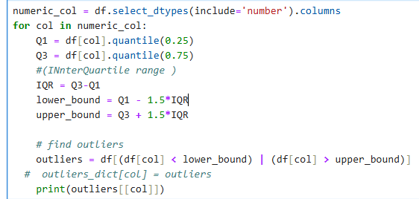
Data Processing

