Slide 1
Public Health Class with R Markdown
Dr Mohd Azmi (MBBS, MPH) Universiti Sains Malaysia, DrPH (Epidemiology) Candidate

Slide 2
Target Audience
Aim: Introductory
Teaching Staff
Student
Disclaimer
Very simple slide
short learning curve
Be creative!
Try, try, try

Slide 3
Motivation
Statistic and Public Health
Multiple output file for same purpose

Slide 4
Teaching Statistic
fast, reproducible
x <- runif(100, 5, 10)
y <- sample(5:10, 100, replace = T)
y2 <- (x+y/2)
fake <- data.frame(x,y,y2)
with(fake, plot(x,y2))

Slide 5
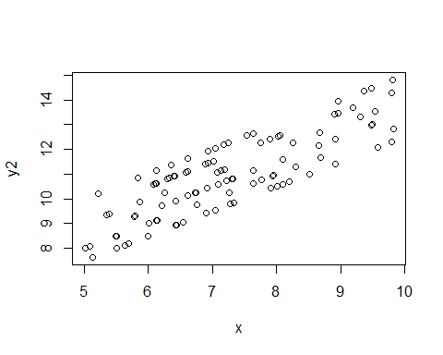

Slide 6
Tidyverse
example using tidyverse
tibble(x=runif(100, 5, 10), y2=(x+sample(5:10, 100, replace = T))/2)
%>% ggplot(aes(x,y2)) + geom_point()

Slide 7
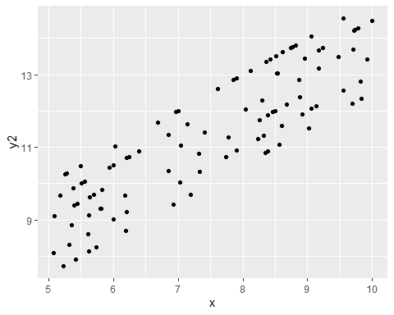

Slide 8
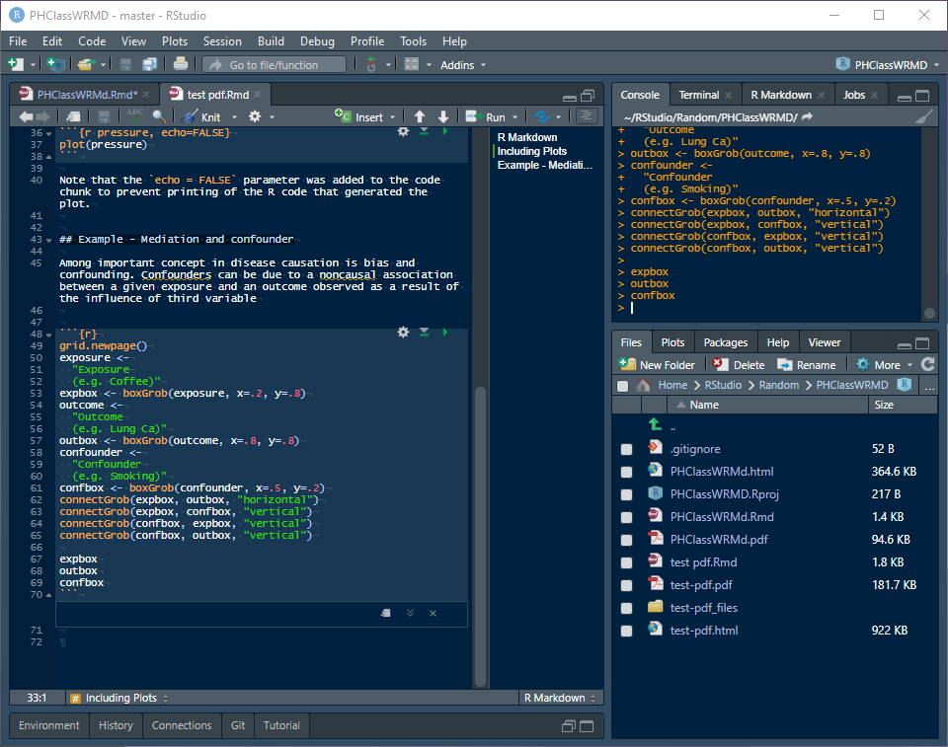
One file, various output
rmarkdown file

Slide 9
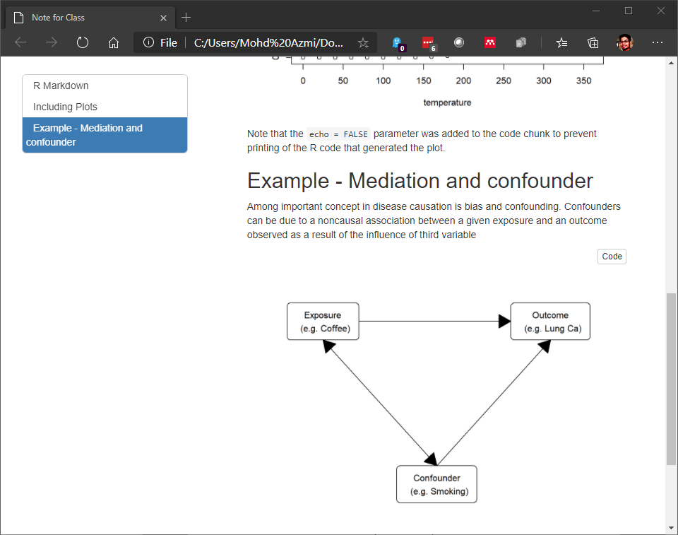
One file, various output
html output

Slide 10
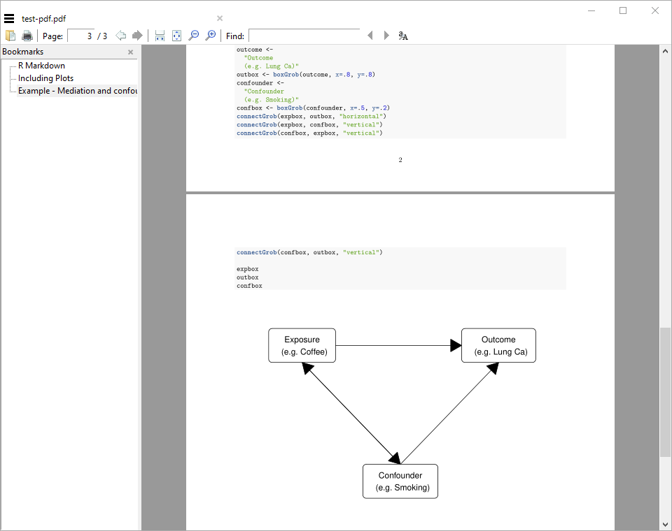
One file, various output
pdf output

Slide 11
Generate simple chart directly
Gmisc and grid package
ggplot (https://rpubs.com/phiggins/461686)

Slide 12
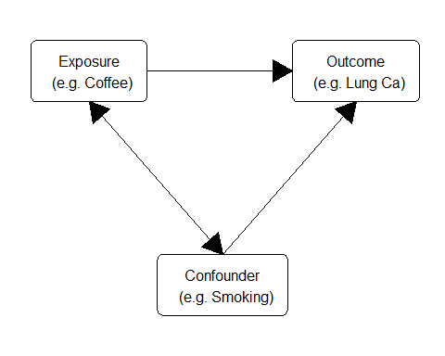

Slide 13
Student
Of course!
Main reason: reproducible

Slide 14
Student Assigment
pdf
html

Slide 15
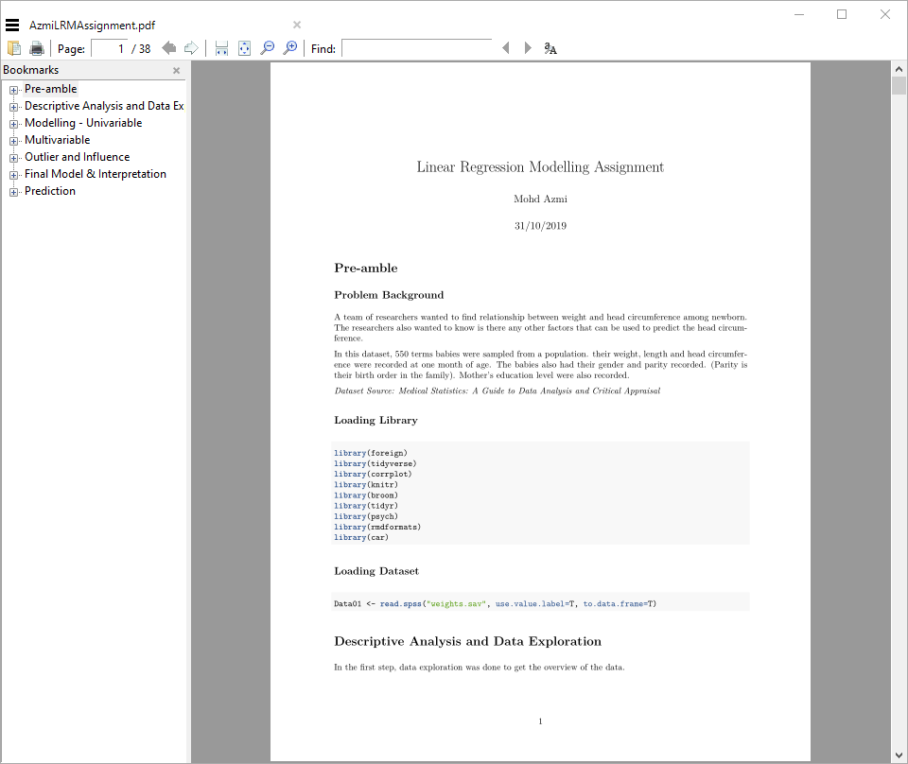
Student Assigment
pdf output

Slide 16
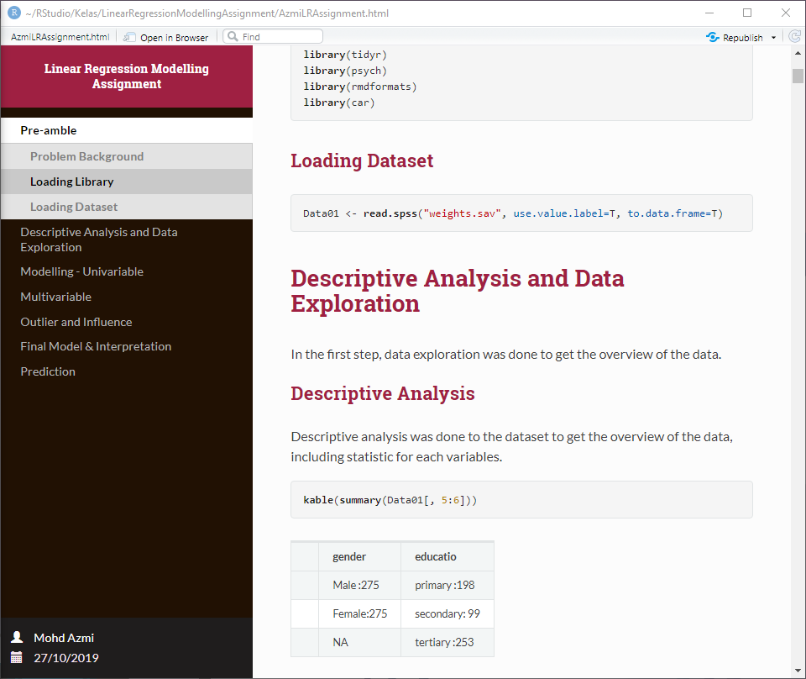
Student Assigment
html output

Slide 17
Assignment Submission
manual
publish
RPubs
RStudio Connect

Slide 18
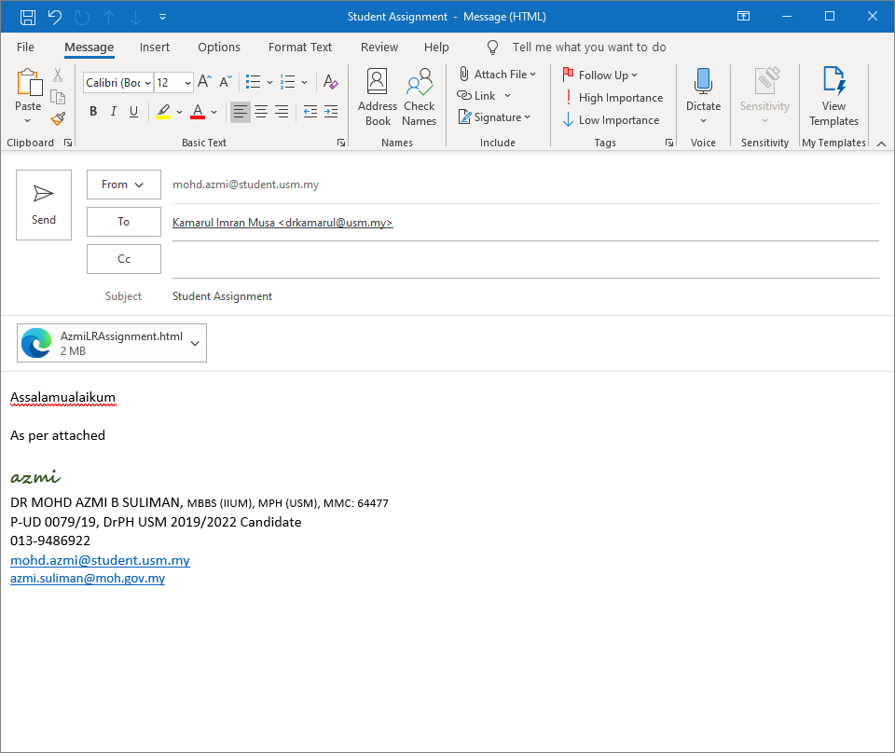
Assignment Submission
submit manual

Slide 19
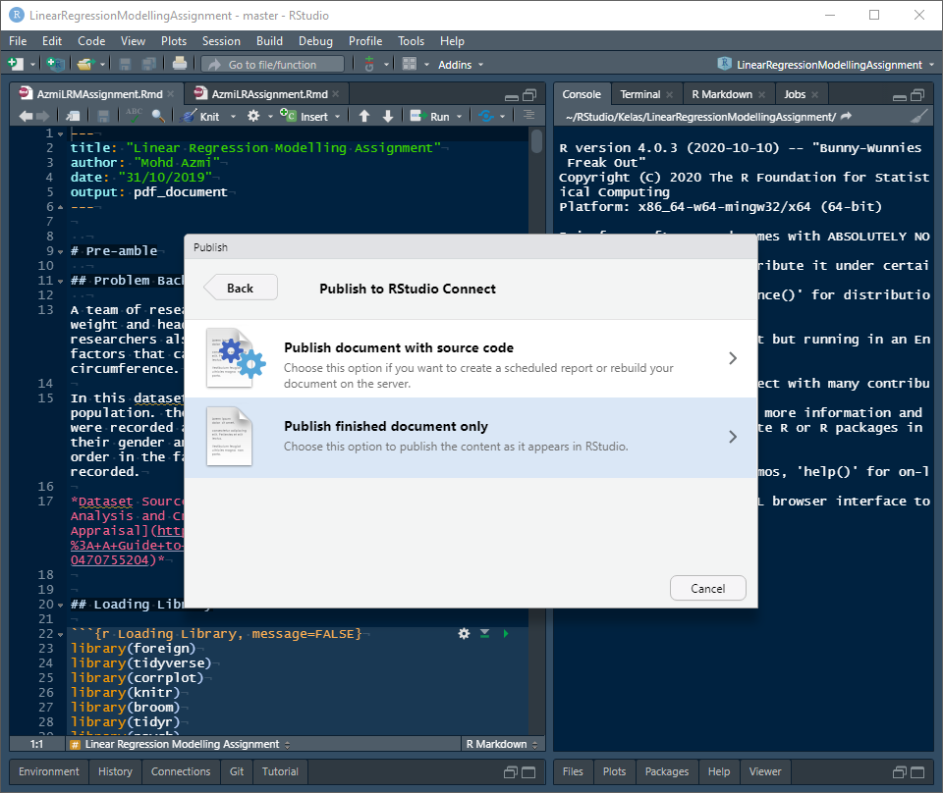
Assignment Submission

Slide 20
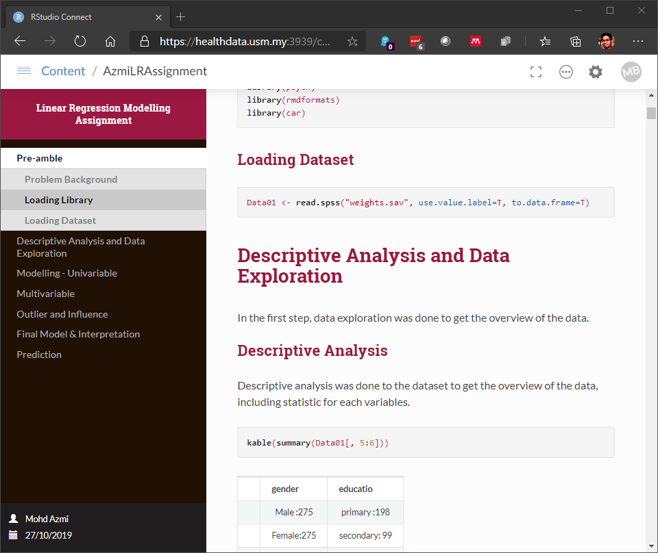
Assignment Submission

Slide 21
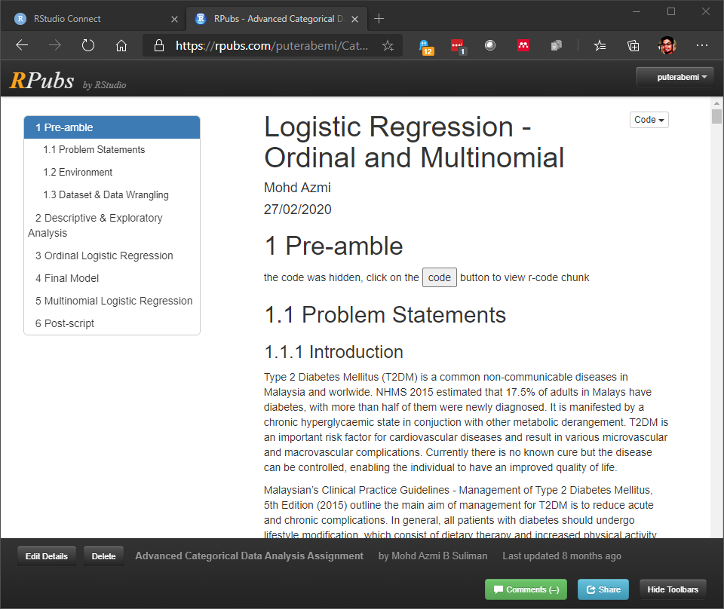
Assignment Submission

Slide 22
Closing
Various Source
R Markdown: The Definitive Guide https://bookdown.org/yihui/rmarkdown/
bookdown: Authoring Books and Technical Documents with R Markdown https://bookdown.org/yihui/bookdown/
pdf theme
rmdformat
prettydoc
presentation
beamer
ioslide
slidy
rmdshower

