Slide 1
Public Health Class with R Markdown
Dr Mohd Azmi (MBBS, MPH) Universiti Sains Malaysia, DrPH (Epidemiology) Candidate

Slide 2
Target Audience
Aim: Experience sharing
Teaching Staff
Student
Disclaimer
Very simple slide
short learning curve
Be creative!
Try, try, try

Slide 3
Motivation
Statistic and Epidemiology classess
Multiple output file for same purpose

Slide 4
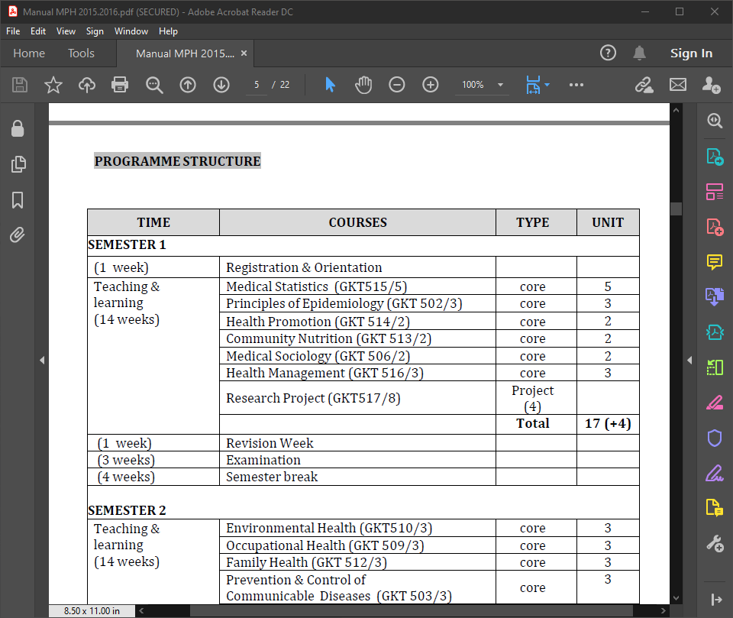
MPH and Medical Statistic
USM MPH Sturcture

Slide 5
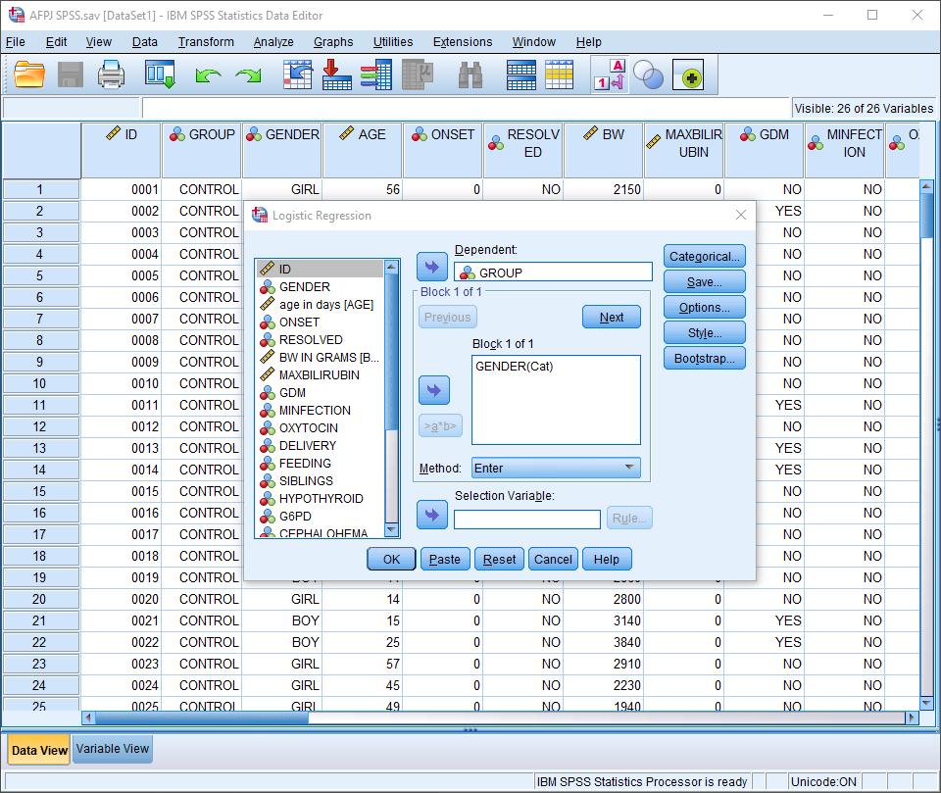
Medical Statistic with SPSS

Slide 6
Teaching Statistic
fast
reproducible

Slide 7
Teaching Statistic
x <- runif(100, 5, 10)
y <- sample(5:10, 100, replace = T)
y2 <- (x+y/2)
fake <- data.frame(x,y,y2)
with(fake, plot(x,y2))

Slide 8
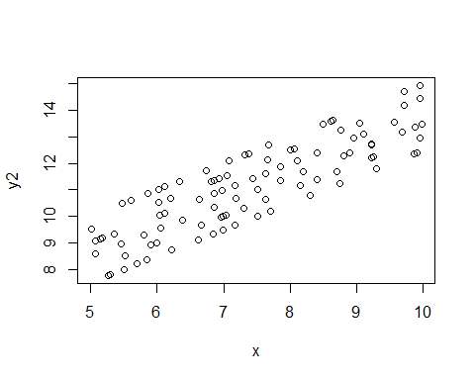

Slide 9
Tidyverse
tibble(x=runif(100, 5, 10), y2=(x+sample(5:10, 100, replace = T))/2)
%>% ggplot(aes(x,y2)) + geom_point()

Slide 10
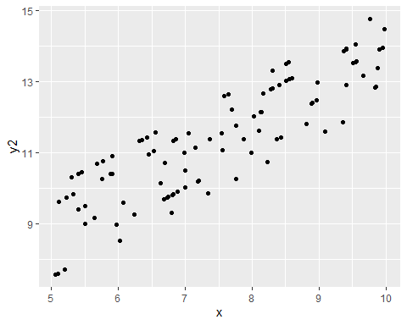

Slide 11
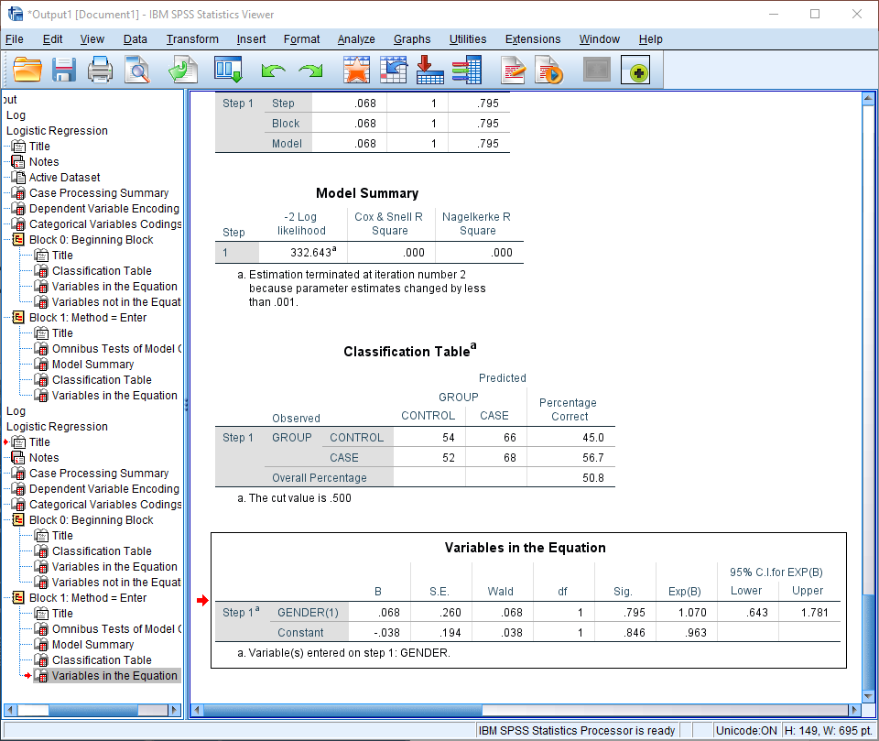
SPSS Output

Slide 12
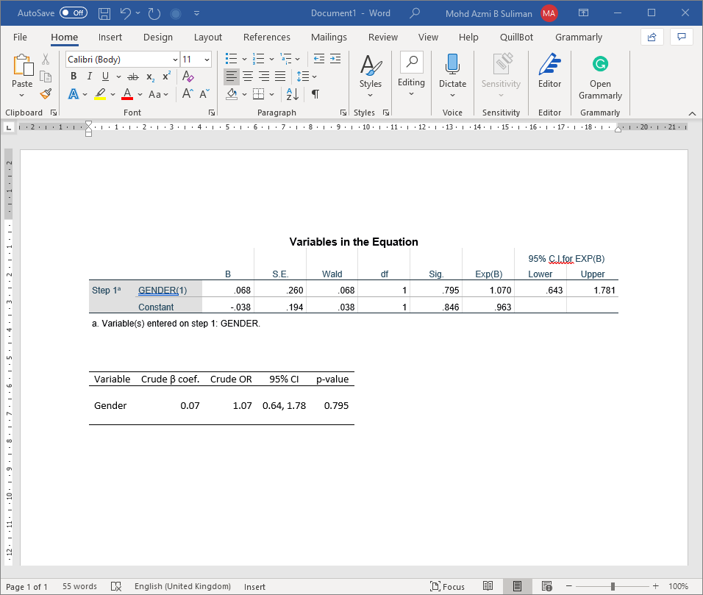
Copying SPSS output

Slide 13
What is R Markdown
Markdown: lightweight markup language
can add formating element to plaintext text document
R Markdown: “provide framework of authoring framework for data science…”
“save and execute code”
“generate high quality reports that can be shared with audience”

Slide 14
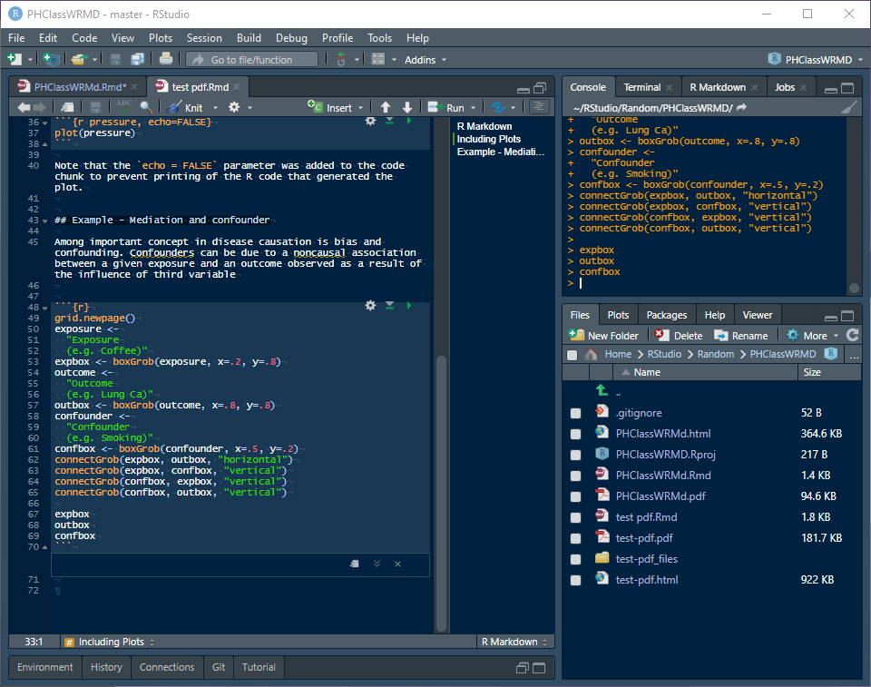
One file, various output
rmarkdown file

Slide 15
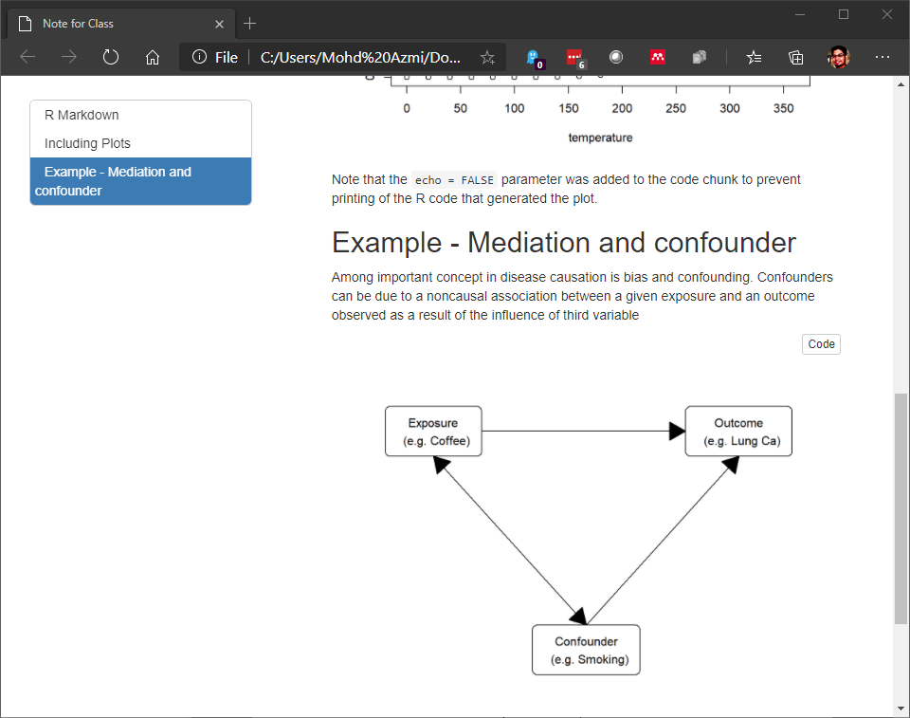
One file, various output
html output

Slide 16
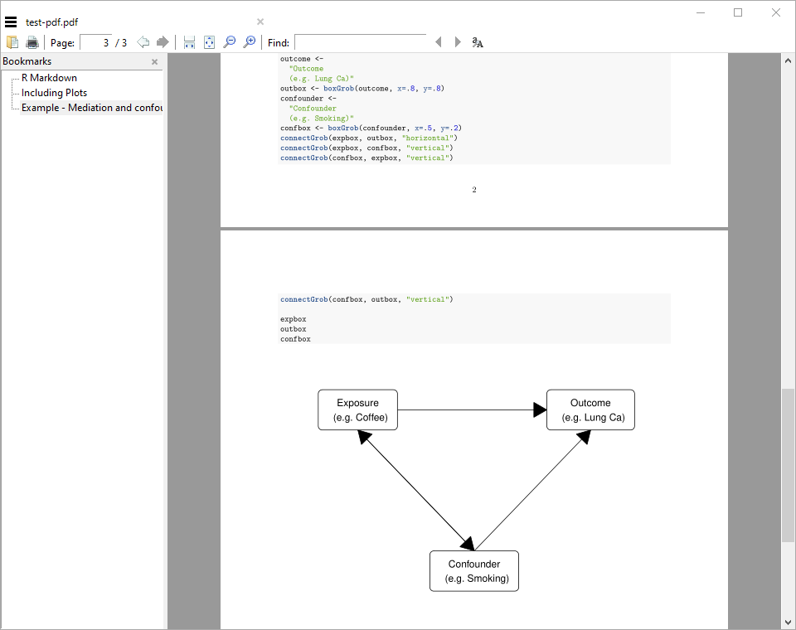
One file, various output
pdf output

Slide 17
Generate simple chart directly
Gmisc and grid package
ggplot (https://rpubs.com/phiggins/461686)

Slide 18
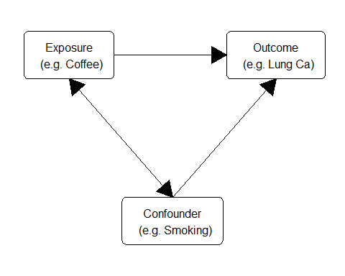

Slide 19
Student
Of course!
Main reason: reproducible

Slide 20
Student Assigment
Report output
pdf
html

Slide 21
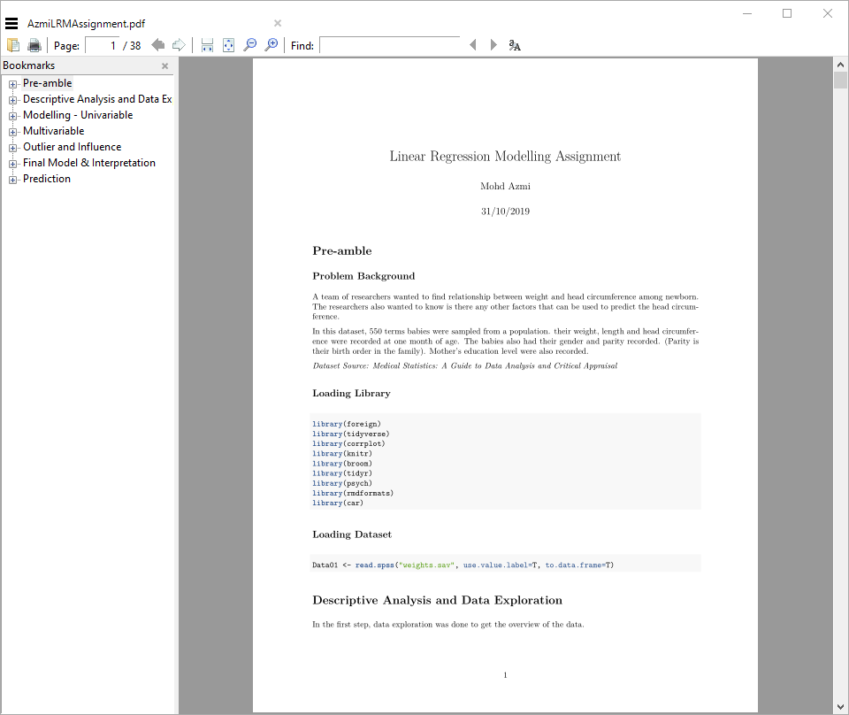
Student Assigment
pdf output

Slide 22
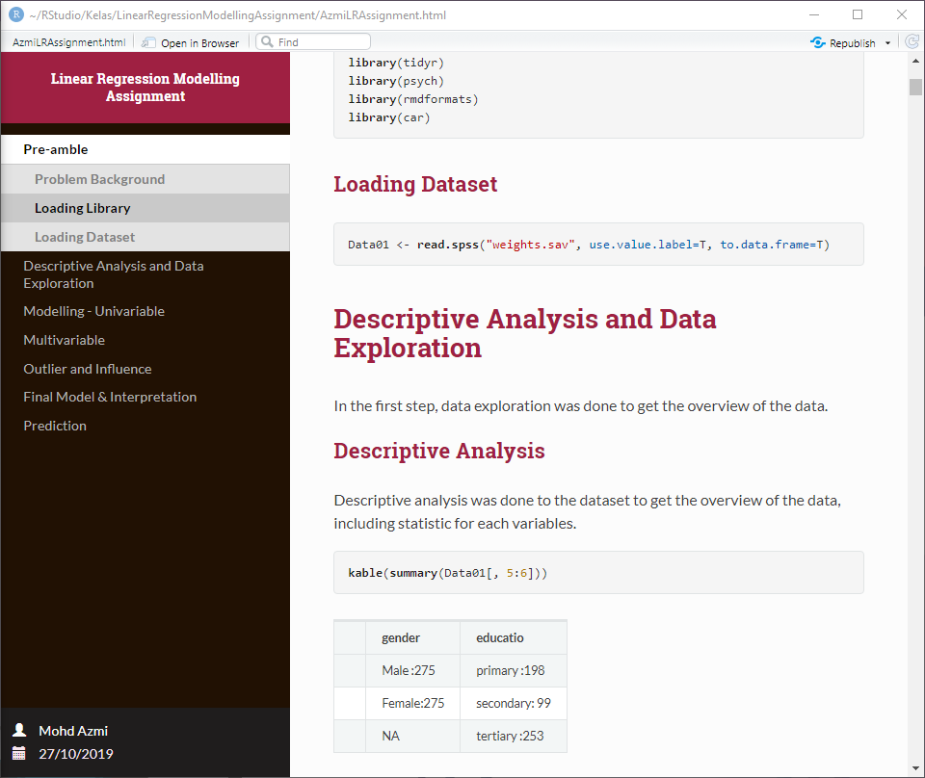
Student Assigment
html output

Slide 23
Assignment Submission
Manual
Publish
RPubs
RStudio Connect

Slide 24
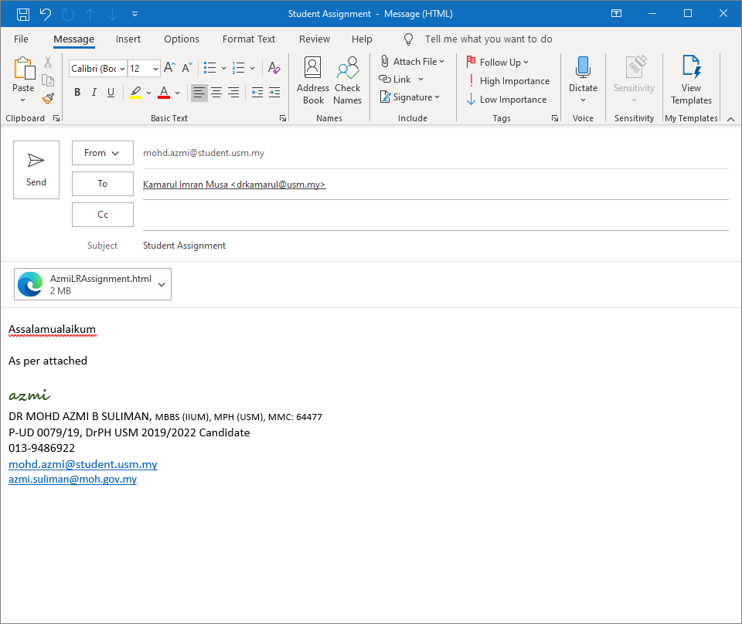
Assignment Submission
submit manual

Slide 25
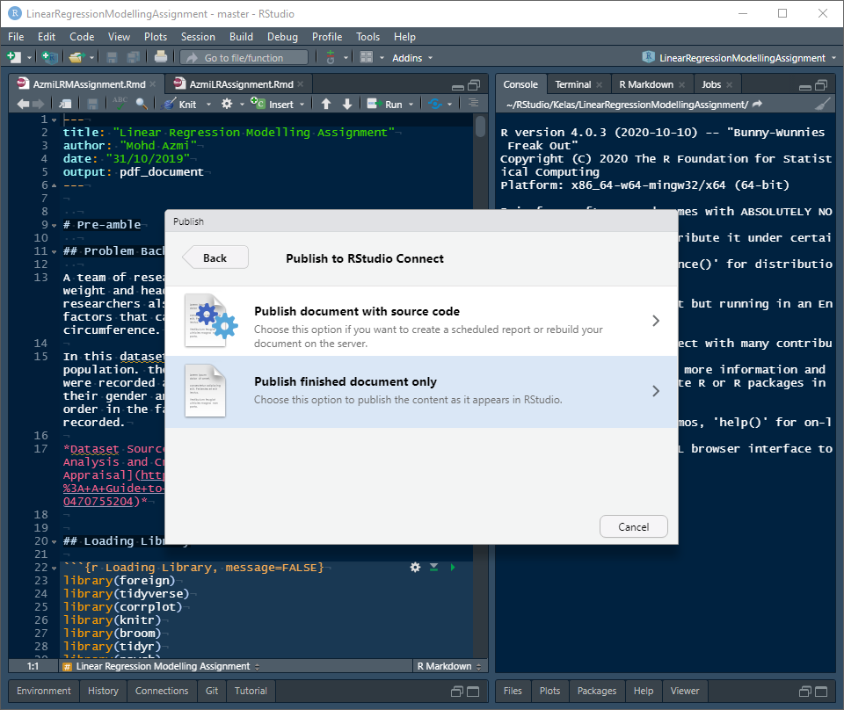
Assignment Submission

Slide 26
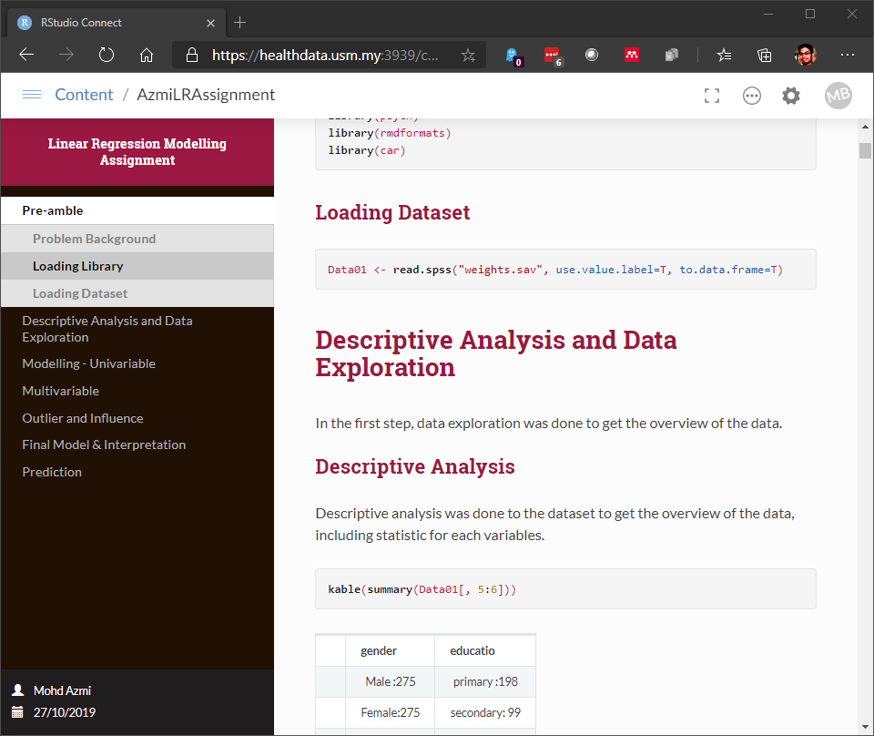
Assignment Submission

Slide 27
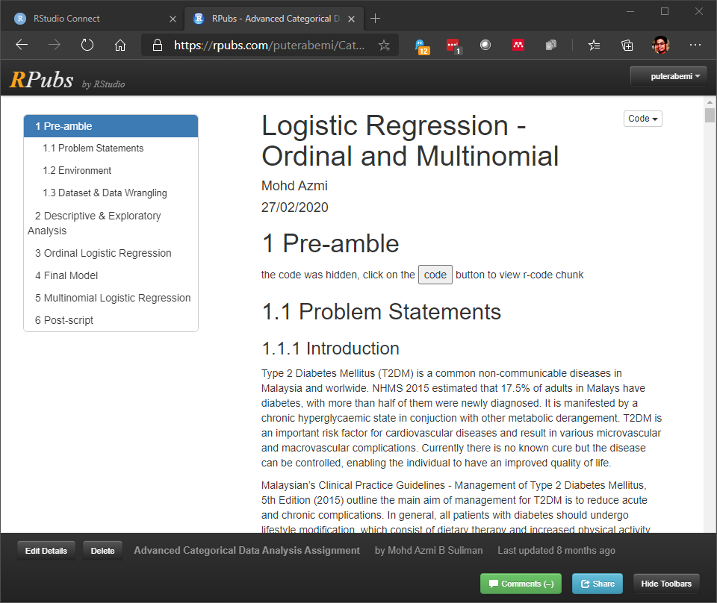
Assignment Submission

Slide 28
Closing
Various Source
R Markdown: The Definitive Guide https://bookdown.org/yihui/rmarkdown/
bookdown: Authoring Books and Technical Documents with R Markdown https://bookdown.org/yihui/bookdown/
pdf theme
rmdformat
prettydoc
presentation
beamer
ioslide
slidy
rmdshower

