Slide 1
Public Health Class with R Markdown
Dr Mohd Azmi (MBBS, MPH) Universiti Sains Malaysia, DrPH (Epidemiology) Candidate

Slide 2
Target Audience
Aim: Introductory
Teaching Staff
Student
Disclaimer
Very simple slide
short learning curve
Be creative!
Try, try, try

Slide 3
Motivation
Statistic and Epidemiology classess
Multiple output file for same purpose

Slide 4
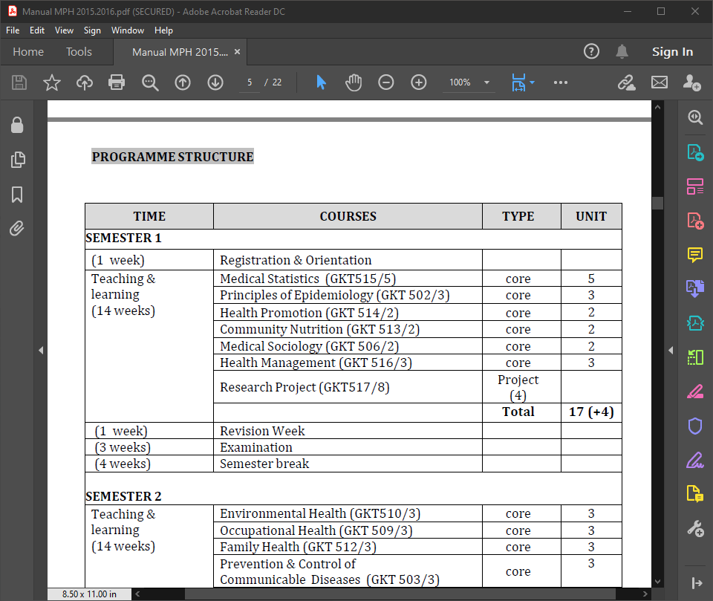
MPH and Medical Statistic
USM MPH Sturcture

Slide 5
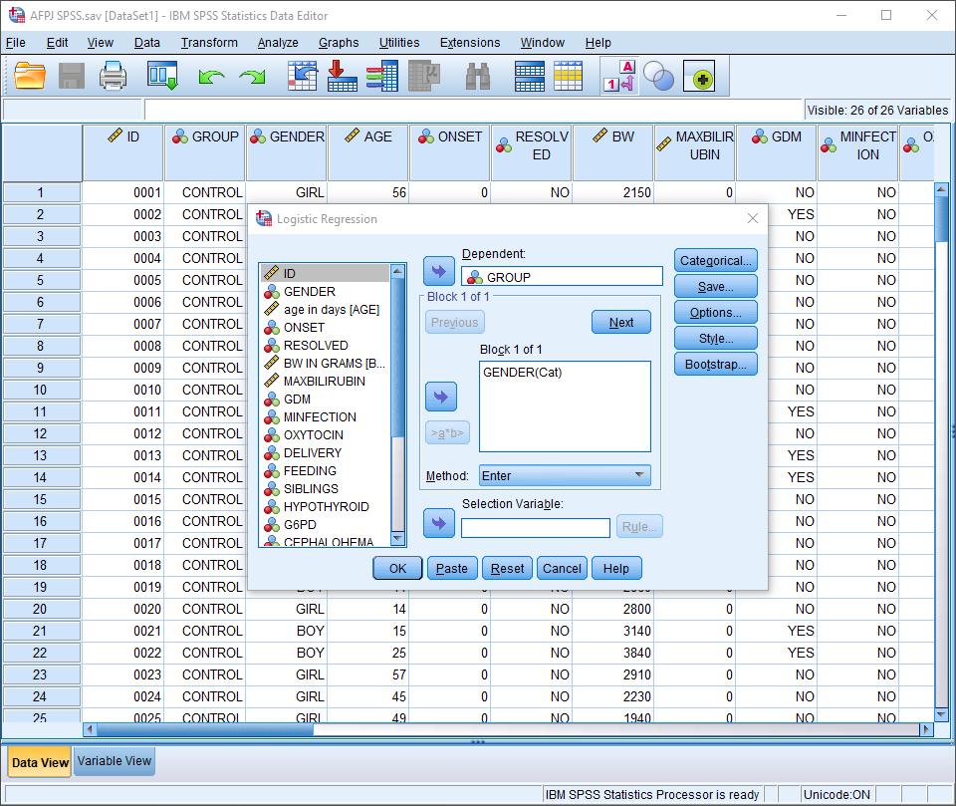
Medical Statistic with SPSS

Slide 6
## Teaching Statistic
fast, reproducible
x <- runif(100, 5, 10)
y <- sample(5:10, 100, replace = T)
y2 <- (x+y/2)
fake <- data.frame(x,y,y2)
with(fake, plot(x,y2))

Slide 7
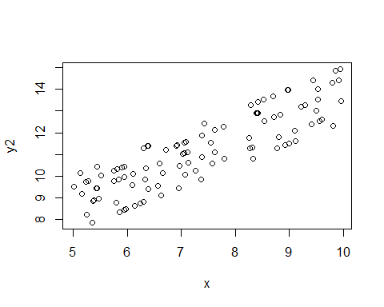

Slide 8
Tidyverse
example using tidyverse
tibble(x=runif(100, 5, 10), y2=(x+sample(5:10, 100, replace = T))/2)
%>% ggplot(aes(x,y2)) + geom_point()

Slide 9
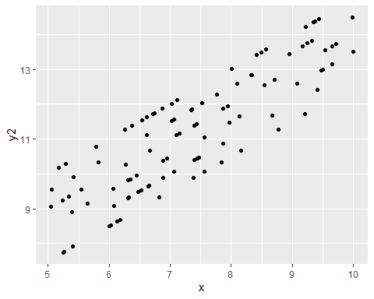

Slide 10
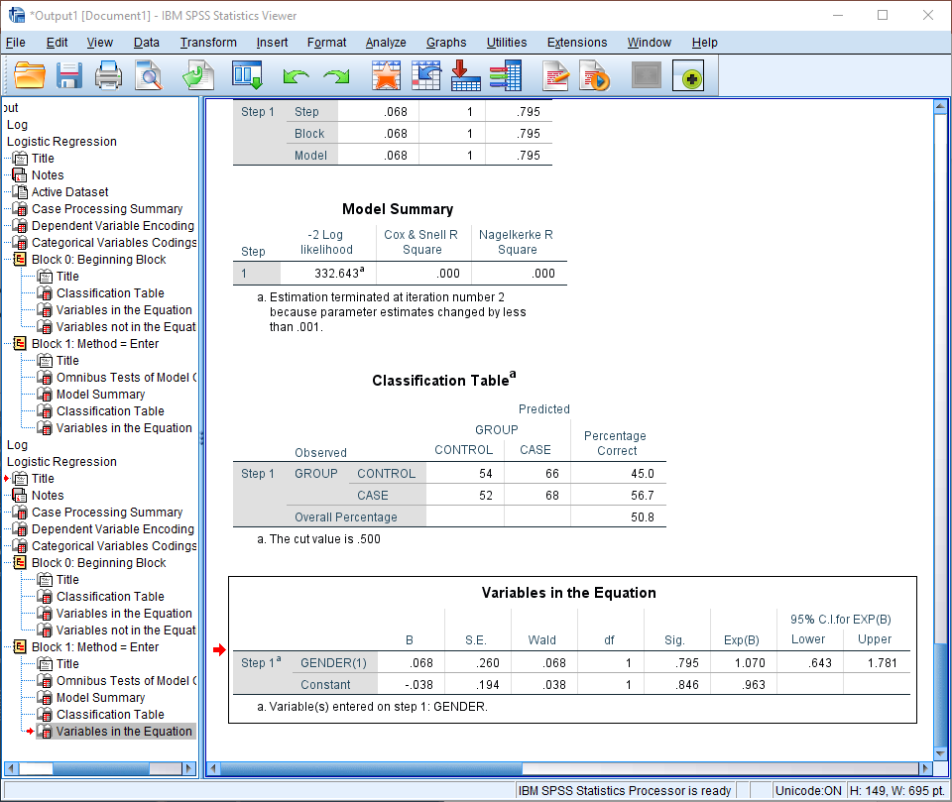
Medical Statistic with SPSS

Slide 11
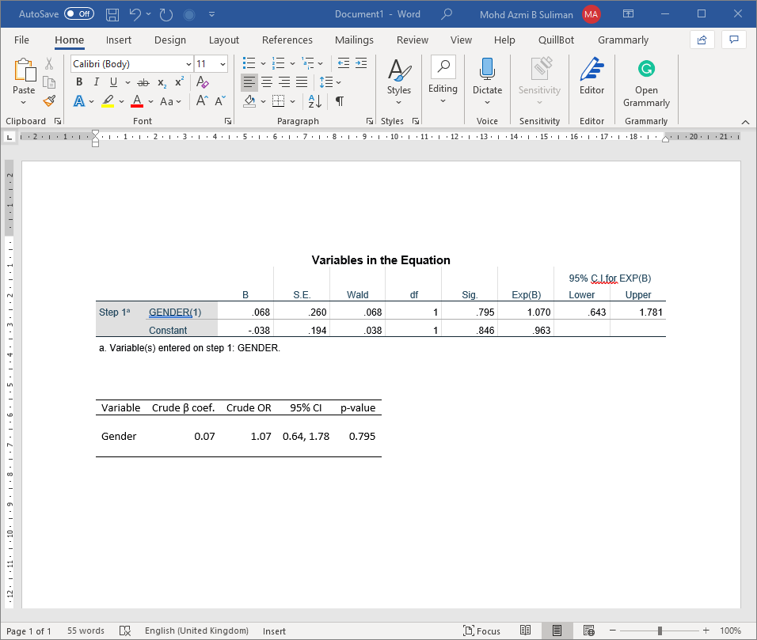
Medical Statistic with SPSS

Slide 12
What is R Markdown
Markdown: lightweight markup language
can add formating element to plaintext text document
R Markdown: “provide framework of authoring framework for data science…”
“save and execute code”
“generate high quality reports that can be shared with audience”

Slide 13
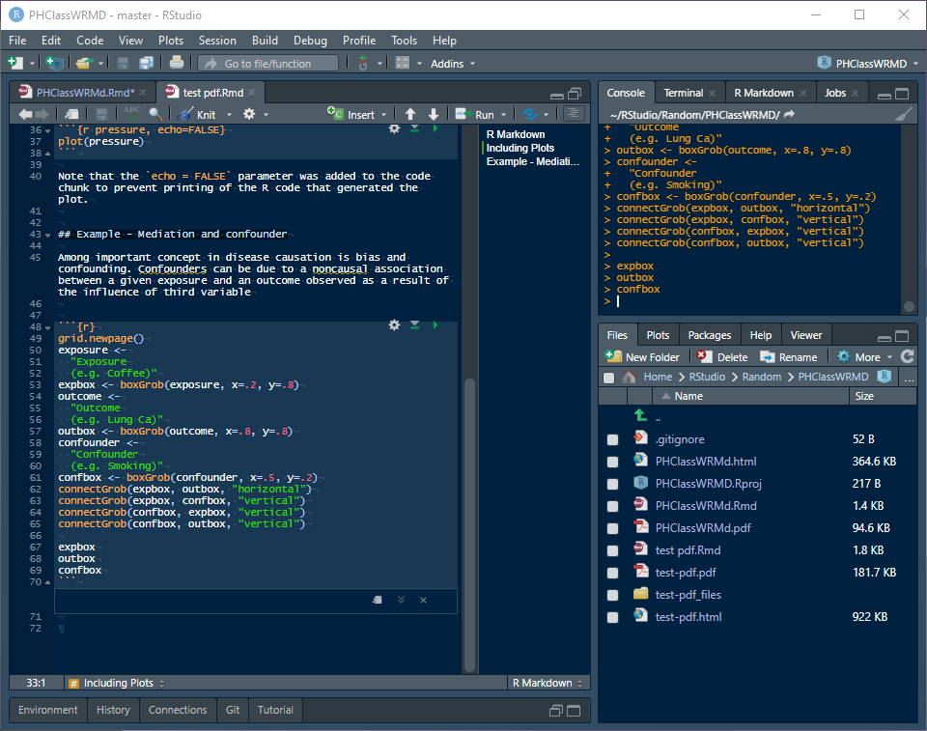
One file, various output
rmarkdown file

Slide 14
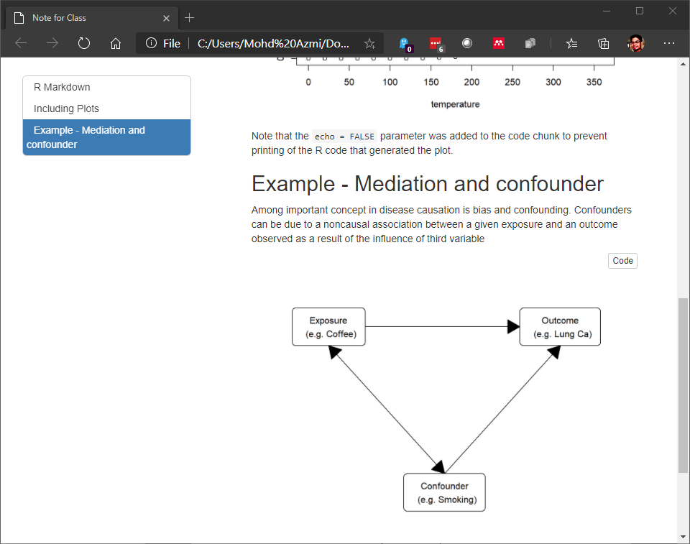
One file, various output
html output

Slide 15
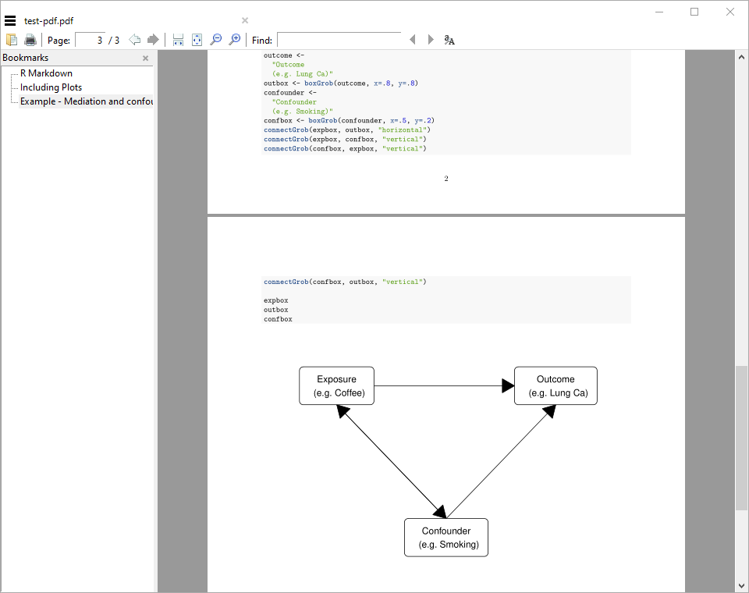
One file, various output
pdf output

Slide 16
Generate simple chart directly
Gmisc and grid package
ggplot (https://rpubs.com/phiggins/461686)

Slide 17
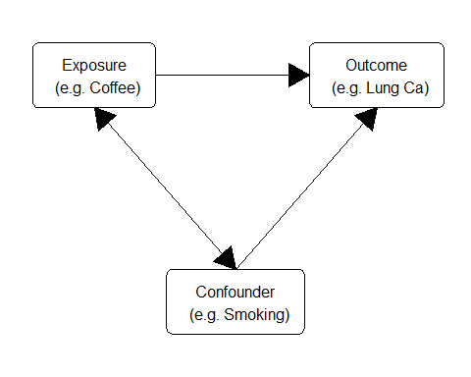

Slide 18
Student
Of course!
Main reason: reproducible

Slide 19
Student Assigment
pdf
html

Slide 20
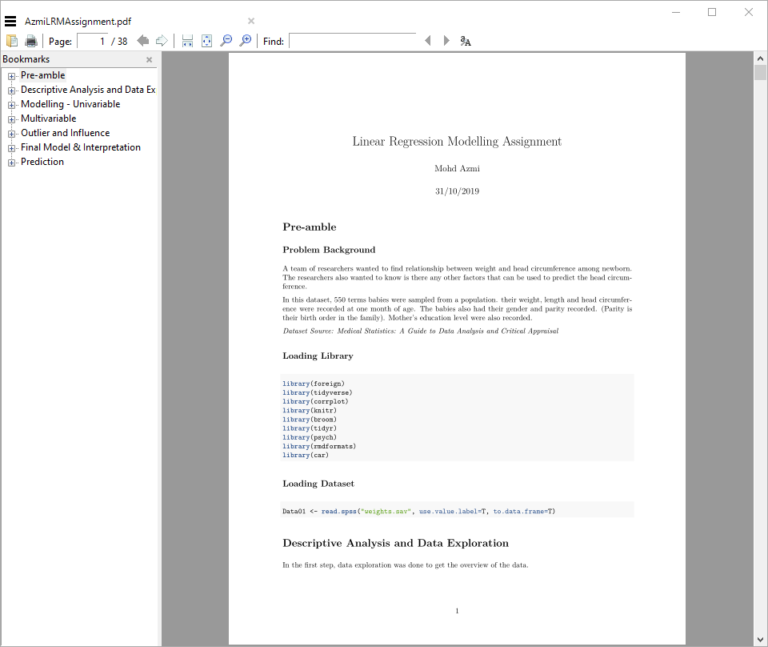
Student Assigment
pdf output

Slide 21
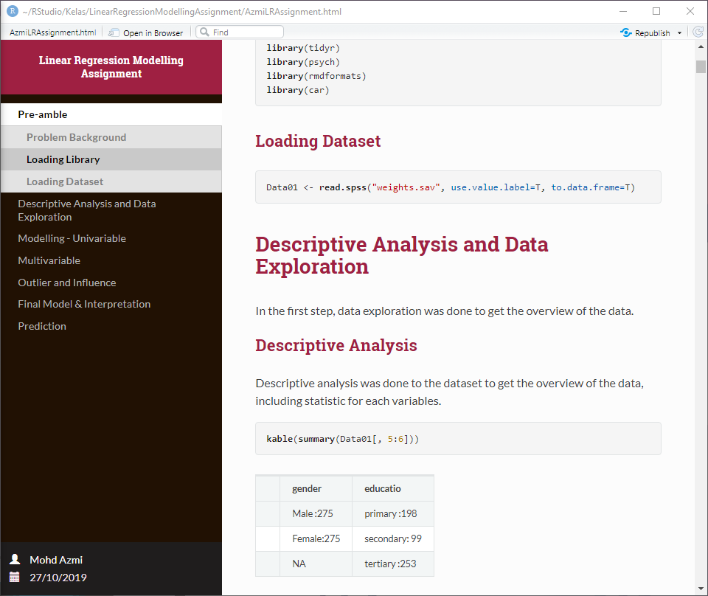
Student Assigment
html output

Slide 22
Assignment Submission
manual
publish
RPubs
RStudio Connect

Slide 23
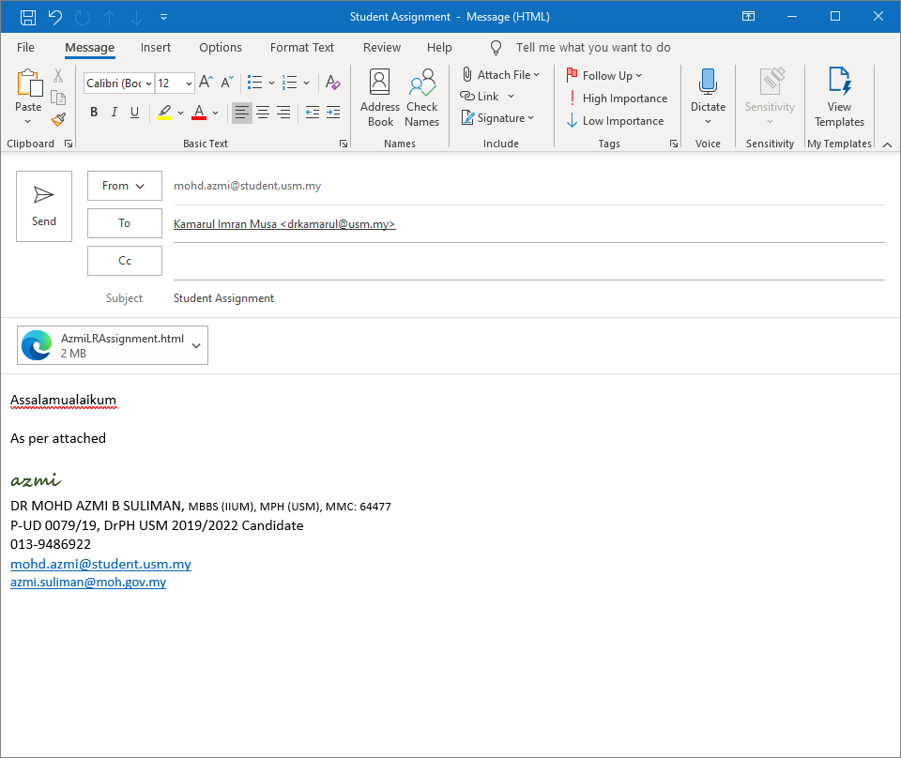
Assignment Submission
submit manual

Slide 24
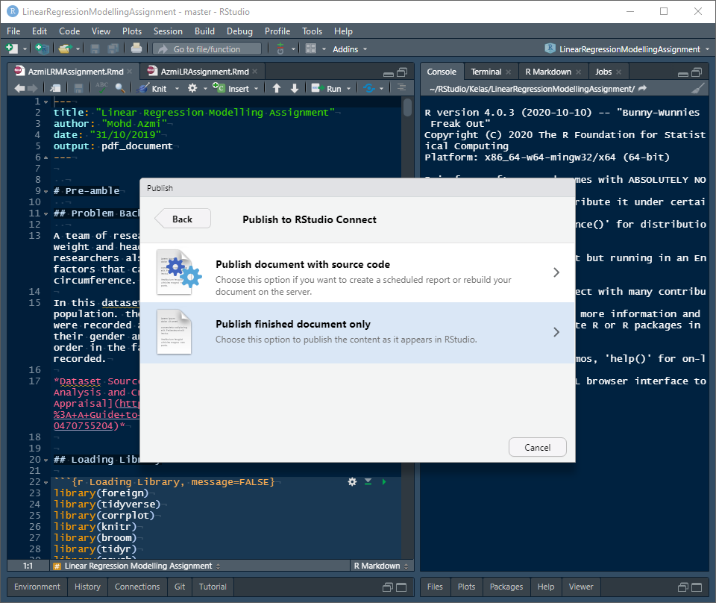
Assignment Submission

Slide 25
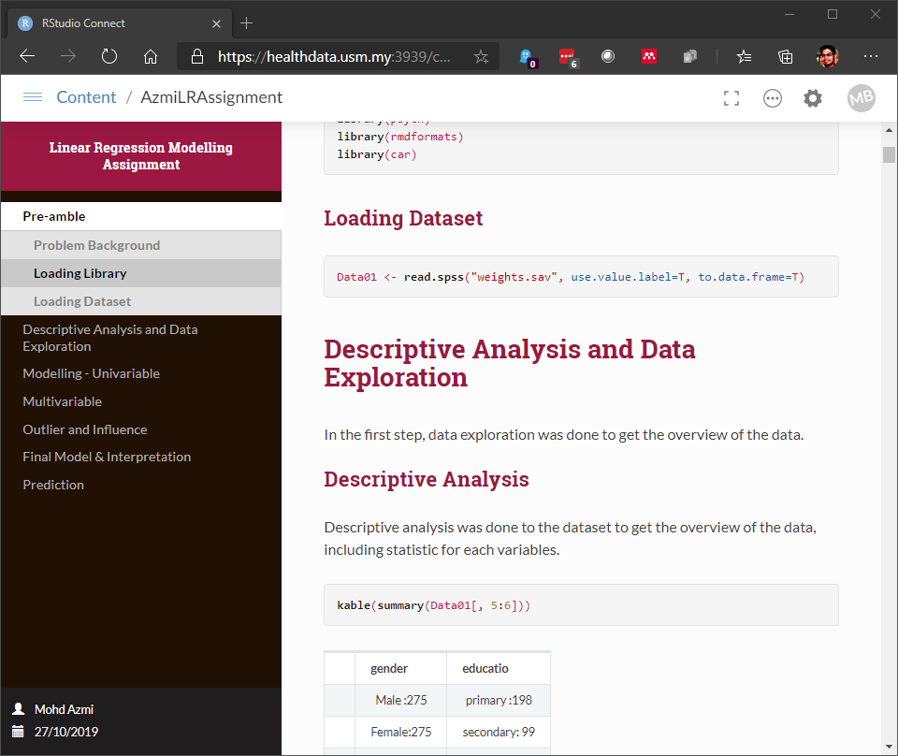
Assignment Submission

Slide 26
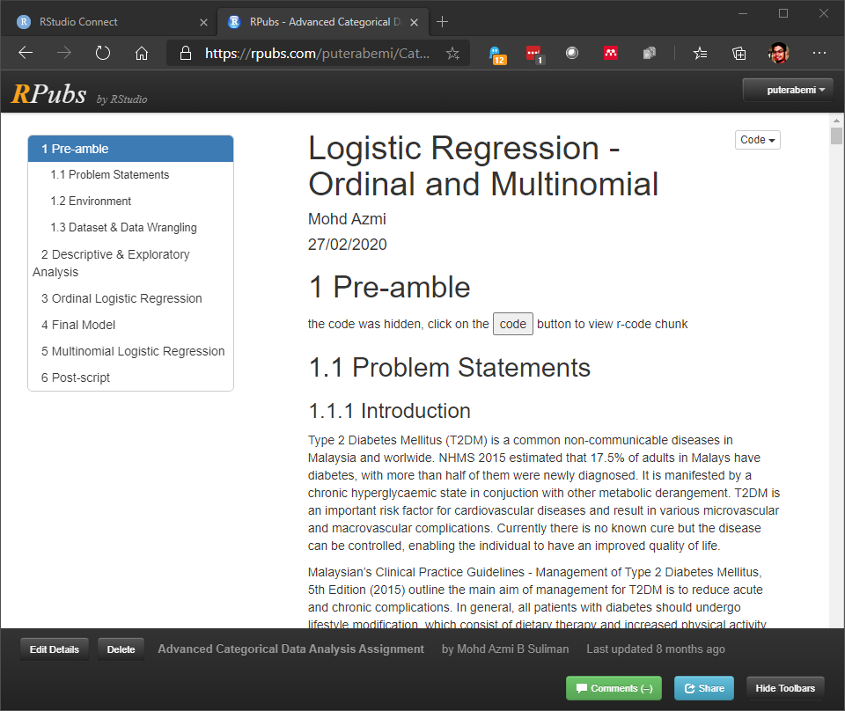
Assignment Submission

Slide 27
Closing
Various Source
R Markdown: The Definitive Guide https://bookdown.org/yihui/rmarkdown/
bookdown: Authoring Books and Technical Documents with R Markdown https://bookdown.org/yihui/bookdown/
pdf theme
rmdformat
prettydoc
presentation
beamer
ioslide
slidy
rmdshower

