Slide 1



ADX V DFM
View in Power BI
Last data refresh:
10/27/2019 11:57:16 AM Arabian Standard Time
Downloaded at:
11/6/2019 12:02:58 AM Arabian Standard Time

Slide 2


Slide 3
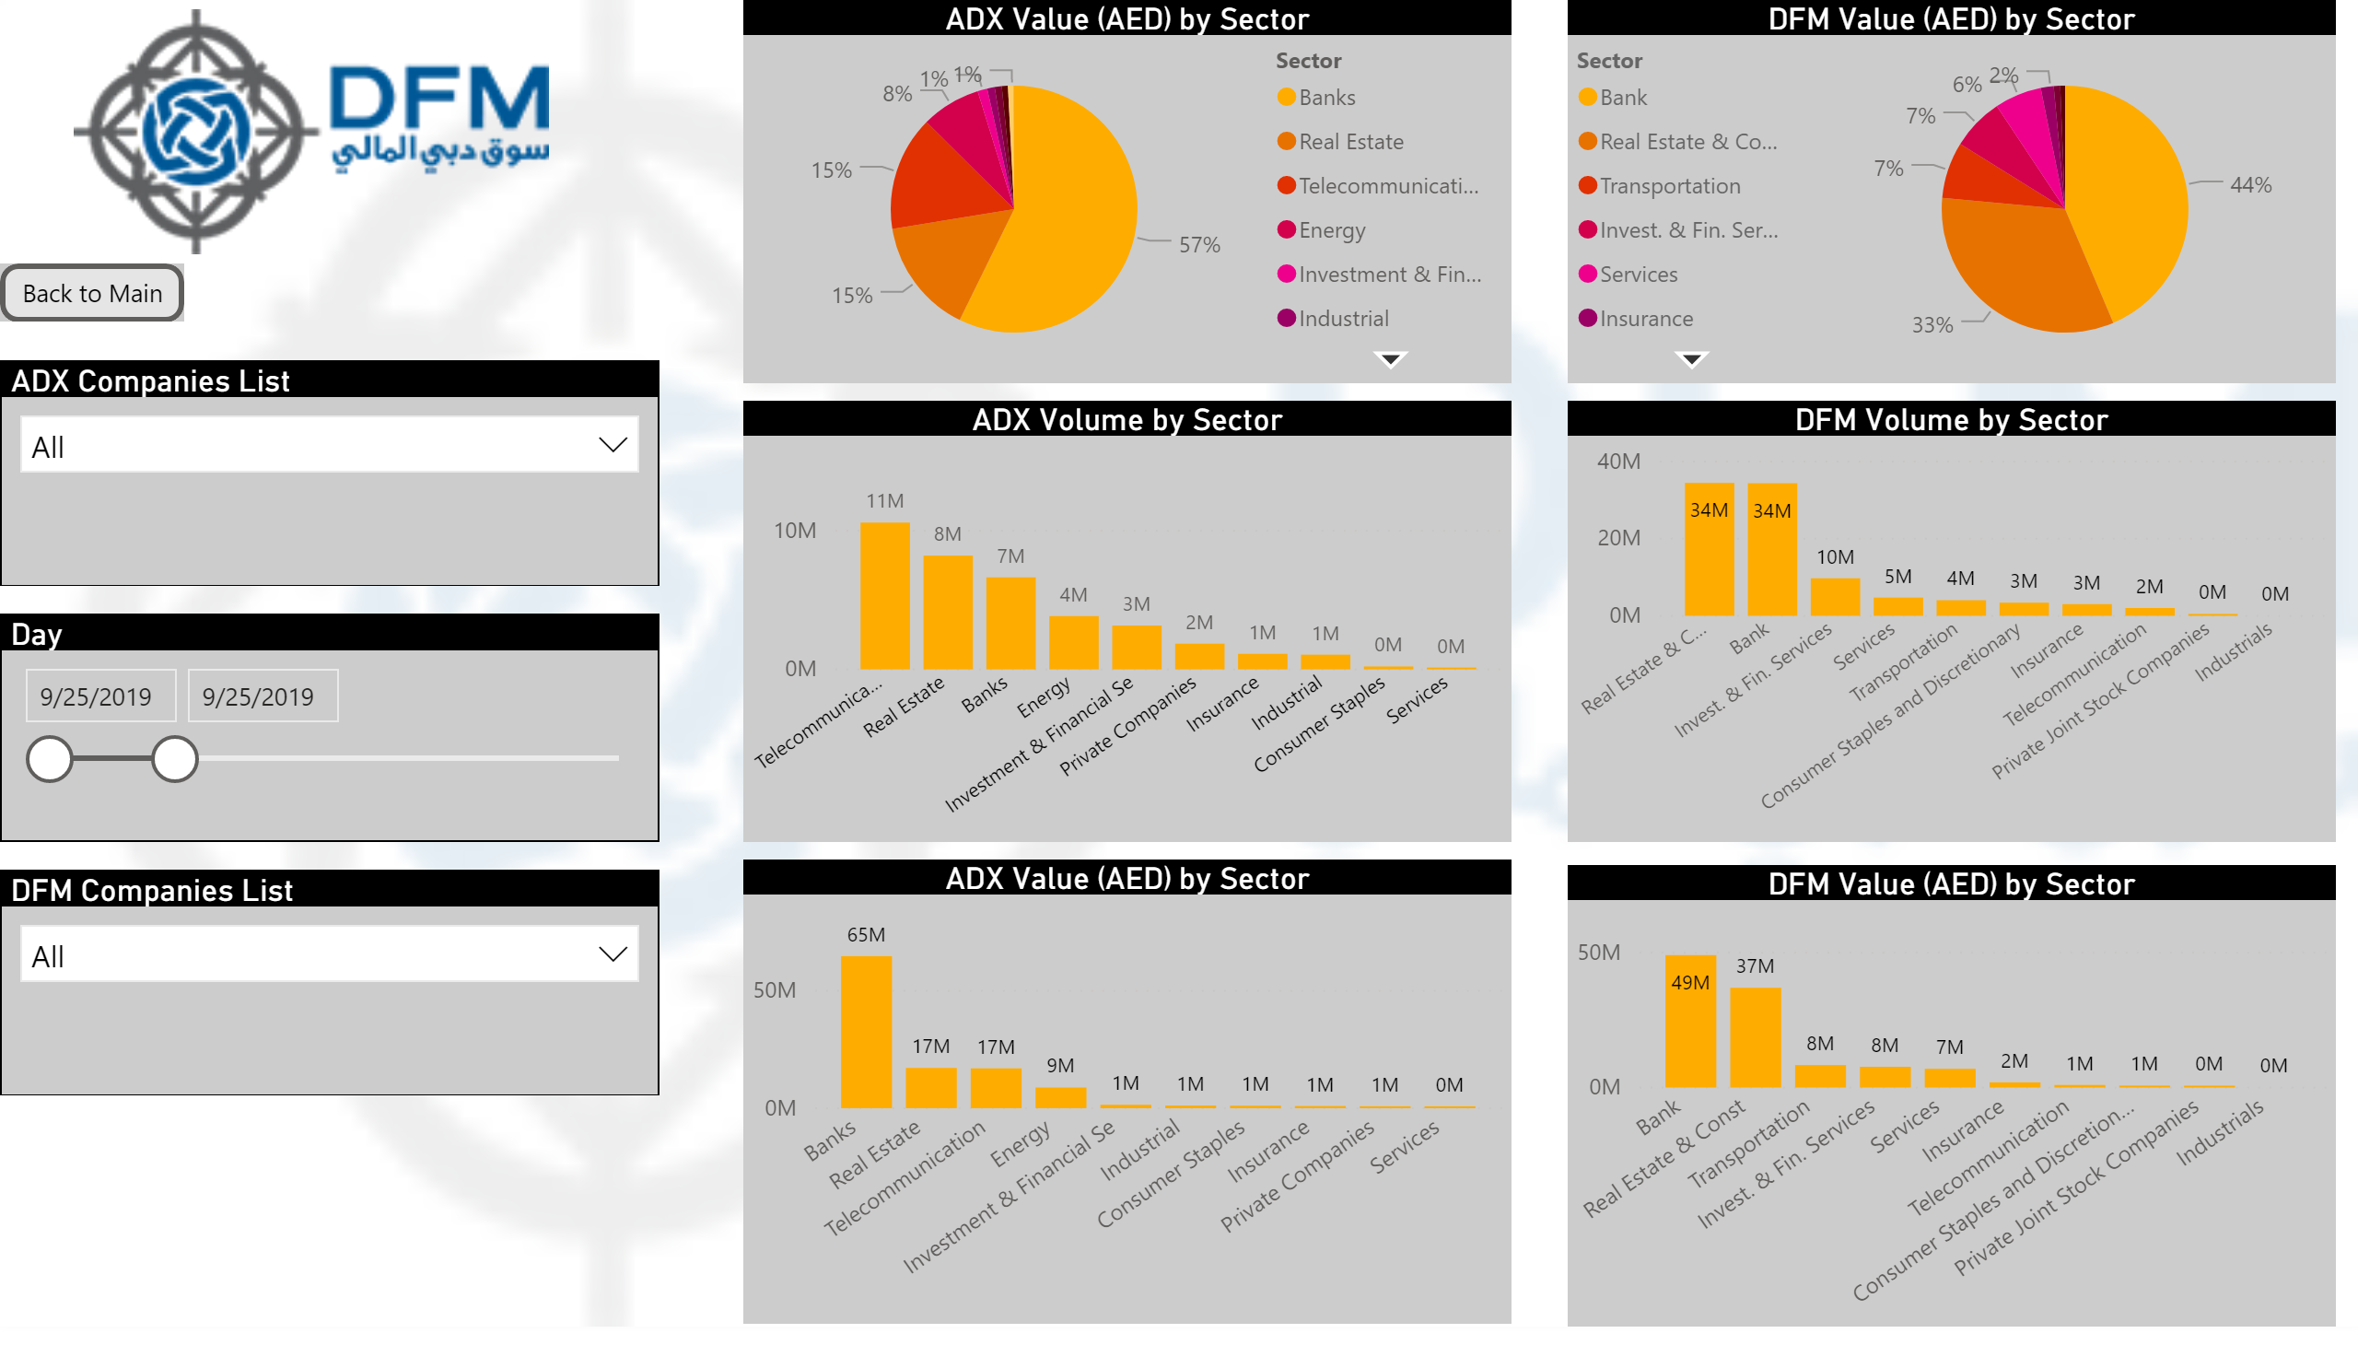

Slide 4
