Slide 1
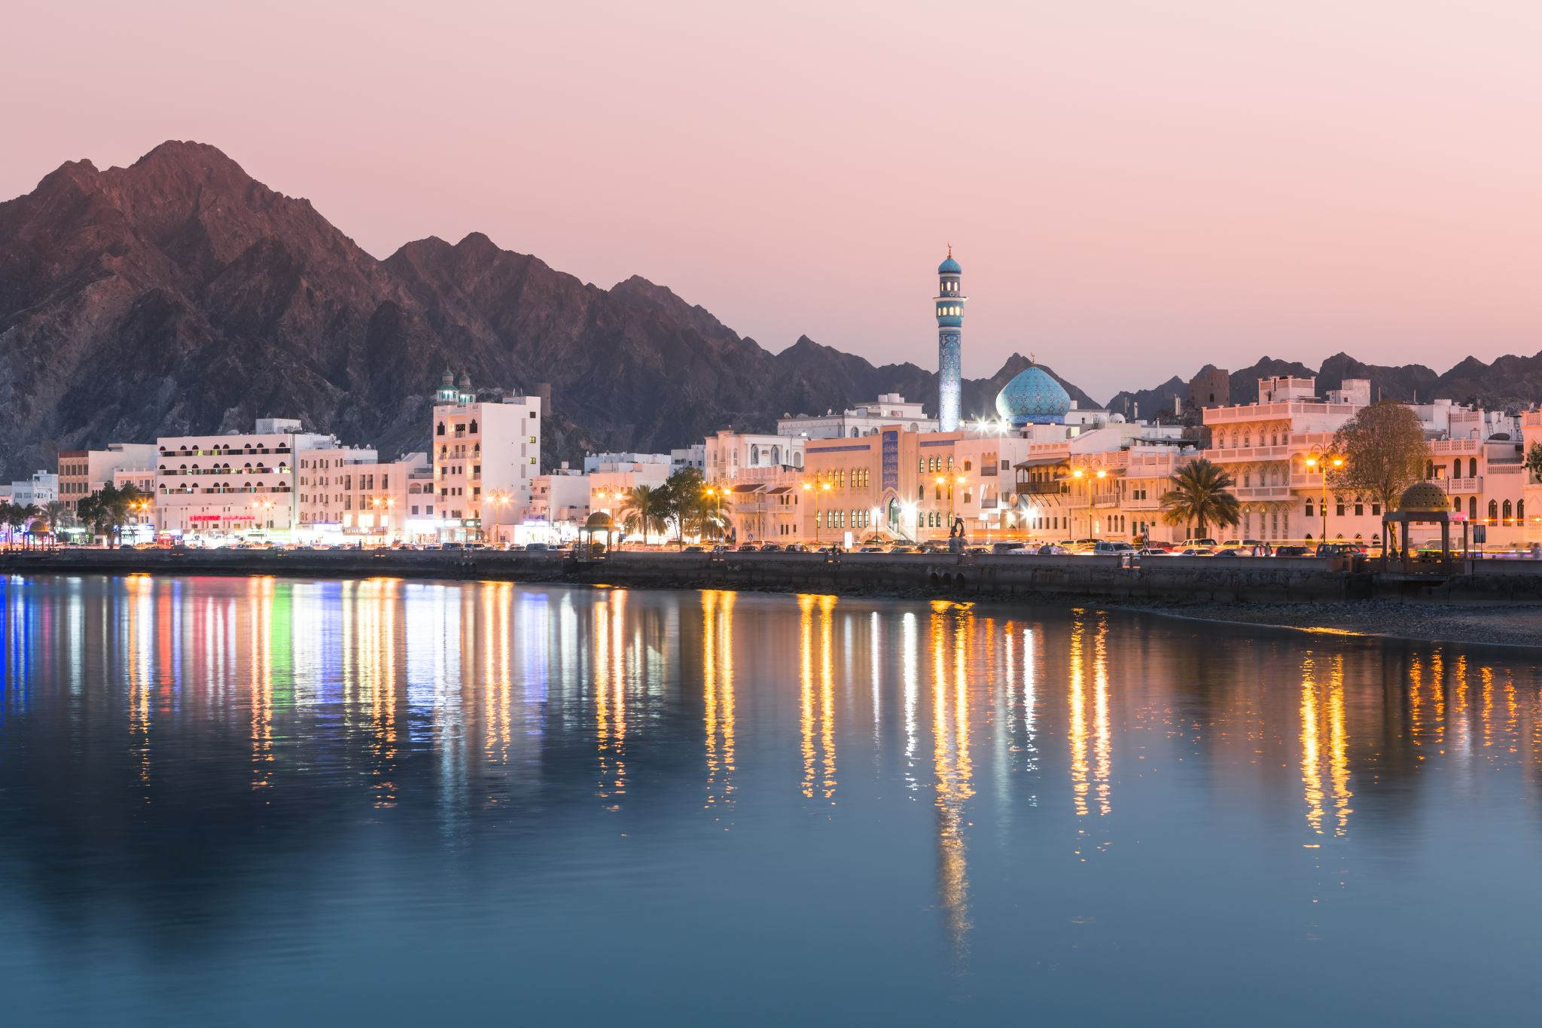
MY DREAM JOURNEY TO MAKKAH MADINA
BY- Mohd fahad KHAN

Slide 2
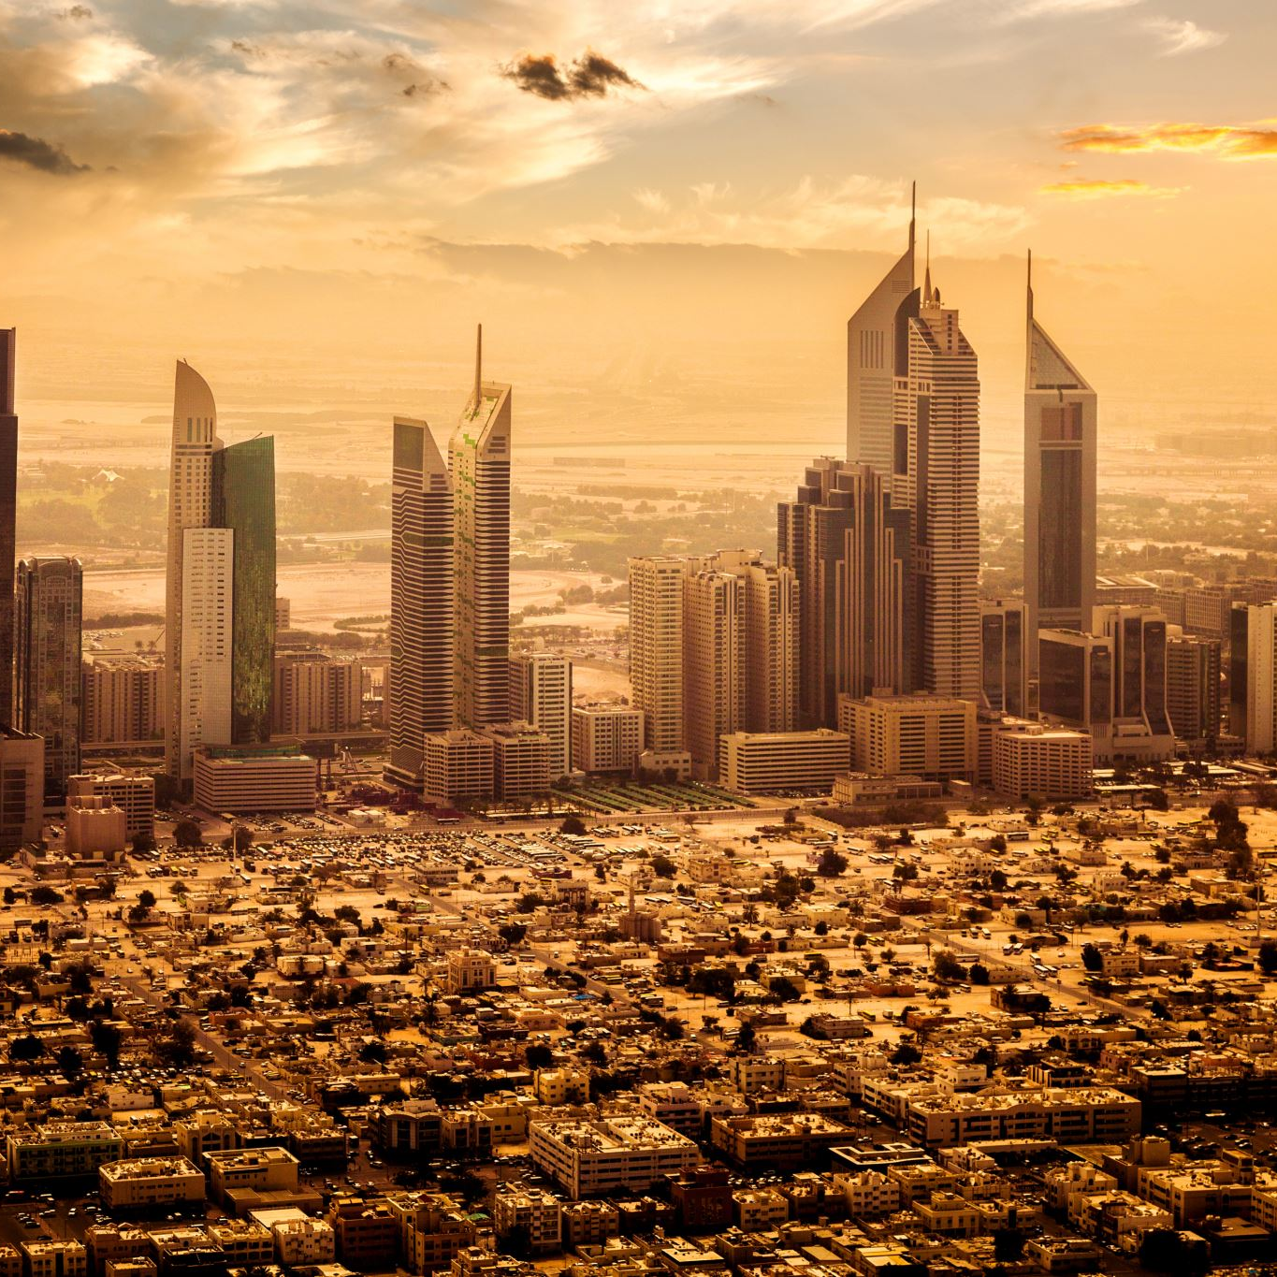
INTODUCTION
Makkah & Madina are two holiest cities in the islam.
They are located in Saudi Arabia.
Every Muslim dreams of visiting these two places.
I wish to go there to strenghth my faith and perform Umrah or Hajj.

Slide 3
VISITING MAKKAH
Makkah is home to the Kaaba, inside Masjid al-Haram. Millions of Muslims visit Makkah each year. I want to do Tawaf around the Kaaba and drink Zamzam water. It is a place of peace, worship, and deep connection with Allah.

Slide 4
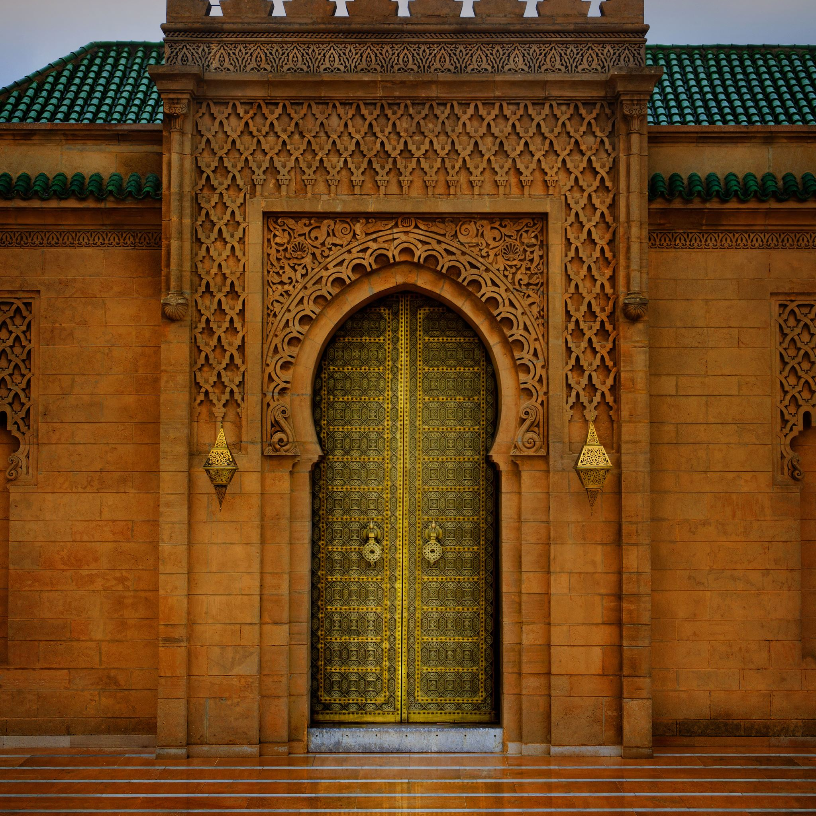
VISITING MADINAH
Madinah is the city of the Prophet Muhammad ﷺ. It is where Masjid an-Nabawi is located. The Prophet ﷺ is buried there. I want to pray in the Rawdah and feel the peace of this blessed city.

Slide 5
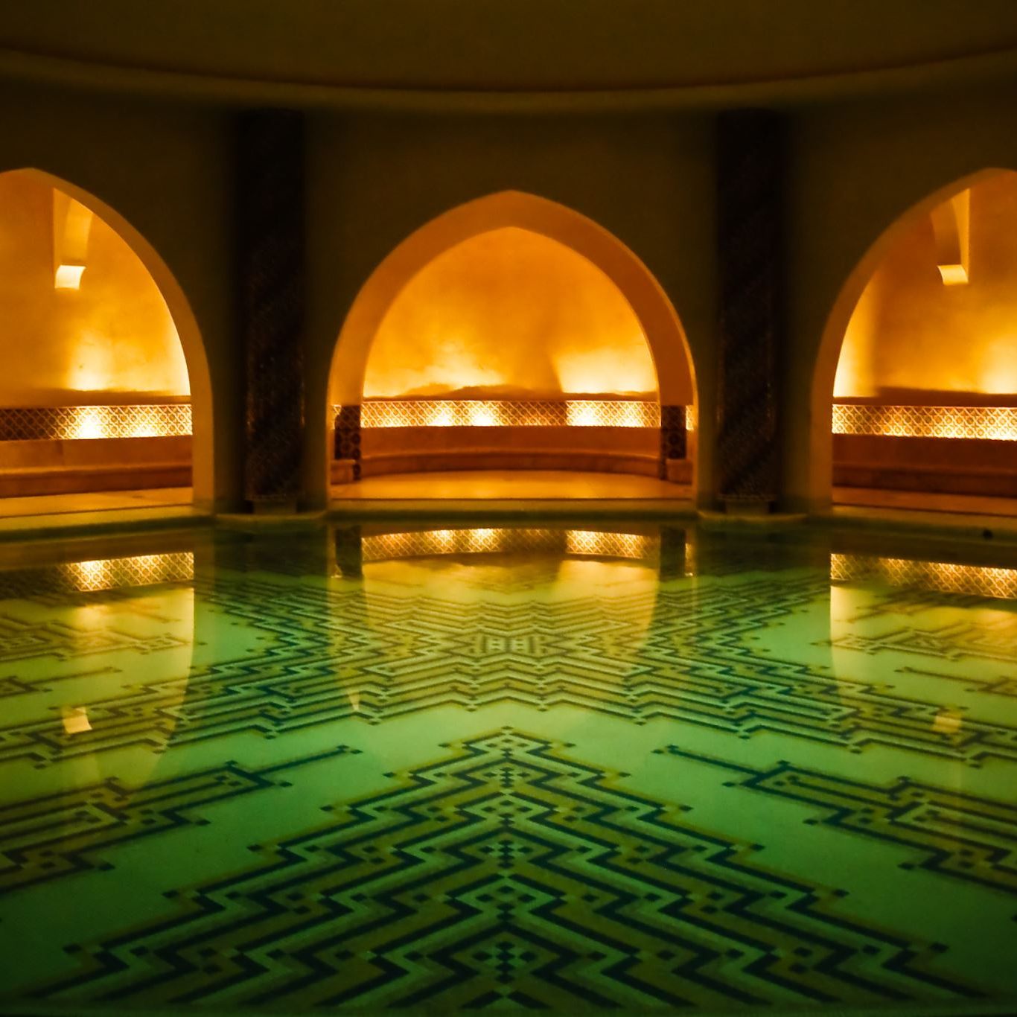
RELIGIOUS SIGNIFICANCE
Makkah & Madinah are the most important cities in islam.
Praying in masjid al Haram gives the reward of 100,000 prayers.
Praying in masjid an Nabwi gives the reward of 1,000 prayers.
Visiting these places brings peace and spritual growth.

Slide 6
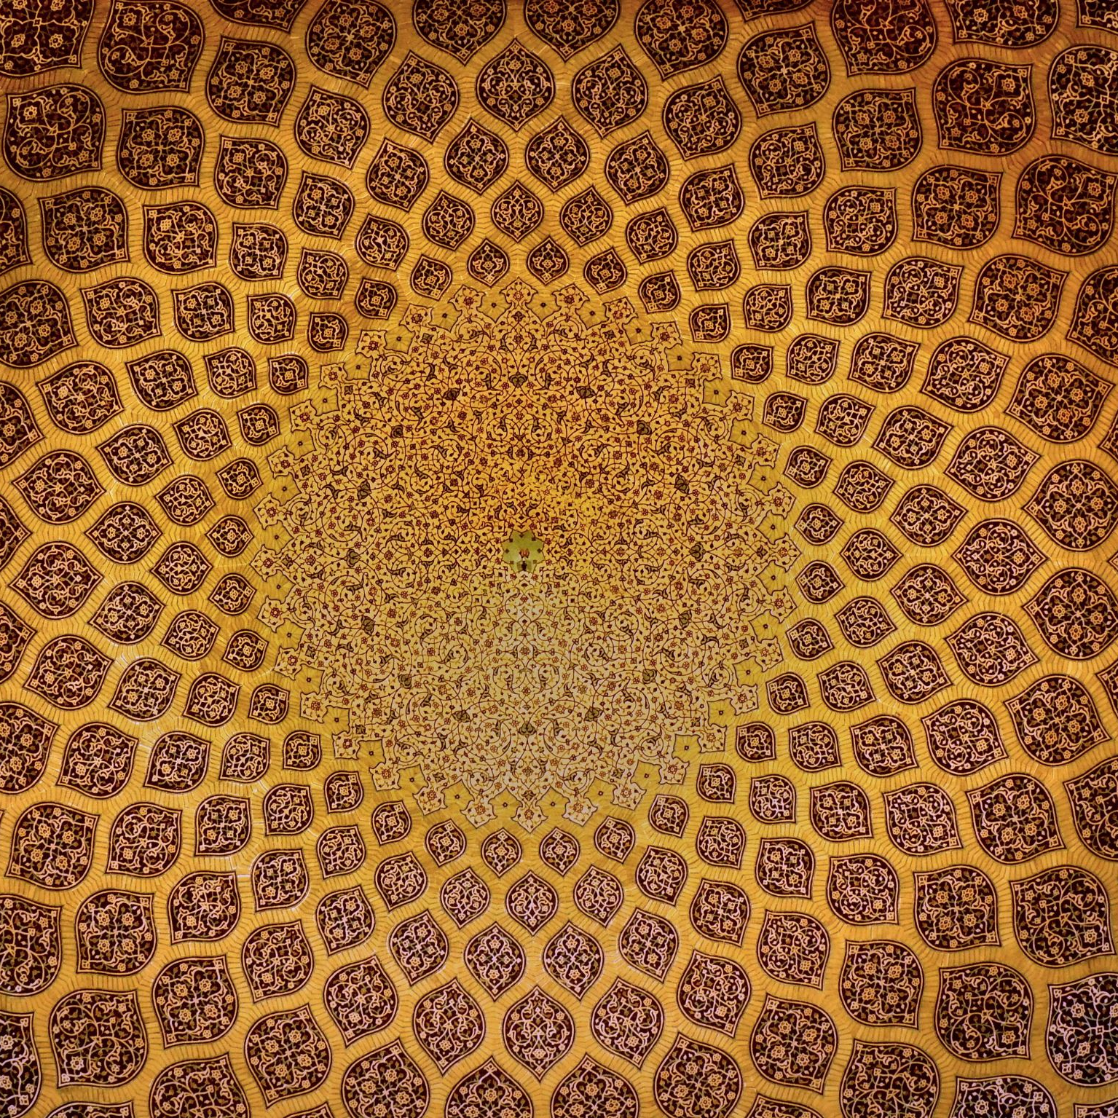
WHAT I WOULD DO THERE
Perform all five daily prayers in the Mosques.
Visit historical Islamic sites like Mount Uhud and Quba Mosque.
READ Quran, make dua, and reflect on the life of the Prophet ﷺ.
Spend time in worship and learn more about Islam.

Slide 7
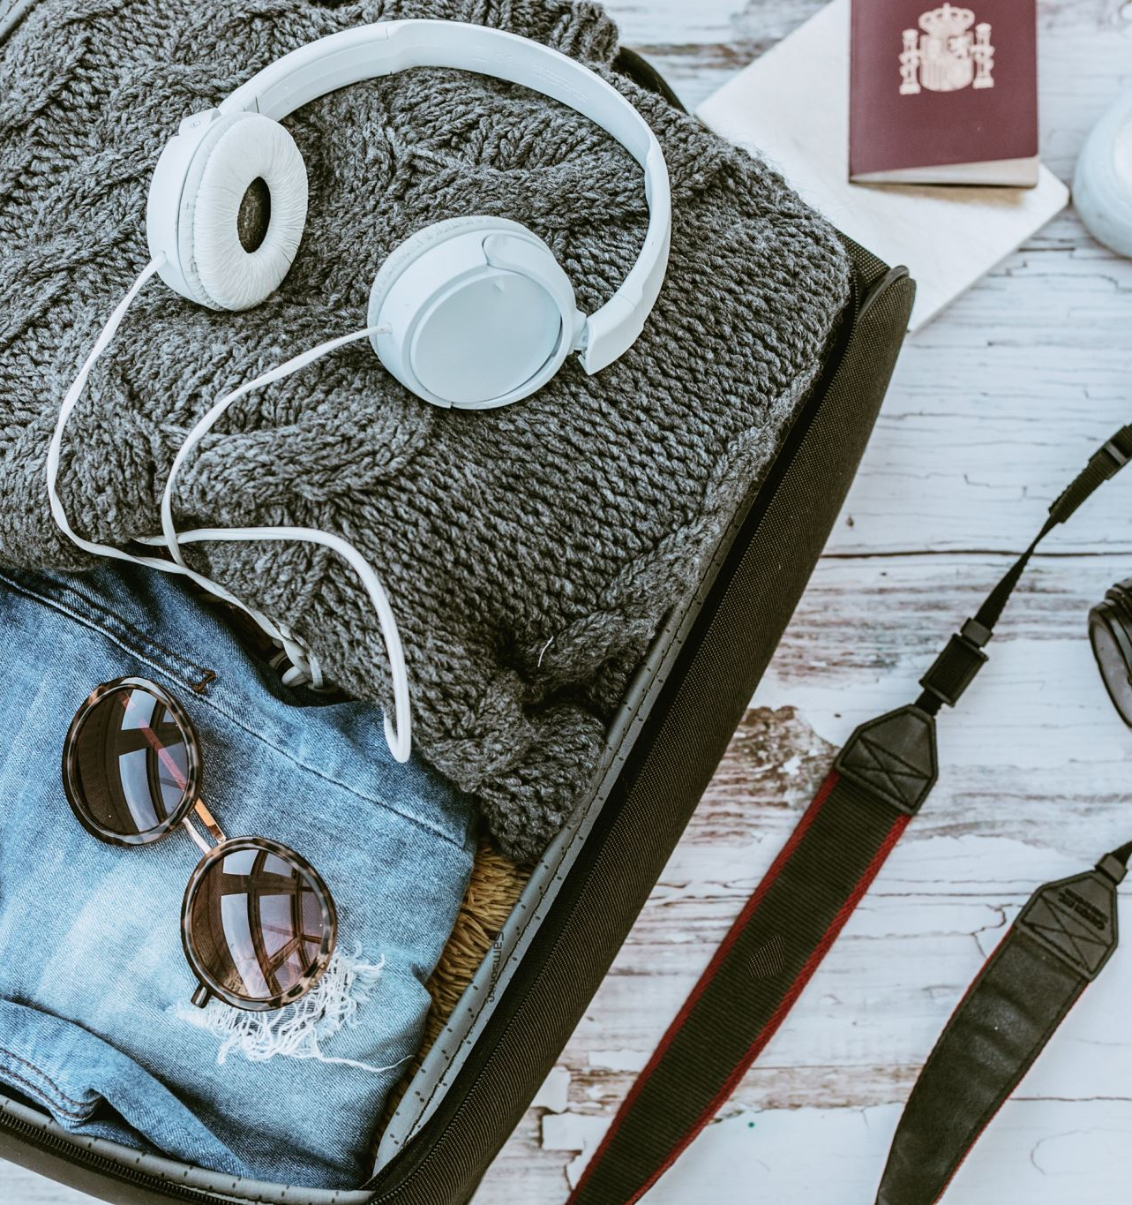
TRAVEL CHECKLIST
Ihram clothes
Quran and prayer mat
Comfortable shoes and simple clothes
Good manners, patience, and respect for others

Slide 8
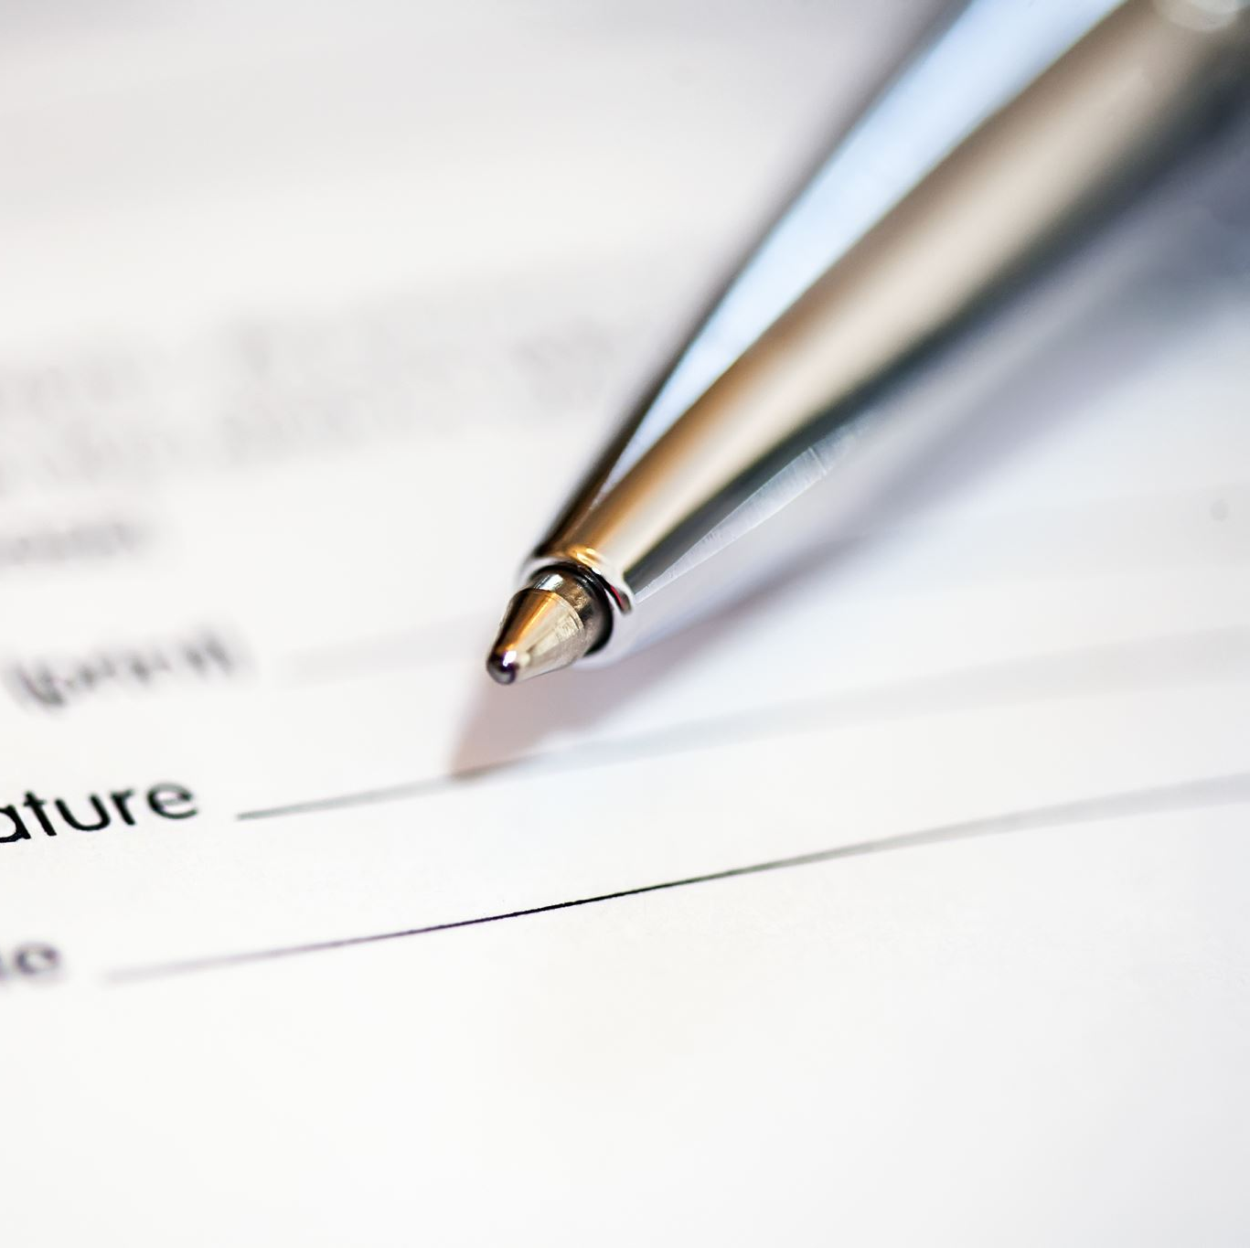
CONCLUSION
Visiting Makkah and Madinah is my dream.​
It is not just a trip --- it is a spiritual journey.​
I hope one day Allah gives me the chance to visit these places.​
Thank you for listening. ​
​ اللهم ارزقني زيارة بيتك الحرام والمسجد النبوي .

