Slide 1






Kompass
Navigate Together
Aswin P[502319]
Jefrin J[502326]
Mohamed Feroz S [502337]
Barnabas Mathew Vaz A [502361]

Slide 2

Problem Statement
Tour groups currently depend on multiple applications for:
This results in:
  Communication
  Fragmented communication
  Navigation and location sharing
  Difficulty identifying missing participants
  Inaccurate or time-consuming attendance
  Attendance management
  Announcements
  Delayed emergency response
  Emergency coordination
  Increased workload for tour organizers

Slide 3



Proposed Solution :
KOMPASS provides a centralized mobile platform for tour organizers, guides and participants.
  Tour and participant management
  Digital attendance using QR code, GPS or manual check-in
  Live participant location tracking
  Circular and polygonal geofencing
  In-app voice calling and messaging
  Announcements and push notifications
  Itinerary and meeting-point management
  Emergency SOS alerts
  Document and ticket sharing

Slide 4
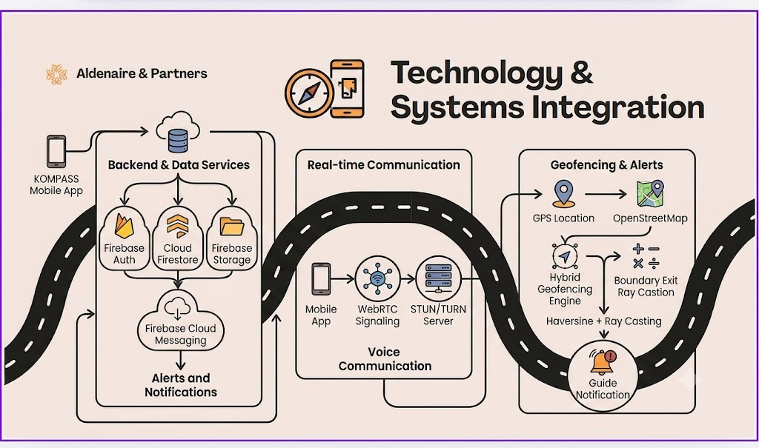

Slide 5
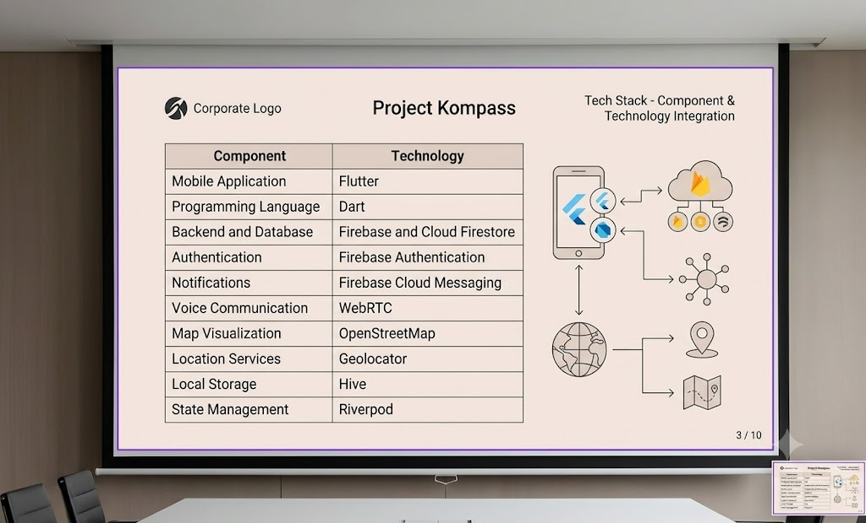
Implementation Details

Slide 6




Expected Outcomes and Future Scope
  Real-time identification of missing participants
  Centralized tour coordination
  Improved emergency response
  Safer and more organized tour experiences
  Accurate digital attendance
  Reduced manual effort for organizers
  Faster communication between
guides and participants

Slide 7
THANK YOU

