Slide 1
Hate Speech Detection
Presented by:
Nishat Salsabil Rainy -1812620042
Mohd. Istiaq Hossain Junaid-1821577642
Samreen sohail-1711648642

Slide 2
Introduction
With the advancement of Technology and Internet, people have got many platforms where they can freely share their thoughts and opinions. We know that everyone has the right of freedom of speech. However, this right is being misused to discriminate and attack others, physically or verbally.
We have thought about developing a system that could catch comments that encourage hate and conflict.

Slide 3
What is defined as hate speech?
The term hate speech is understood as any kind of communication in speech, writing or behaviour, that attacks or uses pejorative or discriminatory language with reference to a person or a group on the basis of who they are, in other words, based on their religion, ethnicity, nationality, race, colour, descent, gender or other identity factor.

Slide 4
Our Proposed System
To create a hate-speech-detecting algorithm, we have used Python-based NLP machine learning techniques.
Tf-Idf vectorization to extract keywords that convey importance within hate speech.
We have trained the models to classify hate speech with different classifiers - SVC, Naive Bayes, logistic regression and Decision Tree.

Slide 5
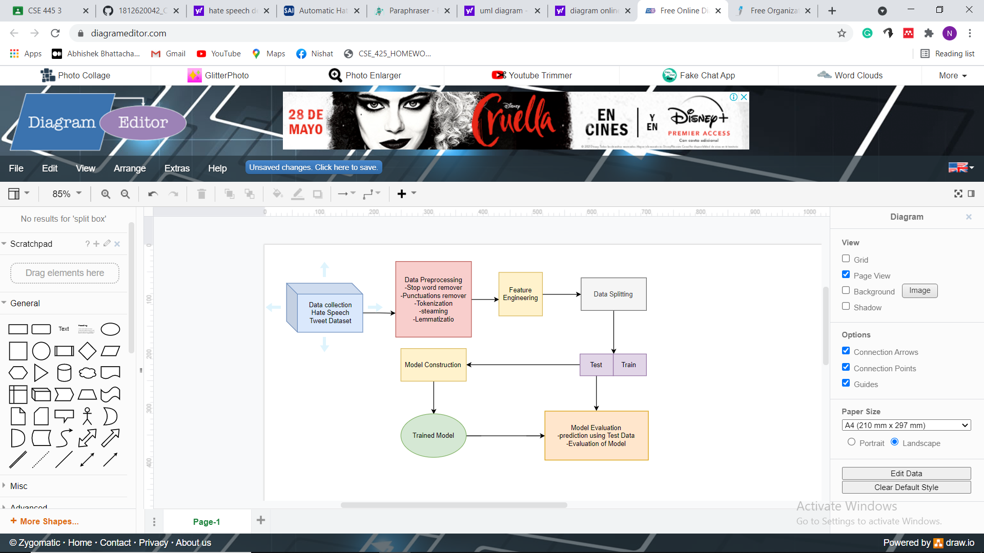
Methodology

Slide 6
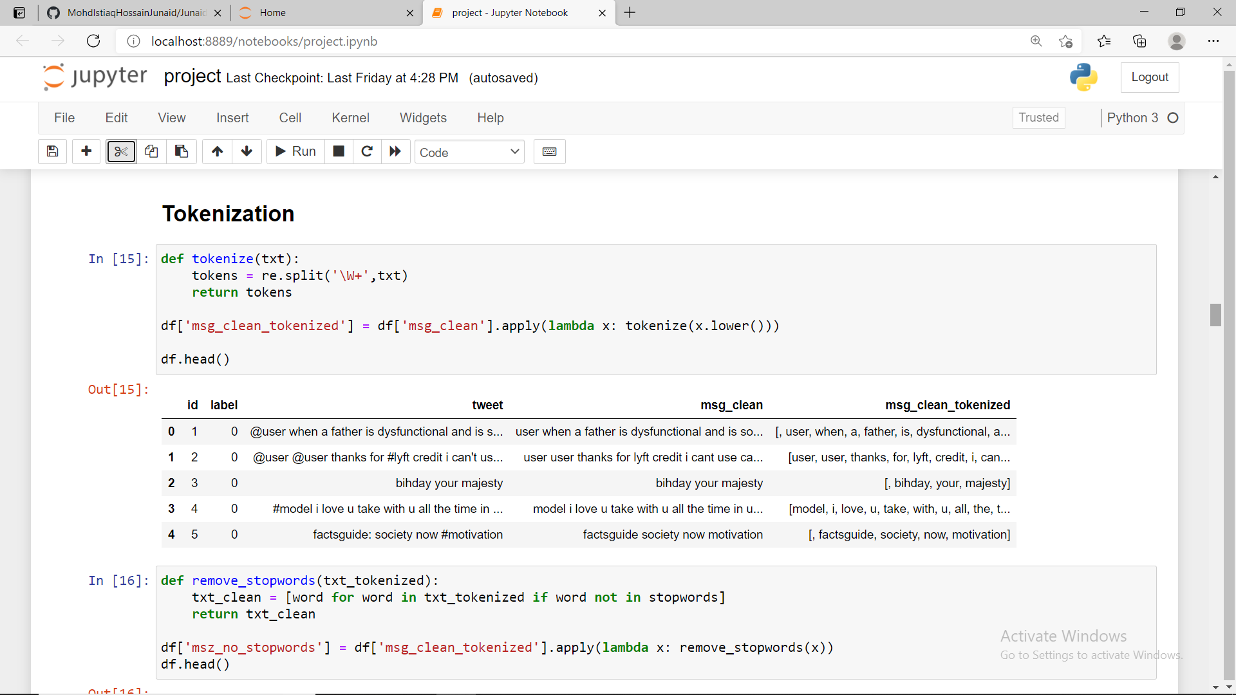
Tokenization

Slide 7
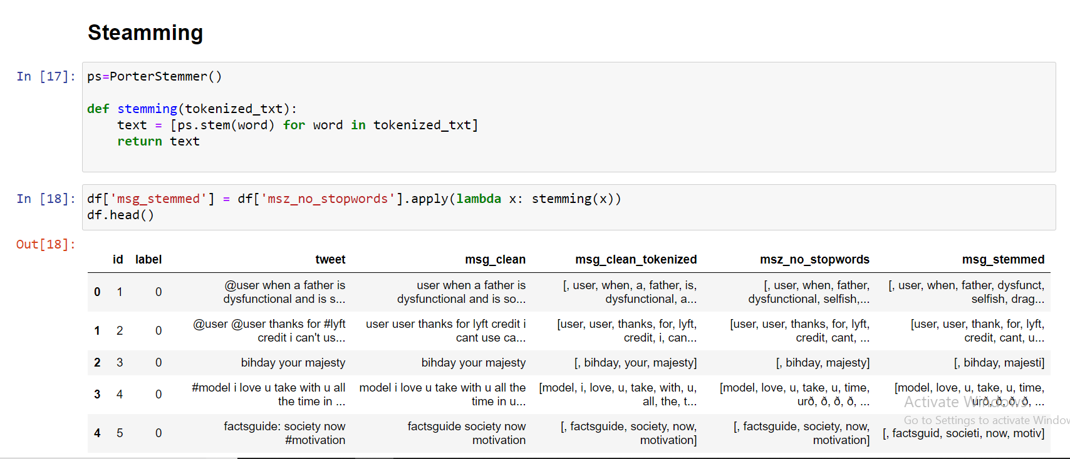
Steaming

Slide 8
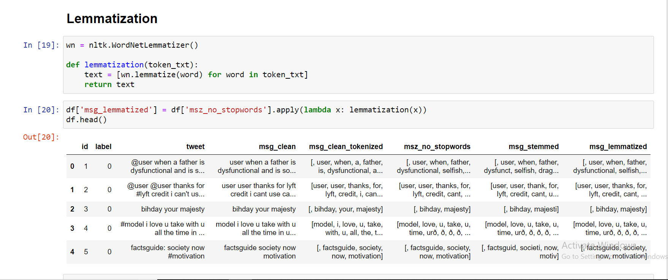
Lemmatization

Slide 9
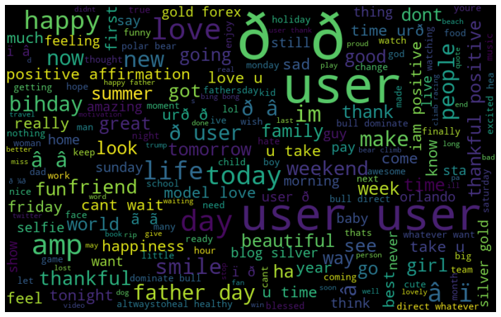
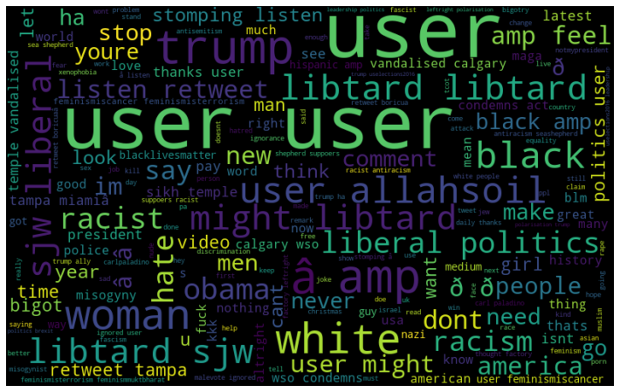
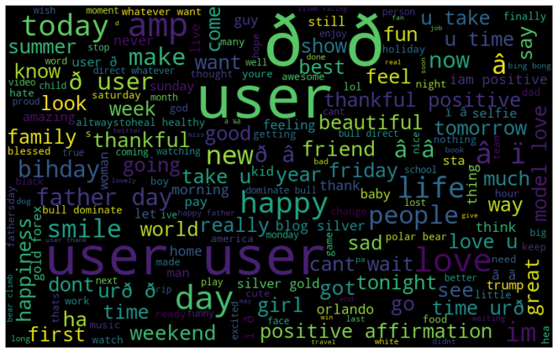
Visualization
word visualization for positive word
Word visualization for negative word
Word visualization for all word in dataset

Slide 10
Result Analysis
Model | Precision | Accuracy | F1 score | Recall
1.Linear SVC | 0.97(0) 0.87 (1) | 0.96 | 0.98(0) 0.69 (1) | 0.99(0) 0.57(1)
2.Multinomial Naive Bayes | 0.94(0) 1.00 (1) | 0.94 | 0.97 (0) 0.27 (1) | 1.00 (0) 0.15 (1)
3.Decision Tree | 0.97(0) 0.61(1) | 0.94 | 0.97(0) 0.58 (1) | 0.97 (0) 0.56 (1)
4.Logistic regression | 0.95 (0) 0.91 (1) | 0.95 | 0.97 (0) 0.44 (1) | 1.00 (0) 0.29 (1)

Slide 11
Conclusion & Future Scope
In this modern age social media plays a very important role. We have to be concerned about the people . So hate speech detection is very important for this morder age to detect and warn or disable hate speeches . It will save us from a huge clash.
In our project we have detected hate speech which are in English. In our future we will try to detect hate speech from other languages as well..

Slide 12
Reference
1.V.K. Singh, R. Piryani, A. Uddin, P. Waila, “Sentiment Analysis of Movie Reviews and Blog Posts”, 3rd IEEE International Advance Computing Conference (IACC), 2013
2.Mostafa Karamibekr, Ali A. Ghorbani, “Sentiment Analysis of Social Issues”, International Conference on Social Informatics, 2012
3.Alaa Hamouda, Mohamed Rohaim, “Reviews Classification UsingSentiWordNet Lexicon”,The Online Journal on Computer Science and
Information Technology (OJCSIT), Volume 2, August-2011

Slide 13
Thank you

