Slide 1
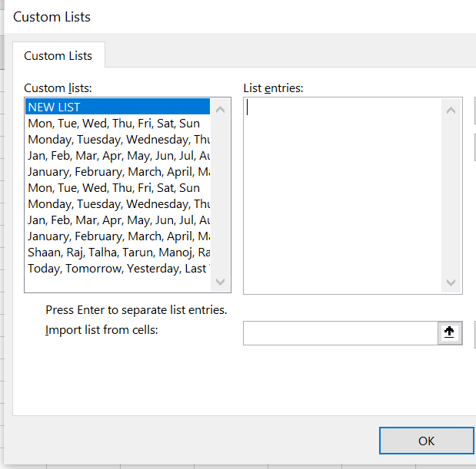
Custom List

Slide 2
Agenda
Add custom list in Excel
1
Delete custom list in Excel
2
Add custom list in VBA
3
Delete custom list in VBA
4

