Slide 1

Boaders

Slide 2

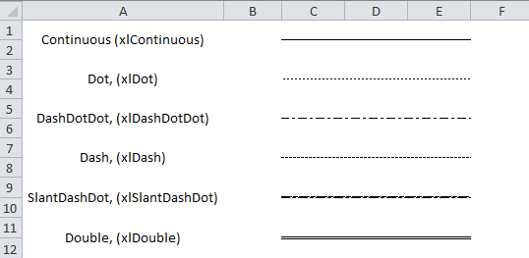
XlLineStyle

